Slide 1
LBTI SPECTROGRAPH UP-GRADE
Team Members:
Vernon Dunlap – Project Manager
Will Hease - Systems
Emily Kopp – Science
Tianquan Su - Optics

Slide 2
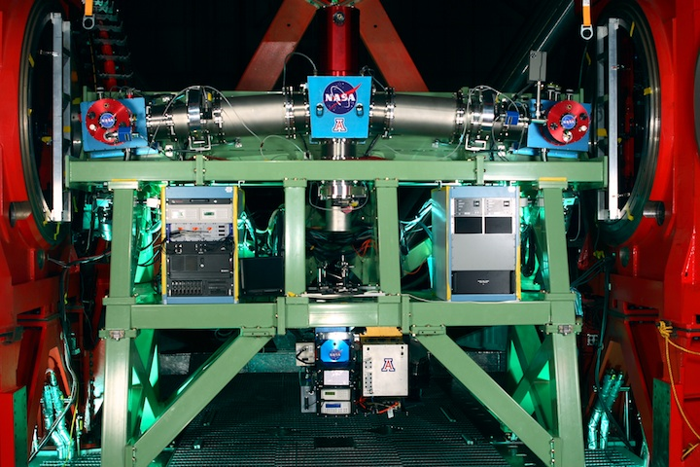
LBTI Installed on LBT

Slide 3
Science Goals
Spectroscopic studies of Protoplanetary disks
Determine rotational velocities and chemical compositions of disks at increasing radii from proto-star: evidence of planet formation
Requires:
- Spectrograph R = 45,000 @ 4mm (SiO line)
- R= 2Dtana/l
- Spatial resolution l/B = 0.036”
- B = 22.8m, LBT baseline edge-to-edge
- Disks are 0.1” to 1.0”
-100AU across at 100-1000pc
- Phase sensor to remove delay-line fringes

Slide 4
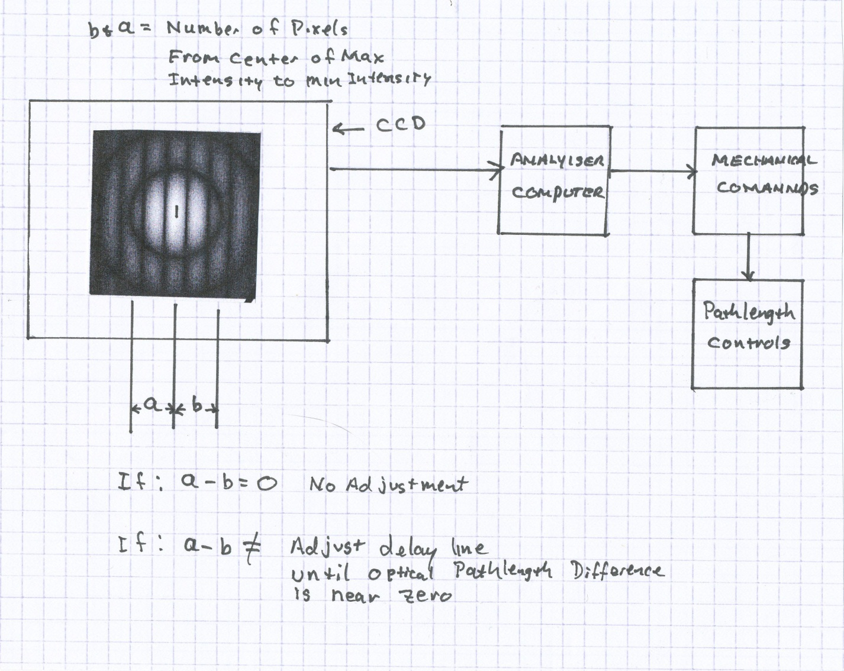
Phase Sensor Concept

Slide 5
Phase sensing
The fringe size on the focal plane is 22µm
pixel size : 30µm for infrared sensors
Need 6X magnifying system (4pix/fringe gives us a range of ±λ/2)
We use a 20X microscope objective in the following configuration :
13.3mm
207.8mm

Slide 6
Phase sensing
Δφ= 0
Δφ= π

Slide 7
Phase sensing
So with 4 pixels/fringe we can achieve a range of π/2 in dephasing.
We get sensitivity by using a close loop and detecting little variations in intensity.

Slide 8
Mapping Disk Structure
Regions of the proto-planetary disk with detail (i.e. planet-forming regions) will allow us to obtain spectral information.
Regions of constant intensity will not produce information about disk structure.
Convolution of fringe pattern with a constant function results in a constant function.

Slide 9
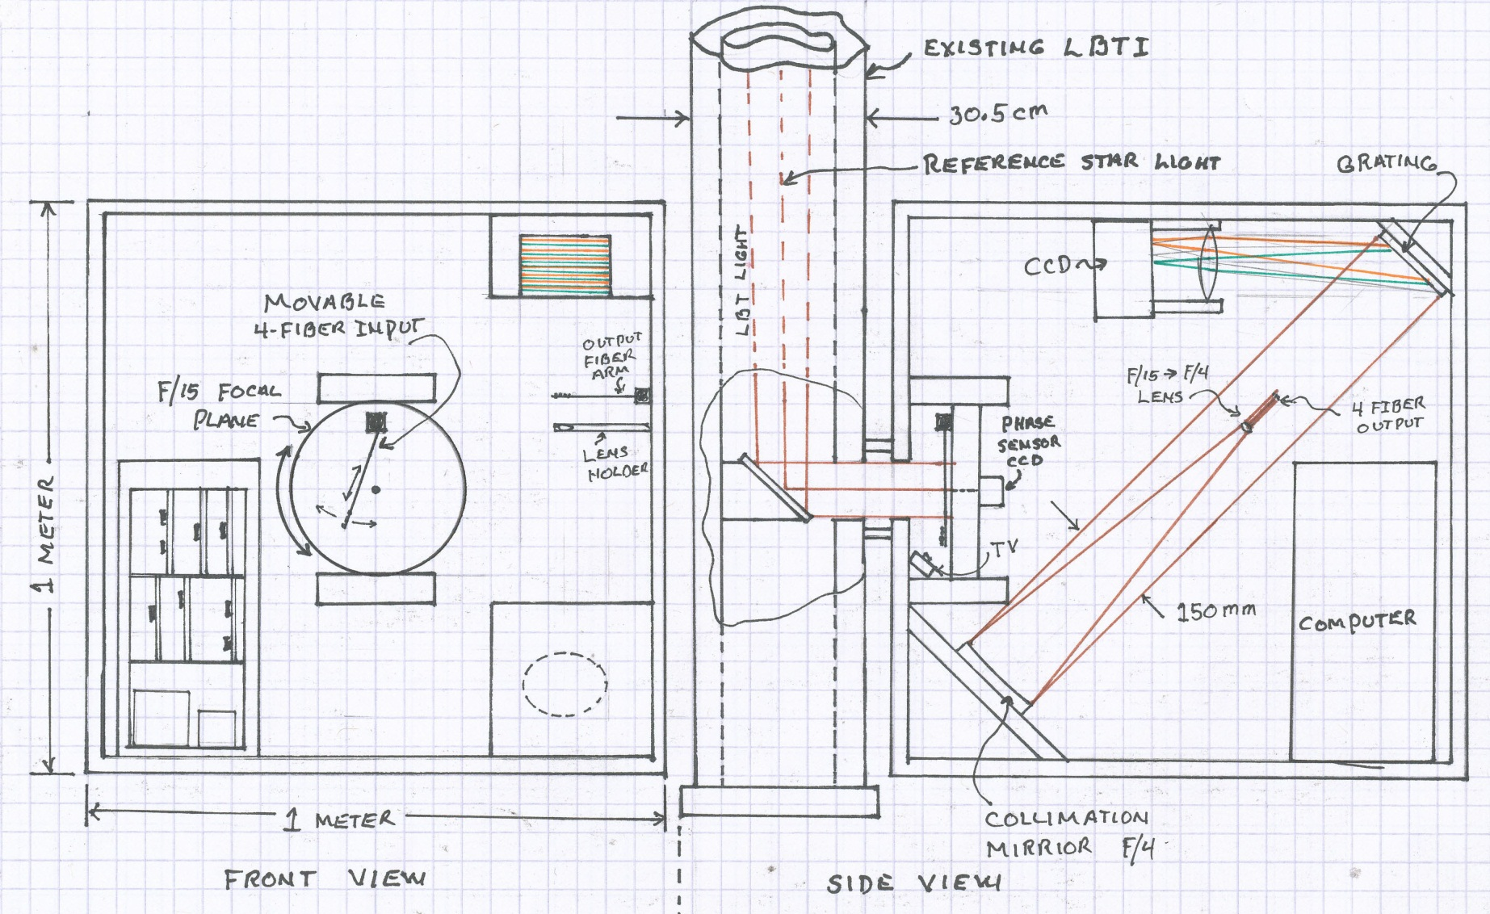
LBTI Up-Grade Layout

Slide 10
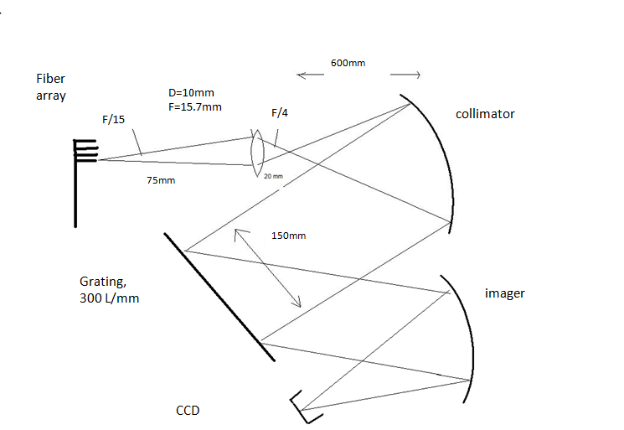
Spectrometer

Slide 11
Spectrometer parameters

Slide 12
Sensitivity
With a background noise of magnitude 9/arcsec² , and a total magnitude of 27 for the disc, we need 2000s of exposure to achive a SNR of 10.

