Slide 1
Red Team – Project 1
Wednesday, February 09, 2011

Slide 2
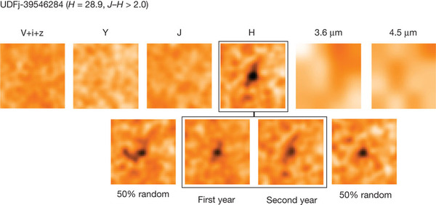
Project Motivation – High Z Galactic Structure
Bouwens, et al, NATURE vol 469/Issue No 7331
Z = 10.3, 500 Myr after Big Bang
mag = 28.92, photos 2.4” on side, H= 1.6 μm

Slide 3
Project Motivation: High Z Galactic Structure
Apparent object size does not decrease for Z>1.6:
θ = S/dA dA = 2.807 GLy
Galaxy Diameter: θ=2.5”
  Central Bulge: θ=0.3”
  Spiral Arm Gaps: θ = 0.37”
Requires
  2.64m diameter telescope
  6.2x10⁶s (~2.4 months) exposure time
  Observations at ~1.6μm
Earth SNR= 0.07 vs. Space SNR= 4.6
Long exposure times require dedicated telescope (this is not part of JWST’s mission)

Slide 4
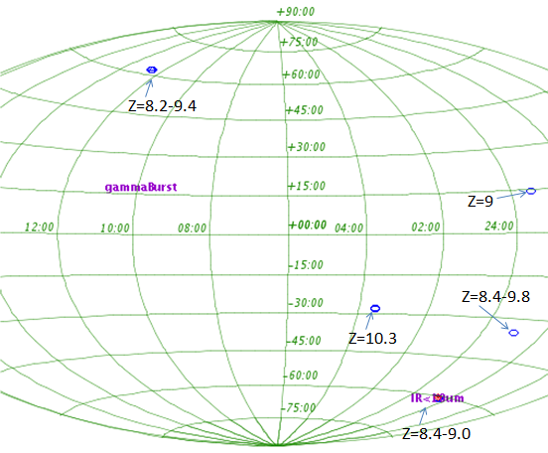
Science Goals I: High-Z Galaxies
Study of high redshift galaxies will give better understanding of
  Early galaxy formation timescales and other processes
  Structure of early galaxies (spiral, elliptical, etc…)
  Precise redshift measurements
Few galaxies of z>8 are known – this mission will focus on obtaining high resolution
imagery of these galaxies
Lyman-α line is red-shifted to
NIR which makes 1-2μm region
optimum band for observation
Stable and long exposures
will be required to obtain
sufficient SNR
High Redshift Galaxies will be one of the main focuses of this mission
Image Credits: simbad.com

Slide 5
Science Goals II: Direct Imaging of Exoplanets and Brown Dwarfs
Telescope will be capable of direct imaging of exoplanets and brown dwarfs with >0.1” separation from primary star
  Additional optical instrumentation (deemed a “black box” for this exercise) may be necessary to image exoplanets with small separations from star
Accurate photometry will be collected for selected brown dwarfs and exoplanets
with large separations
  Data will be used to look
  for transiting moons
  Peak of the Brown Dwarf
  blackbody is at ~2μm
  May led to the discovery of
  exoplanets and brown
  dwarfs

Slide 6
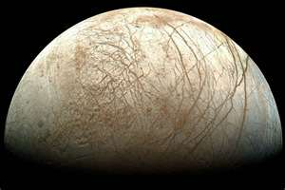
Science Goals II: Direct Imaging of Exoplanets and Brown Dwarfs Continued
Moons of Large Extrasolar Planets
Moons of large Jovian-like planets could harbor habitable moons and extraterrestrial life
  Europa is possibly the most likely body to harbor life in the solar system (see image on right)
Most exoplanets discovered are large gas giants
Accurate photometry of exoplanets will allow for discovery of moons
  Transiting method utilized to find moons around systems with transiting exoplanets
  Accurate photometry requires measurements in wide and narrow FOVs
Habitability around Brown Dwarfs
Concept only theoretically possible at this point
  Understanding of planet formation around brown dwarfs
  Possible to find earth-like planets in the habitable zone a brown dwarf
Europa, of Jupiter’s moon is believed to hold an ocean beneath an ice surface

Slide 7
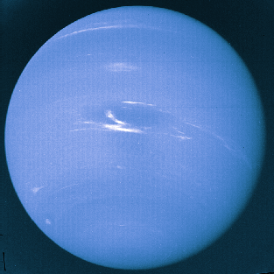
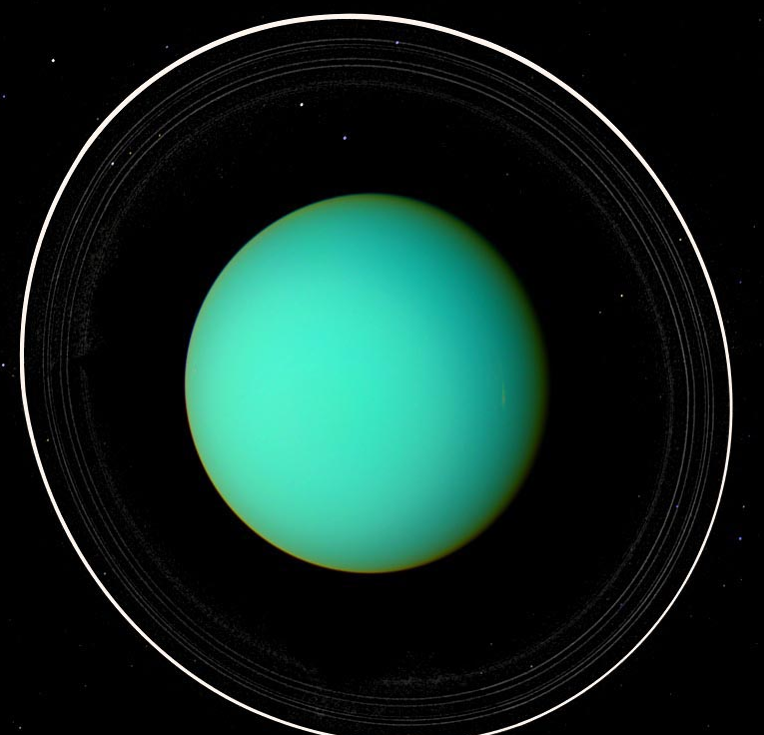
Science Goals III: Solar system planets, Uranus & Neptune
High resolution imaging
Spectroscopy in bands not accessible on earth
Better understanding of “small” (<0.05M_{jup}) gaseous exoplanets
Angular diameter of Uranus is between 3.4-3.7” and Neptune is between 2.1-2.4”
Image Credits: apod.com

Slide 8
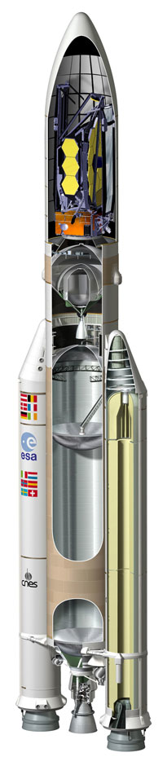
The Telescope Design and
System Requirements
Telescope
  3.5 m aperture
  High resolution NIR space telescope
Telescopic tube and flipping secondary allows two different plate scales and FOVs: 6’ and 13’
Telescope fits on Ariane 5 ECA without folding the primary mirror.
Payload up to 10500kg to GTO orbit.
Drift away orbit.
Passive radiative cooling
Solar energy, no batteries.
Lower cost, complexity and risk than JWST.
Image Credits: ESA

Slide 9
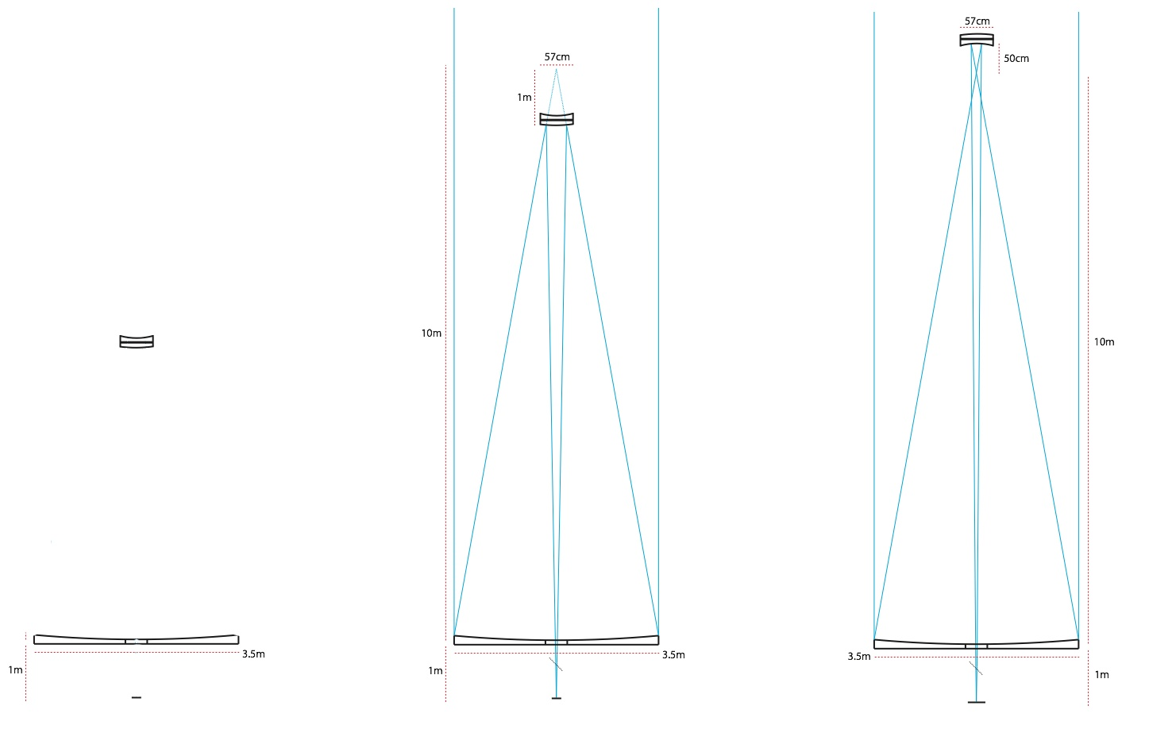
The Telescope Design
Extendable telescope design
Compressed for Launch
Extended to 6’ FOV operation
Extended to 13’ FOV operation

Slide 10
Optical Design
Aperture | 3.5 m
Secondary | 0.57 m
Focal Length | 115 m
System F/# | 32.8
Resolution | 0.07 arcsec
FOV | 6/13 arcmin
Secondary 1
Radius of Curvature: 2.19m
Secondary 2
Radius of Curvature: 1.10m

Slide 11
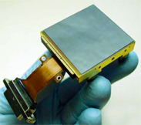
Detectors
0.6 to 5um wavelength range.
Plates scales and pixel size (3.5 m telescope @ 1um)
  Diffraction limit 0.07” or 40 um on the focal plane.
  20 um px pitch will provide nyquist sampling.
  5’ FOV => 8570 px
  Plate scale = 560 um/arcsec
  Array size ~ 8k x 8k = 16 x 16 cm.
Mosaic of 16 2048 x 2048 Hawaii II RG with passive cooling working at 40 K. (Arrays of 5x7 proposed).
Image Credits: Teledyne imaging systems
Vendor | Model | Material | Px size | Array size | Wavelength | Temp.
Teledyne | Hawaii II RG | HgCdTe | 18 um | 2k x 2k | 0.9 - 2.6 | 77 K
Teledyne | Hawaii II RG | HgCdTe | 18 um | 2k x 2k | 0.9 – 5.0 | 40 K
Raytheon | VIRGO | HgCdTe | 20 um | 2k x 2k | 0.9 – 2.6 | 77 K
Raytheon | Orion | InSb | 25 um | 2k x 2k | 0.9 – 5.4 | 23 K

Slide 12
Detectors
Mosaic of 16 2048 x 2048 Hawaii II RG with passive cooling working at 40 K. (Arrays of 5x7 proposed).
  Array size ~ 8k x 8k = 16 x 16 cm.
6 arcmin
FOV

Slide 13
Instrumentation
Filter Wheel with
  Broadband and narrowband filters
  Will be optimized for emissive spectrum
    Galaxy with high redshift
    brown dwarf or exoplanet
Spectrometer
  To obtain moderate to high resolution spectra
PIAA Chorograph
  For exoplanet imaging
Fabry Perot
  Narrow band variable filter for high precision Z determination.

Slide 14
Back-up
Slides

Slide 15
High Z Galactic Structure
Zodical Glow in space at 1.0AU, 1.6μm 42 photons/s/m²/μm/αsec
For t= 6.2e6 s, N_{ZL}= 7.5e7 photons
SNR = 4e4/(4e4 + 7.5e7)^{0.5}

Slide 16
High Z Galactic Structure
Milky Way at Z=10.3
Central bulge 12,000Ly is 0.88” at Z=10.3
UDFj-39546284 image CB ~0.3”, which is 34% of MW-CB
Overall diameter expected of early galaxy (.34)(100,000Ly)/2.807e9Ly = 1.2e-5 rads
θ= 2.5”

Slide 17
High Z Galactic Spiral Arms
MW spiral arm gaps are ~5,000Ly
Estimate for Z=10.3 galaxy: 0.37”
Aperture required, H-Band: 2.64 meters
Estimate exposure time for entire galaxy 6.2e6 sec = 1722 hours
H-Band air glow: 1500ph/s/sq-arcsec/m
Earth SNR = 0.07; Space SNR= 4.6

Slide 18
High Z Galactic HII Region
HII regions - evidence of star formation.
HII regions emit in H-α, 656.3 nm.
Red shifted: (1+10.3)(656.3e-9)= 7.4μm, which is blocked by the atmosphere.
The telescope must be in space in order to detect HII regions in early galaxies.

