Slide 1
Studying Parsec Scale Jets in Star Forming Region
Tae-Soo Pyo
Subaru Telescope

Slide 2
Near-IR NBFs Survey of Jets in Massive Star Forming Region with GLAO
Key words:
-. GLAO : FWHM ~ 0.2” , FoV~ 15’x 15’
-. [Fe II], H2, Br_gamma, etc
-. Parsec Scale Jets

Slide 3
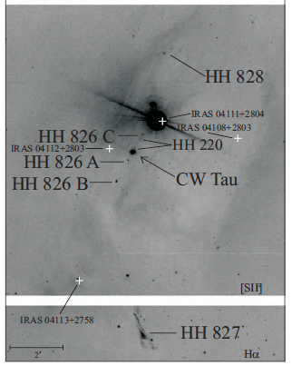
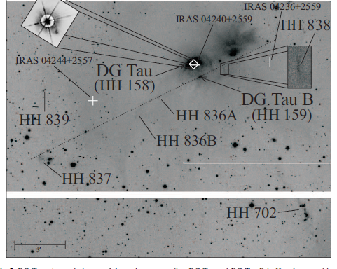
Parsec Scale Jets: Giant HH flows
Outflow activity is associate with the all early stellar evolution states from embedded CLASS 0 to visible young stars CLASS II.
Since mid-1990s
Scale : a few minute length (~ 1.8’ @ 1kpc)
Shock : diagnosis of ICM (inter clump matter)
Detail Structure in [Fe II], H2, Br_gamma, etc
Faint Jets in distant Massive Star forming Region
McGroarrty et al. (2000)

Slide 4
NIR Imaging Surveys
2MASS
DENNIS
UKIDSS (WFCAM:26’x26’)
VISTA (1°x1.5°)
…
Broad Bands
UWISH2 (H2 filter Survey)
To study outflows in imaging, NBFs observation are necessary.

Slide 5
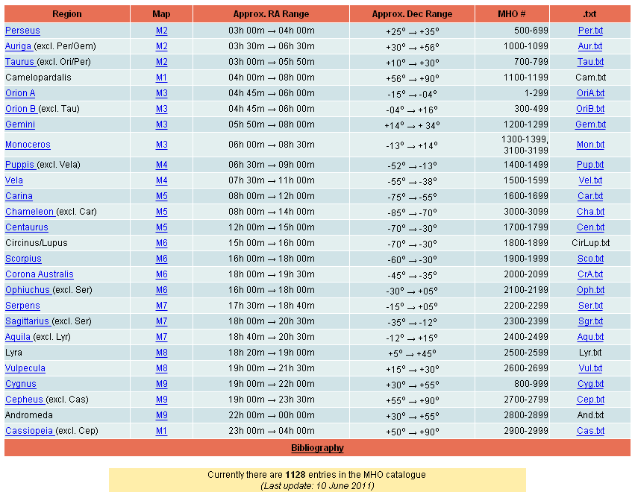
MHO (Molecular Hydrogen Object) Table
Covering
Most major Starforming regions

Slide 6
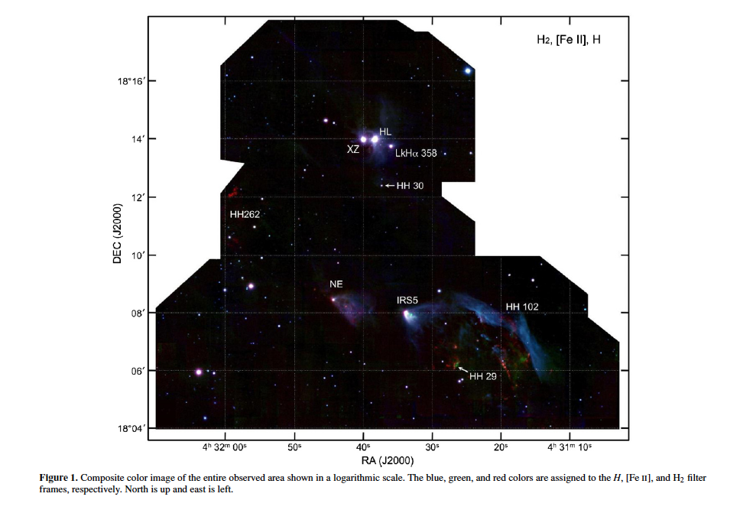
14’
Hayashi & Pyo(2009)

Slide 7
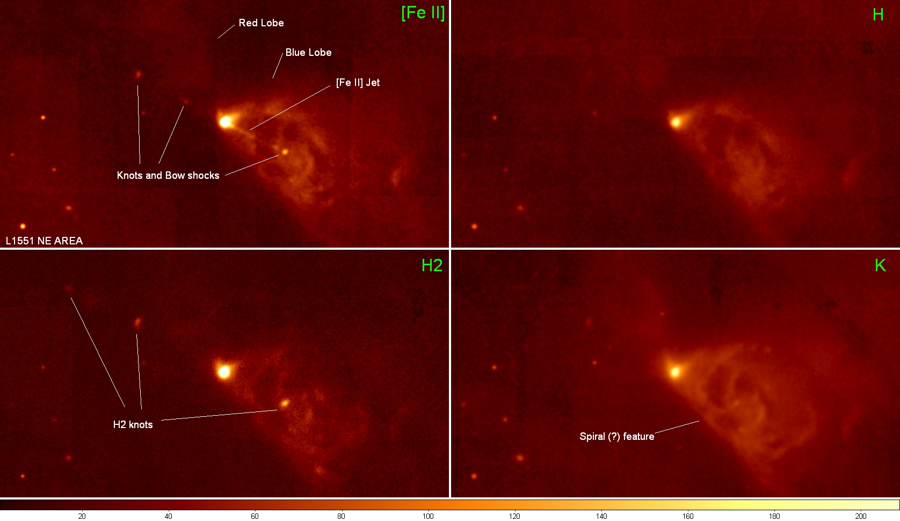
[Fe II] and H2 in L1551 NE

Slide 8
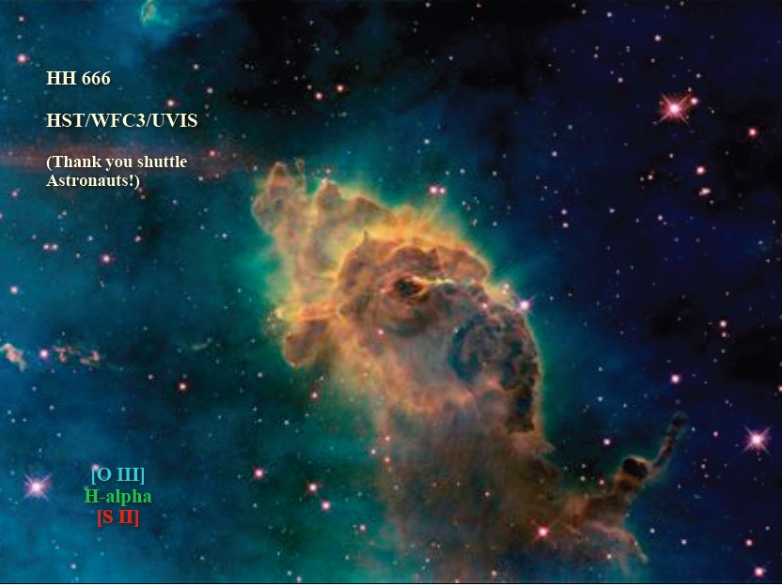
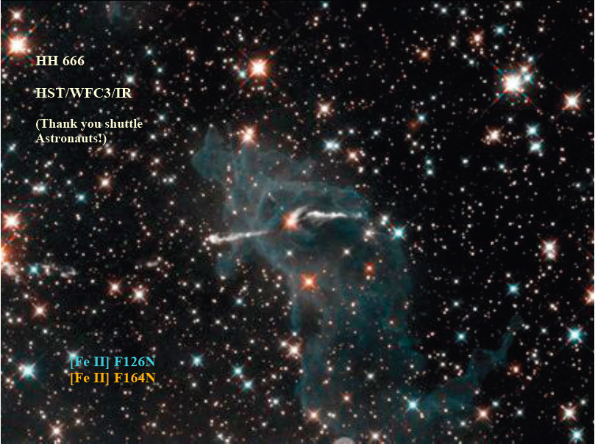
Optical emissions and [Fe II] (HST)
Smith et al. (2004)
NIR [Fe II] has small extinction, clear jet structure, simple background (low scattering).
→ Detection of collimated jets and estimation of the the candidate source

Slide 9
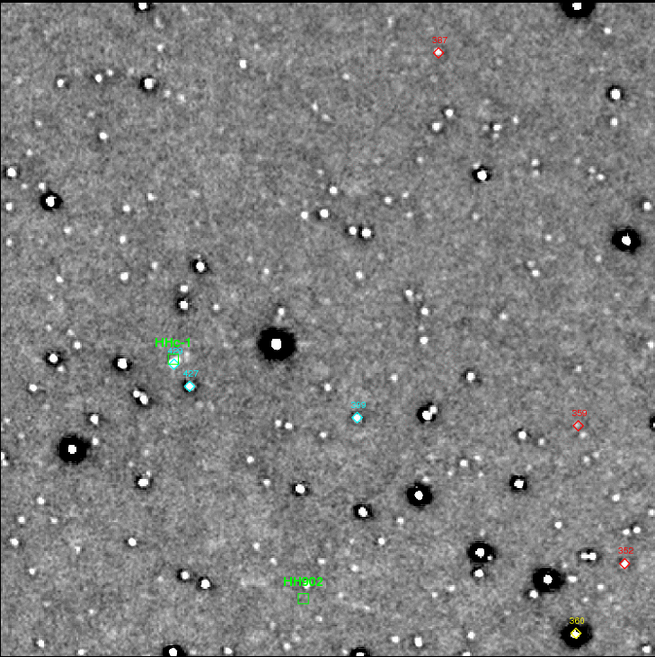
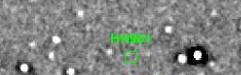
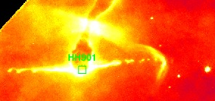
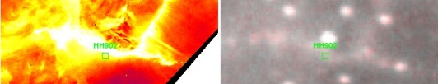
Eg.) HH902, HHc-1 (Carina Nebula)
Faint but sharp jet of HH901
Marginal Detection of [Fe II] Jets
IRIS2/AAO
Bad Seeing: 1.5- 2.3”
30 min on-source time
Long and sharp HH902 [FeII] jet and HHc-1 fossil flow

Slide 10
SUMMARY
Suggestion of NIR NBFs imaging survey with GLAO
New discovery chance of [Fe II] jets in distant massive star forming region
[Fe II] emission is good compliment tracer for outflow phenomenon for H2 emission:
  H2 traces shocked molecular outflows.
  [Fe II] traces shocked and partially ionized atomic jets.
Sub-arcsecond seeing condition is essential to recognize sharp jet features.

