Slide 1
Thermal Infrared Observation using Adaptive Secondary Mirror (ASM)
Hiroshi TERADA
(Subaru Telescope)
Talk Contents
Ground-based Thermal IR w/AO
Subaru Thermal IR w/AOs
Subaru Thermal IR w/ASM

Slide 2
Ground based Thermal IR Observation
Background Emissions
1-2um
OH emission lines
>2um
Thermal Radiation (from Sky and Ambient)
http://www.kusastro.kyoto-u.ac.jp/~iwamuro/LECTURE/OBS/atmos.html
Subaru NGAO Workshop @ Osaka-U on 2011/09/08
Hiroshi TERADA @ Subaru Telescope

Slide 3
Ground based Thermal IR Observation
Atmospheric Transmission
z
J
H
K
L
M
N
Q
Subaru NGAO Workshop @ Osaka-U on 2011/09/08
Hiroshi TERADA @ Subaru Telescope

Slide 4
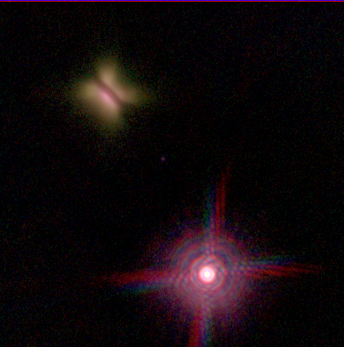
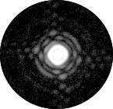
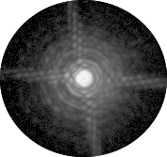
AO Observation @ Thermal IR
Performance in General
Higher Background
Longer wavelength
-> Better correction
-> Covering wider FOV
(angle∝λ(1.2))
Image Quality Good Enough @ Mid-IR under Natural Seeing?
(seeing∝λ(-0.2))
Subaru NGAO Workshop @ Osaka-U on 2011/09/08
Hiroshi TERADA @ Subaru Telescope

Slide 5
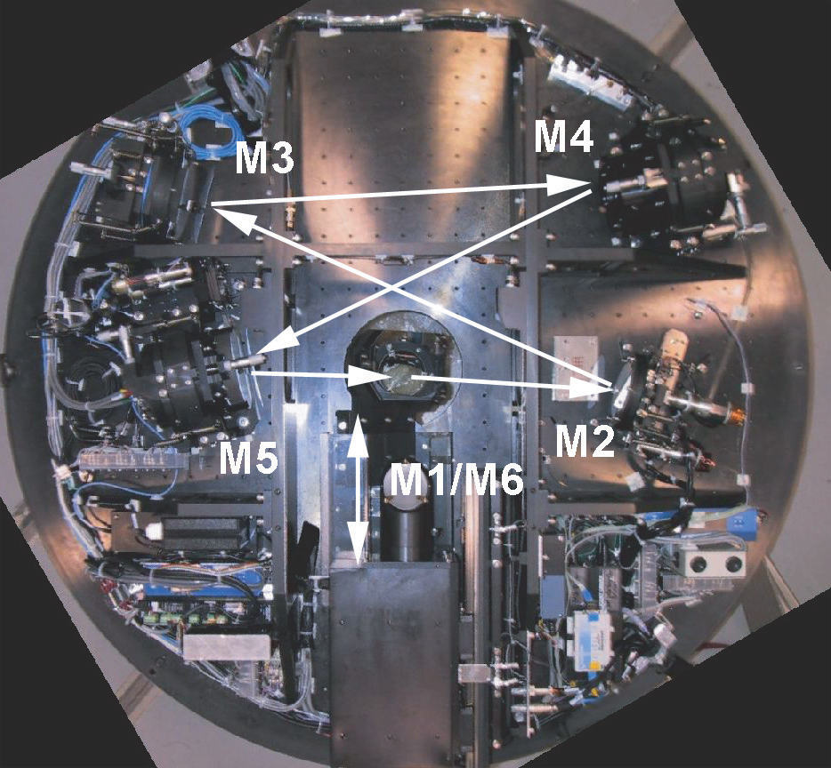
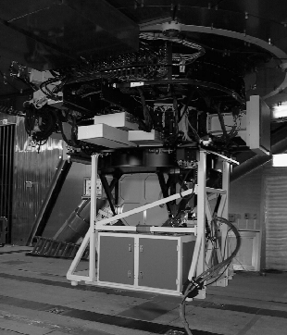
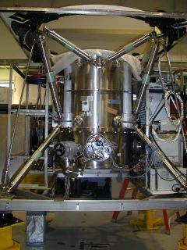
Subaru AO Observation
1st Generation AO (AO36)
AO36@Subaru Cassegrain focus
Beam Splitter: COLD n instrument
IRCS
CIAO
Subaru NGAO Workshop @ Osaka-U on 2011/09/08
Hiroshi TERADA @ Subaru Telescope

Slide 6
Subaru AO Observation
1st Generation AO (AO36)
M’
L’
Background increase w/AO36 from w/o AO36
K’ | -0.08 mag
L’ | -0.33 mag
M’ | -0.16 mag
K’
■ w/ AO36
■ w/o AO36
Subaru NGAO Workshop @ Osaka-U on 2011/09/08
Hiroshi TERADA @ Subaru Telescope

Slide 7
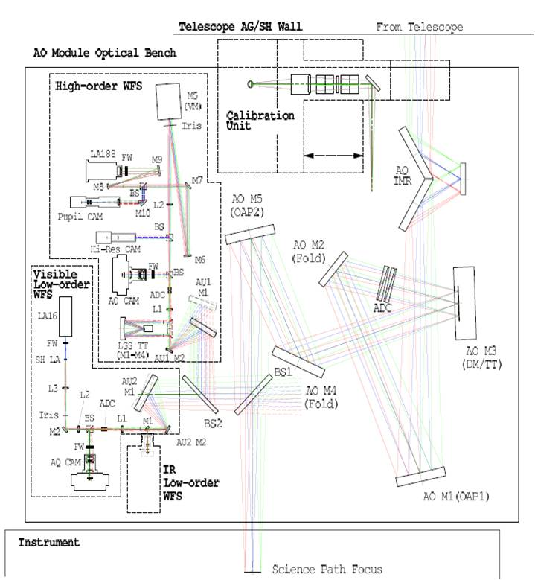
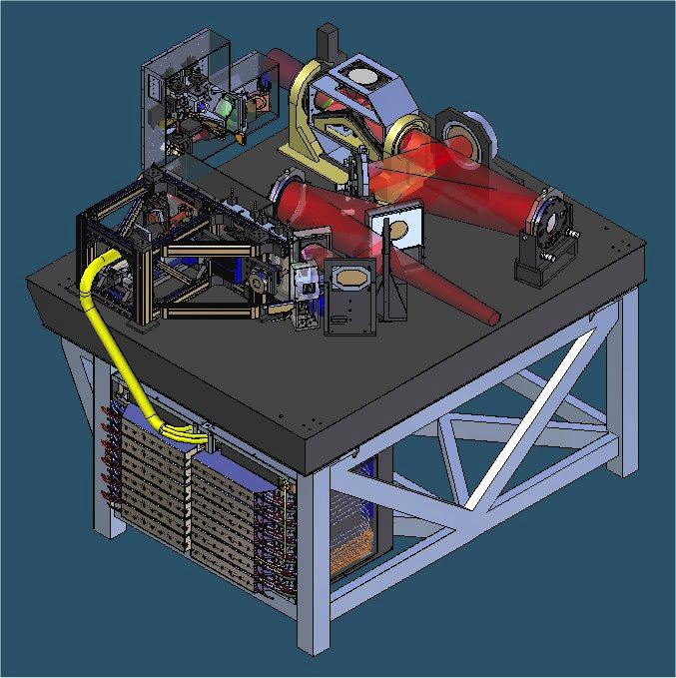
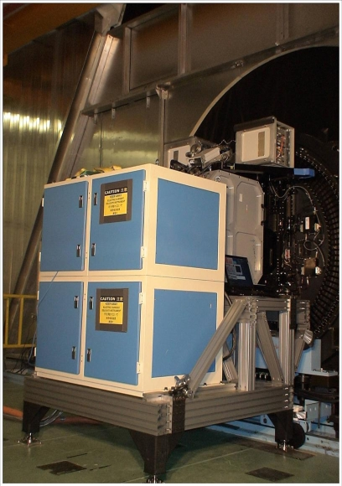
Subaru AO Observation
2nd Generation AO (LGS/AO188)
AO188 @ Subaru Infrared Nasmyth
Beam Splitter: WARM outside instrument
Image Rotator: On AO188
IRCS
Subaru NGAO Workshop @ Osaka-U on 2011/09/08
Hiroshi TERADA @ Subaru Telescope

Slide 8
Subaru AO Observation
2nd Generation AO (LGS/AO188)
M’
Background increase w/AO188 from w/o AO188,ImgRot
K | -0.39 mag
L’ | -0.52 mag
M’ | -0.35 mag
L’
K
■ w/ AO188
■ w/o AO188, w/ImgRot(Tel)
■ w/o AO188, ImgRot(Tel)
Subaru NGAO Workshop @ Osaka-U on 2011/09/08
Hiroshi TERADA @ Subaru Telescope

Slide 9
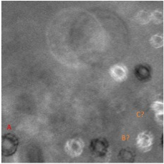
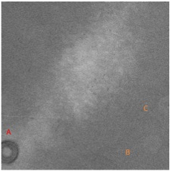
Subaru AO Observation
2nd Generation AO (LGS/AO188)
One More Thing…
Warm dust / Coating defect on
Optical Surface
Cf. Current
Subaru NGAO Workshop @ Osaka-U on 2011/09/08
Hiroshi TERADA @ Subaru Telescope

Slide 10
Subaru AO Observation
w/ and w/o AO188 L-band Observation
L-band Low-resolution Spectroscopy
Slit width: 0”.45 / 90sec * 24 = 2160sec
Slit width: 0”.225 / 50sec * 20 = 1000sec
Comparable S/N w/ half an exposure time
Subaru NGAO Workshop @ Osaka-U on 2011/09/08
Hiroshi TERADA @ Subaru Telescope

Slide 11
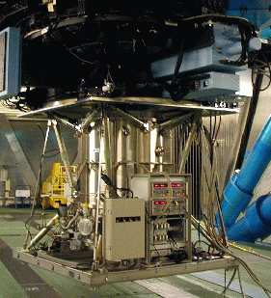

Subaru Mid-IR Observation
COMICS @ Subaru Cassegrain
18.8
8.8
12.4
Diffraction Limited Image
Close to Diffraction Limited Image
in N-band
Stable Diffraction Limited Image
in Q-band
Technically Challenging for
ASM Chopping
Data from 2009-02-01 to 2010-01-31
Subaru NGAO Workshop @ Osaka-U on 2011/09/08
Hiroshi TERADA @ Subaru Telescope

Slide 12
Subaru Low Background Thermal IR Observation
ASM / Cs
Background decrease from [NsIR] AO188 to [Cs]
K/K’ | +0.46 mag
L’ | +0.86 mag
M’ | +0.56 mag
■ w/ AO188 (NsIR)
■ w/o AO36 (Cs)
Subaru NGAO Workshop @ Osaka-U on 2011/09/08
Hiroshi TERADA @ Subaru Telescope

Slide 13
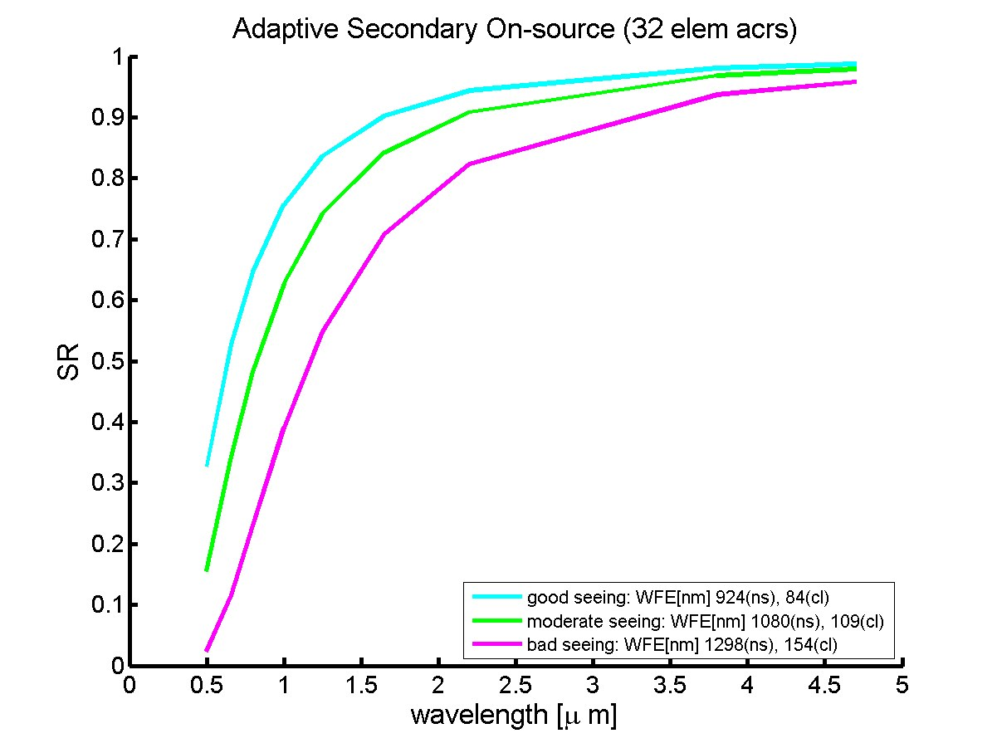
Low Background Observation @ Thermal IR w/ ASM
On-source mode
Strehl > 0.8 in any case
Sensitivity improvement for
all background-limit
observations.
Concept Examples:
IFU @ >3um
(currently not existing)
Wider FOV @ L’, M’-bands
Isoplanatic angle: θ₀ ∝ λ^(1.2)
L’: 30” * (3.77/2.2)^(1.2) ~ 57”
M’: 30” * (4.68/2.2)^(1.2) ~ 74”
from GLAO Simulation by Oya
H2RG (5.5um cut-off)
30mas/pix => 1’x1’
40mas/pix => 1.3’x1.3’
Subaru NGAO Workshop @ Osaka-U on 2011/09/08
Hiroshi TERADA @ Subaru Telescope

Slide 14
Even Lower Background @ Ls? Possible Removal of CH₄
Bottle Neck
CH_{４} lines
http://www.nies.go.jp/kanko/tokubetu/sr52/sr52.pdf
Subaru NGAO Workshop @ Osaka-U on 2011/09/08
Hiroshi TERADA @ Subaru Telescope

Slide 15
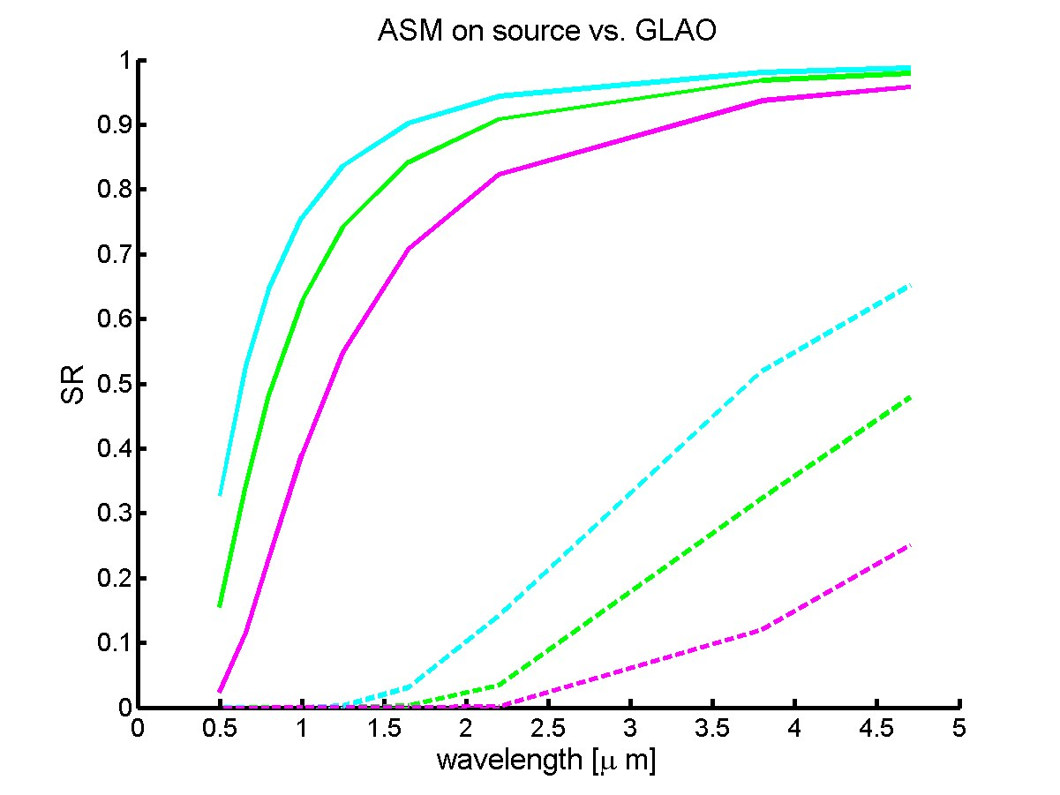
Low Background Observation @ Thermal IR w/ ASM
GLAO mode
Better performance than < 2um
from GLAO Simulation by Oya
Subaru NGAO Workshop @ Osaka-U on 2011/09/08
Hiroshi TERADA @ Subaru Telescope

Slide 16
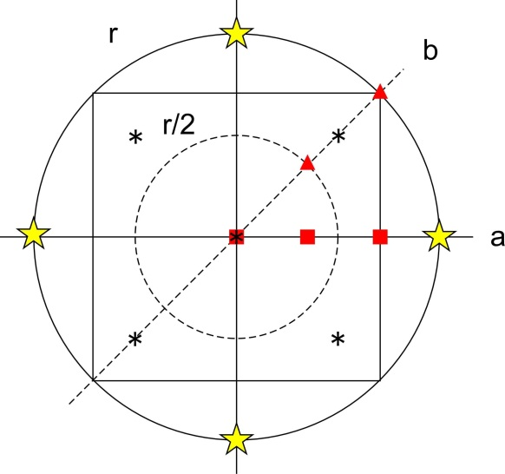
Low Background Observation @ Thermal IR w/ ASM
GLAO mode
Close to Diffraction Limited Image @ L’&M’ over Diameter~10’
Multi Object AO can be realized in this mode..
Not Widest FOV, but Patrol type Instrument..
r=5’
a
b
■ M’
■ M’
■ L’
■ L’
■ K
■ K
Under average natural seeing
Subaru NGAO Workshop @ Osaka-U on 2011/09/08
Hiroshi TERADA @ Subaru Telescope

Slide 17
Low Background Observation @ Thermal IR w/ ASM
MOAO mode
ASM benefitial as Woofer? -> No.
Anyway additional optics is needed…
Negative.
Subaru NGAO Workshop @ Osaka-U on 2011/09/08
Hiroshi TERADA @ Subaru Telescope

Slide 18
Summary
Good AO performance (>2-3um)
AO additional optics => S/N Down >2um
# AO sharp image => S/N Up in the end.
ASM => no degradation in background.
MIR band may not need AO.
Great On source performance (32x32 ASM)
=> Benefit for All the Thermal IR Obs.
Good GLAO performance
=> Patrol covering Wide FOV.
Subaru NGAO Workshop @ Osaka-U on 2011/09/08
Hiroshi TERADA @ Subaru Telescope

