Slide 1
Subaru Flexibly Addressable Integral Field Spectrographs (SuFAIFS)
~ Concept of a new instrument from a collaboration recently renewed ~
Naoyuki Tamura (Subaru Telescope, NAOJ)
J. R. Allington-Smith, G. J. Murray, “DFS” collaboration (Centre for Advanced Instrumentation, Durham Univ., UK)

Slide 2
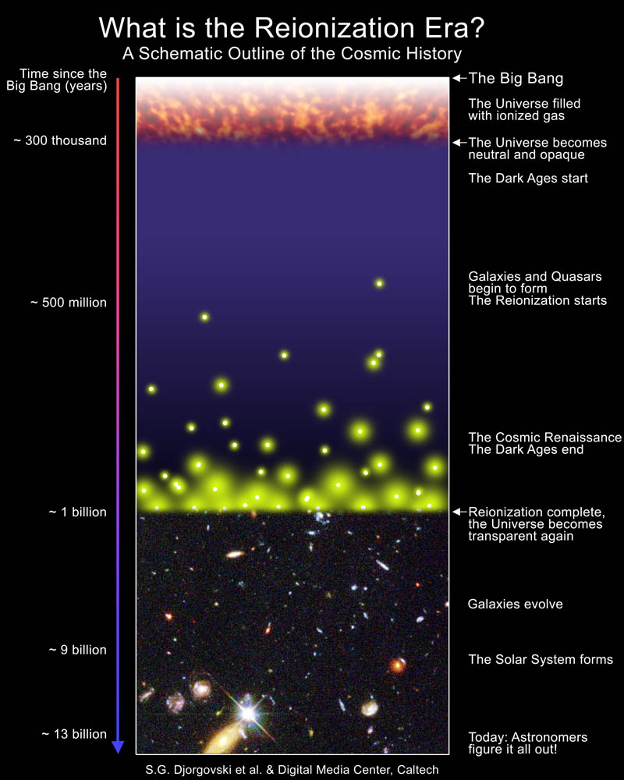
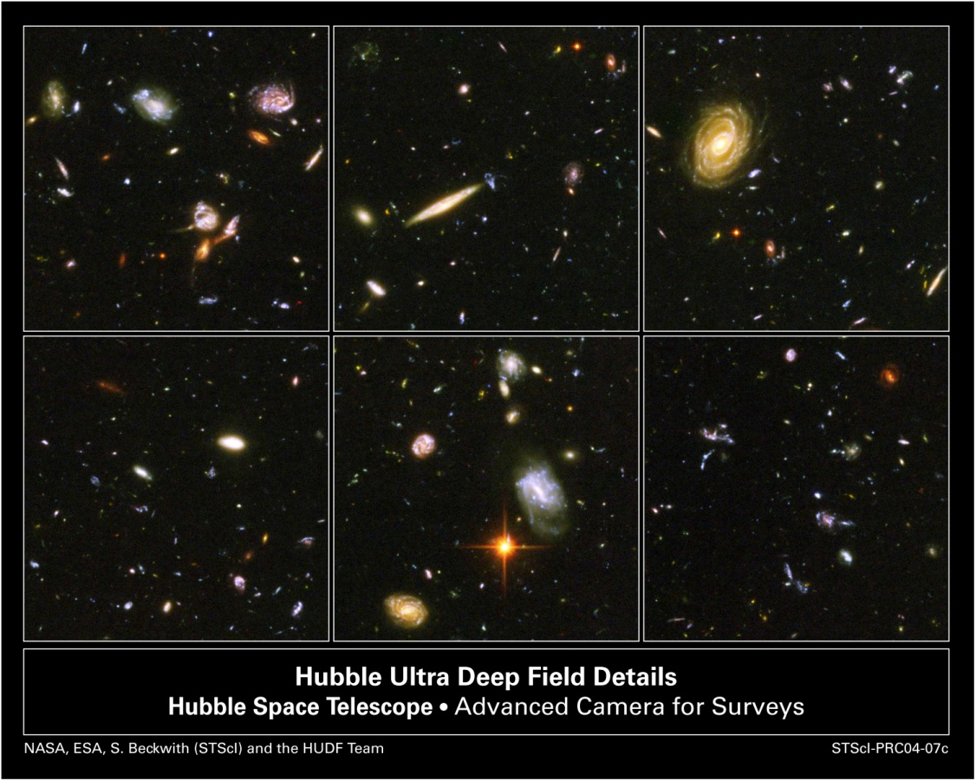
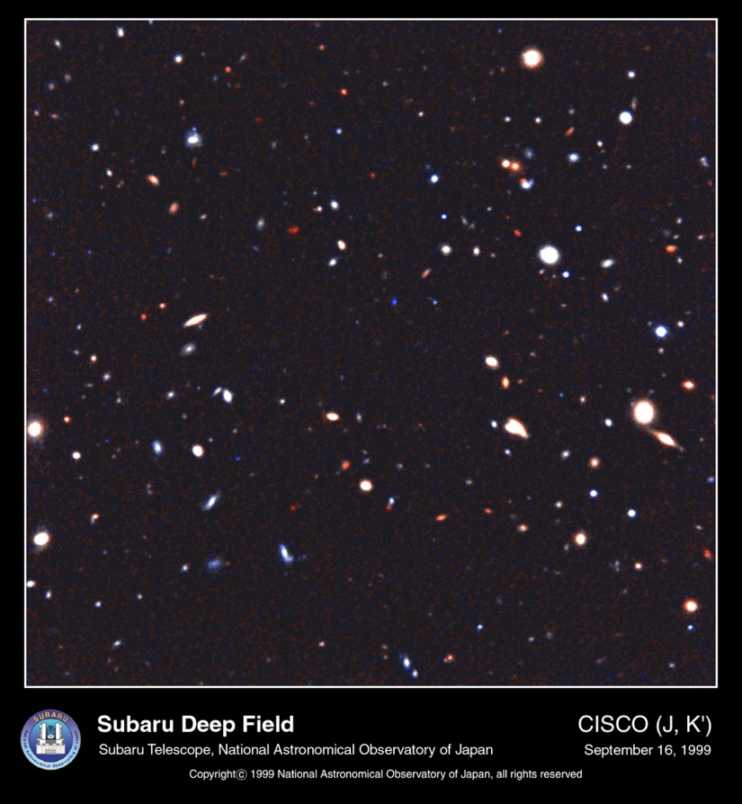
Background
To take “snapshots” of the universe and characterize the galaxy population at each of them, spectroscopic information is necessary.
Redshift, star-forming activity, AGN activity, abundance, stellar age, etc

Slide 3
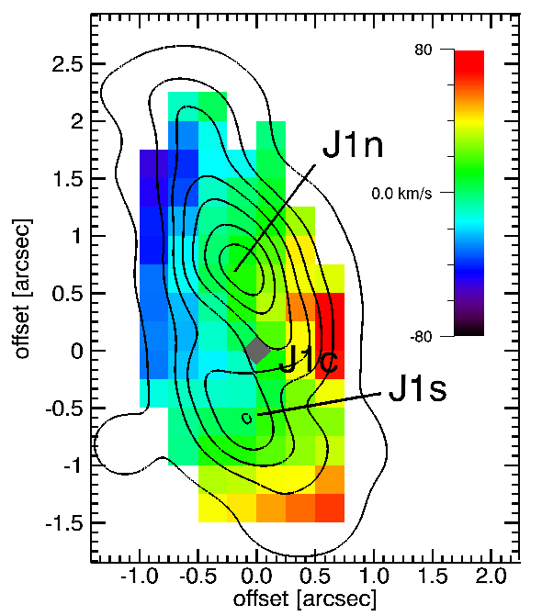
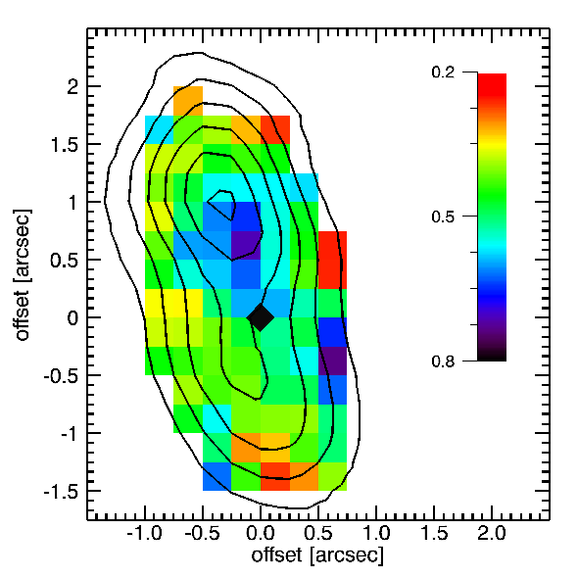
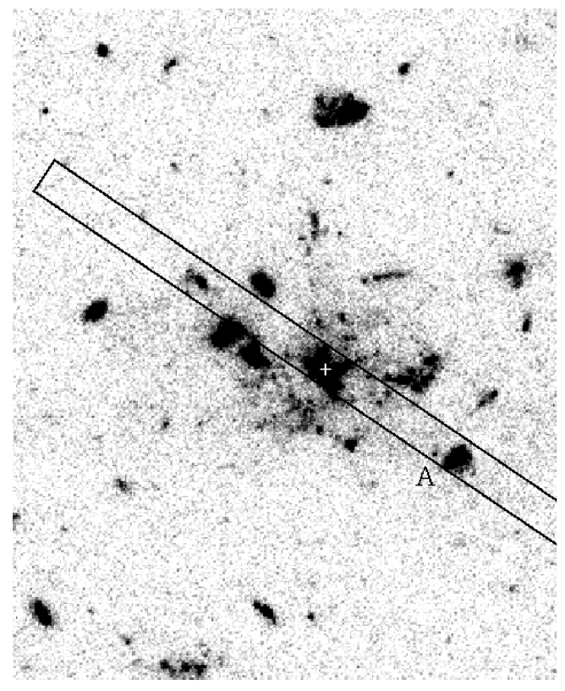
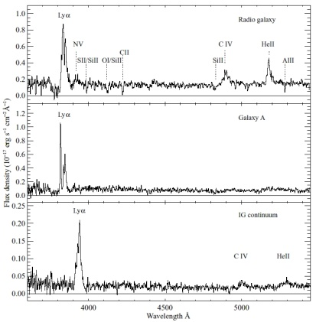
Background
Plus integral field (i.e. 2D) spectroscopy (IFS):
Spatial distribution, kinematics/dynamics, dynamical mass … Clues to knowing what they are, what’s going on & why (→ physics)
Internal structures of galaxy main body (~10 kpc)
SAURON 24h exposure with WHT of LAB-Z/SSA-22 protocluster
An SMG at z~2.5
Extended/diffuse components, halo part of a galaxy (~50-100 kpc)
[NII]/Hα
Diffuse star formation in massive galaxies & cluster assembly?
MRC1138-262@z~2
Hα
(Weijmans et al. 2009)
Nesvadba et al. (2007)
(Hatch et al. 2008)

Slide 4
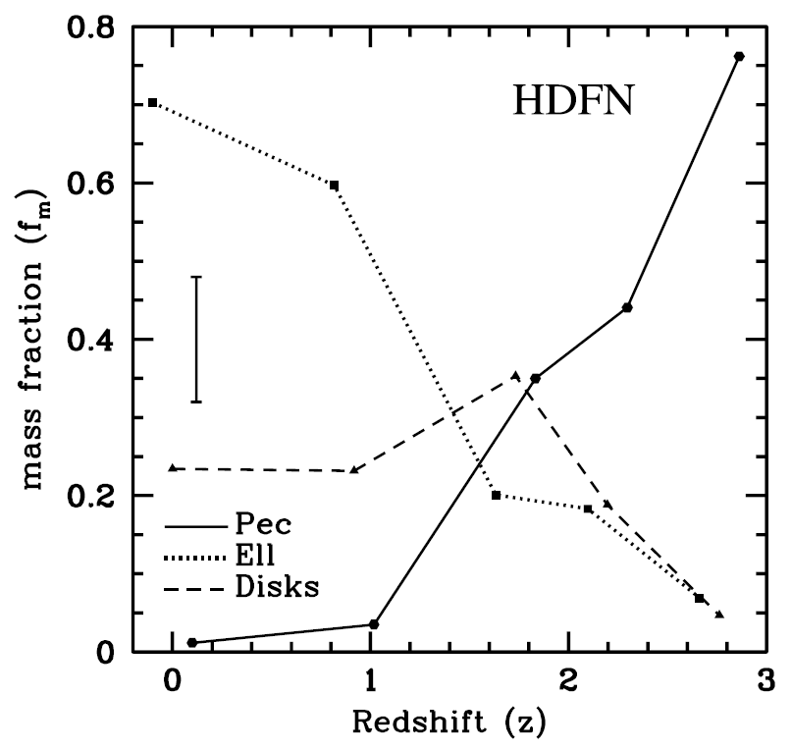
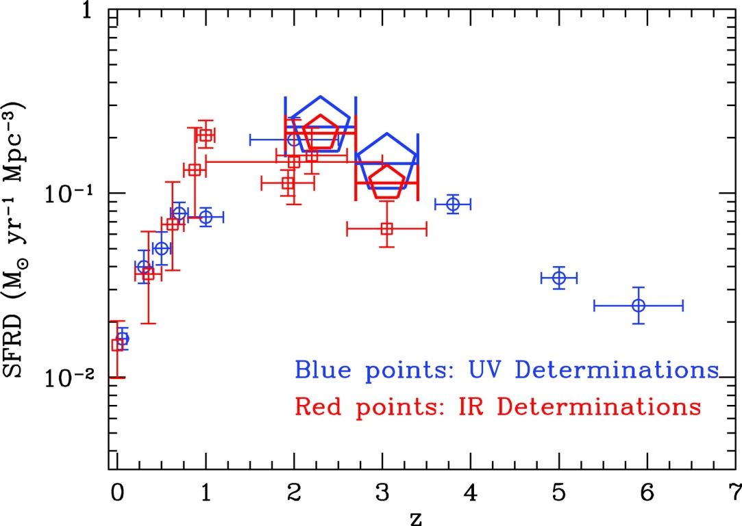
Background
What should Subaru try to address?
Light-gathering power is a key for IFS. TMT should be coming with IFS & AO. SuFAIFS would be a late comer of IFS among 8-10m class telescopes … etc
Little has been explored by IFS, so there should be plenty to do to understand physical process at various redshift, while coordination would be necessary.
(Reddy et al. 2008)
(Conselice et al. 2003)

Slide 5
Integral Field Spectroscopy (IFS)
Deployable multi-Integral Field Units (IFUs) over an FoV OR Complete spectroscopy of a certain (usually small) part of an FoV
“Be clever” type (e.g. VLT/KMOS)
“Get everything” type (e.g. VLT/MUSE)
Usually too ambitious to do an IFS over a wide area of sky. Is there any way to address targets optimally/efficiently?

Slide 6
Goal of SuFAIFS
Allows a flexible selection of regions for spectroscopy among the 2D array of available spaxels on a focal plane, given a limitation in multiplicity of spectrograph(s).
E.g. Number of spaxels to be routed to spectrographs = 64.
Both will be in choice on SuFAIFS: “Diverse Field Spectroscopy (DFS)”
Selected spaxels may be distributed to more than one spectrographs
→ Possibility of additional versatility to spectral domain.

Slide 7
History & current status
“Diverse Field Spectroscopy” was proposed as an arbitrary combination of multi-IFU & complete IFS to efficiently address astronomical objects on sky.
Designing & prototyping switching layer (cascading fiber switches or signal fiber switch + incoherent fiber remapping) mainly with a Rolling grant (for R&D). There are collaborations with other areas (telecom, photonics, etc) outside astronomy.
Adding an idea to share a single focal plane with (existing) several spectrographs, a collaboration for instrument proposal to Subaru has recently started (ear-mid 2010).
- Allington-Smith (2007, MNRAS, 376, 1099) - Murray & Allington-Smith (2009, MNRAS, 399, 209) - Poppett, Allington-Smith & Murray (2010, MNRAS, 399, 443)

Slide 8
Celestial Selector
0
1
2
3
0
1
2
3
0
1
2
3
0
1
2
3
4
5
6
7
4
5
6
7
4
5
6
7
4
5
6
7
8
9
A
B
8
9
A
B
8
9
A
B
8
9
A
B
C
D
E
F
C
D
E
F
C
D
E
F
C
D
E
F
0
1
2
3
0
1
2
3
0
1
2
3
0
1
2
3
4
5
6
7
4
5
6
7
4
5
6
7
4
5
6
7
8
9
A
B
8
9
A
B
8
9
A
B
8
9
A
B
C
D
E
F
C
D
E
F
C
D
E
F
C
D
E
F
0
1
2
3
0
1
2
3
0
1
2
3
0
1
2
3
4
5
6
7
4
5
6
7
4
5
6
7
4
5
6
7
8
9
A
B
8
9
A
B
8
9
A
B
8
9
A
B
C
D
E
F
C
D
E
F
C
D
E
F
C
D
E
F
0
1
2
3
0
1
2
3
0
1
2
3
0
1
2
3
4
5
6
7
4
5
6
7
4
5
6
7
4
5
6
7
8
9
A
B
8
9
A
B
8
9
A
B
8
9
A
B
C
D
E
F
C
D
E
F
C
D
E
F
C
D
E
F
Telescope focus
Observation
control
Selected regions
Primary feed
Switcher
Spectrograph feed
Recorded spectra
Spectrographs
Spectrograph slit
Murray, Allington-Smith (2009) Poppett, Allington-Smith, Murray (2010)

Slide 9
Components
Focal plane array of spaxels & primary feed
Switcher
A focal plane is covered by a micro-lens array with a high filling factor.
Fiber bundles (input fibers) can provide fiber connectors remote from the actual focal plane.
N(input fibers) >> N(output fibers)
→ “Down-selection” of output fibers routed to spectrographs.

Slide 10
Fibre optical switches
n x
Input field: n² points
n x m
n x m switch made from 3
layers of n x 1 switches
Any N_{O} = m points in the field
of N_{I} = n² points can be routed
to the output with downselection
factor, F = n²/m
Example shown: n = 6, m = 3
with contiguous field (red) so
N_{I} = 36, N_{O} = 3, F = 6
n x m
m x
n x 1
Output field: m points
n x m
n x 1
n x m
n x 1
nxm
(1 x m) x n
n x m
(1 x n) x m
Note: If more than one switches could not be used in cascade as above, incoherent remapping would be necessary to enhance flexibility in choice of spaxels on the focal plane.

Slide 11
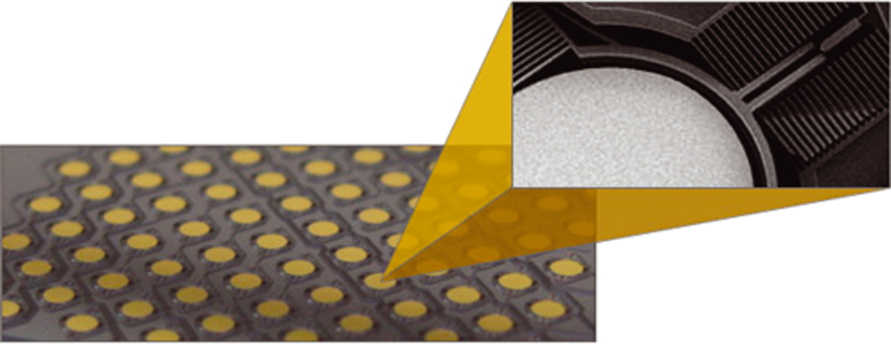
Free-space optical switches
Many fewer interconnections
but
More complex optics
Micromirror array
Microlens arrays
Micromirror array
Optical design:
R. Content (Durham)
(Murray, Allington-Smith 2009)

Slide 12
Novel and efficient row/column downselection in a MEMS mirror array switching scheme
Mirror array 1
Mirror array 2
Output Fibres
Input Fibres
Mirror array 3

Slide 13
An alternative with less fiber interconnections
Inputs: m x n
A two-layer, downselection switching architecture using the two basic switch modules: the n×n and the m×1 devices.
Here, n = 8, m = 6
There are m × (n×n) modules (orange)
There are n × (m×1) modules (blue)
Number of inputs = n × m
Number of outputs = n
The rectangularity of the input dictates the downselection ratio; here 6:1
For the (n×n) modules proposed by an industrial partner, n = 1000 is feasible
Similarly, there is no obstacle in principle to an (m×1) switch, where m = 1000
This technology therefore appears to be the most practical route to DFS systems with >10⁶ channel counts.
Outputs: n

Slide 14
Remapping spaxels
If fiber switches are not used in cascade … The focal plane is divided by cells, from each of which only one spaxel can be selected to be routed to a spectrograph. = “Coherent DFS”, with direct mapping & down selection. ← Not optimal to observe a largely extended object (although this is intended to be a 2D spectroscopy!)
Focal plane
9x1 down selection
Pseudo slit

Slide 15
Remapping spaxels
If Nx1 switches cannot be used in cascade …
Solution Randomize input-output mapping in fiber bundle so that a large fraction of adjacent inputs can be routed to spectrograph(s). = “Incoherent DFS”, with incoherent remapping incorporated.
Focal plane
“Randomized”
down selection
Slit

Slide 16
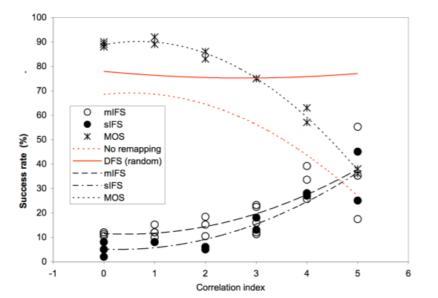
Power of incoherent remapping
Incoherent
DFS
Montecarlo realization of spaxel distribution and selection for spectroscopy: High (low) correlation index → Uniform (clumpy) Spaxel is routed to a spectrograph? Yes → Success.
(MOS)
Coherent
DFS
IFS
(Poppett, Allington-Smith & Murray 2010)
Remapping is very beneficial for clumpy distributions
DFS is much more versatile than IFS or MOS

Slide 17
Components
Focal plane array of spaxels & primary feed
Switcher
Spectrograph feed & spectrographs
Output fibers are re-organized as a slit and are input to spectrographs.
Existing spectrographs? (FMOS, MOIRCS, IRCS, FOCAS …) Given a fiber-feed option can be added …
→ A single focal plane can be shared. → Heterogeneous/Multi-mode spectroscopy is possible.
New spectrographs?
E.g. SuMIRe/PFS → Better “homogeneity” & much higher multiplicity may be offered.

Slide 18
Preliminary specifications
Focus: Ns → Assisted by MOAO? Cs → Assisted by GLAO?
Spectral coverage: Fiber feed, AO assistance → (RI)zYJH?
Spaxel size: AO assistance → ~0”.1? Natural seeing → ~0”.2?
Max. # of spaxels that can be routed to spectrographs cf. FMOS IRS1 & IRS2 has 400 multiplicity in total.
Available spectral resolution
→ Need to await for detailed design studies …

Slide 19
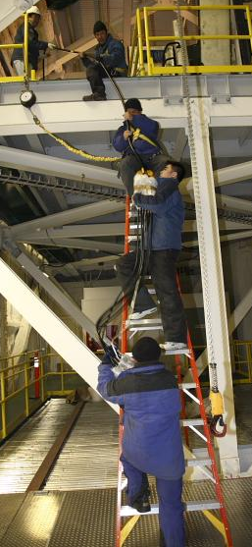
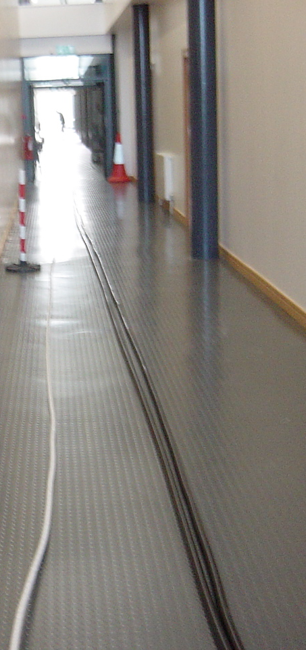
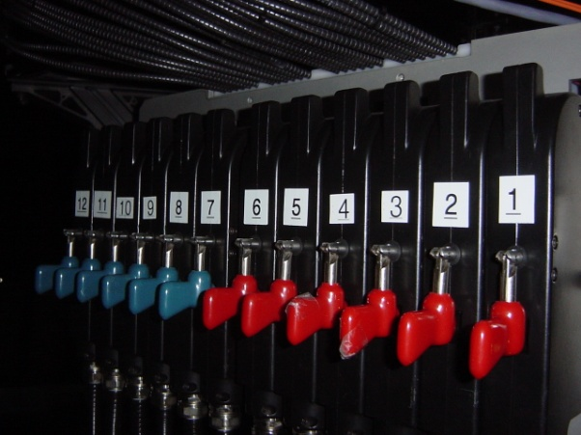
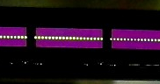
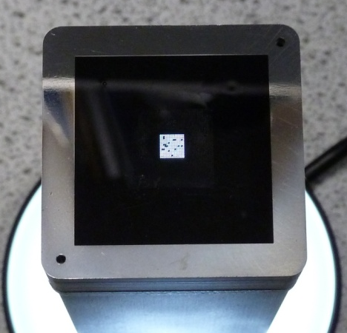
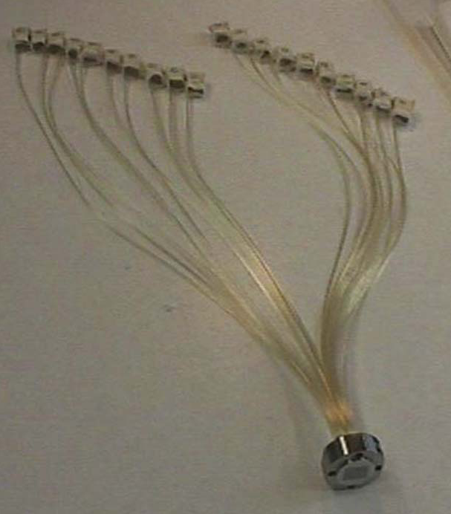
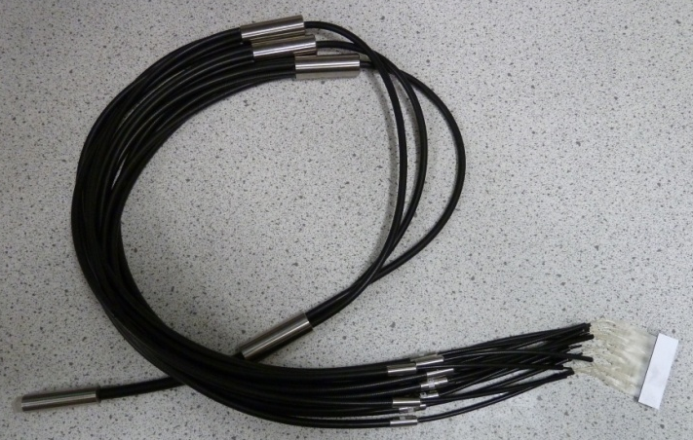
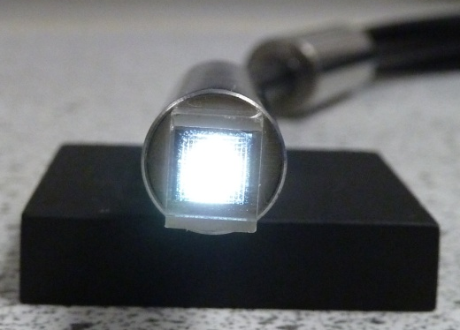
Achievement & on-going progress
FMOS fiber cable
FMOS fiber connectors
Installation
Assembly
FMOS fiber slit
GMOS-IFU
Prototype of fiber bundle & IFU with an incoherent fiber re-mapping.

Slide 20
Summary
“SuFAIFS”: Subaru Flexibly Addressable Integral Field Spectrographs Adding a new significant observing capability to the telescope
Main features
Flexible & optimal selections of spaxels on the focal plane will be allowed: “DFS” → MOS+multi IFU+IFS
A single focal plane is “shared” by N(>=2) spectrographs.
Other details (mostly tentative)
Ns/Cs focus, (RI)zYJH? → Could be assisted by MOAO/GLAO.
Adding a fiber-feed option to existing spectrographs?(FMOS, MOIRCS, IRCS, FOCAS …) → Heterogeneous/multimode spectroscopy
More spaxels? Better “homogeneity” on a focal plane? → Spectrographs for SuMIRe/PFS may be a possibility? Still AO-assisted in the (RI)zY band with full-depletion type CCD?
R&D is on-going in Durham, exploring collaborations including other reseaerch areas (including industrial partners).
Trying to wrap up technical details & scientific potentials expected by them (with instrument throughput predicted).
Current status & near-future plans

