Slide 1

中間赤外線装置MIMIZUKU
MIMIZUKU : Mid-Infrared Multi-field Imager for gaZing at the UnKnown Universe
Takashi MIYATA
Institute of Astronomy, University of Tokyo
S. Sako, T. Nakamura, K. Asano, M. Uchiyama,
T. Onaka, I. Sakon, H. Kataza, and TAO group

Slide 2

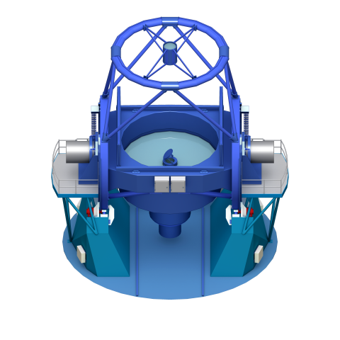
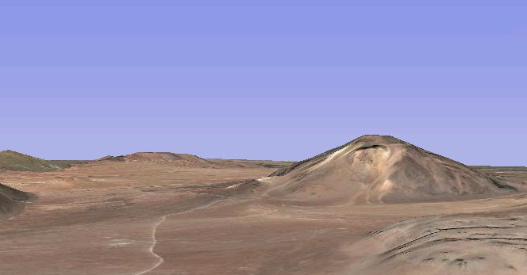
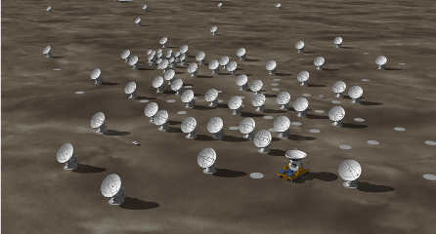
TAO project
Mid infrared observations from the ground
TAO
a 6.5m infrared/optical telescope
the highest site in the world (5,640m)
at Atacama desert, Chile
ALMA Site

Slide 3
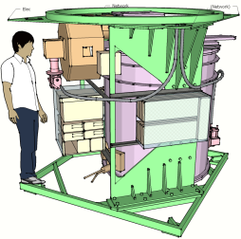
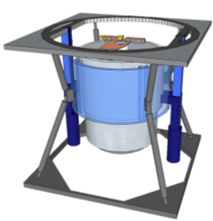
Instruments for TAO
Mid infrared observations from the ground
Excellent sky condition
Transmittance [%]
100
50
0
1 2 3 4 5 10 20 30 40
wavelength [micron]
MIMIZUKU
SWIMS
Motohara+
Two instruments are now under development
→ Can be attached to the SUBARU Cassegrain focus

Slide 4
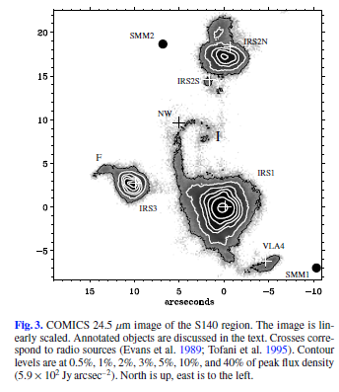
Mid infrared observations from the ground
Mid infrared observations from the ground
Akari and Spitzer achieved excellent results in a number of astronomical fields
very high sensitivity / wide coverage of the sky
Groundbased observations at mid infrared are still important
high spatial resolution
- monitoring capability
c.f. COMICS
de Wit et al. 2009

Slide 5
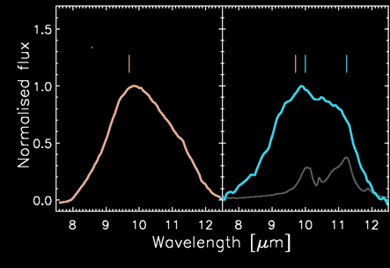
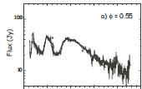
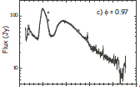
Mid infrared observations from the ground
Mid infrared observations from the ground
Many of MIR objects are variables???
✓ T Tau stars, HAeBe
EX Lupi (FU Ori type, T Tauri star)
quiescence
outburst
amorphous
silicate
amorphous +
crystallized
silicate
Abraham+ 2009
✓ AGB stars, Luminous Blue Variables, WR stars
minimum
maximum
Onaka+ 2002
10 20 30 40
10 20 30 40
Wavelength [um]
✓ Comets....

Slide 6
Accurate monitoring at MIR
Mid infrared observations from the ground
Monitoring observations at MIR wavelength are difficult
Satellite telescopes → lifetime is so limited
observing time is very competitive
Ground-based telescopes → accurate monitoring is too difficult
×Unstable sky condition
×Limited number of (comparison )stars
→ Differential photometry cannot be applied.
c.f. optical / NIR wavelengths….
a lot of stars + wide filed of view
→ Stars around a target object can be used
as a standard of comparison

Slide 7
Accurate monitoring at MIR
Mid infrared observations from the ground
Not many stars in MIR sky
Filed of view of current MIR cameras : not so large (< 1arcmin)
→ Only the target object is observed at once.
Schematics of the mid-infrared sky

Slide 8
Accurate monitoring at MIR
Mid infrared observations from the ground
If we can take two (or more) discrete fields simultaneously.....
Differential photometric method can be applied
→ improve precision and reliability dramatically

Slide 9

Field stacker
望遠鏡の像（仮想的）
1’x2’
1’x2’
ピックアップ鏡
視野合成▽鏡
ピックアップ鏡
回転テーブル
その上にXステージ
2’x2’
低温光学系に
-- consists of two movable pick-up mirrors and a wedge shape mirror
-- picks up two discrete fields of the sky
-- brings into the instrument field of view
Simultaneous observation of two (or more) stars

Slide 10
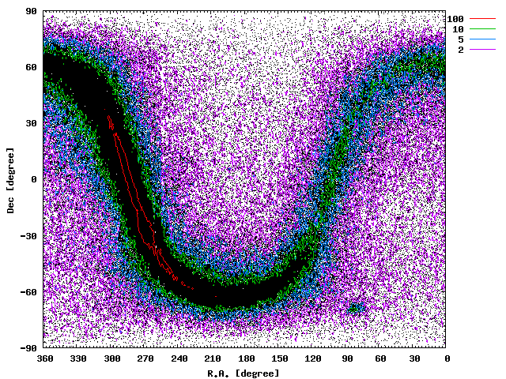
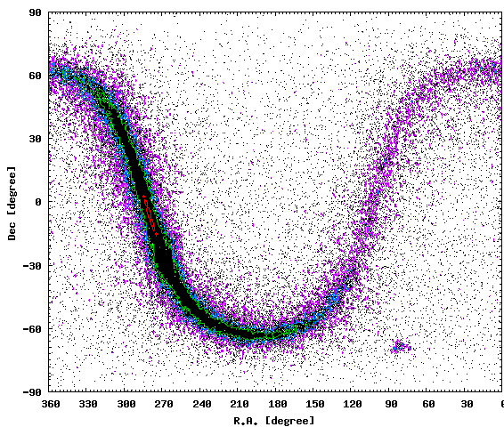
Conceptual studies of the field stacker
There are enough number of MIR stars ??
Fraction of two or more Akari 9um objects in a field
Field of VIew | > 50mJy | > 300mJy
φ25’ | 55% | 51%
φ12.5’ | 48% | 39%
φ5.0’ | 23% | 13%
20% of 9um sources
Fraction of two or more Akari 18um objects in a field
Field of VIew | > 130mJy | > 1000mJy
φ25’ | 50% | 41%
φ12.5’ | 41% | 35%
φ5.0’ | 15% | 0.3%
10% of 18um sources

Slide 11
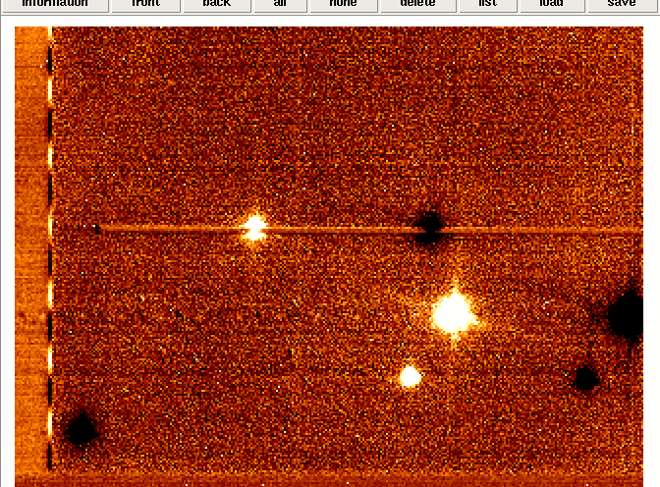
Conceptual studies of the field stacker
Simultaneous observation improves the photometric accuracy?
Time variations of star counts
1.2
MIR images of two or more stars taken by COMICS
Source A
Source B
1.1
A/B
Normalized Intensity
1
0.9
0.8
0
20
40
60
80
100
✓Variation of the intensity : 10% within 100 sec.
✓ Variations of two stars are synchronized
Time (sec)
Power spectra of intensity
100
Source A, B
A/B
10
Power
Simultaneous observations are effective
(at least within 1 arcmin)
1
0.1
0.4
0.01
0.05
0.1
Frequency (Hz)

Slide 12
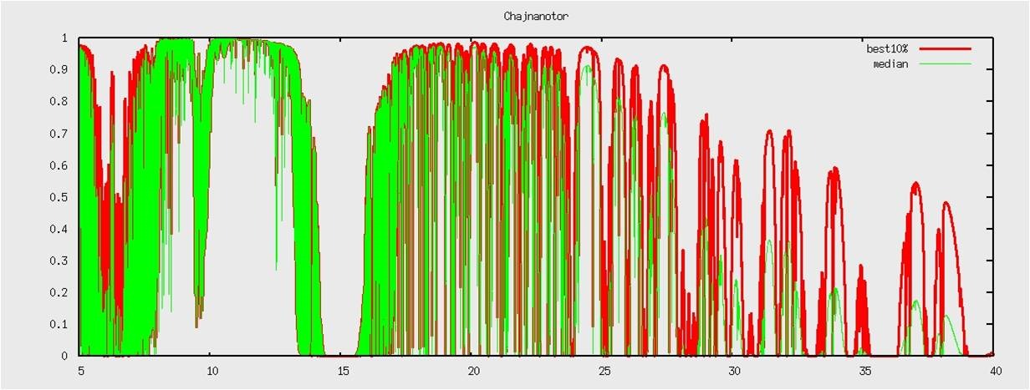
Field stacker for spectroscopy
The field stacker is also useful for spectroscopic observations.
Simultaneous observation enable us
accurate calibration of the atmospheric absorptions
especially for
Ozone absorption band
at 10 micron
Q-band or longer wavelength ranges

Slide 13
MIMIZUKU : Key concepts
Accurate monitoring
with the Field stacker
Wide wavelength coverage
Covers 2-38 micron wavelength region ( over 4 octaves!)
High spatial resolution
Achieves diffraction limited spatial resolution

Slide 14
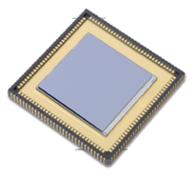
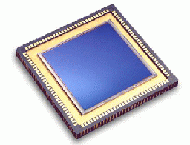
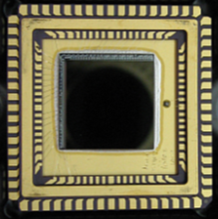
MIMIZUKU : Block diagram
from Telescope
    300K
Field Stacker
Fore Optics
    20K
Slit
Flip-flop mirror
InSb ch.
Si:As ch.
6-25μm
Si:Sb ch.
20-38μm
2-6μm
Filters
Grisms
Filters
Grisms
Filters
Grisms
    5K
Si:As 1k
Si:Sb128
InSb 1k

Slide 15

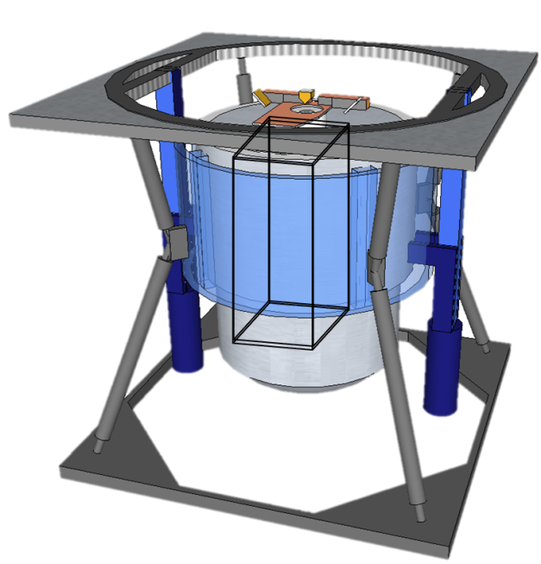
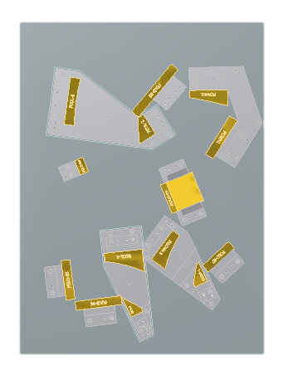
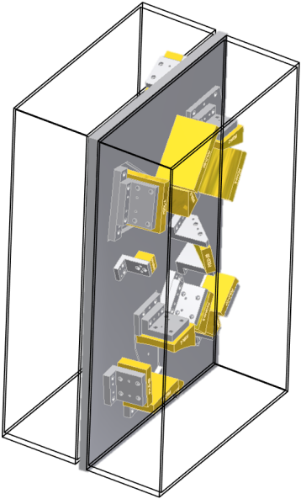
MIMIZUKU : Optics
Wedge
Mirror
Pickup mirror
Pickup mirror
Field Stacker
Up&
down
Cold Optics (20K)
Reflective optics
→ wide wavelength coverage
good performances

Slide 16
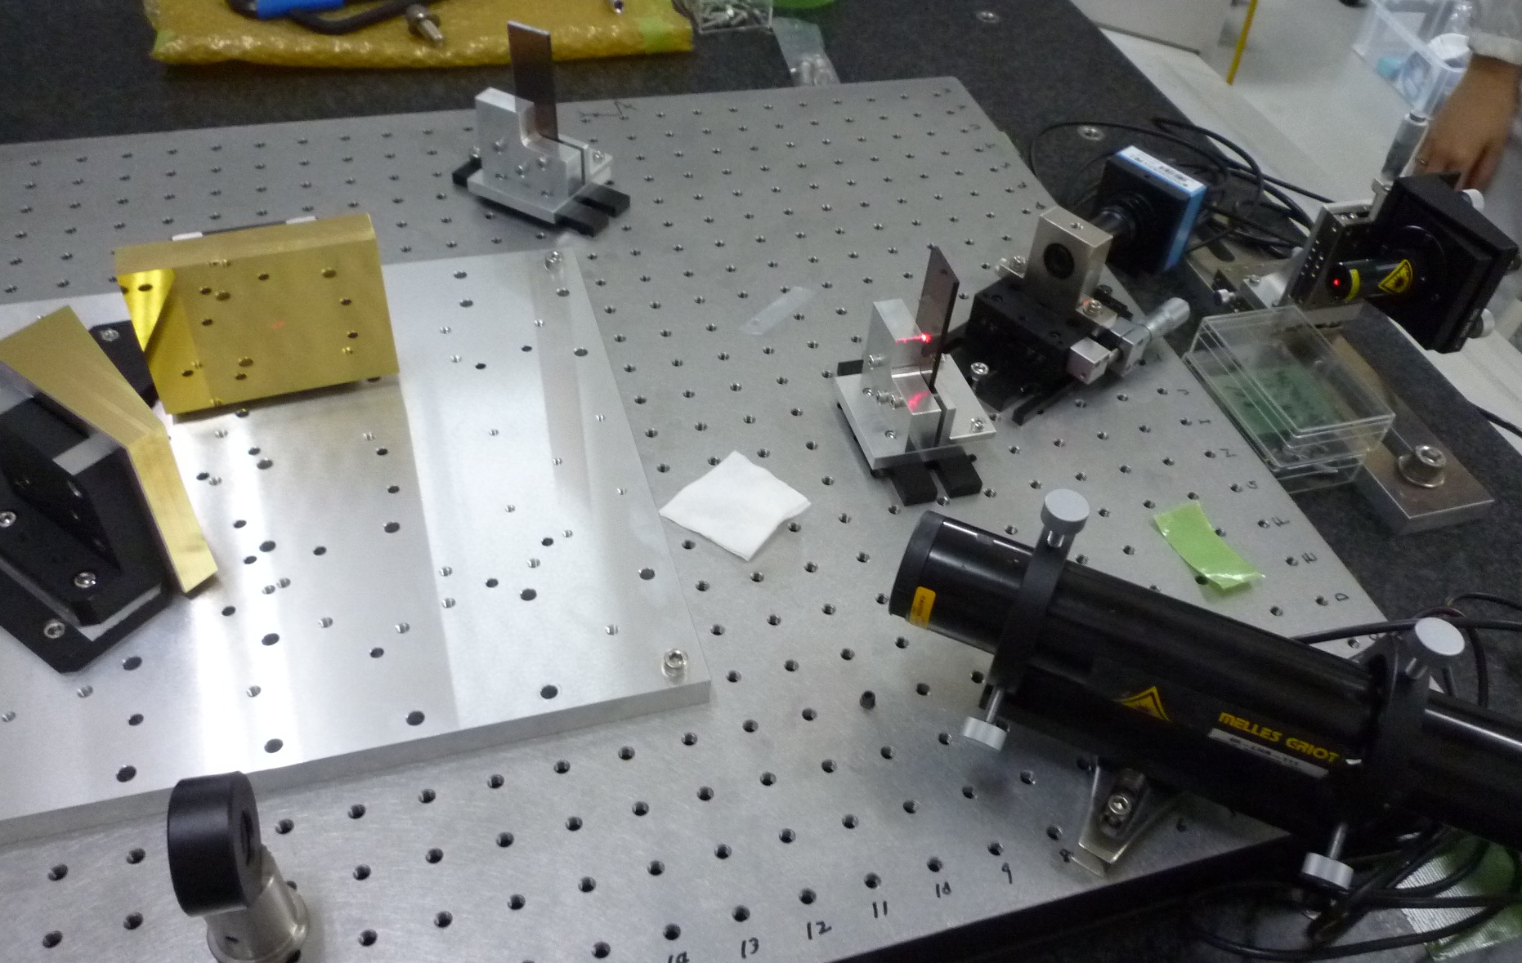
MIMIZUKU : Optics

Slide 17
MIMIZUKU : Specifications
Parameters | Values |  |  | Notes
# of channels | 3 (Si:As / Si:Sb / InSb)
Detectors | Si:As 1k x 1k | Si:Sb 128 x 128 | InSb 1k x 1k
Wavelength coverage | 6-25um | 20-38um | 2-6um
Pixel scale | 0.1”/pix | 0.4”/pix | 0.1”/pix | @SUBARU
Field of view | 2’ x 2’ or 1’x2’ x 2fields | 1’ x 1’ or 0.5’x1’ x 2fields | 2’ x 2’ or 1’x2’ x 2fields | @SUBARU
Filters | 10 filtes (6-25um) | 7 filtes (20-38um) | 13 filtes (2-6um)
Spectroscopy | R ~400 @Nband R~400 @Qband | R~50 @30um | R~600 @LMband | w/ grism
Sensitivity (Img.) 1sig1sec | 40mJy @10um 130mJy @20um | (400mJy @30um?) |  | for point sources
Instrument size | 2m x 2m x 2m , ~ 2ton
Others | - A cold chopping unit is installed in fore-optics

Slide 18
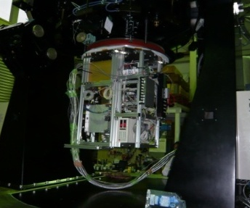
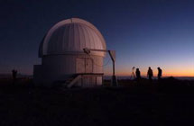
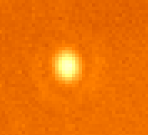

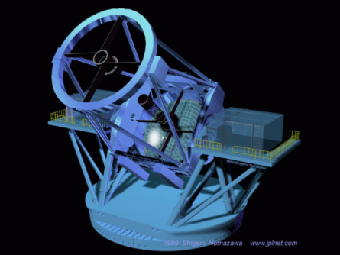
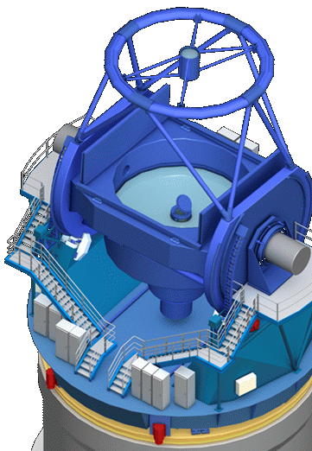

MIMIZUKU : Schedule
FY 2010
2011
2012
2013
2014......
Prototype instrument
MAX38
Point source images @ 31um / 37um
(Diffraction rings can be seen)
Atacama 1m telescope
MIMIZUKU
Desgin and Development
Tests @ Mitaka
Tests
@ Hilo
Observations
@ SUBARU
Observations
@ TAO
first light

Slide 19



Summary
MIMIZUKU
✓ Wide wavelength coverage (2-38μm )
✓ High spatial resolution
✓ Accurate monitoring w/ Field stacker
adds an unique
“Monitoring Capability”
develops pioneering technology
supplies human resources
....

Slide 22
MIMIZUKU : Specifications
MIR performances compared with COMICS
 | MIMIZUKU | COMICS
Sensitivity | ~40mJy @10um 1s1s | ~30mJy @10um 1s1s
Spatial resolution | diffraction limited | diffraction limited
Filed of view | 120” x 120” or 60”x120”x2filed | ~ 40”x30”
Spectral resolution | R~400 @N-band R~400 @Q-band | R~250/2,500/10,000 @N-band R~2,500/5,000 @Q-band
Monitoring Accuracy | Good (w/ Field Stacker) | ---
△
○
○
○
○
◎
◎
COMICS has advantages of
slightly higher sensitivity ( because MIMIZUKU has warm optics)
med/high resolution spectroscopic capabilities
MIMIZUKU will add an unique function of
MIR monitoring observations to the SUBARU telescope

