Slide 1
すばるTACから
Comments from TAC
嶋作一大 (東大)
Kazuhiro Shimasaku (Tokyo)

Slide 2
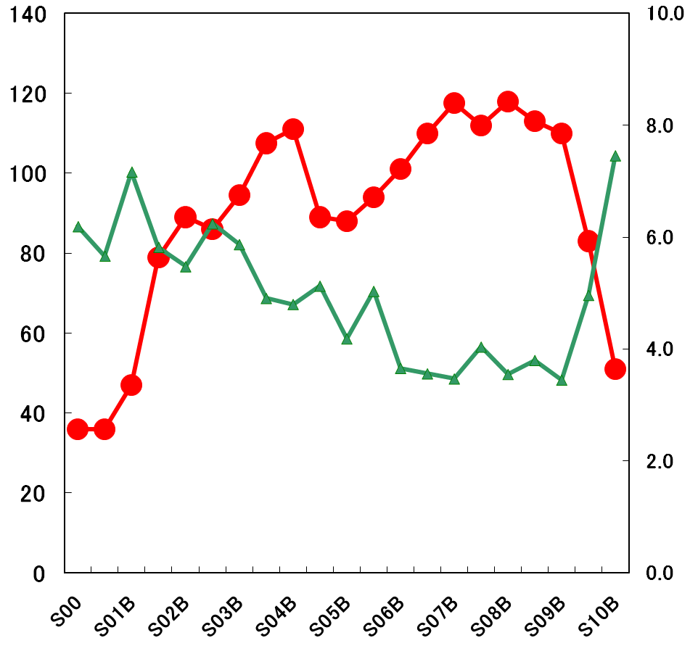
Oversubscription rate of previous semesters
(total nights requested/total nights offered)
140
120
100
80
60
40
20
0
10
8
6
4
2
0
S10A 83Ns, OS=5
mirror recoating
top-unit refurbishing
total nights offered
(excl. SSP)
oversubscription rate
S10B 51Ns, OS=7.5
mirror recoating
top-unit refurbishing
SEEDS 10Ns

Slide 3
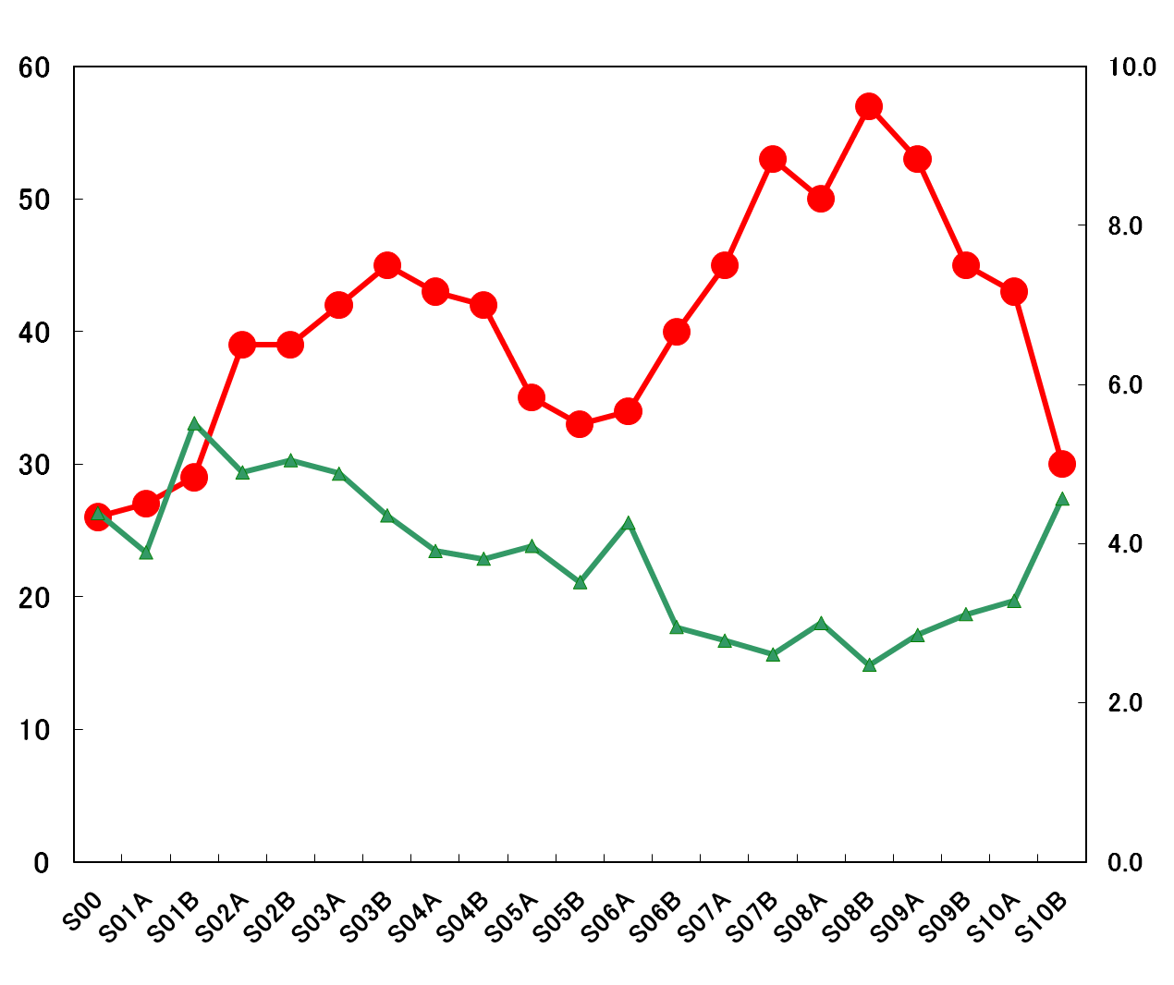
Oversubscription rate of previous semesters
(props submitted/props approved)
# of proposals approved
Oversubscription rate

Slide 4
http://www.naoj.org/Observing/Proposals/Submit/pastinfo.html

Slide 6
SAC’s simulation:
Open-use nights from 2012 to 2022 (excl. SSP)
2012-2017 SEEDS,FMOS,HSC
Max 96 (12A, SSP=17)
Min 67 (14B, SSP=52.5)
67 (13A, SSP+mirror recoating)
Ave 80
oversubscription rate ～5-6
2018-2022 PFS
Ave 90
oversubscription rate ～5

Slide 7
too high oversubscription rate: TAC’s agony(苦悩)
順位 | タイトル
1 | ．．．
2 | ．．．
3 | ．．．
4 | ．．．
5 | ．．．
6 | ．．．
7 | ．．．
8 | ．．．
9 | ．．．
10 | ．．．
11 | ．．．
12 | ．．．
13 | ．．．
14 | ．．．
15 | ．．．
16 | ．．．
17 | ．．．
18 | ．．．
19 | ．．．
20 | ．．．
excellent
example:
clusters of galaxies,
LSS, cosmology
category
worth carrying out
(やらせてみたい)
sure
interesting
high risk high return
bad

Slide 8
高い競争率の悪影響
bad influences of too high oversubscription rate
良いプロポーザル(自分のプロポーザル)が落ちる
サイエンスの多様性、意外性が失われる
分野によっては存亡の危機
利用者が減り、顔ぶれも固定化
国際プロポーザルが優位になる
継続課題の完遂にかかる時間が長期化
対抗措置は？
1課題当たりの夜数を減らしてたくさん採択
インテンシブを禁止
SSPに参加する

Slide 9
シミュレーションはシミュレーション
A simulation is no more than a simulation
ユーザーの意見で結果は変えられる
You can change the future

