Slide 1
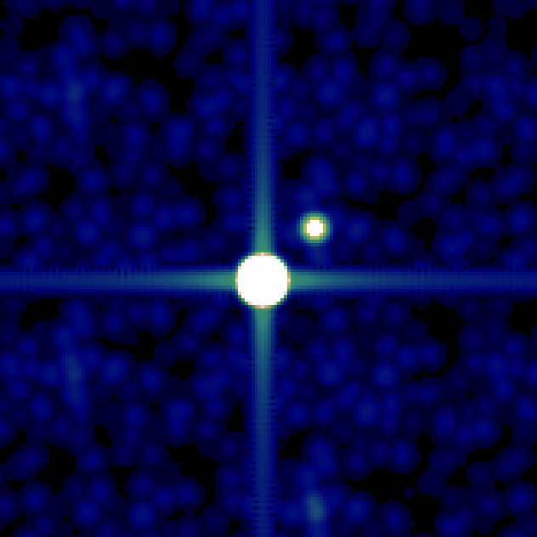
光ファイバー干渉計技術を用いたすばる用超高角分解能・高ダイナミックレンジ撮像装置について
Extremely High Angular-resolution, High-dynamic range Imaging Instrument with Single-mode fiber interferometric techniques
Takayuki Kotani (ISAS/JAXA)

Slide 2
Overview
Future instruments to realize very high-contrast, high-angular resolution imaging with/without AO for Subaru
Pupil Remapping:
A new concept for diffraction-limited, high-contrast imaging in visible to NIR wavelengths
Aperture masking + single-mode fiber interferometer
OHANA
Optical/Infrared Interferometer array on Mauna Kea
Extremely high angular resolution (< mas)
Combining large AO-equipped telescopes including Subaru with a single-mode fiber

Slide 3
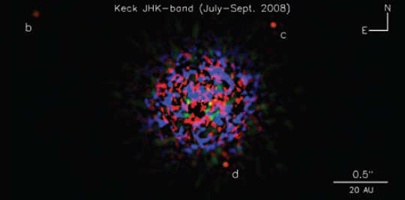
High-Contrast, diffraction-limitted imaging from the ground
⇒ Adaptive Optics already realized diffraction limited imaging
However,
Relatively low dynamic range around ～λ/D due to residual Atmospheric turbulences
AO performance is limited in the visible wavelengths
Solution： Aperture Masking＋Single-mode fiber

Slide 4
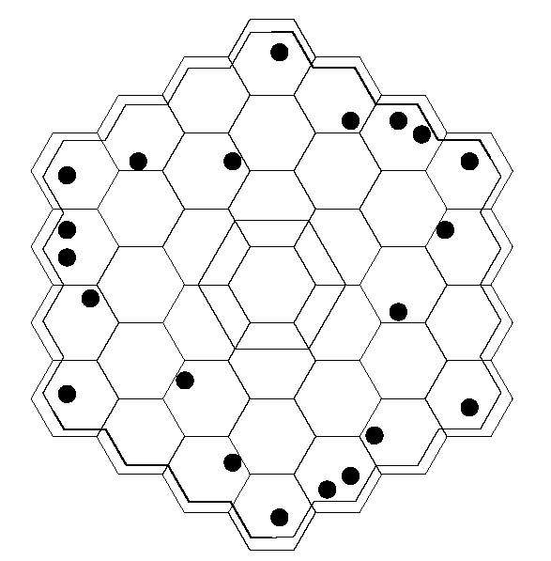
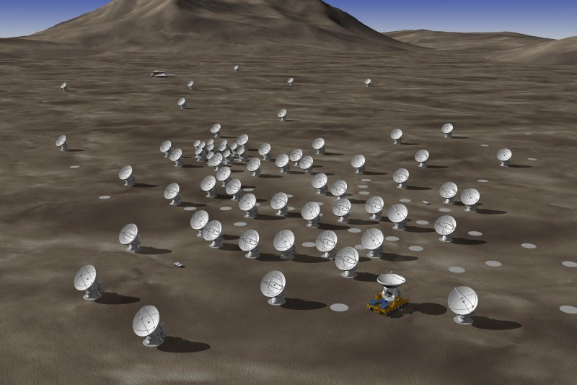
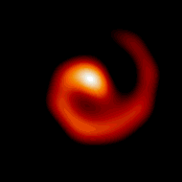
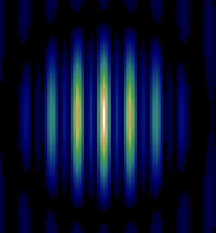
Aperture Masking
≒
Several sub-apertures can be used as the array of small telescopes
Original image can be reconstructed with interferometric techniques
WR104 at K-band
0.1 arcsec
Tuthill, Monnier & Danchi, Nature 1999, 398, 487

Slide 5
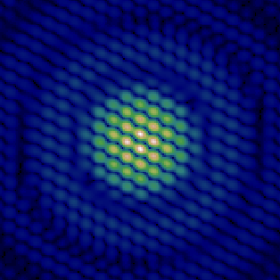

Image reconstruction with Aperture Masking
Telescope (Mask)
Focal Plane
Image reconstruction
(Clean, Maximum Entropy, etc)‏
Complex
visibility
measurement
Non-Redundant
Interference between each sub-apertures
Sub-aperture size < fried length r₀
Exposure time (1 frame) < Coherence time t₀
Non-Redundant aperture configuration
Redundant

Slide 6
Limirations of Aperture Masking
Sub-aperture size < fried length r₀
1) Wavefront erros inside a sub-aperture cannot be zero
Non-Redundant mask
2) Only small part of a telescope aperture can be used
3) Limited number of baselines
Dynamic range is limited to <1000

Slide 7
FIRST (Fibered Imager foR Single Telescope)‏
Aperture Masking + Single-mode fiber
・Single-mode fiber can filter out atmospheric turbulences
・Re-arrangement of Sub-aperture positions
Single-mode fiber
Redundant array
Non-Redundant array
Degraded wavefront
Flat wavefront

Slide 8
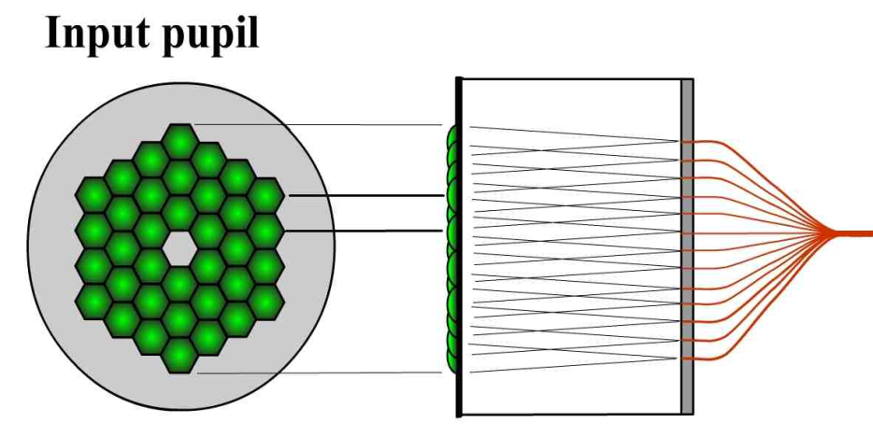
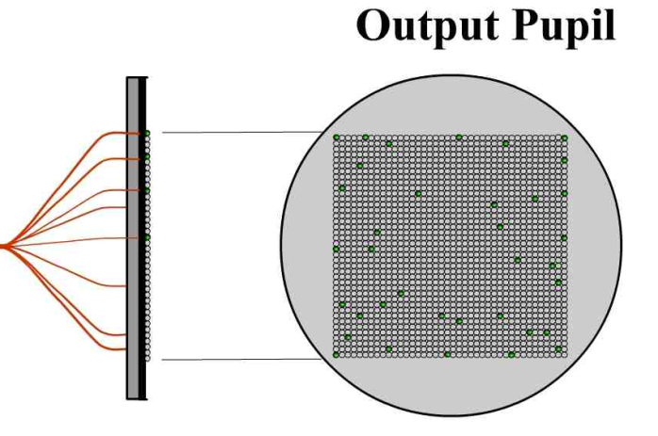
FIRST (Fibered Imager foR Single Telescope)‏
Lenslet array
Single-mode
fibers
Redundant Configuration
+ Corrugated Wavefront
Non-Redundant Configuration
+ Spatially Filtered Wavefront
Perrin et al. 2006; Lacour et al. 2006
1. SM fibers remove wavefront errors within each sub-apertures
2. Re-arrangement of sub-apertures non-redundantly leads to a full usage of a telescope aperture
3. Post-data processing can remove piston errors between fibers
Extremely high-contrast, sensitive imaging possible

Slide 9
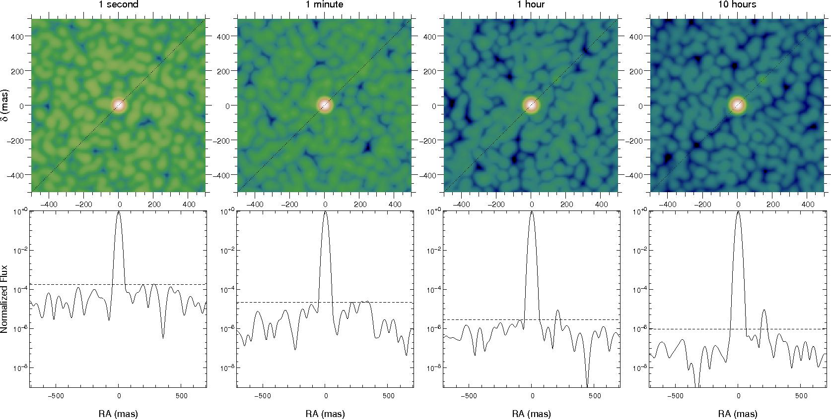
Simulation (8m telescope)
Integ. Time
0.2 sec
13 sec
13 min
2.2 hour
Dynamic range
10⁴
10^{4.8}
10^{5.5}
10⁶
0.5 arcsec
Dynamic range = Photon noise limit
・Hot-Jupiters can be directly detected from the ground!
・Only this technique can achieve extremely high-contrast imaging in the visible wavelengths
Seeing: r₀ = 8cm @ 550nm, t_{o} = 8 msec
Integration time per frame: 1 msec
8m telescope
λ = 550 nm, Δλ = 90 nm
Star magnitude = 5

Slide 10
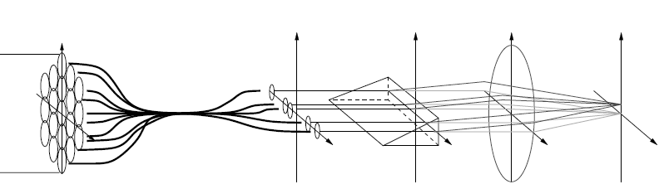
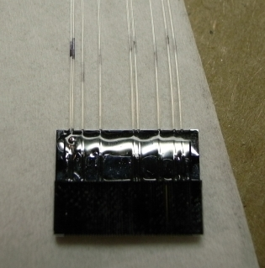
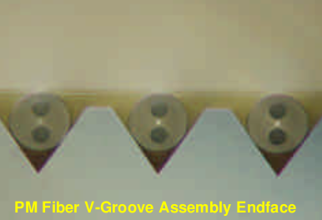
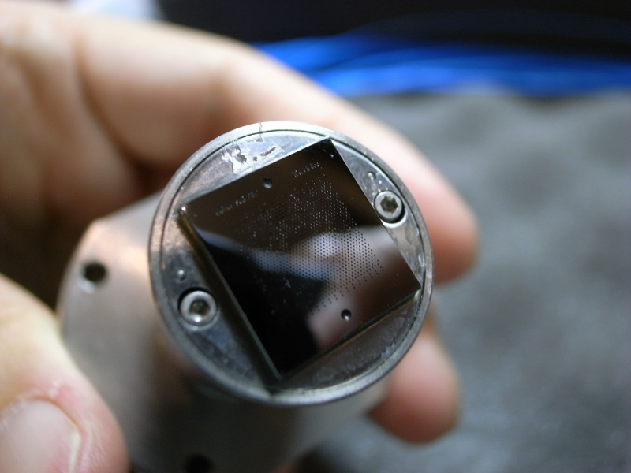
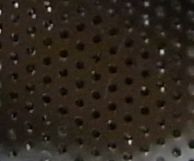
FIRST: Development of a 9-fiber prototype system
9-fiber, single-mode fiber Pupil Remapping System
Operating at the visible wavelength (600-800nm)‏
Spectroscopy (R ~ 100)‏
Observations at the Lick Shane Telescope(3m)
Single-mode
Fiber
Input telescope Pupil
Lens Array
Non-redundant Array
2D-Fiber Array
Silicon V-groove chip

Slide 11
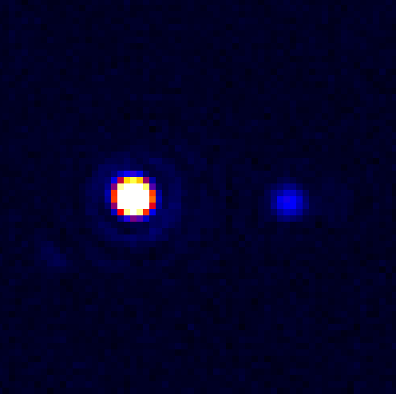
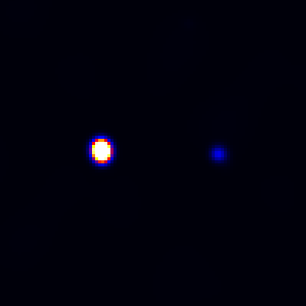
Image reconstruction in the laboratory
Kotani et al., 2009, Optics Express, 17, 1925
CCD Image
Reconstructed image from visibility measurements
(2 x He-Ne Laser)

Slide 12
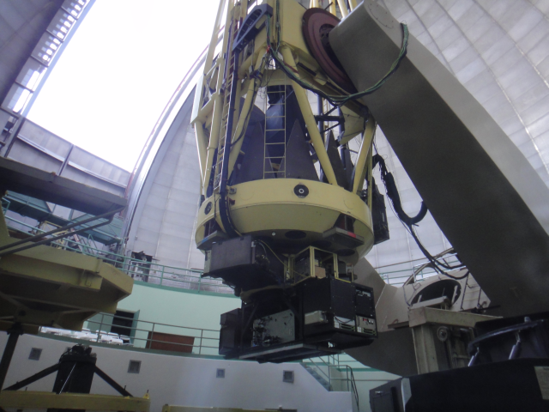
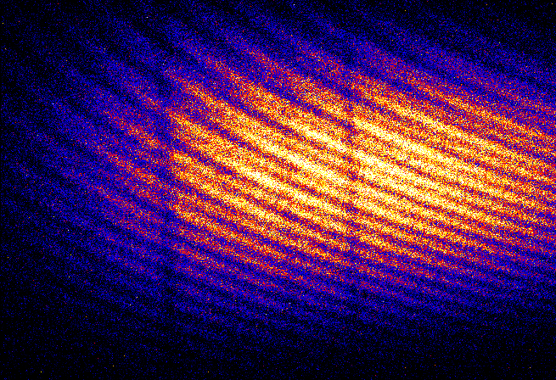
On-sky demonstration successfully completed!
July, 29, 2010
Interferogram of Vega
Lick 3m telescope
9-fiber system
Spectro-interferometry
600-800nm
Ready to go for a larger telescope
(Subaru… )
λ
800 nm
600 nm

Slide 13
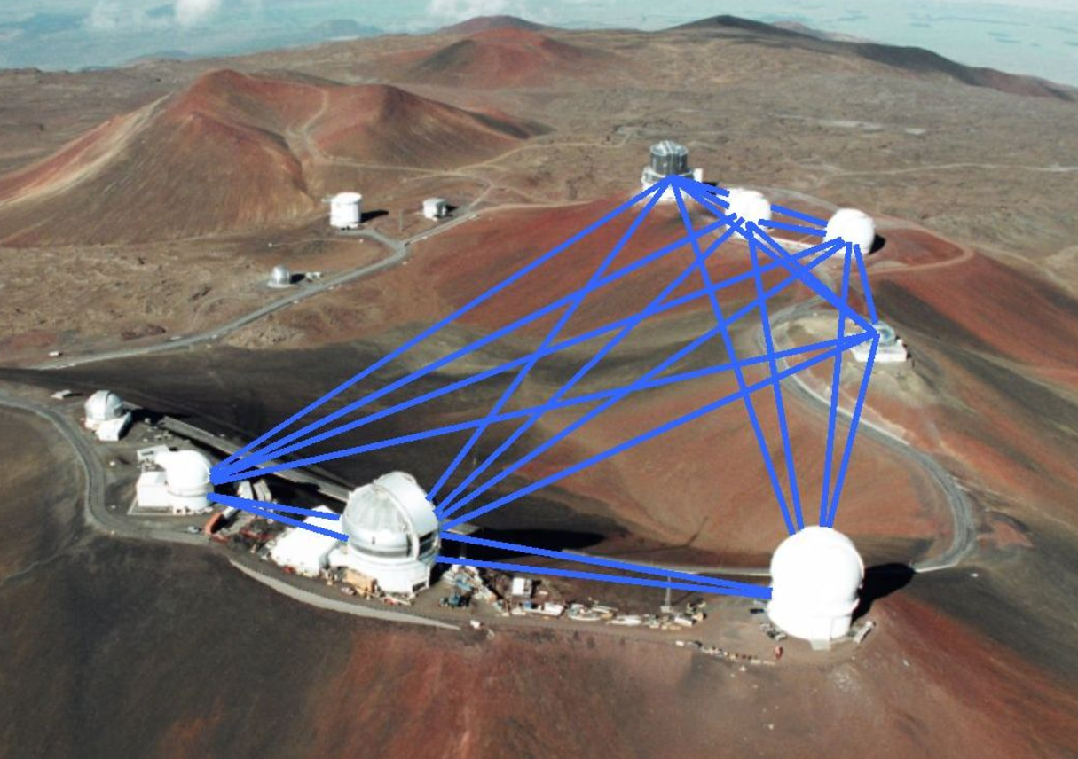
OHANA: Optical Interferometer on Mauna Kea

Slide 14
OHANA: Optical Interferometer on Mauna Kea
≒
OHANA (Optical Hawaiian Array for Nanoradian Astronomy)
Optical/Infrared Interferometer array on Mauna Kea
Combining AO-equipped large telescopes including Subaru with a single-mode fiber
Extremely high angular resolution (sub mas)
Project started in 2000 (the international team led by Paris observatory)
2006: First on-sky fringes at Keck-I and Keck-II in the K-band

Slide 15
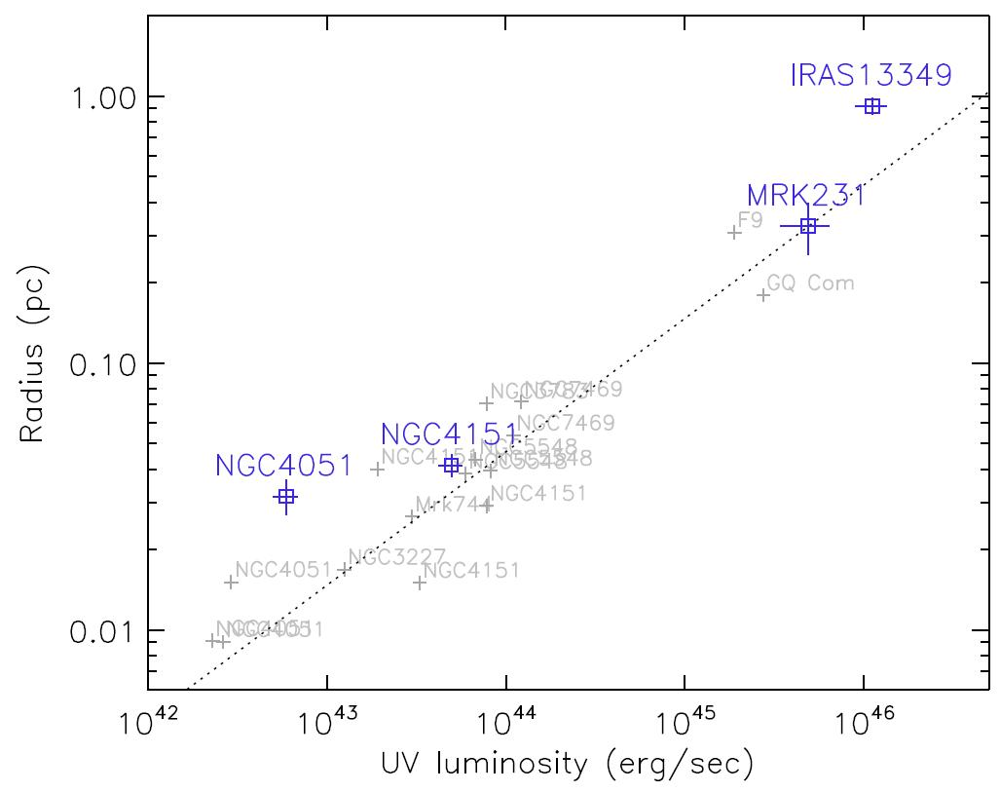
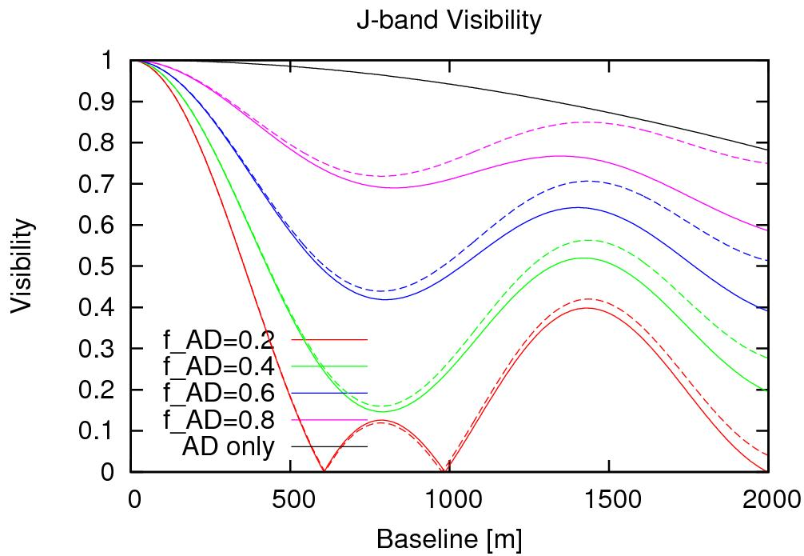
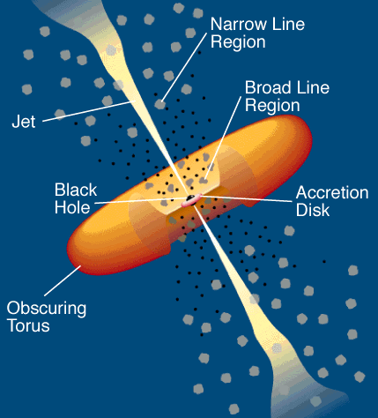
What can we do with OHANA?
OHANA has a potential of:
Resolving inner most regions of AGN torus
Directly measuring an accretion disk size
Directly Measured-
Size-Luminosity Relation!
Radius of Inner Dust Rim
Kishimoto et al. 2009, A&A, 507, L57
UV Luminosity
Measured AGN torus size with Keck-interferometer
Futur plan
2011: CFHT – Gemini recombination
201?: Subaru – Keck
Design of a fiber injection module for Subaru is ongoing at NAOJ

Slide 16
Summary
Pupil Remapping:
High-dynamic range, high-angular resolution imaging can be realized with the single-mode fiber pupil remapping technique in the visible to NIR wavelengths
On-sky demonstration successfully completed at the Lick 3m telescope
Pupil remapping at Subaru: up to 10⁶ dynamic range, 12 mas angular resolution imaging possible
Direct detection of extra-solar planets (Hot-Jupiters) in the visible is possible with Subaru
OHANA:
Extremely high-angular resolution optical interferometer
Resolving inner-most regions of AGN dust torus
R&D is ongoing to realize Subaru-Keck interferometer
Notes:
- A single-mode fiber pupil remapping system allows a diffraction-limited, high dynamic range imaging at visible wavelengths
- Development of a 36 element prototype system is underway
- Laboratory experiments succesfully demonstated that complex object visibilities can be measured correctly
- FIRST will be tested at the 1m telescope in Meudon in this fall

Slide 17
Thanks for your attention!
Takayuki Kotani

Slide 18

ピストン（位相差）は解くことができる！
V_{k}: Object Visibility
G_{i}: 複素透過率 (位相と入射効率)‏
実際に観測できる量は天体のVisibilityではなく、µ (Mutual coherence factor)‏
Input (Redundant)‏
Output (Non-redundant)‏
14個の未知数
(5個の複素透過率G＋9個の複素数Visibility)‏
15個の観測可能な量 > 14個の未知数
Post data processingにより、位相差・入射効率の影響を取り除き、完全にフラットな波面を再構築できる！

Slide 19
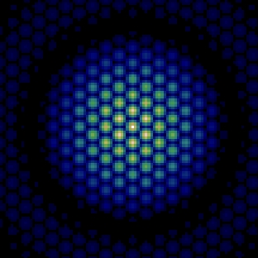
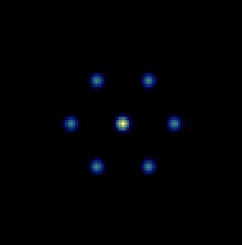
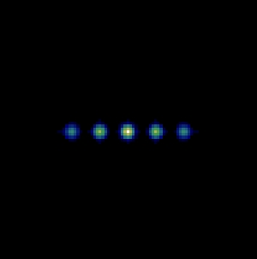
Non-redundant VS Redundant
Non-redundant
mask
FT
?
Redundant
mask
FT
+
２つの干渉縞を分離できないので、
Visibilityを正確に測定できない
＝低S/N, 低ダイナミックレンジ
縞の間隔が等しい２つの干渉縞の重なり
位相・振幅は互いに独立に時間変化する

