Slide 1
すばる次世代補償光学系に期待すること What we demand for the next generation Subaru AO - Kick off - 1. Current＋ 2. Next-generation
Masayuki Akiyama
(Astronomical Institute, Tohoku Univ.)
2010/09/10

Slide 2
What do we demand for “current+” system
Sky coverage, larger is better
For example, good correction with R=18mag TT-guide star with 60” distance, see later.
NIR TT-guide star (TT-correction with AO-corrected stars) ?
Information on PSF at target position. Possible ? How reliable ?
Especially for narrow fov observations. Accuracy with FWHM=0.10”+-0.02”, see later.

Slide 3
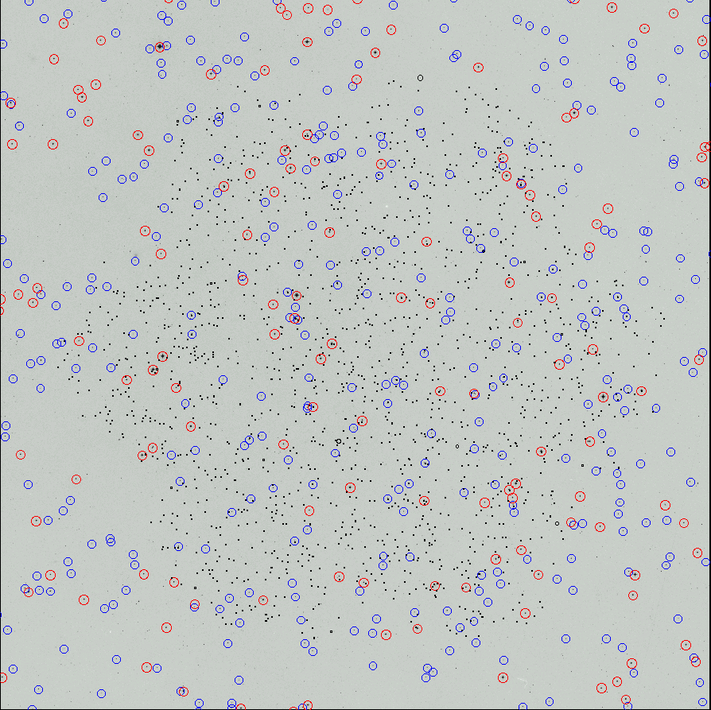
Sky coverage limitation
Yes of course with NGS AO
K-band SR~0.2 with R=13mag @ 30” (blue) ~6%@SXDS
K-band SR~0.1 with R=15mag @ 30” (red) ~3%@SXDS
SXDS fov
~1000 X-ray sources are plotted with small dots

Slide 4
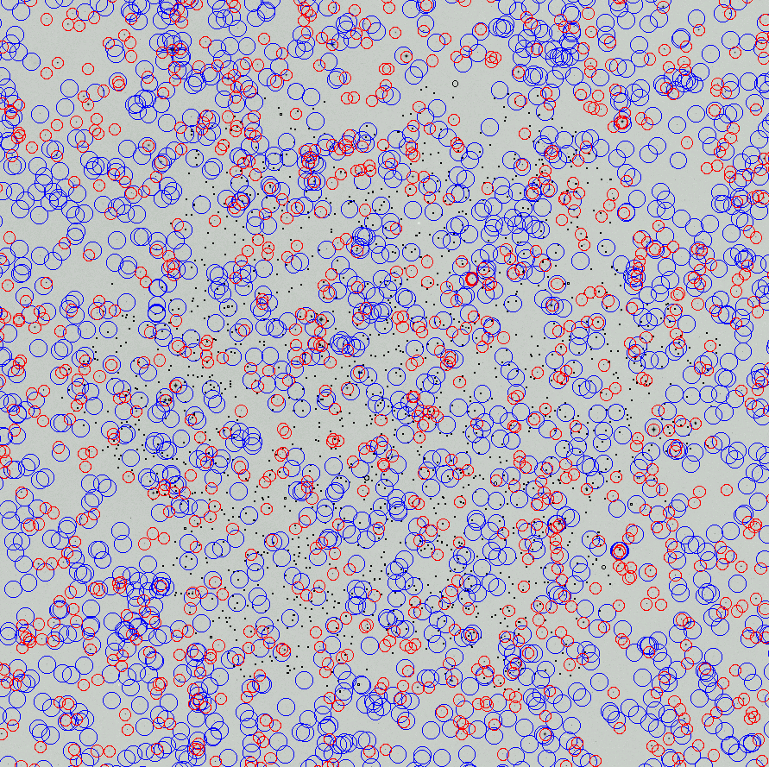
Sky coverage limitation
Even with LGS AO (Keck LGS)
K-band SR~0.2 with R=16mag @ 40” (blue) ~16%@SXDS
K-band SR~0.1 with R=18mag @ 60” (red) ~58%@SXDS
SXDS fov
~1000 X-ray sources are plotted with small dots

Slide 5
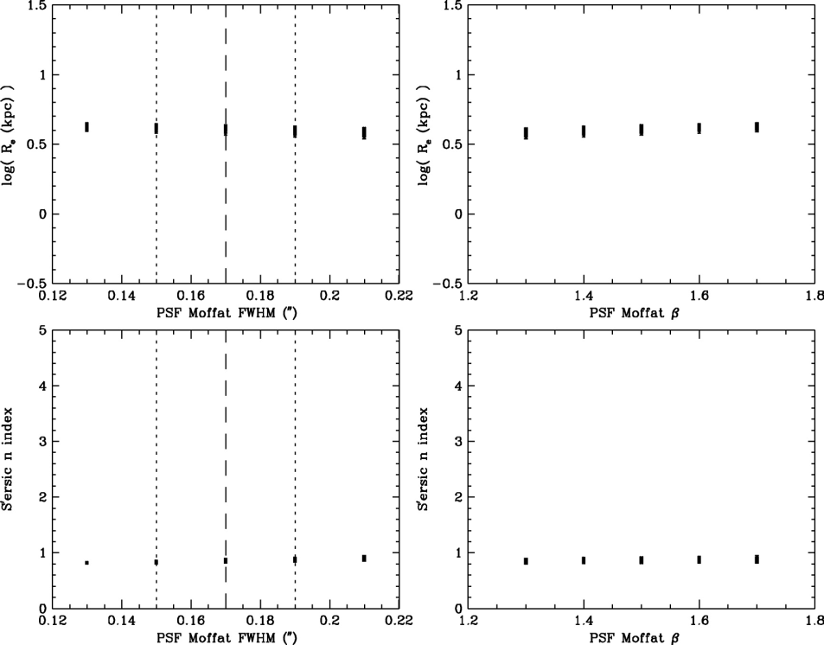
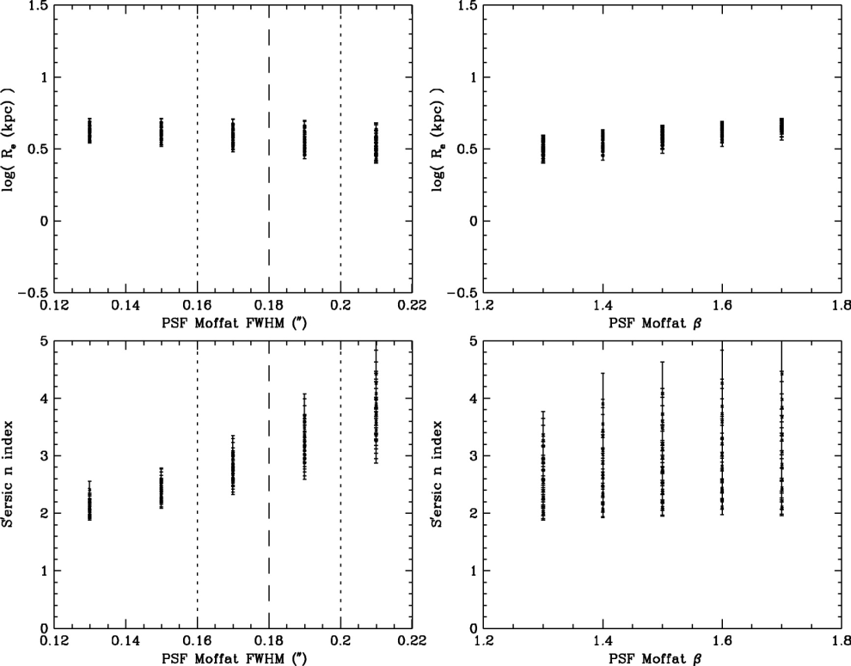
PSF estimation
Feasible ? With what accuracy ?
No estimation necessary for point source spectroscopy.
Required accuracy is not so high for morphological studies of distant galaxies. Best fit morphological parameters do not severely depend on model PSF used.
Very high accuracy required for QSO host galaxy studies.
MA+2008

Slide 6
Next-generation general-purpose AO and Subaru’s originality
Targeting “cutting-edge + big size + general-purpose” = “costly and time-consuming” instrument ? Or chose either of one ?

Slide 7
Next-generation general-purpose AO and Subaru’s originality
Unique AO instrument of ground-based 8-10m class telescope in the era of JWST(2014 launch)？
Competitive instrument even in the TMT(2018?) era ?
Wide field ? At least 5-10’ scale FoV. High-resolution version of NIR (prime-focus) wide-FoV camera.
2.2’ x 2.2’ x 2 0.03” sampling with JWST NIRcam
High-spectral resolution ? R=3000 or higher with wide spectral coverage, at leaset one octove.
R<1000-3000 0.1-0.2” sampling with JWST NIRspec
Shorter wavelength range ? High-spatial resolution observation in wavelength range 1um or shorter.

Slide 8
NIRCam Design Features U of Arizona (M. Rieke) plus Lockheed ATC
NIRCam images the 0.6 to 5μm (1.7 - 5μm prime) range
Dichroic used to split range into short (0.6-2.3μm) and long (2.4-5μm) sections
Nyquist sampling at 2 and 4μm
2.2 arc min x 4.4 arc min total field of view seen in two colors (40 MPixels)
Coronagraphic capability for both short and long wavelengths
NIRCam is the wavefront sensor
Must be fully
redundant
Dual filter/pupil
wheels to
accommodate
WFS hardware
Pupil imaging
lens to check
optical
alignment

Slide 9
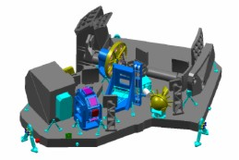
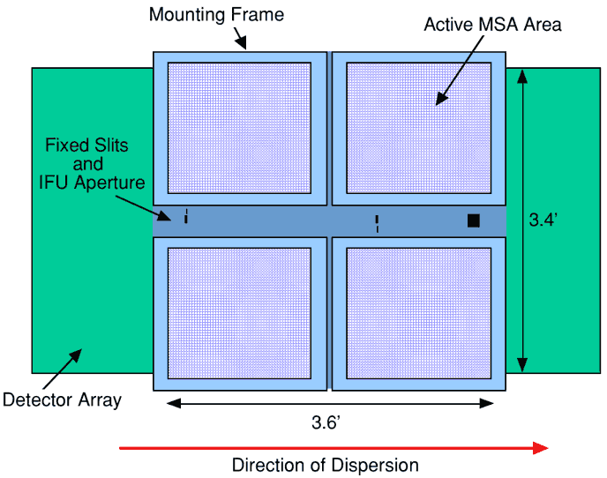
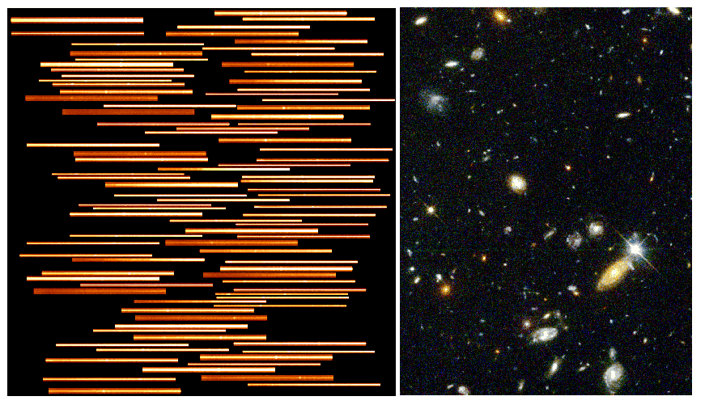
NIRSpec
Multi-object dispersive spectrograph (MOS) for 1-5 µm
R~1000 or R~100 for MOS
MOS pixels ~0.2", and cover a ~ ~3’x3’ field
Capable of observing > 100 objects simultaneously.
Several fixed slits and an IFU (3”x3”) are also available with R as high as 3000.
Being built by the European Space Agency

Slide 10
Directions, which do you want ?
Ultra-deep observation of individual target / 個別天体の深観測：
Spectroscopy of very high-redshift galaxies: Lya emitter @ z=7
High-SN, R~10,000 spectroscopy of QSOs：GP trough of z=6-7 QSOs
Require higher SR
= Extending shorter wavelength range
With high sky coverage (targets are very rare)
Deep observation of multiple targets / 多天体の深観測：
NIR spec. of red gals at intermediate z: Galaxies, AGNs @ z=1-3
Moderate SR
Wide FoV multi-object
Very-high spatial resolution of individual / 個別天体高空間分解能観測：
High resolution observation of nearby galaxies: AGNs, stellar pops galaxies
OPTICAL w.length range JWST will not reach,
Higher spatial resolution than HST in optical
Direction 1
~ Keck-NGAO
~ Gemini-GEMS
Direction 2
Gemini-GEMS
Direction 3
Subaru-SCExAO？
Gemini-GPI ?

Slide 11
Sky coverage limitation with next-gen.
With MCAO(Gemini GEMS)
2’ fov covered with 3 TT guide stars brighter than R=18.5
10% sky coverage at galactic pole with SR 0.6 in K-band
3 R<18.5 stars within 60” = 15% @SXDS
Degraded operation mode with 1 or 2 TTgs

Slide 12
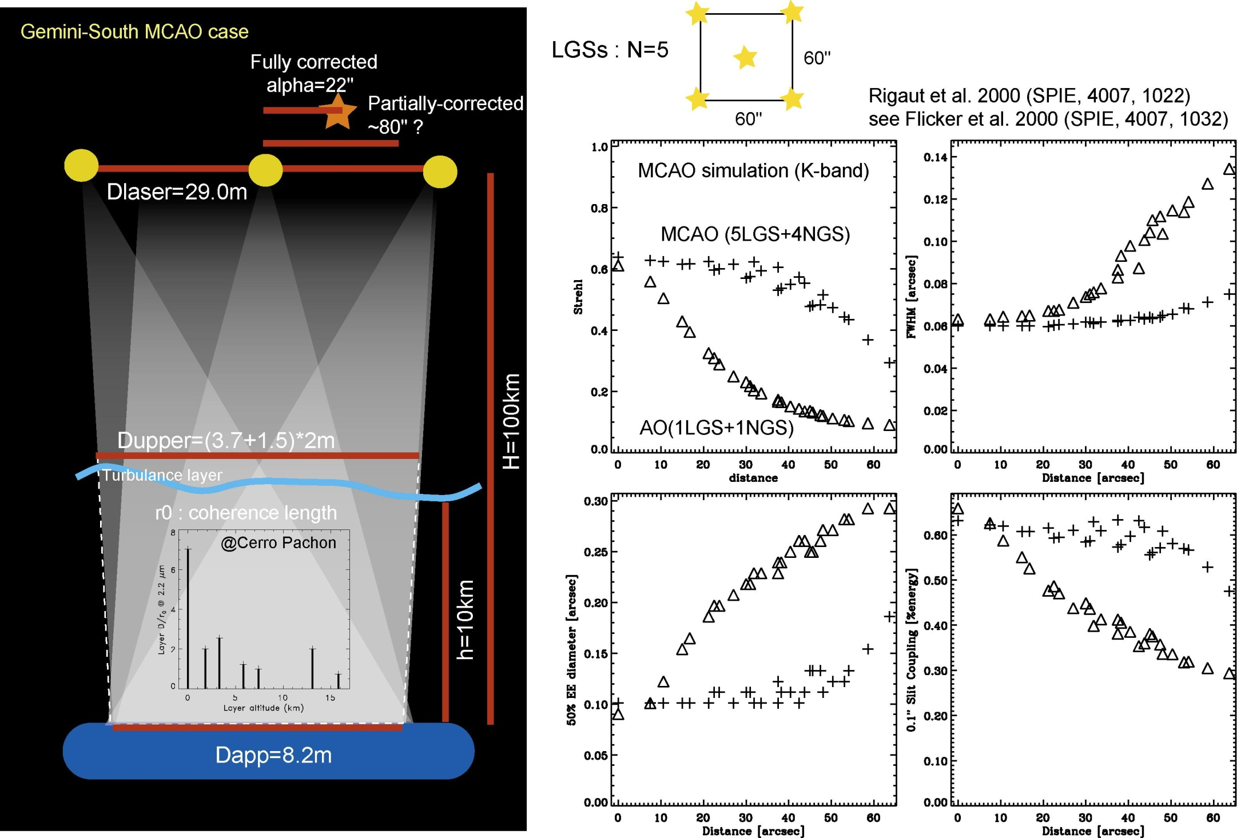
Direction 1, not 2：Gemini GEMS
GEMS is wide-field MCAO, but the expected performance is more closer to Keck NGAO (Direction 1), i.e. small FoV.

Slide 13
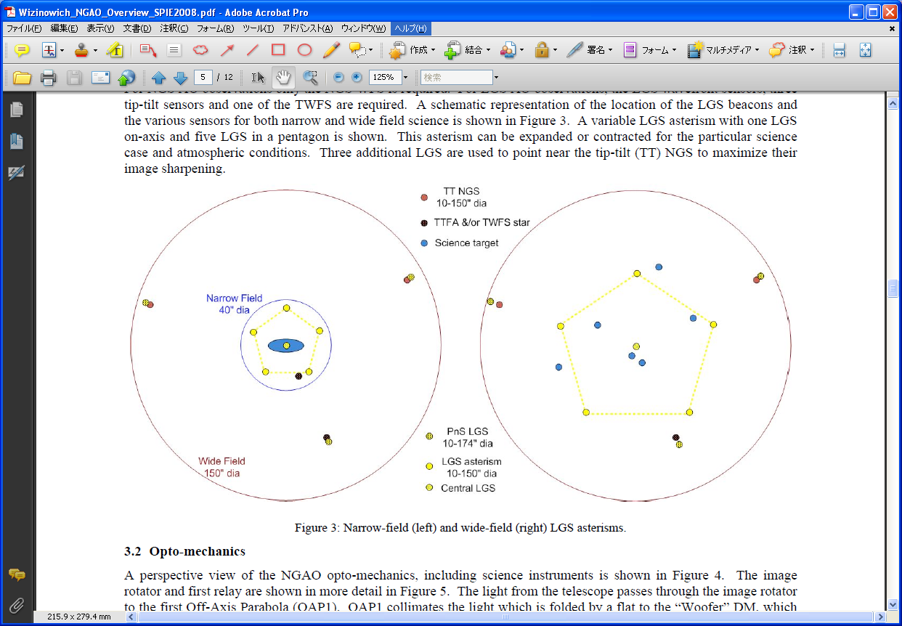
Sky coverage limitation with next-gen.
With tomographic-AO (Keck NGAO)
Requirements similar to Gemini GEMS?

Slide 14
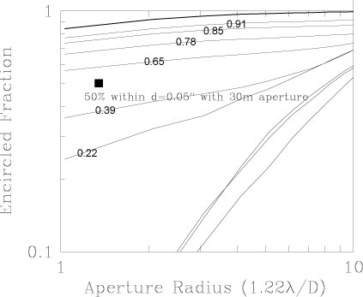
What SR do we want ?
Fraction of light within a slit varies with slit width. Different lines represent different SR ratio (shown with small numbers)
Seeing-limited
0.12” slit
1/44
=2.1mag deeper
0.24” slit
1/11
=1.3mag deeper
0.80” slit
0.06” @ 8m K-band

Slide 15
What SR do we want ?
If background limited and point source, then, 3 mag deeper than current seeing limited observation with SR=0.7-0.8
60-80% encircled
0.8 mag deeper
~0.7
~0.4
SR~0.2
~30-40%
0.12” slit
1/44
=2.1mag deeper
0.24” slit
1/11
=1.3mag deeper
0.80” slit
0.06” @ 8m K-band

Slide 16
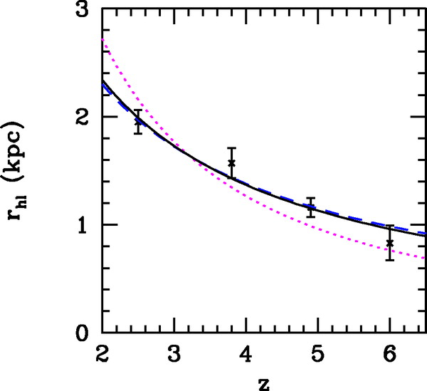
BUT, the gain with higher SR is small for spec. of entire gals (extended obj.)
Narrower slits can be used for point sources with higher SR, BUT,,,
Galaxies at the intermediate redshifts (or at even higher redshifts) are significantly extended than diffraction limit, the gain with high SR will be smaller.
Of course, you can do spatially-resolved studies with high SR…
0.22” [OIII] in K
0.19” [OII] in H
0.17” [OII] in K
Bouwens et al. 2004, ApJ, 611, L1

Slide 17
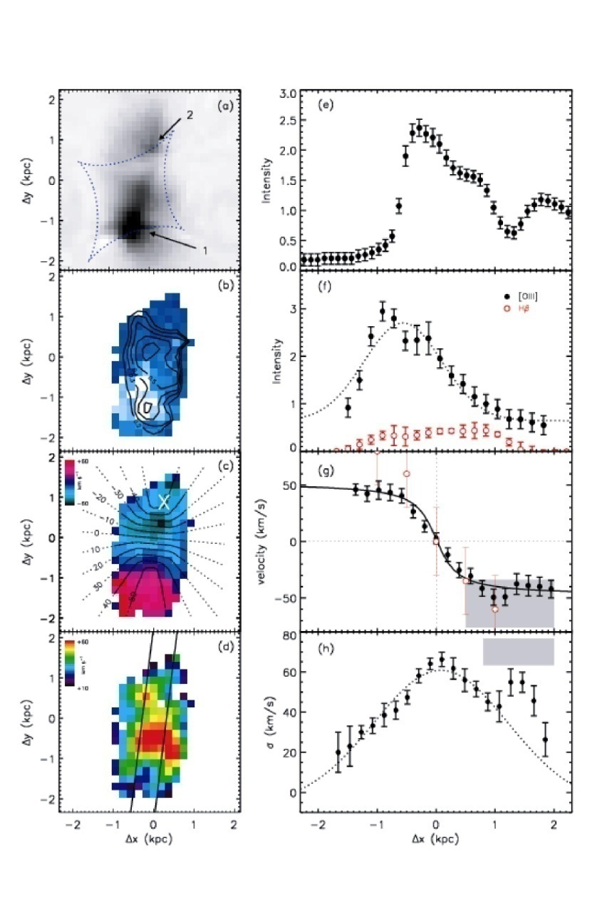
Spatially-resolved obs. of distant gals
Z=3 galaxy is observed with effectively 100pc (20-40mas) resolution thanks to gravitational lensing effect (Stark et al. 2008 Nature, 455, 755) 。
Clear rotation is detected for the first time with this very high spatial resolution.
Need to resolve 10km/s scale velocity structure, R~10,000 is necessary.
Considering required amount of light to achieve high-spatial and high-spectral resolution, this science case is for TMT ???
Major velocity structure within 1kpc (~0.1”)

Slide 18
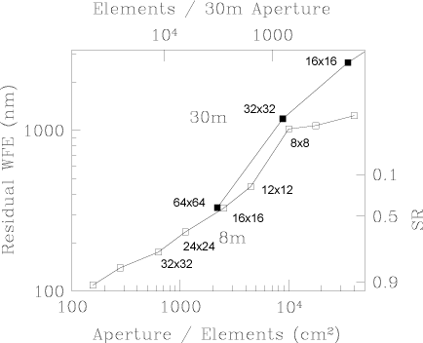
Target SR and required elements
AO36
Direction２
AO188
AO1000
Direction１,3

Slide 19
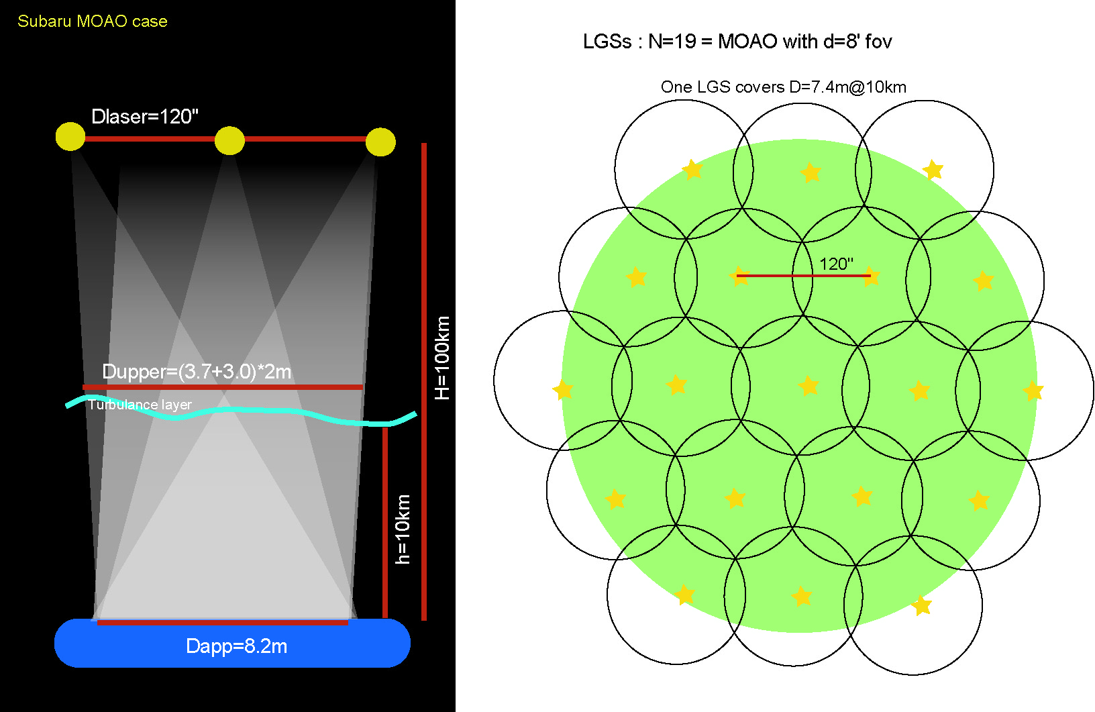
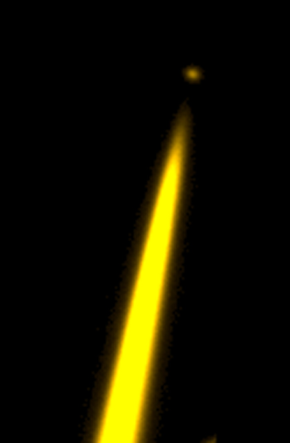
What kind of inst do we need if dir２?
Wide FoV (d=8’) MOAO multi-object spec (only with long slits=no IFUs), R=3,000 double-beam spectrograph with zJHK coverage ?
Difficult to realize due to Rayleigh-scattering ?

Slide 20
Summary (in J)
個別天体の深観測： HSCデータベースとの親和性は高い
高赤方偏移の銀河の分光: Lya emitter @ z=7
QSOの中分散(R~10,000)高SN分光：Gun-Peterson trough of z=6-7 QSOs
より高いSR (0.6-0.7 @ K-band = 1,000 elements) で、
=より短い波長 (~9000Aなど) で、
高い sky coverage (>50%：GS:R=18mag,60”,1GS ) で。
多天体の深観測： MOIRCSなどの蓄積
中赤方偏移の赤い銀河の分光観測: Galaxies, AGNs @ z=1-3
そこそこのSR (0.1-0.3 @ K-band ~ 100 elements) で、
広い視野(5-10’ scale)で多天体同時に。
個別天体の高空間分解能観測： わが道を行く？
銀河中心の高空間分解能観測: AGN, stellar pops in local galaxies
JWST の届かないより短い波長(<9000A)で。
HSTで分解できなかったものを分解(SR=0.1@1um)。
Direction 1
~ Keck-NGAO
~ Gemini-GEMS
Direction 2
Direction 3
Subaru-SCExAO？

Slide 21
Future works: until the next WS
Directions １,３
Simulate Keck NGSAO-like, Gemini GEMS-like instruments
The expected performance can be confirmed ?
How shorter wavelength range can we reach ?
Direction２
Simulate trade-off between SR and size of FoV.
Next round, which direction is the most attractive scientifically ? Which one do you want ?
Do we need next generation general-purpose AO ? Small-scale grade up (SCeXAO, IRWFS etc) or engineering (RAVEN) are not sufficient ?

Slide 22
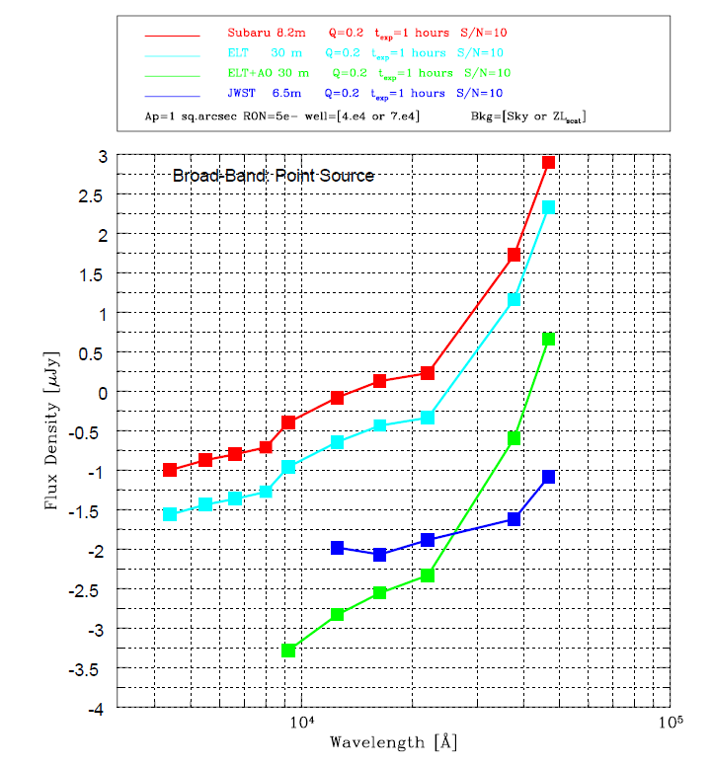
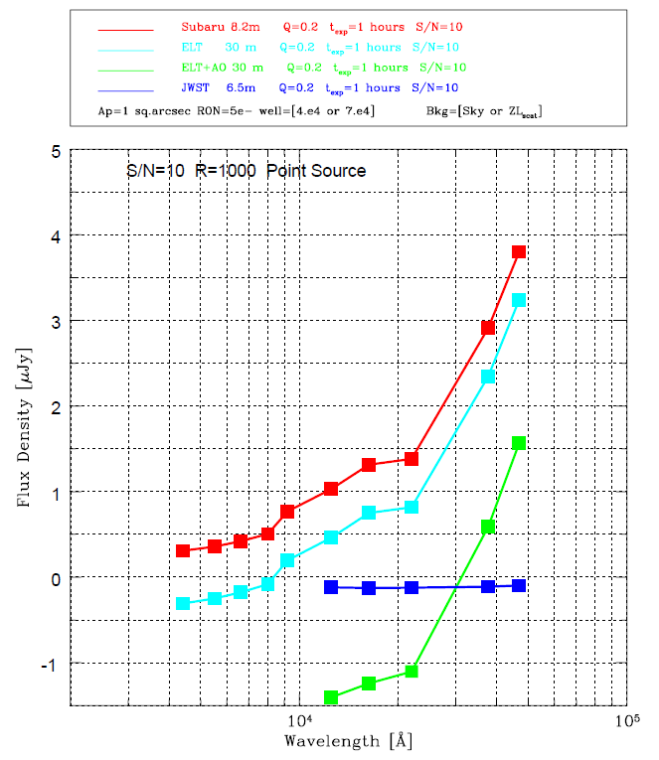
Sensitivity : vs. TMT, JWST
“Stellar objects” ： TMT: 1.0”/sample or 0.05”/sample vs. JWST 0.2”/sample @ K-band
Imaging SN10/1hour
Spectroscopy R=1000 SN10/1hour
Subaru
Subaru
KAB~22
TMT
JWST
TMT
JWST
TMT+AO
TMT+AO
KAB~26.5
In this spectroscopy limit calculation, OH line fluxes are included.

