Slide 1
SWIIMS A New NIR MOS Spectrograph for TAO 6.5m Telescope
K. Motohara, M. Konishi, S. Sako, N. Mitani, T. Aoki, K. Asano, M. Doi, T. Handa, K. Kawara, K. Kohno, S. Koshida, T. Minezaki, T. Miyata, T. Nakamura, T. Soyano, M. Tanaka, T. Tanabe, K. Tarusawa, Y. Yoshii

Slide 2
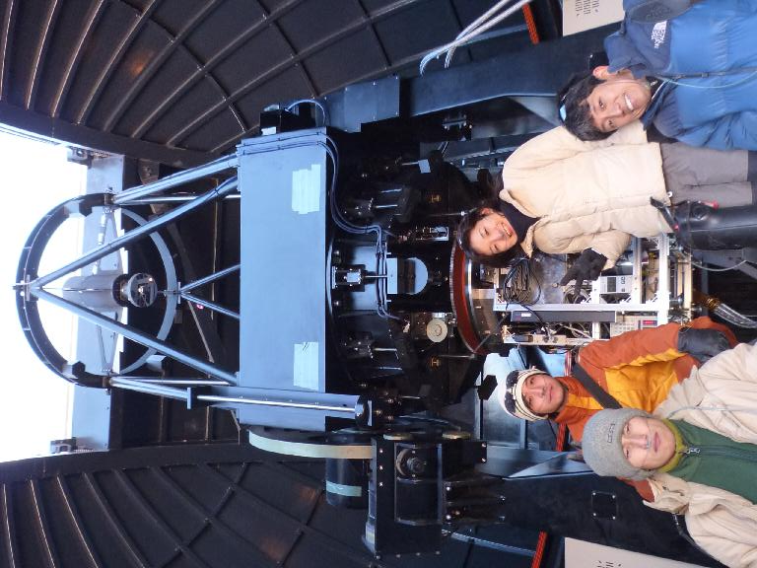
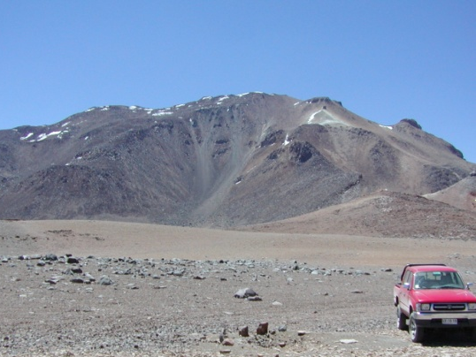
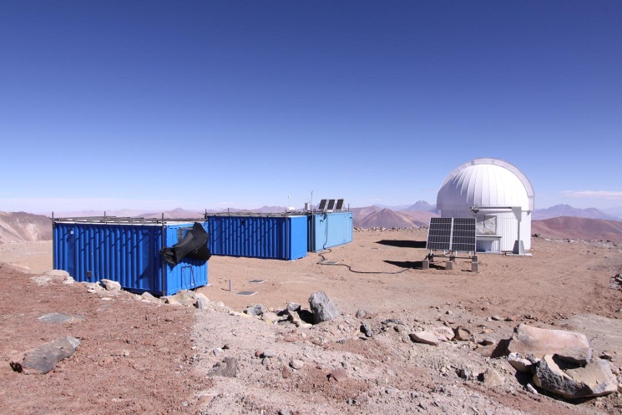
TAO The University of Tokyo Atacama Observatory Project
Construct an infrared-optimized 6.5m telescope at the world’s highest site of 5650m(18000ft) altitude, Co. Chajnantor at Atacama desert, Chile
Current status:
Installed a 1m telescope (called miniTAO), and started observations in the near- to mid infrared

Slide 3
Advantage of Co. Chajnantor
Nice climate, with photometric nights > 60%, and usable >80% (Miyata+08)
Seeing is as good as Mauna Kea; DIMM measurement shows median seeing of 0.7” (KM+08)
Thanks to the low pressure (<0.5atm) and dry climate, extremely low perceptible water vapor (PWV) is achieved : 0.5mm (25%tile) (MK has 1mm)
This results in excellent observational condition in both NIR(1-2.5μm) and MIR (5-40μm)

Slide 4
Atmospheric Transmittance
5600m
PWV=0.5mm
4200m
PWV=1.0mm
2600m
PWV=6.0mm

Slide 5
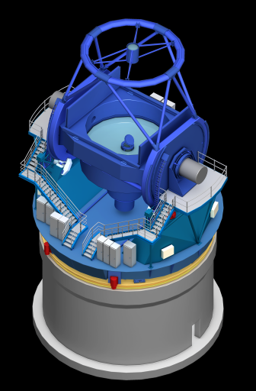
The 6.5m Telescope
Optics | Ritchey-Chretien
Primary Mirror | Φ 6,500 mm （effective Φ 6,154 mm）
2ndry Mirror | Φ 897 mm
Foci | Cassegrain, Nasmyth x 2
FoV | Φ 25’
PM F-ratio | 1.25
Final F-ratio | 12.2
Synergy with
the Subaru Telescope

Slide 6
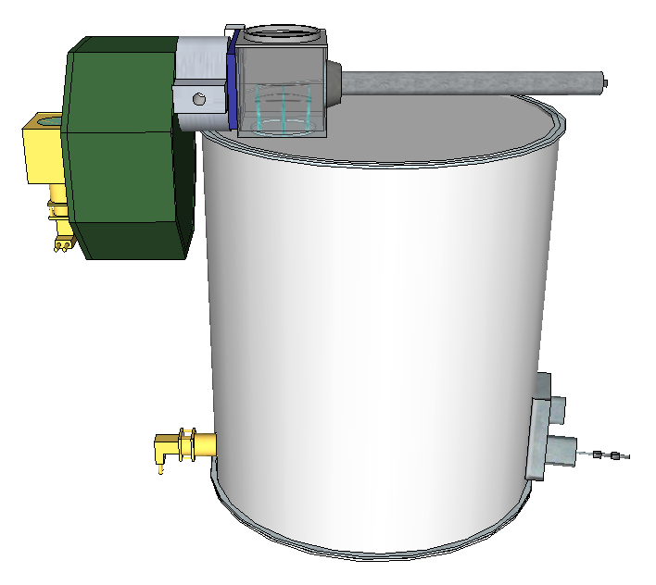
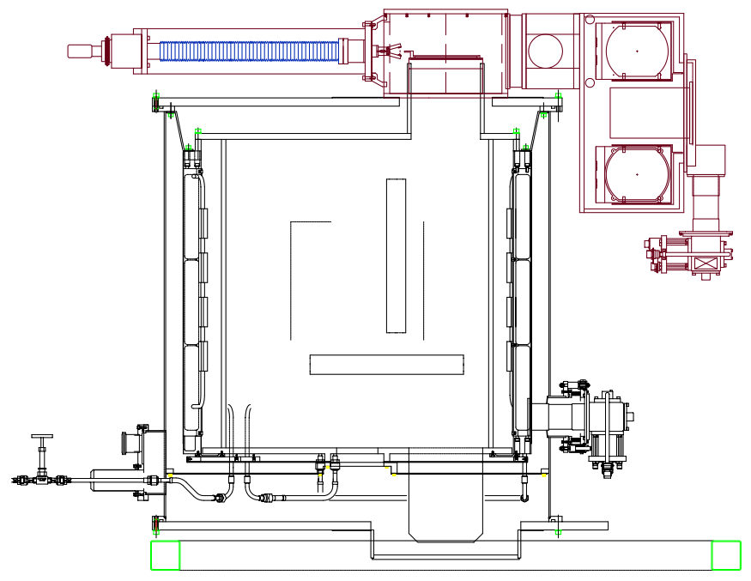
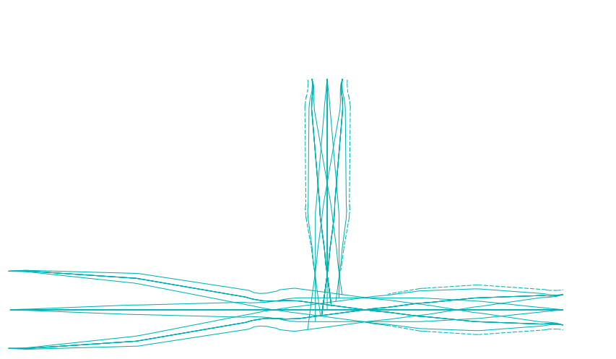
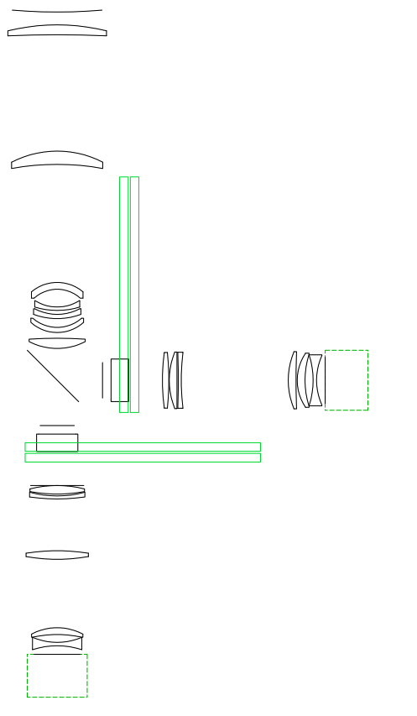
SWIIMS Simultaneous-color Wide-field Infrared Imager and Multi-object Spectrograph
NIR Spectrograph for TAO 6.5m
Wide-Field (9.6’ Φ FoV on TAO)
MOS Spectrograph
2-band simultaneous Imaging/Spectroscopy : 0.9-1.4 and 1.4-2.5μm
~1.9 m

Slide 7
Science with SWIIMS
High transmittance at TAO site : Ideal for the redshift survey in the infrared
Full 0.9-2.5mm spectra can be obtained simultaneously : precise continuum / line ratio measurement possible
Simultaneous Hi-z Narrow-band Imaging (e.g. Hα/OIII, Hβ/OII)

Slide 8
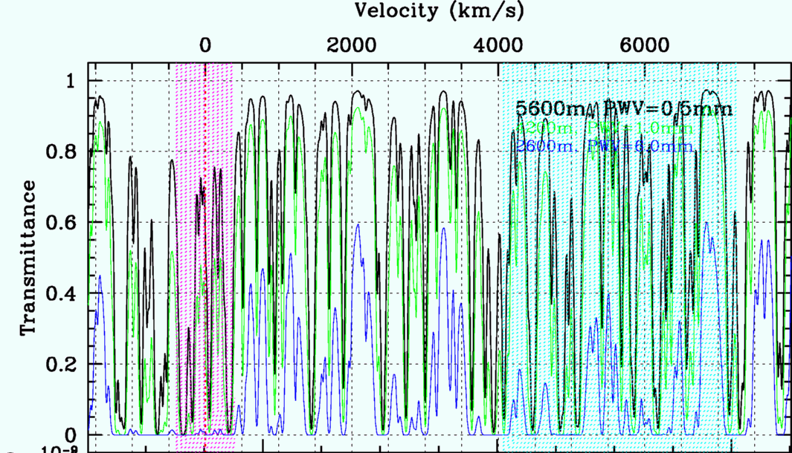
Paschen α at Co. Chajnantor
Hydrogen Paα line (1.8751mm) available
Strongest Hydrogen Line in NIR
Good probe in dusty environment

Slide 9
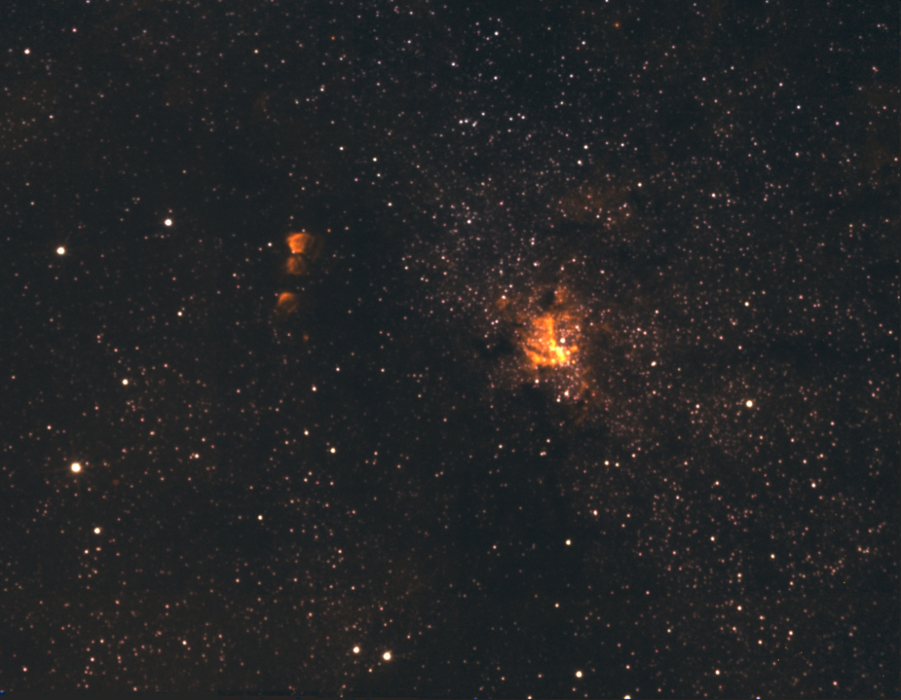
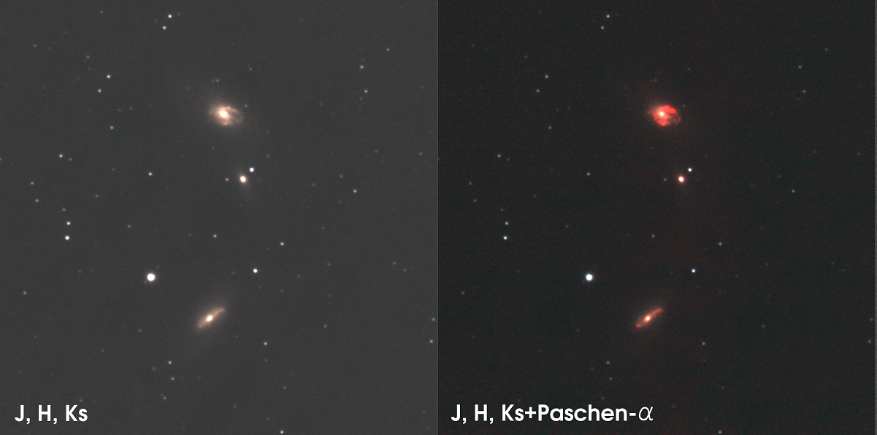
Paα Imaging with ANIR at Co. Chajnantor
Starburst Galaxies IC4686/4687
Galactic Center (Sgr A*)

Slide 10
1st SWIIMS Science Workshop (Sep. 11, 2009)
Hi-z Cluster Survey by NBFs
YSO eclipsing binary survey
Elliptical Galaxy distance measurement by Mira variables
Chemical properties of Hi-z QSOs
SN follow-up
AGN monitoring
Synergy with ALMA
Synergy with HSC
GRB follow-up
…

Slide 11
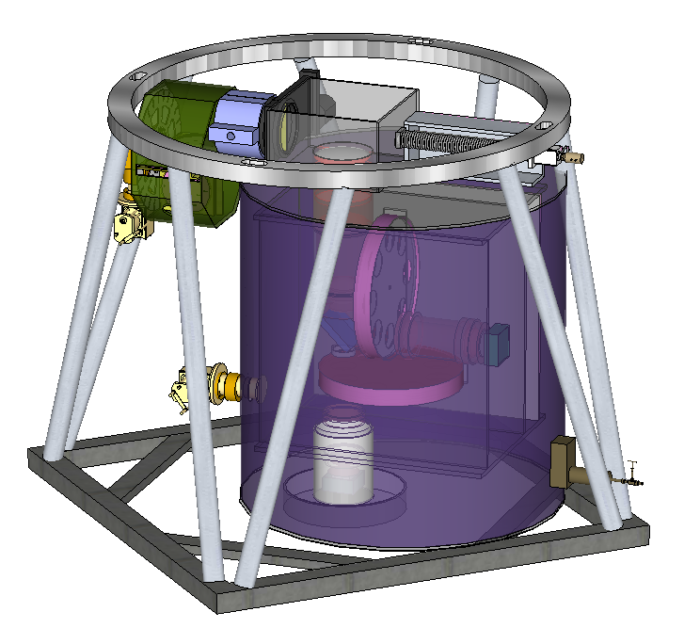
SWIIMS on Subaru/Cassegrain
TAO 6.5m not available before 2015
First science with Subaru
Collimator design optimized for Subaru
FoV of 7’ x 3.4’ (MOIRCS : 7’x4’)

Slide 12
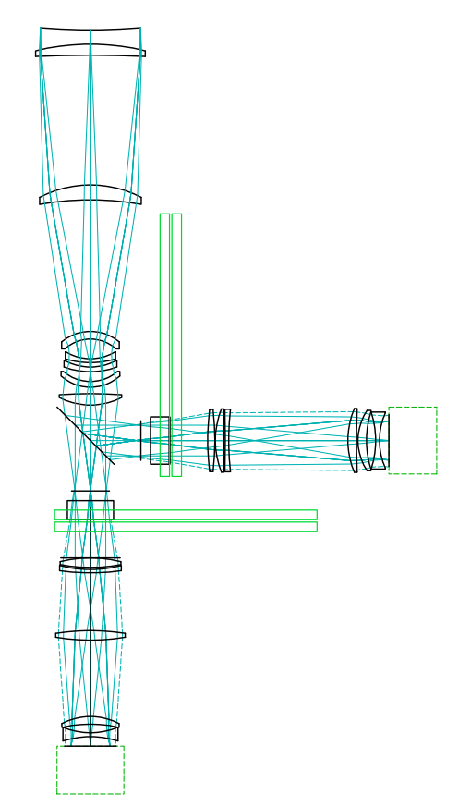

SWIIMS Optics for Subaru
210 mm
Split collimated beam using a Dichroic Mirror(DM) at 1.4mm
Final F-ratio=4.8
As only 4 arrays were procured, each focal plane is covered by 2 HAWAII2-RGs with FoV of 7’x3.5’
Collimator for Subaru
1600 mm
DM
Blue Channel
(λ = 0.9-1.4 μm)
Red Channel
(λ = 1.4-2.5 μm)
7’ x 3.4’
F 7.6’
→
Future

Slide 13
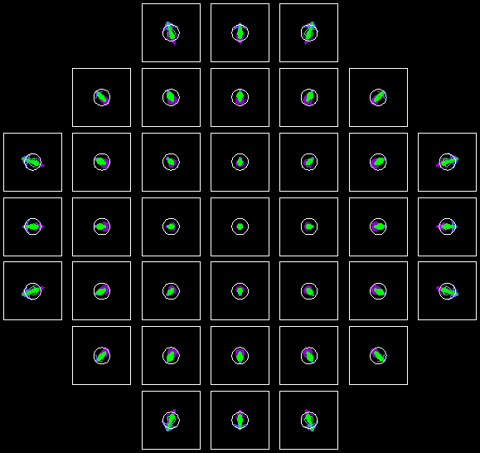

Performance of Optics (Red Channel)

Slide 14
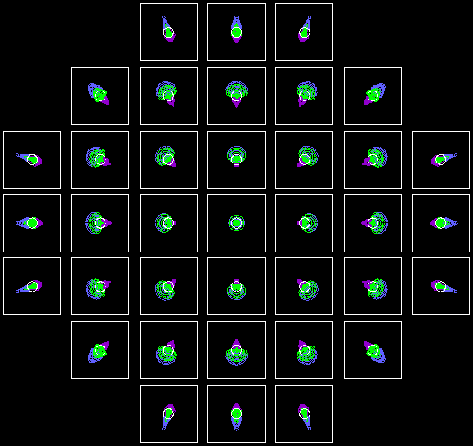
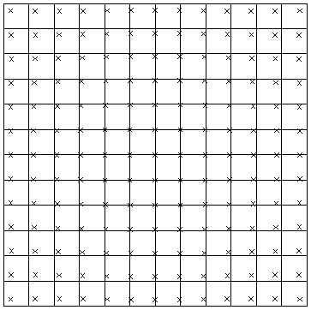
Performance of Optics (Blue Channel)

Slide 15
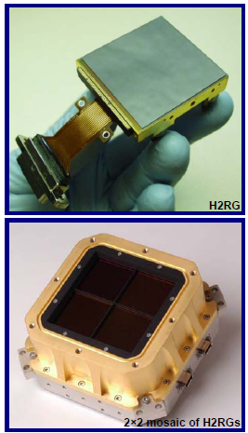
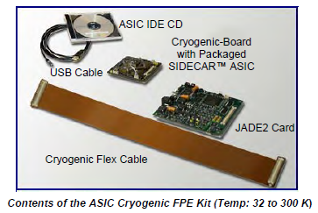
Focal Plane Arrays
4 HAWAII2 RGs / 2.5μm cutoff
SIDECAR ASICs for readout
Covers central 7’x3.5’ FoV
0.1”/pix sampling

Slide 16
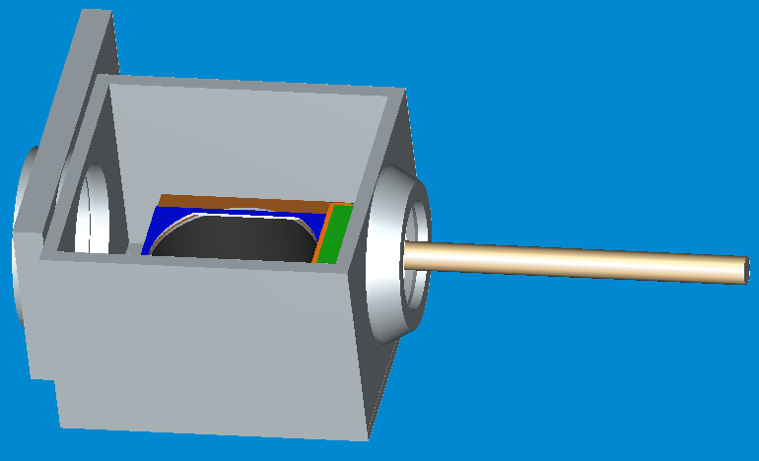
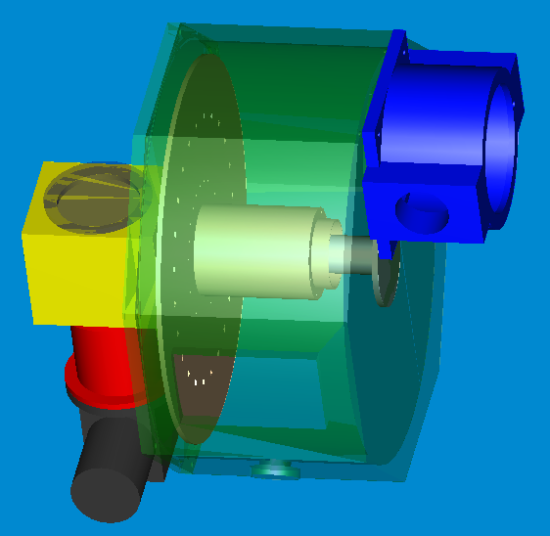
MOS Slit Plate Exchanger
Based on the design of MOIRCS
Turret-type mask stocker
Robotic mask exchanger
2.3m

Slide 17
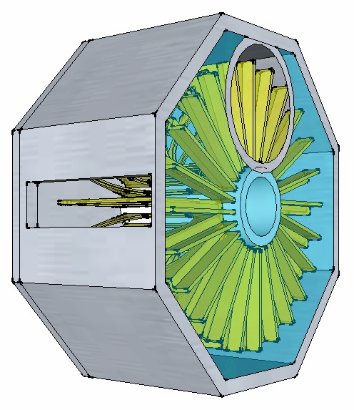
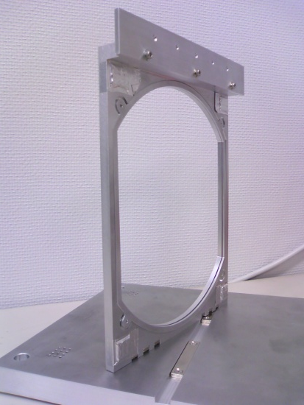
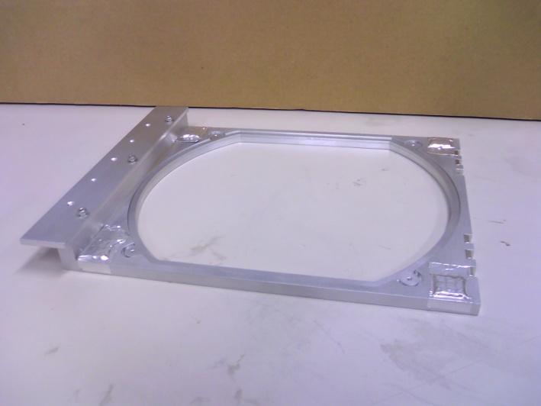
MOS Unit
Maximum # of mask slit : 20 or more
New design with high reliability
Magnet – latch (Both at the focus and the stock)
Operative even at the TAO Nasmyth focus
Curved mask possible
Neodyium Magnets
210mm
250mm
Prototype Mask Holder

Slide 18
Schedule
2010/Q3 : Fix the design of dewar, MOS, optics
2010/Q4 : Array delivery
2011/Q1 : Delivery of the dewar, MOS, optics componetns
2011/Q2-2012/Q2 : Assembly, adjustment, etc…
2012/Q3 or later : Transport to Subaru, setup
2013/Q1 : First Light at Subaru ?

