Slide 1

TAO-MIR
Takashi MIYATA
Institute of Astronomy, University of Tokyo
S. Sako, T. Nakamura, K. Asano, M. Uchiyama,
T. Onaka, I. Sakon, H. Kataza, and TAO group

Slide 2

Mid infrared observations from the ground
Akari and Spitzer achieved excellent results in a number of astronomical fields
very high sensitivity / wide coverage of the sky
Groundbased observations at mid infrared are still important
- high spatial resolution
- monitoring capability

Slide 3
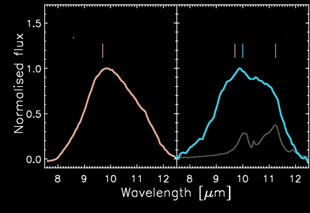
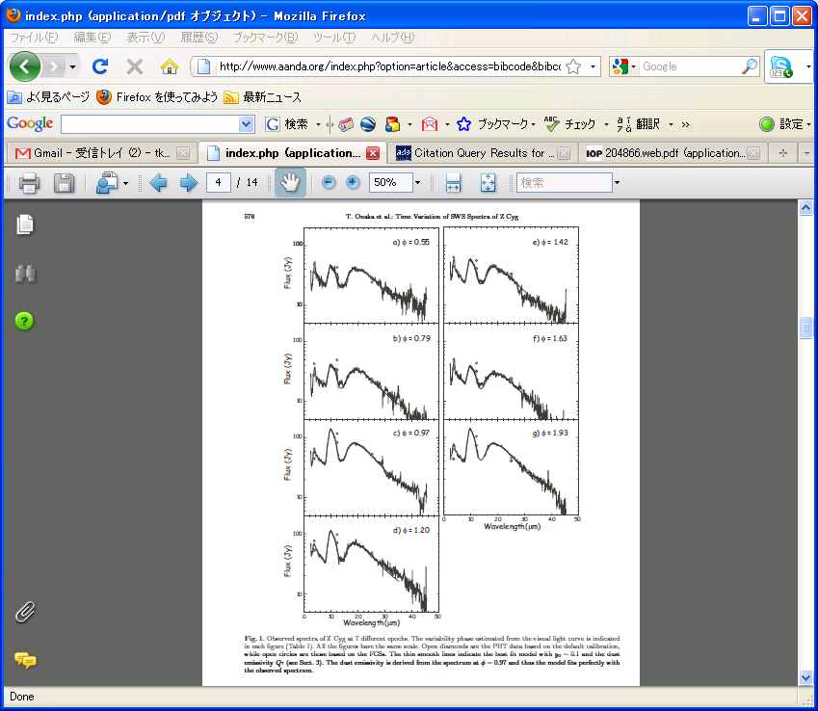
Key concepts of the TAOMIR
Recently time variations at mid-infrared wavelengths have been reported
✓ T Tau stars, HAeBe
EX Lupi (FU Ori type, T Tauri star)
quiescence
outburst
amorphous
silicate
amorphous +
crystallized
silicate
Abraham+ 2009
✓ AGB stars, Luminous Blue Variables, WR stars
minimum
maximum
Onaka+ 2002
10 20 30 40
10 20 30 40
Wavelength [um]
✓ Comets....

Slide 4
Accurate monitoring at MIR
Monitoring observations at MIR wavelength are difficult
Satellite telescopes → observing time is very competitive
Ground-based telescopes → accuracy of the photometry is a problem
×Unstable sky condition
×Limited number of comparison stars
→ Differential photometry cannot be applied.
c.f. optical / NIR wavelengths….
a lot of stars + wide filed of view
→ Stars around a target object can be used
as a standard of comparison

Slide 5
Concept of the Field Stacker
Not many stars in MIR sky
Filed of view of current MIR cameras : not so large (< 1arcmin)
→ Only the target object is observed at once.
Schematics of the mid-infrared sky

Slide 6
Concept of the Field Stacker
If we can take two (or more) discrete fields simultaneously.....
Differential photometric method can be applied
→ improve precision and reliability dramatically

Slide 7
Concept of the Field Stacker
Field Stacker
Schematic drawing of the field stacker
From telescope
From telescope
Wedge shape mirror
Pick up mirror
Pick up mirror
To cold optics
-- consists of two movable pick-up mirrors and a wedge shape mirror
-- picks up two discrete fields of the sky
-- brings into the instrument field of view
Simultaneous observation of two (or more) stars

Slide 8
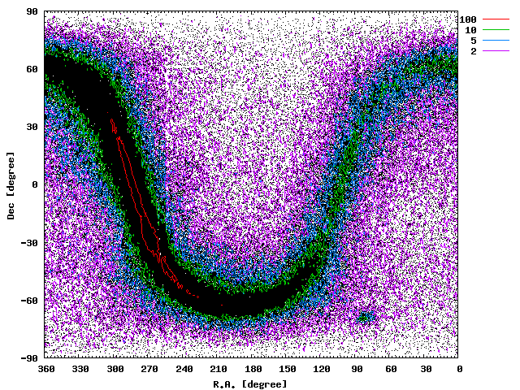
Conceptual studies of the Field Stacker
There are enough number of stars ??
We counted # of MIR objects of Akari 9um survey data.
-- Akari 9um survey : ~7M objects with > 50mJy
( ~ 1sig1sec sensitivity of the TAOMIR)
Fraction of two or more objects in a field
Field of VIew | > 50mJy | > 300mJy
φ25’ | 55% | 51%
φ12.5’ | 48% | 39%
φ2.5’ | 23% | 13%
You can use the Field Stacker
for ~ 30% of Akari 9um sources

Slide 9
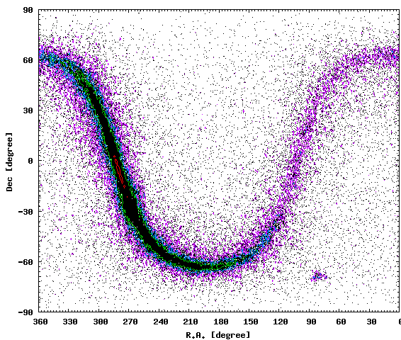
Conceptual studies of the Field Stacker
There are enough number of stars ??
At 18 micron
-- Akari 18um survey : ~1.6M objects with > 130mJy
( ~ 1sig1sec sensitivity of the TAOMIR)
Fraction of two or more objects in a field
Field of VIew | > 130mJy | > 1000mJy
φ25’ | 50% | 41%
φ12.5’ | 41% | 35%
φ2.5’ | 15% | 0.3%
You can use the Field Stacker
for ~20% of Akari 18um sources

Slide 10
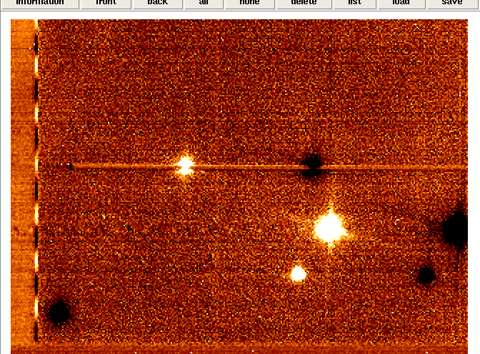
Conceptual studies of the Field Stacker
Simultaneous observation improves the photometric accuracy?
Time variations of star counts
1.2
MIR images of two or more stars taken by COMICS
Source A
Source B
1.1
A/B
Normalized Intensity
1
0.9
0.8
0
20
40
60
80
100
✓Variation of the intensity : 10% within 100 sec.
✓ Variations of two stars are synchronized
Time (sec)
Power spectra of intensity
100
Source A, B
A/B
10
Power
Simultaneous observations are effective
(at least within 1 arcmin)
1
0.1
0.4
0.01
0.05
0.1
Frequency (Hz)

Slide 11
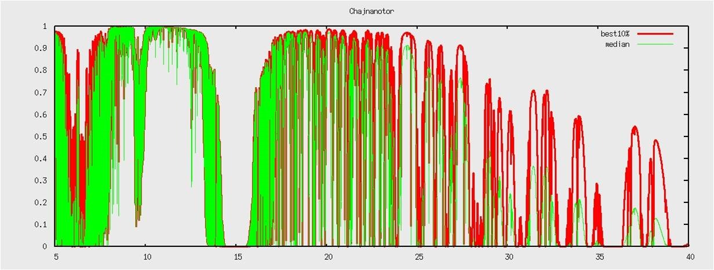
Field stacker for spectroscopy
The field stacker is also useful for spectroscopic observations.
Simultaneous observation enable us
accurate calibration of the atmospheric absorptions
especially for
around the ozone absorption band at 10 micron
Q-band or longer wavelength ranges

Slide 12
Key concepts of the TAOMIR
✓ Wide wavelength coverage
Covers 2-38 micron wavelength region ( over 4 octaves!)
✓ High spatial resolution
Achieves diffraction limited spatial resolution
✓ Accurate monitoring
with the Field stacker

Slide 13
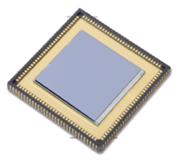
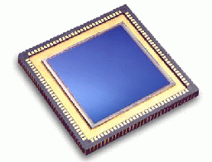
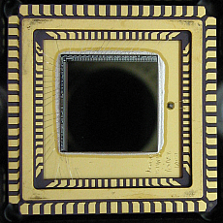
Desgin of the TAOMIR
from Telescope
    300K
Field Stacker
Fore Optics
    20K
Slit
Flip-flop mirror
InSb ch.
Si:As ch.
6-25μm
Si:Sb ch.
20-38μm
2-6μm
Filters
Grisms
Filters
Grisms
Filters
Grisms
    5K
Si:As 1k
Si:Sb128
InSb 1k

Slide 14
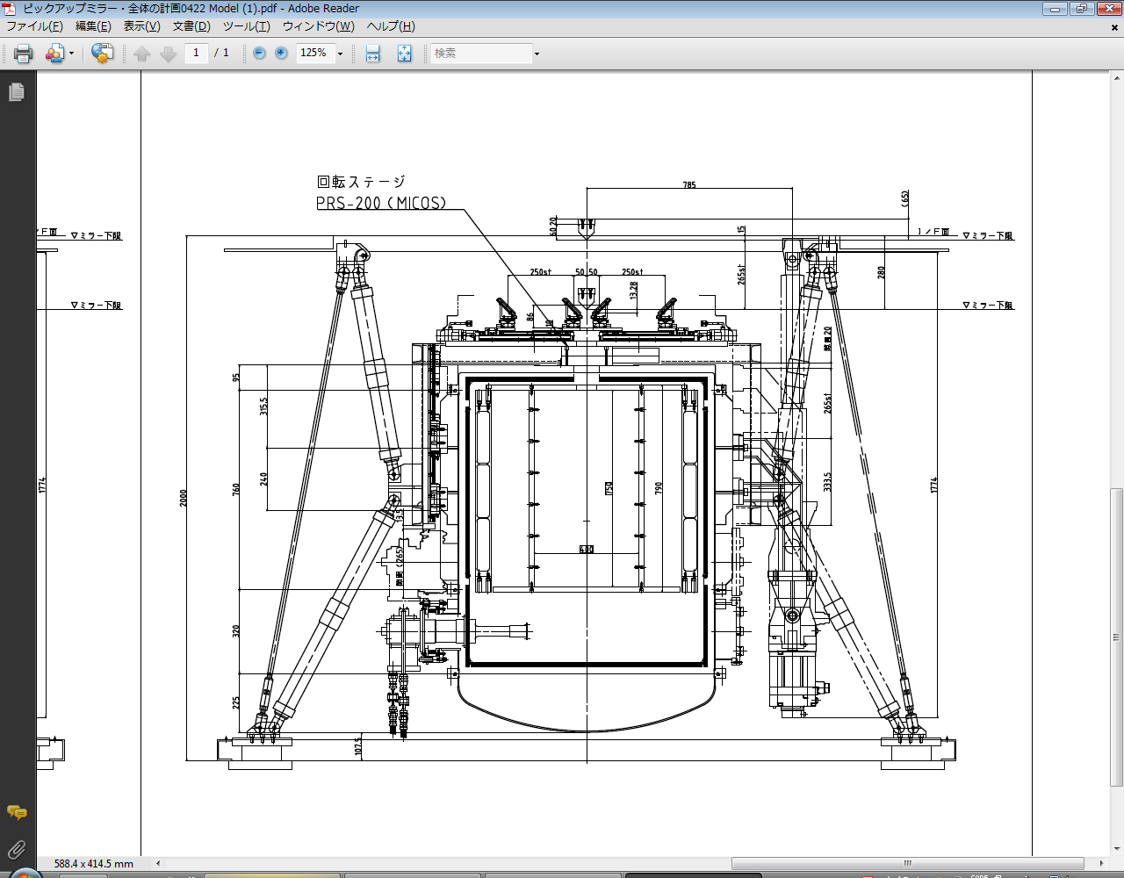
Desgin of the TAOMIR
Wedge
Mirror
Pickup mirror
Pickup mirror
TAOMIR
↑ Cassegrain Focus
Optics : 20K
Optics : 20K
Si:As Channel
2m x 2mx 2m
4K GM
cryocooler
InSb Channel
Si:Sb Channel
Cold optics
(~20K)
two 4K cryocoolers (SHI)
Fore Optics
All optics are reflective
→ achieves good performances

Slide 15
TAOMIR : Specifications
Parameters | Values |  |  | Notes
# of channels | 3 (Si:As / Si:Sb / InSb)
Detectors | Si:As 1k x 1k | Si:Sb 128 x 128 | InSb 1k x 1k
Wavelength coverage | 6-25um | 20-38um | 2-6um
Pixel scale | 0.1”/pix | 0.4”/pix | 0.1”/pix | @SUBARU telescope
Field of view | 2’ x 2’ or 1’x2’ x 2fields | 1’ x 1’ or 0.5’x1’ x 2fields | 2’ x 2’ or 1’x2’ x 2fields | @SUBARU telescope
Filters | max 16 filtes (6-25um) | max 16 filtes (20-38um) | max 16 filtes (2-6um)
Spectroscopy | R ~250 @Nband R~250 @Qband | R~100 @30um | R~300 @Lband (TBD) | w/ grism
Sensitivity (Img.) 1sig1sec | 40mJy @10um 130mJy @20um | (400mJy @30um?) |  | for point sources
Instrument size | 2m x 2m x 2m , < 2ton
Others | - A cold chopping unit is installed in fore-optics

Slide 16
TAOMIR : Specifications
MIR performances compared with COMICS
 | TAO-MIR | COMICS
Sensitivity | ~40mJy @10um 1s1s | ~30mJy @10um 1s1s
Spatial resolution | diffraction limited | diffraction limited
Filed of view | 120” x 120” or 60”x120”x2filed | ~ 40”x30”
Spectral resolution | R~250 @N-band R~250 @Q-band | R~250/2,500/10,000 @N-band R~2,500/5,000 @Q-band
Monitoring Accuracy | Good (w/ Field Stacker) | ---
△
○
○
○
○
◎
◎
COMICS has advantages of
slightly higher sensitivity ( because TAOMIR has warm optics)
med/high resolution spectroscopic capabilities
TAOMIR will add an unique function of
MIR monitoring observations to the SUBARU telescope

Slide 17
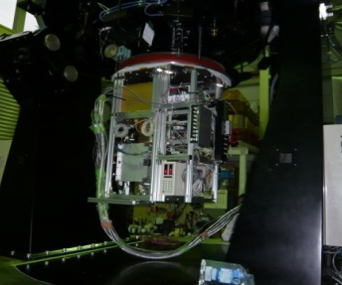
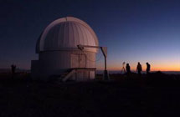
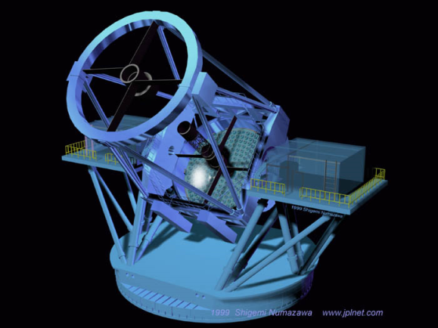
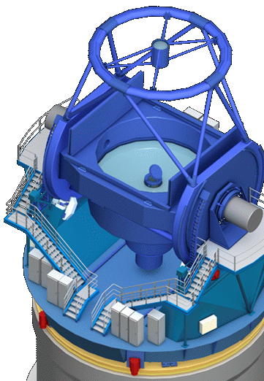
TAOMIR : Schedule
2010
2011
2012
2013
2014......
Prototype instrument
MAX38
Atacama 1m telescope
TAO-MIR
Desgin and Development
Tests @ Mitaka
2m x 2mx 2m
Observations
@ SUBARU
Observations
@ TAO
TAO-MIR
first light

Slide 18
Summary of this talk
✓ TAOMIR is a new mid-infrared instrument
- wide wavelength coverage
- high spatial resolution
- accurate monitoring capabilities
✓ TAOMIR employs the field stacker system,
which picks up two discrete field
and brings them into the instrument filed.
➔ improves the precision and reliability
➔ accurate monitoring / spectroscopic observations
a new function to the SUBARU MIR observations!

