Slide 1
HDS toward 2020s? W/power-saving (?) mode
Easy for maintenance
Most stable / No instrument change
Usable w/any M2 (PA/MA required)
5 hrs for operation temp.
Scientific competitiveness
No high disp. spec. in TMT (, yet)
mature technology → Larger aperture is better
Max R~160,000 (UVES/HIRES R~80,000-100,000)
UV (< 360 nm) capability (EEV CCD, Blue ImR, Direct focus)
Multi (4) Objects Unit (~2015), Image Slicers
Requirements from ToO obs. (better in facility)

Slide 2
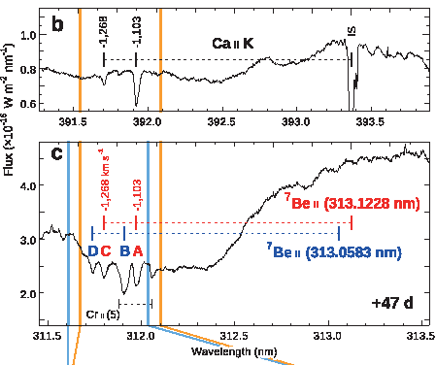
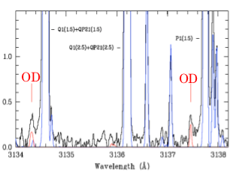
UV obs. w/HDS
10-20 % of all proporsals
Be II at 3130A
OH/OD in commets
QSO absorption system …

Slide 3
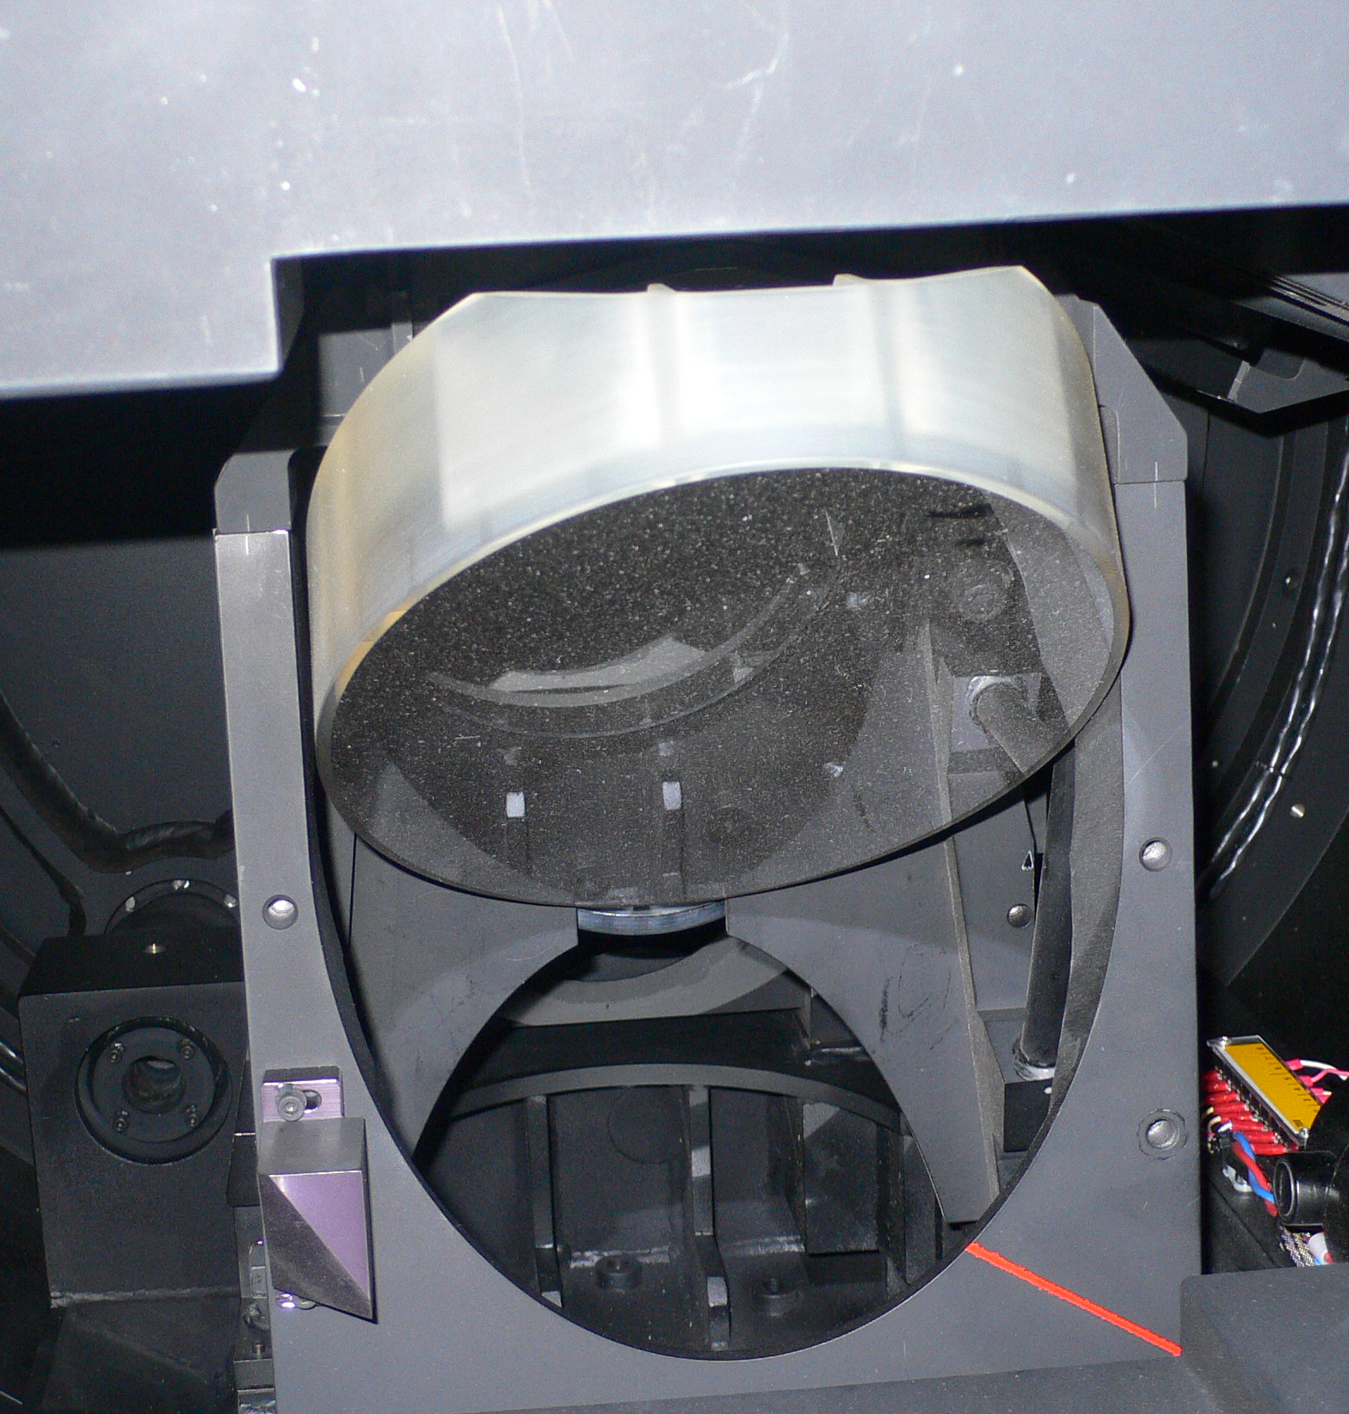
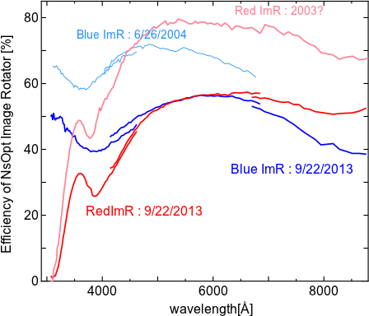
How to keep UV capability?
[Problem] Degradation of ImR
→ Recoating Blue ImR ? (~15M JPY in 2002 by NIKON)
A cover is necessary on NsOpt hole?

Slide 4
How to save man-power?
Already, it's easiest to operate & maintain...
Decomission of Red ImR
only used for extended targets... (< 5 %)
Function can be achieved w/Blue ImR (if recoated)
2-modes only (w/ADC w/oImR, w/oADC w/BlueImR)
+ IR-M2 (1-mode; w/ADC w/oImR)
NsOpt-M2 is still necessary (> 3 nights run?)
Efficiency, UV capability...
1-2 nights run can be operated w/IR-M2
Blue-ImR recoating? (New ADC??)
AG is not important (but for PA/MA?), SV is important!

