Slide 1
Role of FOCAS
Takashi Hattori (as FOCAS SA)
12/9/2014

Slide 2
FOCAS
not unique
better scores in stability/work-load
(but there is a long history of repair/improvement ...)
decreasing demand?
high demand
low success rate (fraction of accepted proposals)
unavoidable for a utility instrument?

Slide 3
FOCAS submitted proposals
 | S08A | S08B | S09A | S09B | S10A | S10B | S11B | S12A | S12B | S13A | S13B | S14A | S14B | S15A
IMAG | 2 | 2 | 2 | 1 | 1 | 1 | 2 | 1 | 0 | 1 | 0 | 1 | 1 | 1
LS | 15 | 15 | 12 | 13 | 8 | 8 | 9 | 8 | 6 | 6 | 6 | 7 | 5 | 12
MOS | 12 | 9 | 6 | 7 | 7 | 11 | 15 | 6 | 5 | 5 | 7 | 10 | 10 | 9
POL | 1 | 3 | 2 | 2 | 2 | 2 | 1 | 3 | 3 | 2 | 5 | 6 | 2 | 5
TOTL | 30 | 29 | 22 | 23 | 18 | 22 | 27 | 18 | 14 | 13 | 18 | 24 | 18 | 27

Slide 4
FOCAS submitted proposals
trend in recent proposals
decrease in true multi-object spectroscopy
single primary target in the field
reference stars, secondary targets, secure alignment for a faint target
increase in polarimetry?
S13B to S15A
follow-up spectroscopy of rare objects (SN/QSO) found in HSC data (S14B, S15A)

Slide 5
Role of FOCAS
"versatile optical instrument with multi-object capability"
before
multi-object spectroscopy
follow-up spectroscopy of deep fields
SDF, SXDS, ...
now
versatility/utility
variety of observing mode
follow-up/detailed-observation of interesting targets
deep spectroscopy, polarimetry, etc.
test of new observation technique

Slide 6
to reduce work-load
usage of IRM2
still want to use ADC
need to modify Mitsubishi software
buffle for IRM2
stop operation
and to see how it goes

Slide 7
versatility/flexibility
special observing mode
fast photometry (~1sec)
PI : Andrea Richichi
put a star on the slit
exposure
charge transfer
exposure
charge transfer
…
Star
Slit
charge transfer

Slide 8
versatility/flexibility
special observing mode
on-chip folding
PI : Mikio Morii
phase resolved imaging-
polarimetry of pulsars
extra-ordinary light
ordinary light

Slide 9
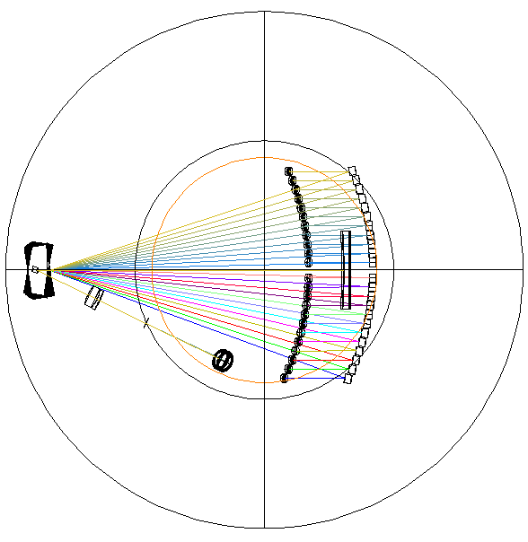
versatility/flexibility
IFU for FOCAS
PI : Ozaki (TMT Project Office)
supported by grant-in-aid (FY2014-)
type | image slicer
FoV | 13".5 x 9".2
slit width | 0".4
R=87mm (φ6arcmin)
Slit for sky
Folded mirror
Pupil mirrors
Magnification optics: Spherical mirror
Slicer
Telescope focal plane
R=100mm
Magnification optics: Lens
Slit mirrors
Pick-off mirror
R=200mm

Slide 10
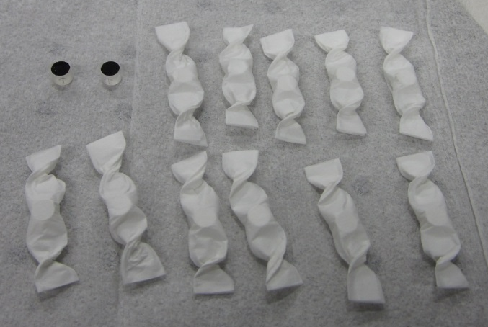
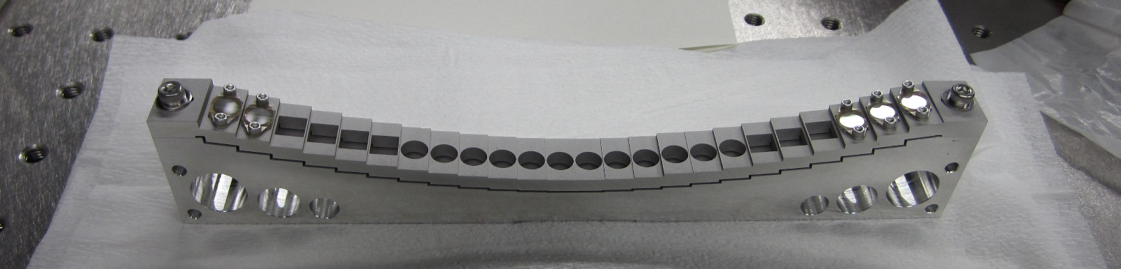
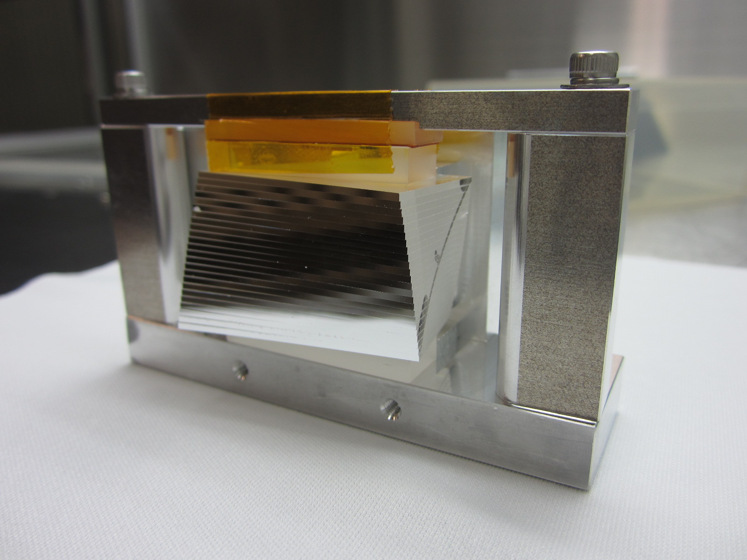
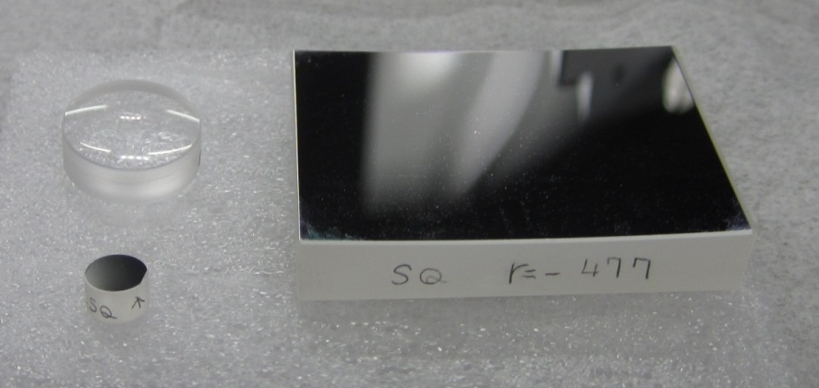
versatility/flexibility
IFU for FOCAS
fabrication of components
test and installation in 2015

