Slide 1
IRCS+AO188 decommission?
Yosuke Minowa

Slide 2
IRCS
AO assisted NIR imager and spectrograph
Wavelength coverage:
  1-5 micron (Aladdin III 1024x1024 InSb array)
Observing mode
  Imaging (20mas, 52mas), FOV~20”x20” or 53”x53”
  Low-resolution grism spectroscopy (20mas, 52mas, R<2000)
  High-resolution echelle spectroscopy (55mas, R~5,000-20,000)
History
  2000 : First light
  2001~2005: AO 36
  2005: Moved to NsIR and used w/o AO until 2008
  2008~: AO188
  2011~: LGS mode
  2013: spectro-polarization mode
Stably operated without major problems so far

Slide 3
IRCS: Science Case
AO assisted high-resolution images
  Resolve high-z galaxies
  High-contrast imaging with ADI mode
Thermal infrared (L, M) band imaging/spectroscopy
  SEEDS follow-up --- low-resolution spec.
  Dust obscured AGN --- low resolution spec.
  ISM (or IGM) --- high-resolution spec.
  Radial Velocity measurement with NH3 gas-cell
Fast readout imaging mode (up to ~160 Hz)
  Lucky imaging
  High temporal resolution (pulsar, flare from SgrA*)

Slide 4
Alternative instruments
Imaging/low-resolution spectroscopy
  Keck NIRC2 --- AO performance is slightly better
  Gemini NIRI+Altair --- AO performance is almost similar
  VLT NACO --- low thermal background
High-resolution spectroscopy
  Keck NIRSPEC – almost similar to IRCS
  Gemini NIFS (R~5000) – lower spectral resolution than IRCS
  VLT CRIRES – a bit better spectral resolution than IRCS
The modes not covered by IRCS
  mid-resolution spectroscopy (R=2000-5000)
  IFU (Keck OSIRIS, Gemini NIFS, VLT SINFONI)
Note: all of the alternative instruments are already more than 10 years old (same age as IRCS).

Slide 5
IRCS science publication history
Number of refereed science papers which cite IRCS instrument papers (Kobayashi et al. 2000, Tokunaga et al. 1998).
First light
Moved to NsIR (No AO)
AO188 (NGS) open use
AO36 open use
AO188 DM broken
AO188(LGS) open use
Number of refereed paper

Slide 6
Recent upgrade for IRCS
Shri Kulkarni’s Subaru Seminar
The usable lifetime of instruments, if not upgraded, is 10 years
Upgrades increase the productivity of instruments at very low cost
2008-2011 AO upgrade (AO36→AO188+LGS)
  Number of extragalactic program is increasing
2013: New filters, grism
  Follow-up emission line galaxies discovered by MOIRCS survey with Subaru’s unique NB filter set
2013: Spectro-polarization mode in YJHK
  unique capability, which is not available with the similar instruments at the other telescope
2014 or Future: TBD
  Expand the wavelength coverage of the polarization mode up to L-band

Slide 7
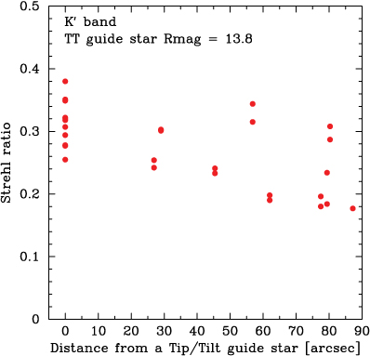
AO188
188 elements curvature WFS and bimorph DM
Used with IRCS, HiCIAO, Kyoto-3DII, SCExAO, CHARIS, IRD
History
  2008 NGS open use
  DM broken
  2011 LGS open use
Alternative
  Keck: (NIRC2, NIRSPEC, OSIRIS)
  Gemini: Altair (NIRI, GNIRS), GEMS (GSAOI, FLAMINGOS, GMOS)
  VLT: NAOS (NACO), SINFONI, CRIRES
Uniqueness of AO188
  AO performance is almost same as the other 8-10m telescope AO system
  The area for finding TTGS for the LGS mode is the widest among the AO system at Maunakea
Weakness of AO188
  No NIR IFU capabilities
  A bit larger overhead due to immature operation procedure
  Faint LGS (the laser power is the weakest)
Altair limit
Keck AO limit

Slide 8
Comparison with the other AO system
from Peter Wizinowich’s presentation at Keck strategy meeting

Slide 9
AO188 science publication history
Number of refereed science papers which cite AO188 instrument papers
(Hayano et al. 2008, 2010, Minowa et al. 2010).
AO188 (NGS) open use
AO188 DM broken
AO188(LGS) open use
Number of refereed paper

Slide 10
AO science paper publications
Refereed science paper using AO published in 2013
(from Peter Wizinowich’s presentation at Keck strategy meeting)

Slide 11
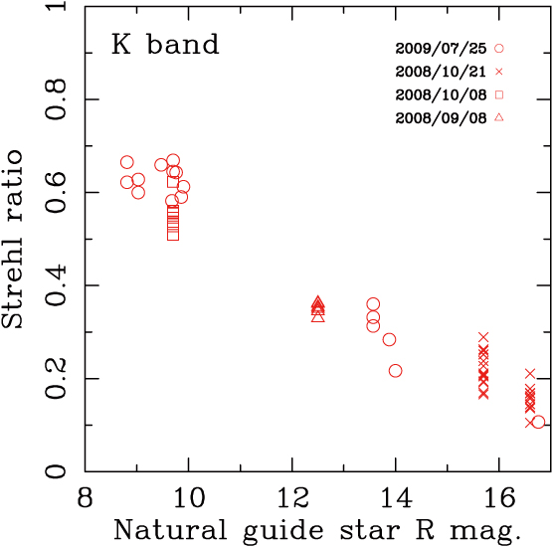
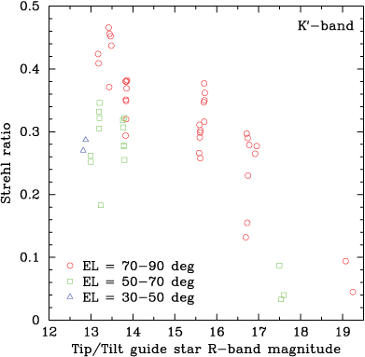
Future upgrade for AO188
New High power laser to make brighter (R~9-10mag) LGS
  TOPTICA fiber laser, which will provide 20W instead of current 4W, is a candidate
  Increase maximum achievable Strehl ratio from current 0.3 (FWHM~0”.1-0”.2) at K to 0.5 (FWHM<0”.1)
Performance optimization
  Make operation easier
  Reduce overhead
    M. Liu (IfA) who have used all AO system at Maunakea told me at the Keck strategy meeting that performance of AO188 is almost same as Keck-AO, but overhead is much larger for AO188 than Keck AO.

Slide 12
Extreme AO
from Peter Wizinowich’s presentation at Keck strategy meeting
SCExAO with Phase-II capabilities will be available from 2015
  >90% Strehl ratio at H-band is expected
CHARIS will be delivered to Subaru at the end of 2015, which will provide NIR IFU capability for characterizing the atmosphere of exoplanets.
High contrast imaging is not planned for TMT 1st gen. instruments
  SCExAO could beat early TMT (mid 2020) in this area (Thayne Currie’s Subaru Seminar)
AO188 (or new AO with adaptive M2) is necessary for Subaru’s ExAO

Slide 13
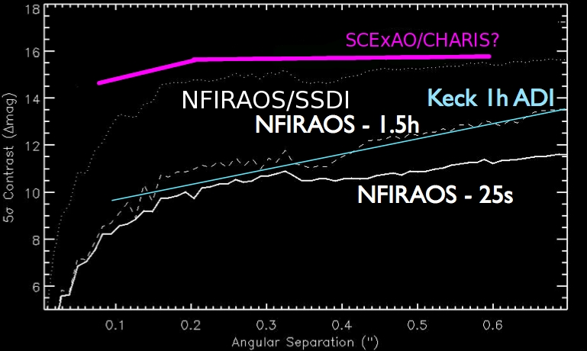
From Thayne Currie’s presentation at Subaru Seminar (06/12/2014)
SCExAO vs. First-Light TMT
NFIRAOS estimates from Marois et al. 2012
SCExAO: Likely best exoplanet imager in North until 2nd gen TMT (~2030)

Slide 14
Future AO system
from Peter Wizinowich’s presentation at Keck strategy meeting
ULTIMATE-Subaru GLAO 4 x Sodium YES Fiber IFU?, Imager? NIR imaging , IFS

Slide 15
Summary (IRCS)
IRCS provides basic functions of 8m class telescope, which are useful for all types of astronomy (solar system, exoplanets, galacitc objects, extragalactic).
Although IRCS is 1st gen. instrument at the Subaru, the demand for using IRCS is increasing after AO188
  Number of the submitted proposals is always at the highest or the second highest after HSC.
  Keeping the number of the publication at the same level since 2001
There are similar instruments at Keck/Gemini which can be used through time exchange program, but those are almost same age as IRCS (i.e., there is a risk of the failure or decommission).
It is not good idea to actively decommission IRCS without making coordinated instrument development/decommission plan with Keck/Gemini.
Even after AO188 is decommissioned, IRCS can be a unique instrument at Maunakea with thermal infrared imaging/spectroscopy capabilities if the Subaru have a deformable secondary mirror, which realizes low-background and high Strehl ratio of ~ 1.0 (same concept as VLT/ERIS).
Without deformable secondary, IRCS is not a competitive instrument at all within several years.

Slide 16
Summary (AO188)
AO188 provides the similar performance as the other AO system at Maunakea, slightly wider FOV for finding TTGS, although the publication record is poor compared with the other AO at the 8m class telescopes.
Number of the extragalactic publications has been increasing since LGS mode was opened on 2011 (but still low).
Future laser upgrade will make the LGSAO performance of AO188 highest level among the SCAO system in the world.
Science capabilities with AO188 itself will not be unique at all after future AO system becomes available.
AO188 (or newAO with ASM) +SCExAO is still a unique ExAO at the northern hemisphere even in the era of TMT
It is not good idea to decommission AO188 without having the other facility AO system

