Slide 1
Simulating Observations of z~2 galaxies with GLAO
Yosuke Minowa, Ikuru Iwata
(Subaru telescope)
2013/6/13-14 Subaru GLAO Science WS @ Hokkaido Univ.

Slide 2
Motivation
What is the most unique capability of the GLAO instrument?
GLAO will start observation from somewhere around 2020
  It is important to think about the uniqueness of the Subaru GLAO comparing to TMT and any other space based telescope.
Evaluate the competitiveness of GLAO imager, MOS spec., and IFU spec.
Case study for z~2 galaxies by simulating the actual observations.

Slide 3
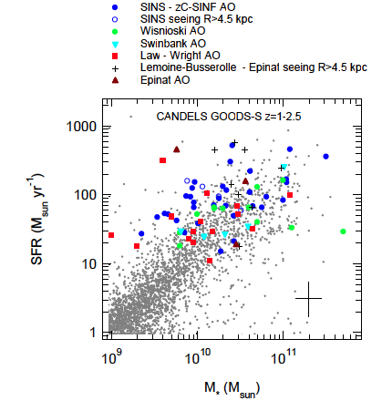
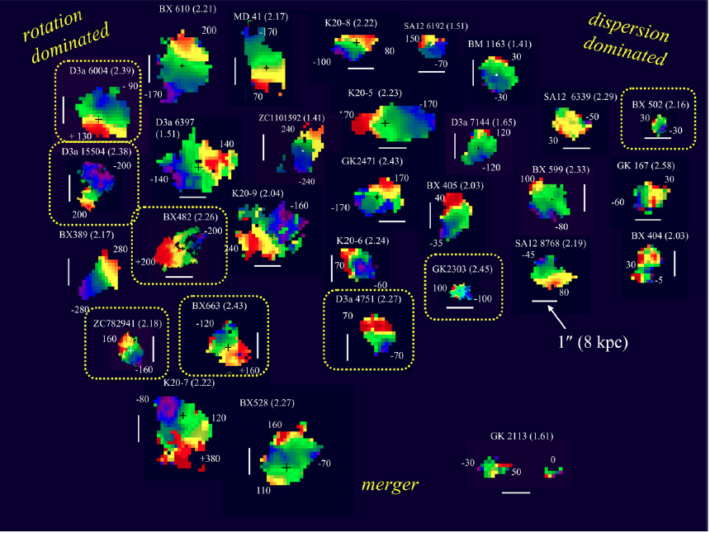
Science requirement: Sensitivity
SINFONI spectroscopic survey of z~2 star forming galaxies (Forster Schreiber+09)
Can we detect Hα emission line corresponds to SFR ~ 1-10 M_{sun}/yr to study < 10 ¹⁰M_{sun} galaxies?
(Newman+13)

Slide 4
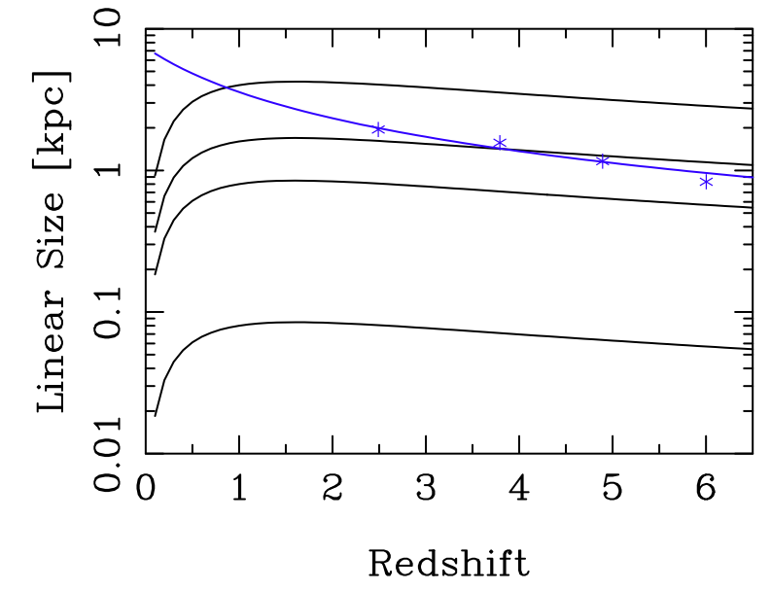
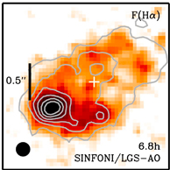
Science requirement: Spatial Resolution
Seeing (0”.5)
Star-forming galaxies
(Forster-Schreiber+11)
GLAO (0”.2)
AO188 (0”.1)
Bowens+04 (Size evolution of UV-dropout galaxies)
TMT (0”.01)
Redshift
Can we spatially resolve ~1kpc scale star-forming clumps at z~2?
Can we reconstruct morphological parameters of z~2 galaxies?

Slide 5
Simulating GLAO observation of z~2 galaxies
z~2 galaxy sample selection
  HST/WFC3 H-band (F160W) image of z~2 galaxies
    Highest resolution image currently available
  Data from CANDELS (Koekemoer et al. 2011) GOODS-S survey whose survey area (~120arcmin²) is comparable to the GLAO instrument
  Selected K_{AB}<23.9 BzK galaxies from MUSYC（Cardamone et al. 2010) catalog
    z=2.1-2.6 star-forming BzK with spec-z: 40
    --- K-band imaging/spectroscopy
    z=1.3-1.7 passive-BzK with phot-z: 6
    --- H,K-band imaging/spectroscopy

Slide 6
GLAO galaxy simulation recipe
  Extracted galaxy morphological parameters
    --- Sersic profile fit: Effective radius Re, Sersic index N, Axis ratio, and Position angle
    ※ Simple convolution of the WFC3 image may not reproduce well the GLAO image since WFC3 spatial resolution (FWHM~0”.18) is worse than the best GLAO resolution (FWHM~0”.15).
  Construct the model galaxy image from the morphological parameters without any PSF convolution.
  Convolve the model galaxy image with the GLAO PSF
  Add noise corresponds to 5 hrs integration
We used 5hrs integration time and 5sigma S/N for all simulation,
so as to evaluate the limitation in just 1 night observation.

Slide 7
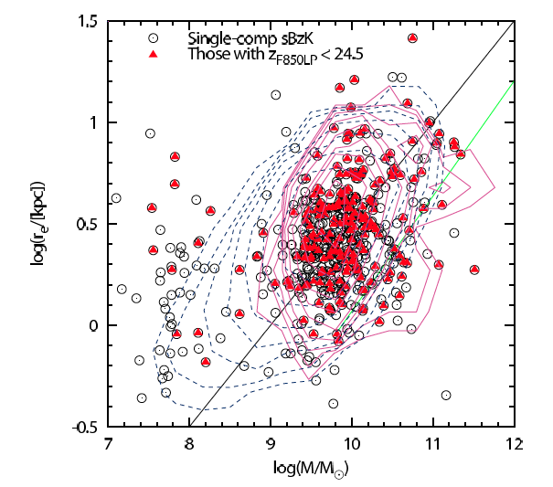

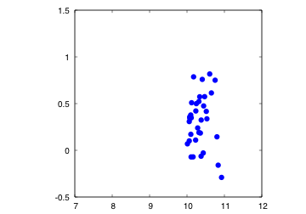
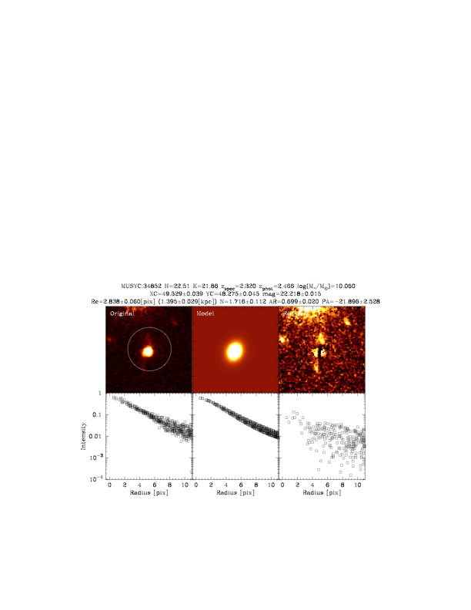
Star-forming BzK at z=2.1-2.6 (Model)
Modeling sBzK galaxies based on GOODS-S WFC3 image (CANDELS)
Comparison with z~2 sBzK sample at GOODS-N (Yuma et al. 2011)
Our sample
Effective radius log(Re[kpc])
WFC3
Model
Residual
z=0
Sersic profile
Stellar mass log(M*/M_{sun})

Slide 8

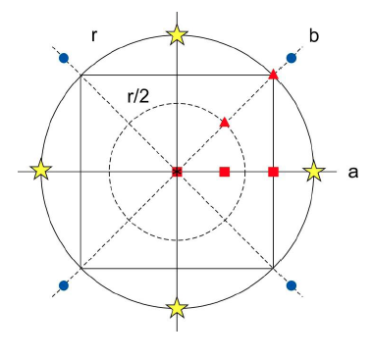
GLAO PSF
(from Oya-san’s talk)
We used the center PSF at the moderate seeing condition to simulate the observation of z~2 galaxies.
Seeing condition：
Bad (75%) : 0”.56@K
Moderate (50%): 0.44@K
Good (25%): 0”.35@K

Slide 9
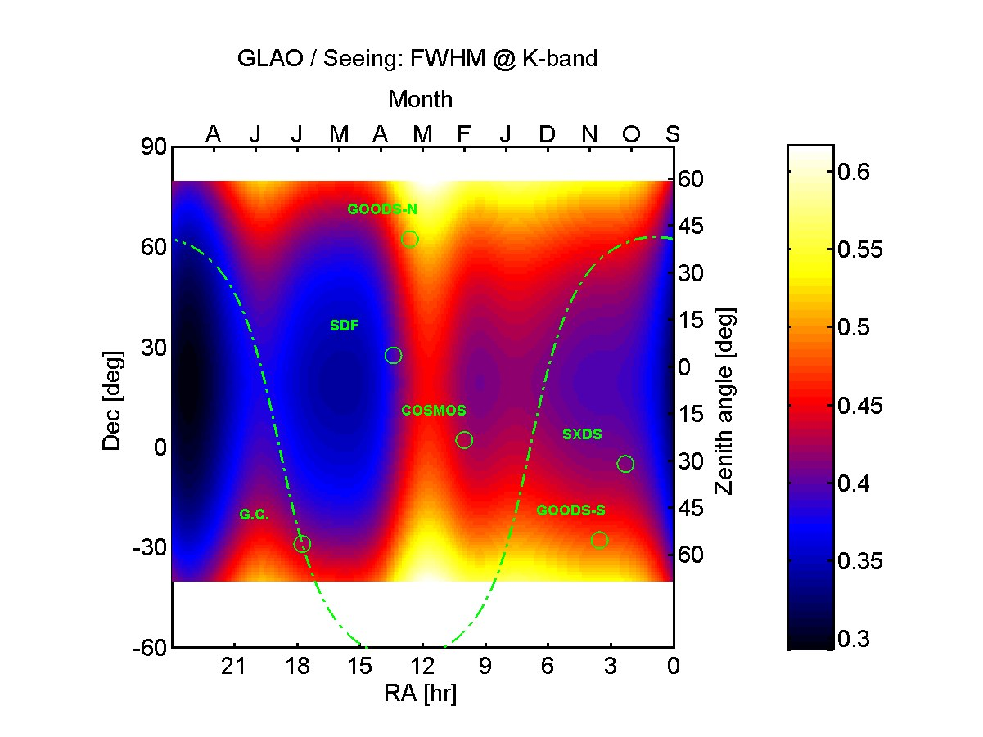
PSF for each target field
(from Oya-san)
Subaru Deep Field (Dec =+27.5deg) → Apr, z=15deg
COSMOS (Dec=+2.2deg) → Feb, z=15deg
SXDF/UDS (Dec=-5.2deg) → Oct, z=30deg

Slide 10
Summary of the PSF used in this simulation
 | COSMOS | SDF | SXDF
Zenith angle | 15 | 15 | 30
Month | Feb. | Apr | Oct
FWHM(Seeing)@K | 0”.48 | 0”.46 | 0”.48
FWHM(GLAO)@K | 0”.23 | 0”.18 | 0”.22

Slide 11
Simulated Observations
Wide Field NIR imaging
  Broad-band (BB) imaging
  Narrow-band (NB) imaging
Multi-Object Slit (MOS) spectroscopy
  Emission line
  Continuum
Multi-IFU spectroscopy
  Emission line

Slide 12
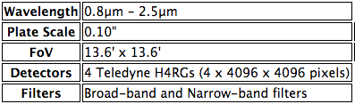
Imager
Baseline Specification
Wider than any NIR imager on 8m class telescopes
The instrument throughput is assumed to be same as VLT/HAWK-I (~60%@JH, ~50%@K)
Seeing performance is just same as VLT/HAWK-I

Slide 13
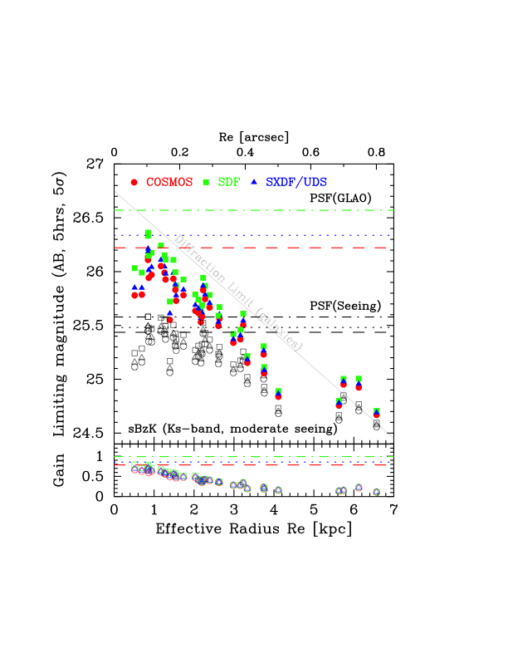
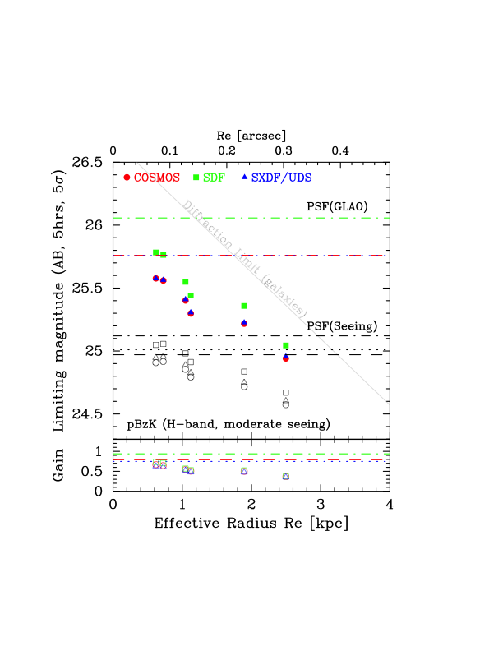
Broad-band imaging: Sensitivity
Star-forming galaxies at z~2
(Ks-band)
Passively evolving galaxies at z~1.5
(H-band)

Slide 14
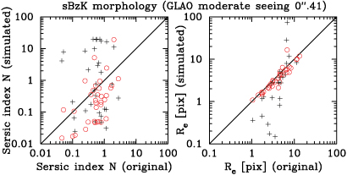
Morphological study with GLAO as of 2011, 2012
FWHM~0”.2

Slide 15
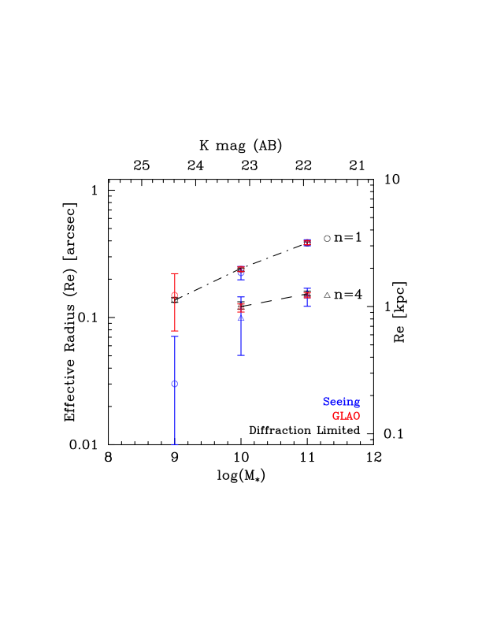
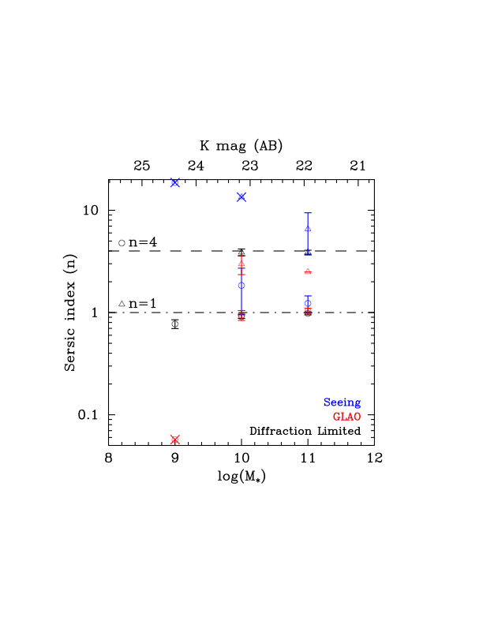
BB imaging: Possibility for reconstructing the morphological parameters with GLAO imager

Slide 16
BB imaging: summary
Simulated z~2 galaxy imaging in H, K-band with new GLAO PSF which takes into account the PSF difference according to the zenith angle and seasonal seeing change.
The point source sensitivity gain against the normal seeing instruments (such as VLT/Hawk-I) is different for each field. (1.0 mag for SDF, 0.7 mag for COSMOS)
The sensitivity gain for galaxies are almost same for all fields.
  0.3-0.6 mag for compact galaxies (<3kpc).
  Hereafter, we used COSMOS PSF to simulate the observations of z~2 galaxies.
The limiting mag. is more than 3 magnitude brighter than TMT or JWST (~30mag in K, Wright et al. 2010).
  Broad band imaging cannot be competitive
  Wide-field capability might be useful for finding rare objects like passively evolving galaxies.
Morphological parameters (Re, N) can be reconstructed from the GLAO image for galaxies whose mass is larger than 10¹⁰ M_{sun}
For lower mass galaxies 10⁹ M_{sun,} we can reconstruct size (Re), but cannot reconstruct Sersic index.

Slide 17
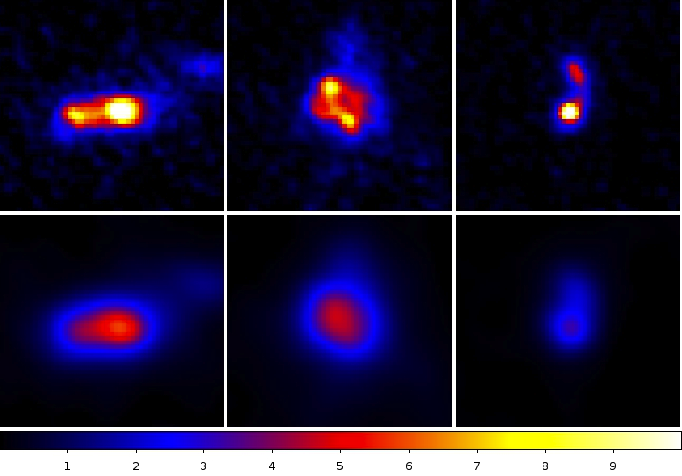
Narrow-band imaging: Hα map
Simulated Brγ-image of Hα emitters at z=2.3 with 5hrs integration
  made from HST/WFC3 images of star-forming galaxies in SXDF (Tadaki+13)
log(M*/M_{sun}) ~ 10.8
SFR ~ 300 M_{sun}/yr
log(M*/M_{sun}) ~ 11.2
SFR ~ 230 M_{sun}/yr
log(M*/M_{sun}) ~ 8.9
SFR ~ 90 M_{sun}/yr
GLAO
~ 3”.0
Seeing
S/N: 1 2 3 4 5 6 7 8 9 10

Slide 18
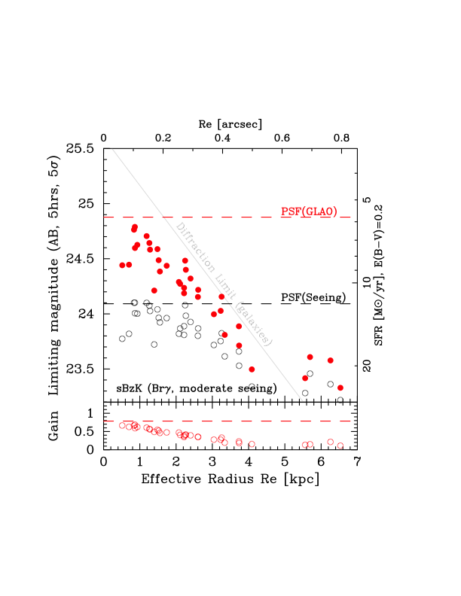
NB imaging: Sensitivity for detecting Hα from z~2 galaxies

Slide 19
NB imaging: Summary
Star-forming clumps in galaxies can be clearly resolved with GLAO NB imaging.
GLAO can reach about 0.3-0.6 mag deeper than VLT/HAWK-I for compact galaxies (<3kpc)
Brγ-imaging can reach Hα emitters with SFR < 10Msun/yr for compact galaxies with re < 3kpc.
  Wide field NB-imaging can be a good sample provider for the IFU study with TMT
JWST/NIRCAM (F212N) can reach about 1.8 mag deeper than GLAO NB image for galaxies with re~2kpc and more for point sources (from Iwata-san’s calculation).
  More than 100hrs integration required to achieve similar depth as JWST/NIRCAM.
  Legacy type survey could achieve this integration.

Slide 20
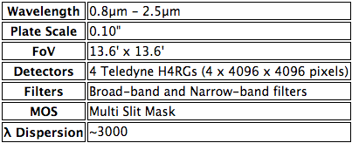
Multi-Object Slit Spectrograph
Baseline Specification
Keck/MOSFIRE type instrument with 13’x13’ FOV
  Wider FOV than any existing MOS spectrograph on 8m class telescopes
Assume similar throughput as Keck/MOSFIRE
  the highest throughput ever achieved (30-40%@JHK)
  Seeing performance is just same as Keck/MOSFIRE
Slit width is assumed to be 0”.4 which is 2 times wider than GLAO PSF.

Slide 21
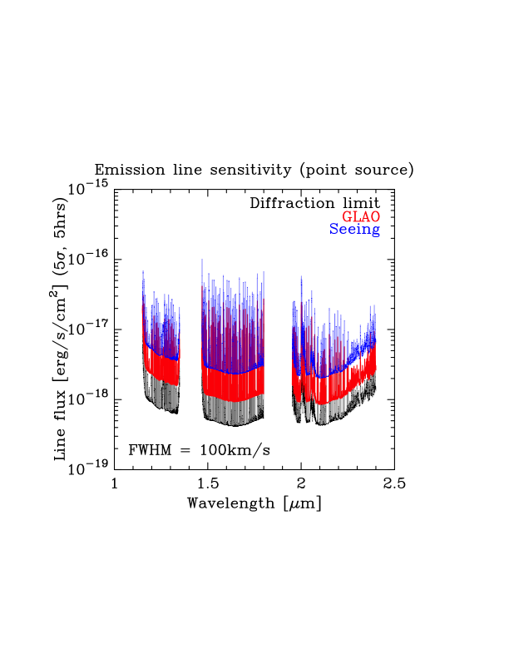
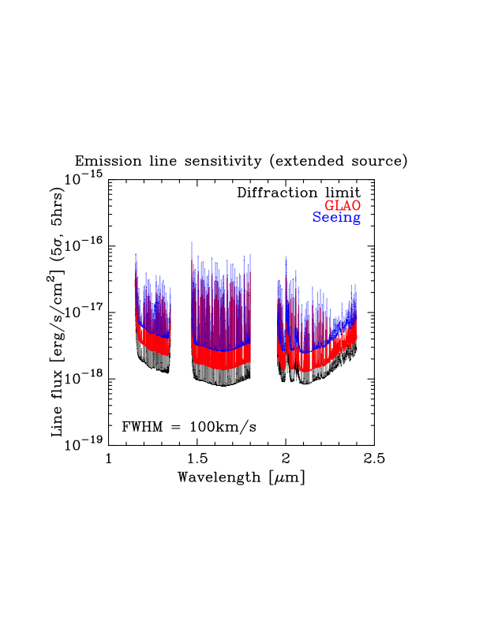
MOS Spec.: emission line sensitivity
Emission line 5σ sensitivity for point source and extended source (Re~1kpc or ~ 0”.12 and N=1) with 5hrs integration.

Slide 22
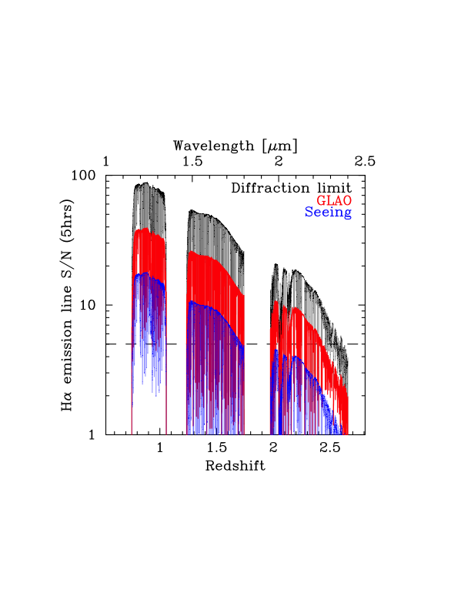
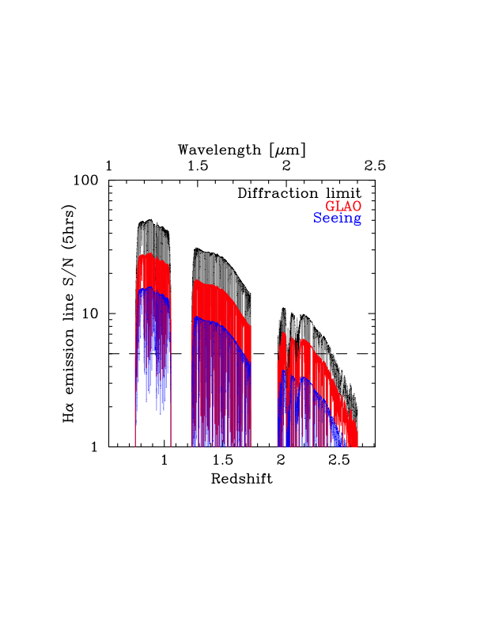
MOS Spec.: Emission line sensitivity
S/N of Hα emission line flux which corresponds to SFR~ 1 M_{sun}/yr (assume E(B-V)=0.2) with 5hrs integration
(Point Source)
(Extended Source)

Slide 23
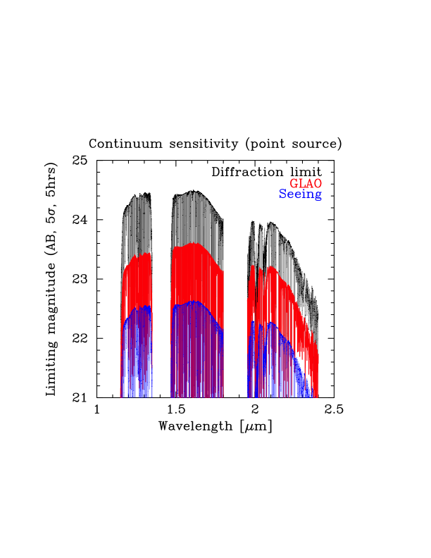
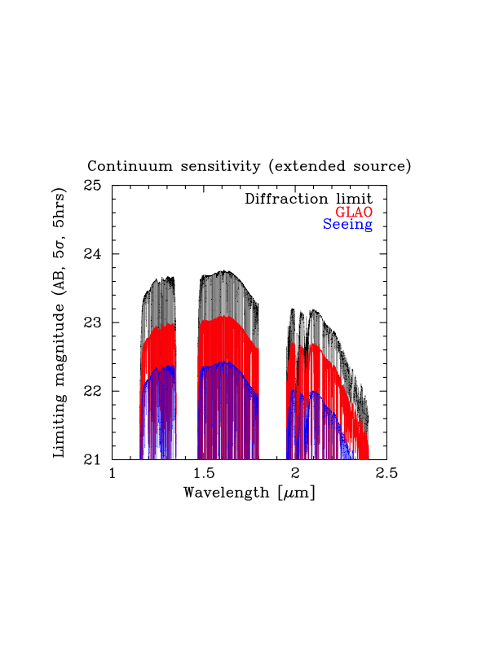
MOS spec.: Continuum Sensitivity
Continuum 5 σ sensitivity for point and extended source with 5hrs integration

Slide 24
MOS. Spec: Summary
Emission line: GLAO can increase the S/N of emission lines by 2 times higher than MOSFIRE.
SFR~1M_{sun}/yr can be detected with Ha emission line located between sky emission line.
Provides better sensitivity than NB-imaging, which enables redshift confirmation of the Ha-emitter discovered by NB imaging.
Although TMT can achieve 3 times better S/N than GLAO (based on Law et al. 2006), the MOS capability is still required to enable rapid follow-up of the target discovered by GLAO NB imaging.
Continuum sensitivity is worse than K~23mag. Follow-up spectroscopy of z~2 passive galaxies discovered by BB imaging should be done by TMT.

Slide 25
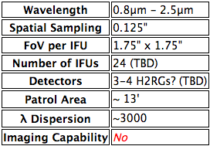
Multi Object IFU
Baseline Specification
VLT/KMOS type multi-IFU
Throughput is assumed to be 80% of MOSFIRE due to the optical components for IFUs.

Slide 26
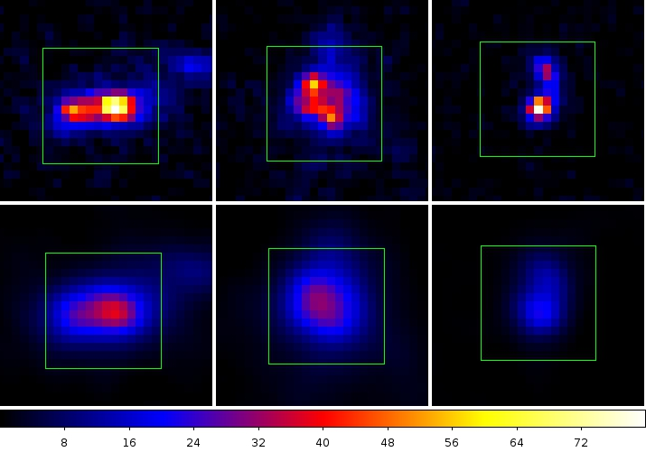
Multi-IFU: mock image
Simulated IFU S/N map of Hα emitters at z~2.3
  same objects as we used for NB imaging
1”.75x1”.75
GLAO
Seeing

Slide 27
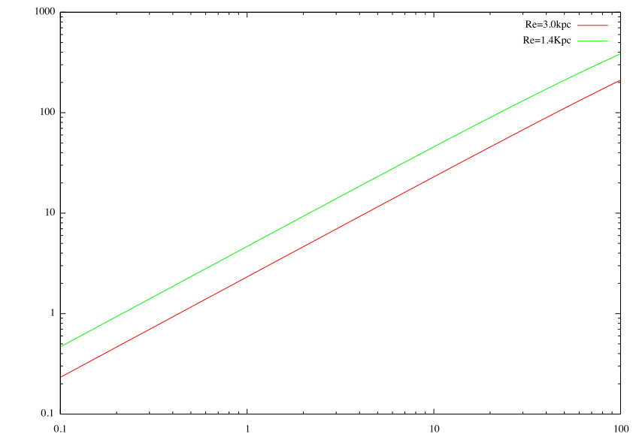
Multi-IFU: Sensitivity
Re=1.4kpc
S/N
Re=3.0kpc
SFR=1Msun/yr can be detected with S/N=5 for galaxies Re=1.4kpc
Star Formation Rate [Msun/yr]

Slide 28
Multi-IFU: Summary
Star-forming cramps can be resolve with IFU.
GLAO IFU spectrograph can be detected Hα emission line from z~2 galaxies corresponds to SFR~ 1Msun/yr, if size of galaxies is less than 2 kpc.
TMT/IRIS can detect SFR~1Msun/yr from similar size galaxies with S/N>40 (Wright et al. 2010)
To be competitive with TMT/IRIS, GLAO IFU should have multiplicity of targets with more than 64 pick-off arm.
  Need to investigate if this number is technically possible.

Slide 29
Conclusion
Competitive
less competitive
Competitive??? (in Japanese 微妙）
Broad band imaging is not very competitive against the TMT/JWST, although >0.5mag gain can be obtained from the normal seeing instrument.
NB imaging can reach the galaxies with SFR <10 Msun/yr, which can be good targets to follow-up with TMT IFU.
Emission line sensitivity is only 3 times worse than TMT/IRIS, which could be competitive by combining with the GLAO NB imaging survey.
Continuum sensitivity is less competitive as we can detect galaxies brighter than 23 mag in K-band.
Multiple-IFU could be competitive against TMT/IRIS if we can have more than 60 pick-off arms , but it is better to invest TMT/IRMOS.
Any comment or request for the simulations of GLAO observations are welcome.

Slide 30
おまけ

Slide 31
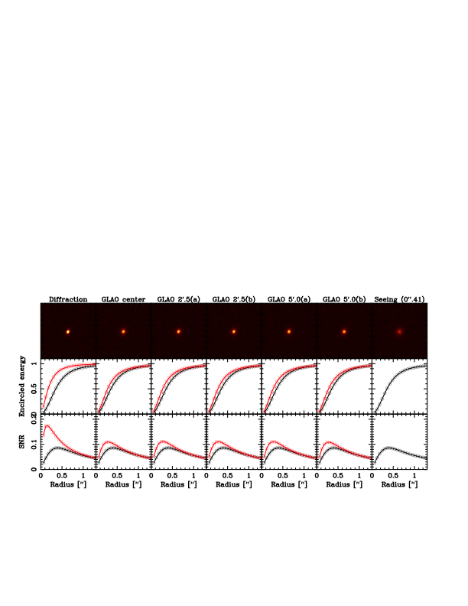
Star-forming BzKs at z=2.1-2.6 (GLAO image)
Assuming 5 hours integration in K-band under moderate seeing condition (0”.5)
GLAO
Seeing (0”.5)
2.5@r=0”.2
1.5@r=0”.2
1.5@r=0”.2
1.5@r=0”.2
1.5@r=0”.2
1.5@r=0”.2
2.02
1.28
1.29
1.29
1.29
1.27
MUSYC 34852: z_{spec}=2.32, H=22.5, K=21.9, log (M*/M_{sun})=11.1, R_{e}=1.4[kpc], N=1.7
Notes:
2.5 = 1mag, 1.5 = 0.4, 2.02 = 0.8, 1.28 = 0.27

Slide 32
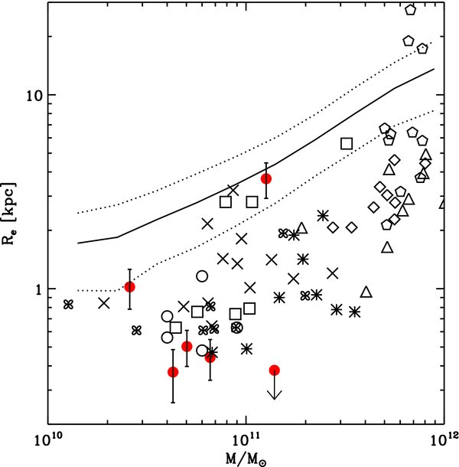
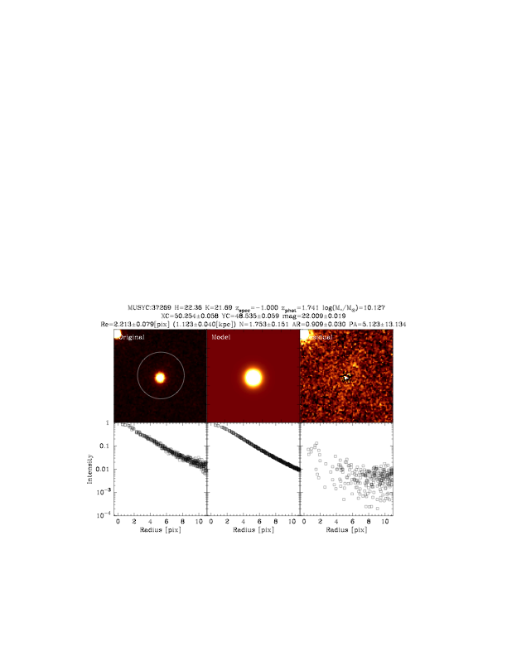
Passive BzKs at z=1.3-1.7 (Model)
Comparison with the other z~2 passive galaxies at HUDF (Cassata et al. 2010)
Modeling pBzK galaxies from GOODS-S WFC3 image (CANDELS)
Our sample
Effective radius Re（Kpc）
z=0
WFC3
Model
Residual
Stellar mass （M*/M_{sun}）

Slide 33
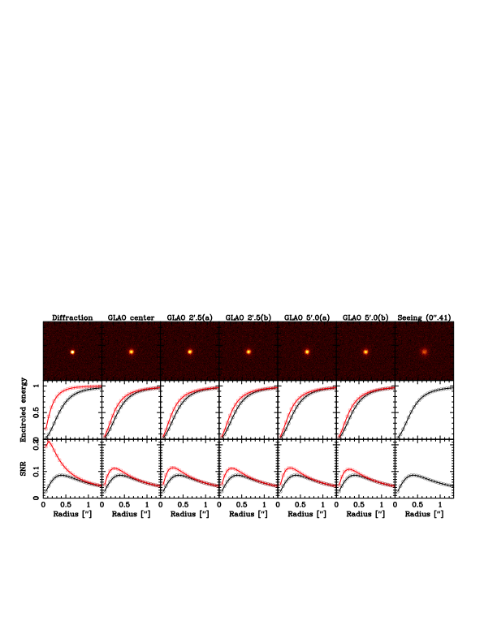
Passive BzKs at z=1.3-1.7 (GLAO image)
Assuming 5 hours integration in H band under moderate seeing condition (0”.5)
GLAO
Seeing (0”.5)
2.8@r=0”.2
1.6@r=0”.2
1.6@r=0”.2
1.6@r=0”.2
1.6@r=0”.2
1.4@r=0”.2
2.49
1.30
1.33
1.30
1.31
1.26
MUSYC 37269: z_{phot}=1.74, H=22.4, K=21.7, log (M*/M_{sun})=11.1, R_{e}=1.1[kpc], N=1.7

Slide 34
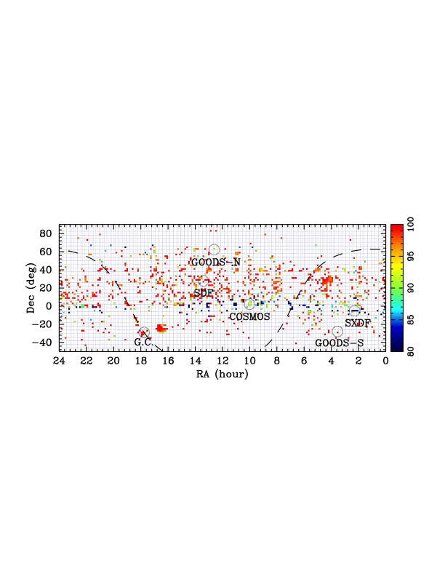
Impact of the LGS satellite closure

Slide 35

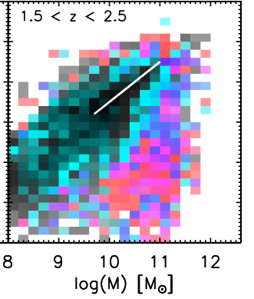
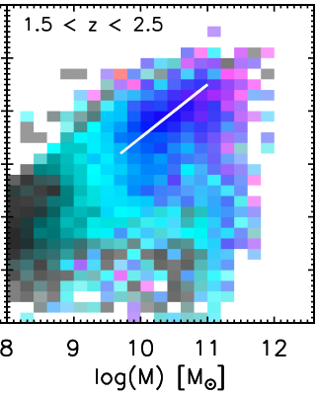
BB imaging: Morphological study
Sersic index (n)
Log(re) [kpc]
(Wuyts+2011)

