Slide 1
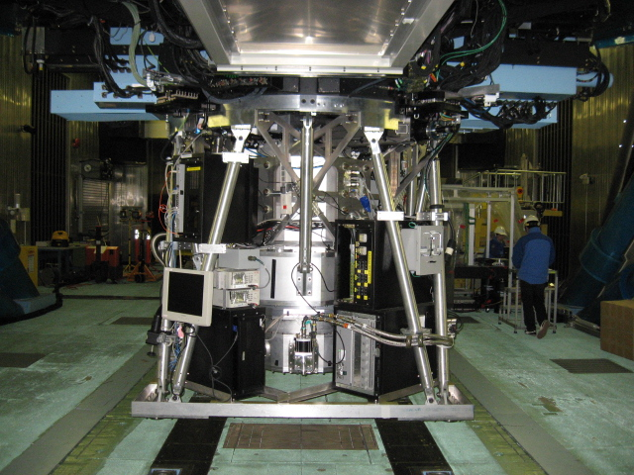
GLAO Instrument from MOIRCS Perspective
2004
2013
2020?
Ichi Tanaka
Subaru Telescope

Slide 2
Preface
Question:“How you want to use 8-m Telescope in 2020s when TMT/GMT/JWST/WISH etc are there?”
“Attractiveness” of the instrument itself is the key for success.
Attractive=Challenging (no counterpart). If overcome, great idea will follow (I believe).
「人に使ってみたくさせる様な、魅力的な装置」をいかに
(経済的に) 作るか。進化の可能性を維持する事ができるか。

Slide 3
MOIRCS
FL … Sep 2004 (imag) & 2005 (MOS).
Open-use started from S06A.
The First NIR MOS open-use instrument among large telescopes.
The First Wide-Area NIR instrument for large telescopes until arrival of HAWK-I
Imaging: 4’x7’ FOV by 2 H2. YJHK & many NBs
MOS/long slit. R500, R1300, VPH(YJHK).

Slide 4
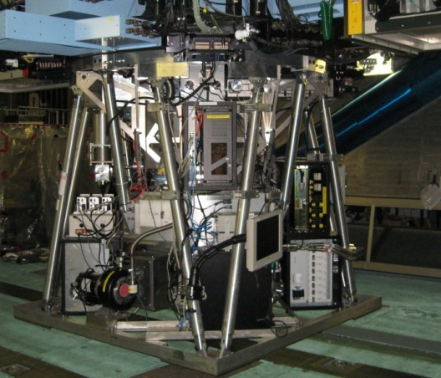
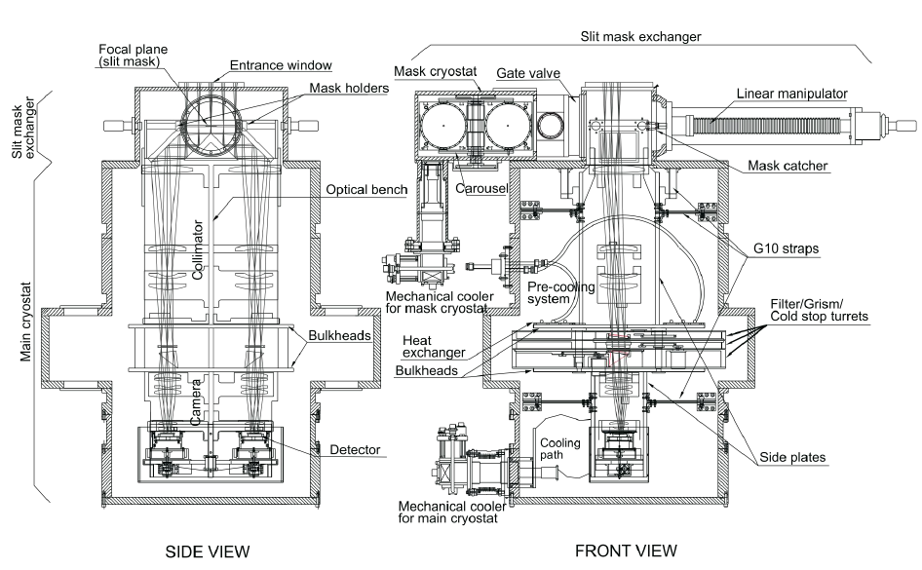
MOIRCS

Slide 5

MOIRCS: Pros
Cs instrument →Better background performance in K than Ns (cf. HAWK-I).
3 Filter/Grism/Stop Turrets (total 36 ports) → Many Filter Ports available for user filters & grisms.
0.117”/pix → Good sampling for good condition. ~3 pix condition is not so rare. → Good choice.
2 independent channel … Die Hard to trouble (half-channel operation possible).
Complicated operation (e.g., ch1->sp, ch2->im)
is also possible.
Dubbed by Kodama san

Slide 6
MOIRCS: Cons
Flexure … Large line residual after sky subtraction (Sp.). Shift of the spectra. Fringe on imaging data.
Poor Align of Cold Stop. No way to fine adjust.
Large overheads: Too slow detector readout. Slow MOS alignment time.
R500…too many OH lines. R1300…very low sensitivity for YJ. Image degration by grism itself. VPH…Peak efficiency wavelength shift: very difficult to use for MOS.
Frequent focus change (telescope). AG does not help for check due to the focus mismatch.

Slide 7
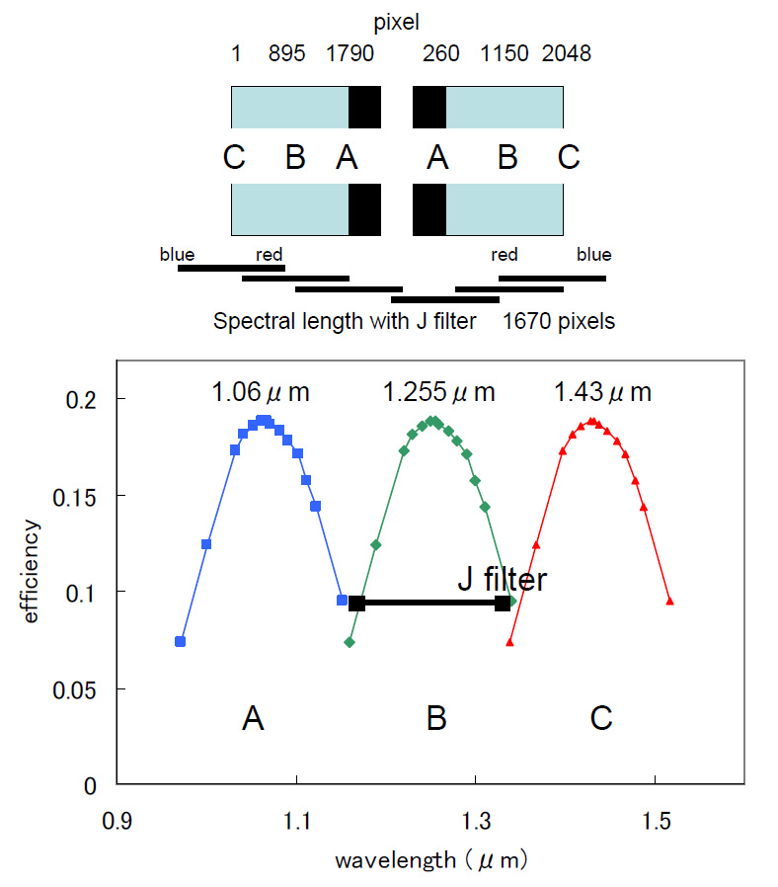
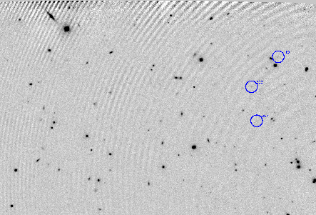
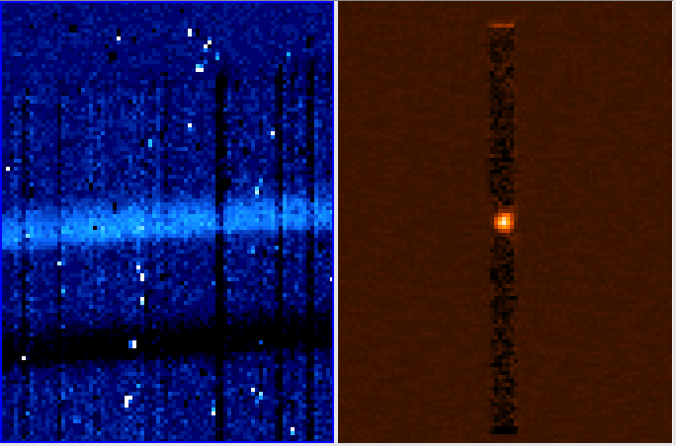
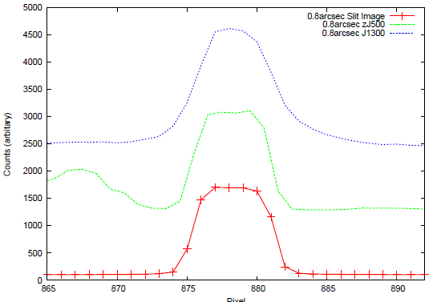
Fringe Residual (H2 filter)
Peaky & Large Tc shift
for VPH Grism
Degration for spatial direction
Degration for spatial direction (R1300)

Slide 8
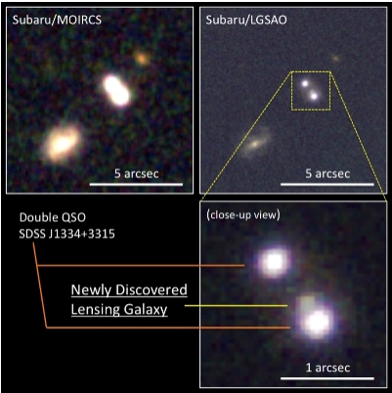
MOIRCS: Scientifically…
Good Imaging Performance. But studies for
morphology are limited. Mostly just photometric
use.
Deep obs … condition averaged out -> degrade.
Deep Imaging Data…follow-up impossible?
(But All visible objects will be spectroscopic targets for TMT !!)
Many users went for field galaxy studies. → “Main” targets are not so rich in the MOIRCS FOV. Many are just filler objects. (cf. FMOS)
Limit of photo-z and instrument sensitivity: >50% success rate for spec-z is a hard task (partly due to fillers).

Slide 9
Spec data is quite sensitive to seeing under 0.8”-width slits. Slit loss is a serious issue.
  Narrower slit is preferred to avoid OH lines.
  But NOT all galaxies are compact enough to confidently use 0.2”-0.4” slits. Extended galaxies might also be morphologically complex.
  Extragalactic People may choose wider slits after all (more photon is preferred)? e.g. 0.6” slit for 0.06”/pix => 10pix profile!
  Cf.) oversampling problem on FOCAS (Dr.Ohyama’s review 2005).
  Is simple MOS still attractive for 2020 era? But MOSFIRE type/microshutter technology may worth trying.

Slide 10
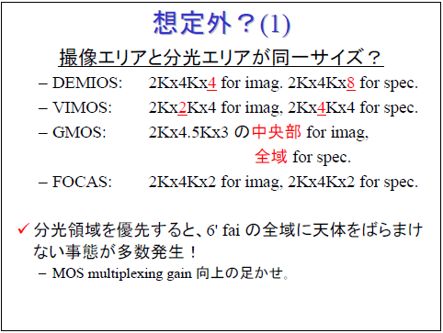
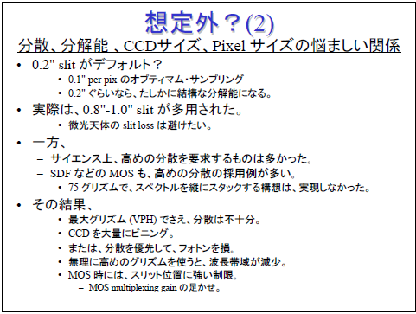
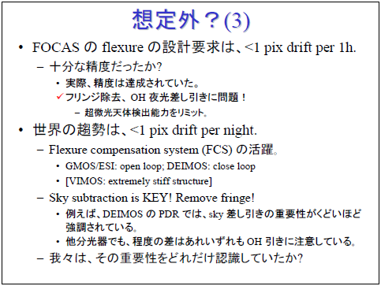
FOCAS進化論(FOCAS Instrument Review) by Dr. Y. Ohyama (2005)
FOCAS: Subaru optical MOS Spectrograph.
Dr. Ohyama --- 1st FOCAS SA.
His Review --- Suggestive to NGAO Instrument.
http://optik2.mtk.nao.ac.jp/~cyoshida/SACsympo/

Slide 11
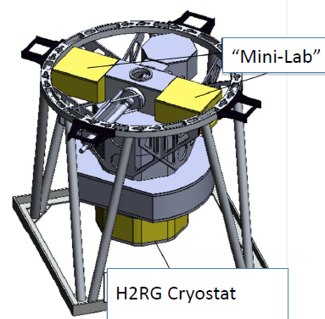
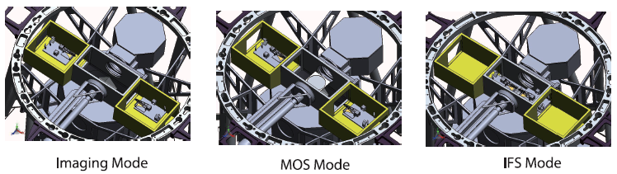
νMOIRCS: MOIRCS upgrade (2012~)
H2→H2RG+ASIC: much better overhead & less cosmetics, good noise level expected.
IFUs: 4 IFU arms will be added. Other options (MLA mode etc) are also on work.
Instrument Improvement: Efforts for flexure suppression etc.
MOIRCS could be a 1st light GLAO instrument depending on the condition.

Slide 12
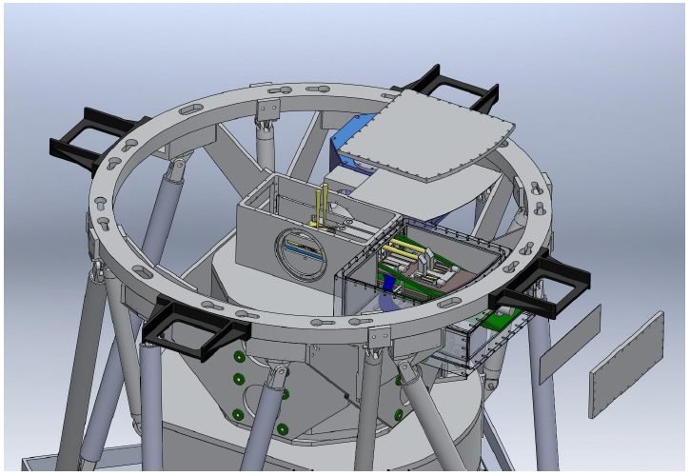
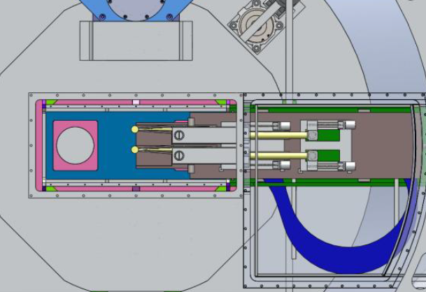
νMOIRCS “Wing Box”
Two wing boxes. 2 IFUs for each.
If 4 IFUs are combined, it works as a large single IFU.
Flexibility for Other Applications (test bench).
Modification: just replacement of Focal Plane Box.
Same box can come here too.
Great Idea for NGAO Instrument

Slide 13
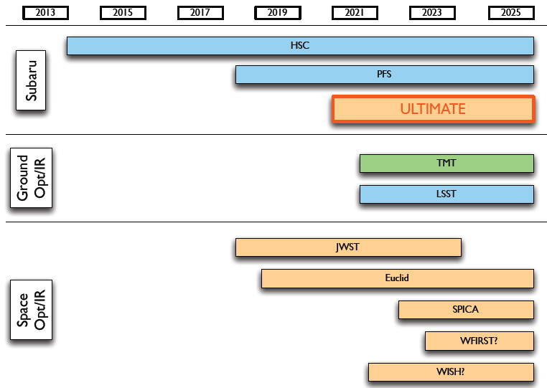
NGAO Instrument and 2020
From Iwata report (2013)
JWST, EUCLID (and I wish WISH too) will already be there.
TMT comes soon. GMT may already be there (FL late 2019). E-ELT will be soon(early 2020s).
TAO will be soon (SWIMS could also be a FL instr for GLAO).

Slide 14
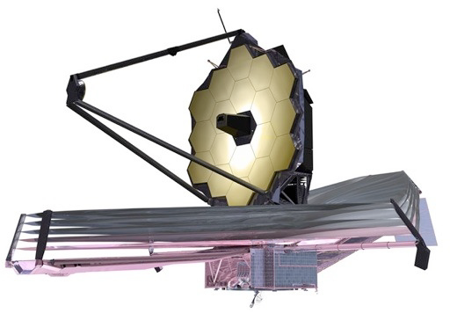
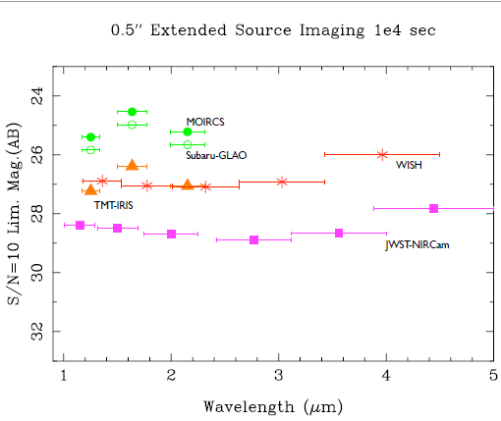
JWST (Imaging)
NIRcam can go extreme depth.
Wide-area shllaow(still deep) scan should also be an easy task.
Pressure for COSMOS-Like Legacy Data →deg²-scale survey likely to be executed. But 10² scale would be too time-consuming for JWST.
Wide FOV of NGAO Inst. can make the data with 10-100 sq.deg with reasonable time. We may keep some niche, until WISH comes.
Any NB deep & wide-area survey would keep its own niche until WFIRST comes (next).
K-band wide and deep would be attractive for EUCLID Deep Field (and WFIRST).

Slide 15
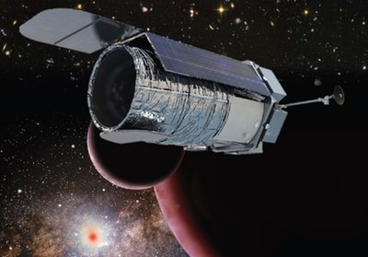
WFIRST-24
1st –ranked space mission by Decadal Survey 2010.
Significant revision in 2013: 1.3m → 2.4m. Two Mirrors and optics system are already in NASA (given from NRO)!
18 H4RG. FOV=0.281 deg²(0.11”/pix). 0.76-2.0um (no K).
Slitless Grism (R~700)+ 3.0”x3.1” IFU(R~100).
Imaging (YJH~<26.7) and Spectroscopy (7s to 5e⁻¹⁷erg) for ~2000deg²!
If started next year, Launch will be ~2022.
For GLAO Inst…only K-band (NB,BB) is the niche. Early start is advantage.

Slide 16
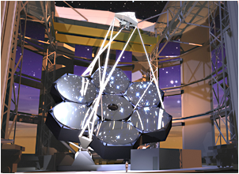
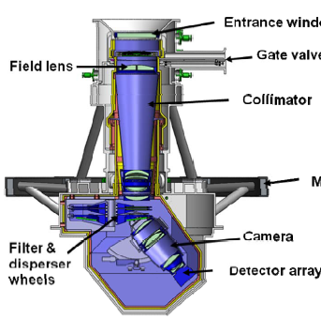
GMT NIRMOS: Potential Threat?
GMT … FL goal is end of 2019. Construction started, 2 mirrors already done (3rd in Aug?).
NIRMOS … 1st generation propsed instrument. GLAO-assisted 6.5’x6.5’ NIR imager/MOS (CfA).
3x2 H4RG.
MOS mask or MOS robot.
CoDR review approved. Actively seeking funding.
Filter space is currently quite limited.
NGAO Instr….NB/IB only?

Slide 17
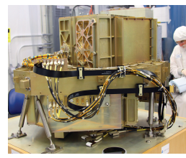
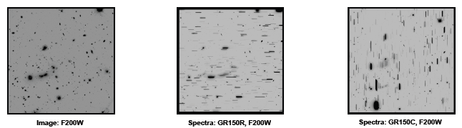
JWST: NIRISS
Space … Power of slitless spectroscopy.
JWST NIRISS: R~150 slitless spec. across ~2’x2’ FOV. Instrument is already in GSFC for test.
Extreme sensitivity: best for faint z>7 LAEs.
Narrow FOV? Survey volume of slitless spectroscopy is large (6<z<17). They will do Legacy-class survey anyway (deg²)?.
Subaru NGAO inst. may still have a niche in targeted wide-FOV NB business. For K-band region we have.

Slide 18



What our NGAO Instrument would be…
We want everything (Imaging, MOS, IFUs)!
But budget is limited. Weight limitation is also tight.
nuMOIRCS Approach might be a solution…

Slide 19
“NuMOIRCS” approach … great idea.
Making Imager First.
  High Throughput. Simple Design.
  Wide Fov, optimized to K band.
  The Design for future addition of spec. function (=MOS/IFU etc) must already taken into account.
Making Unitized Additional Components
  MOS Robot Unit (MOSFIRE-type)?
  IFU(s)
  Near-Focal Plane NB Filters w/stacker?
  Is High Throughput “Giant” NIR-FP possible?
  Easy Convertibility --- they should be detachable with small downtime (~1 mo).
  Unitization has advantage on risk/cost/manpower management.

Slide 20
Example of development case…
2015 2016 2017 2018 2019 2020 2021 2022 2023 2024 2025 2026
Imager Part
Operation
Development:NAOJ+collaborators
Got Grant!
MOS Part
Operation
Got Grant!
IFU Part
Development: A Institiute.
Got Grant!
MOS Robot
Development: B Univ.
Got Grant!

Slide 21
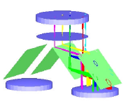
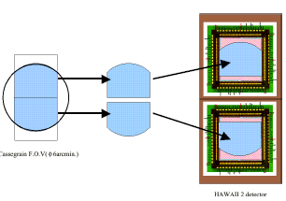
Option 0’:“Cheapest” IFU option?
A Further MOIRCS Update Project
2 IFUs arms → 4 IFU arms or 2 Larger-format IFUs
Change to more smart IFU arms?
Larger IFU pick?
νMOIRCS Design
Upgrade:
2 more H2RG for specral data.
Change of Whole camera section &
bottom dewar part.
1.Afford more IFU spaxel.
2. MOS … wider area for target selection
Project: “νMOIRCS” →
“F_{ν} MOIRCS?”

Slide 22
Summary
NGAO Instrument … Starting from Imager may be a realistic option.
Unitized Design for further update (νMOIRCS-like approach) could be the solution for collaboration and difficult budget situation.
FνMOIRCS? Good timing for it? As SWIMS comes to Subaru as a guest instrument.
(For me) manpower appears potentially the most serious issue for the project. How the project is going for realization??

Slide 23
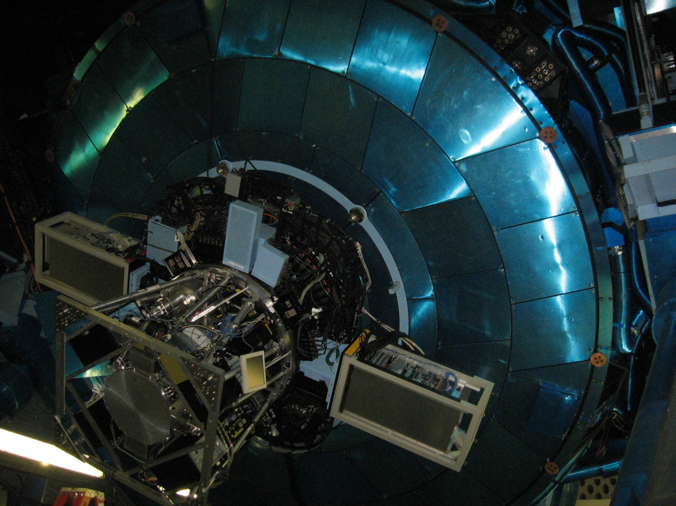
Omake Idea…
(Based on a word from Y.Tanaka)
If 2-m limit causes more number of lenses, degraded pupil,etc…
Let’s seriously think about using whole bottom of telescope.
Ligntweight design of the dewar is also the key! Honeycomb-like wall?

