Slide 1
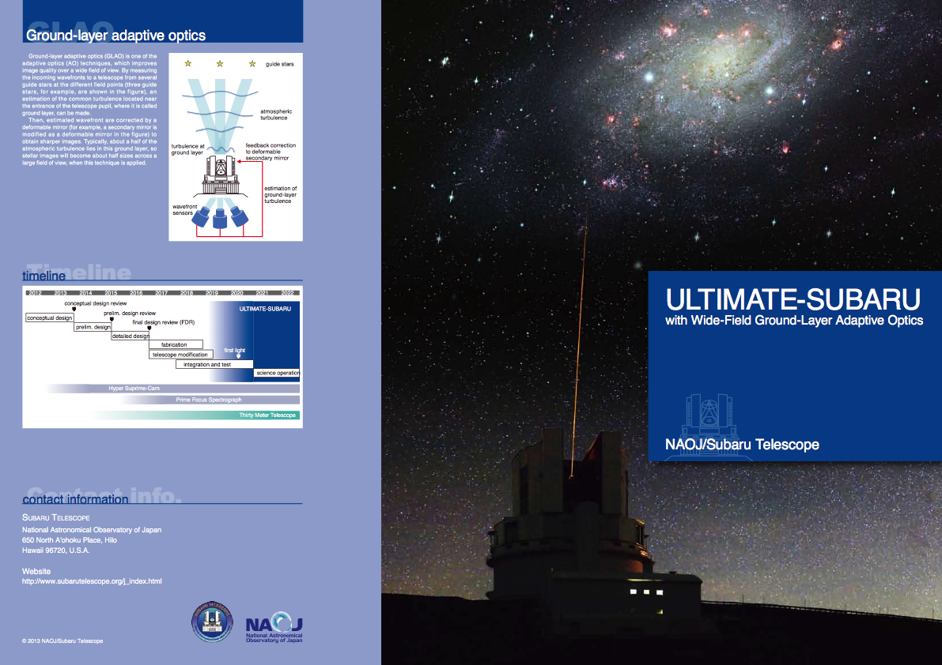
Next generation wide field AO (GLAO) and NIRMOS for Subaru Telescope.
Ultra-wide-field
Laser
Tomographic
Imager and
MOS with
AO for
Transcendent
Exploration
by
SUBARU telescope.

Slide 2
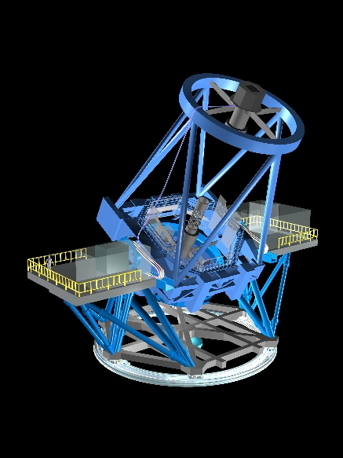
Adaptive Telescope
4 laser guide star
Adaptive
Scondary
Mirror
Wavefront
Sensor
NIR instrument

Slide 3

Guide stars
Atmospheric
turbulence
Turbulence at
ground layer
Feedback correction
to deformable
secondary mirror
Estimation of
ground-layer turbulence
Wavefront
sensors

Slide 4
GLAO - Specifications under Consideration
Guide stars | 4 LGSs + 3 NGSs
DM | Secondary mirror | ~1000 actuators, modification of VLT ASM.
HO-WFS | > 8x8 SH | visible, EM-CCD(TBD)
TT(F)-WFS | 2x2 SH or quad | visible
Laser | 20 W CW | TOPTICA (589nm) (option: Rayleigh)
LGS constellation | 15’ in diameter
Laser Launch | ~25cm dia. (TBD) | side launch

Slide 5
NIR Instrument - Specifications under Consideration
Wavelength | 0.8-2.5μm
Plate Scale | 0.06-0.1”/pix
FoV | approx.13‘x13’ | Wider with Split FoVs?
Filters | Broad+Narrow | R?, I,z,J,H,K, NB
MOS | Multi Slit Mask | Alternatively Multi-IFU
λ Dispersion | 2000(TBD) | Under Investigation

Slide 6
Comparison: Imaging
 | Subaru MOIRCS | Subaru GLAO | TMT IRIS | HST WFC3/IR | JWST NIRCam
Telescope Aperture | 8.2m | 8.2m | 30m | 2.4m | 6.5m
Wavelength Coverage | 0.9-2.5μm | 0.9-2.5μm | 0.84-2.4μm | 0.9-1.7μm | 0.9-2.3μm / 2.4-5.0μm
Spatial Resolution | 0.117”/pix 0.4”@2μm | ~0.1”/pix 0.2”@2μm | 4 mas 10mas@1μm | 0.13”/pix FWHM~ 0.25” | 32 mas / 64 mas
Field of View | 28 □’ | ~180 □’ | 0.075 □’ | 4.65 □’ | 9.7 □’

Slide 7
Comparison: Spectroscopy
 | Subaru MOIRCS | Subaru GLAO | TMT IRIS | HST WFC3/IR | JWST NIRSpec
Wavelength Coverage | 0.9-2.5μm | 0.9-2.5μm | 0.84-2.4μm | 0.9-1.7μm | 0.6-5μm
Spatial Resolution | 0.117”/pix 0.4”@2μm | ~0.1”/pix 0.2”@2μm | 4 - 50 mas | 0.13”/pix FWHM~ 0.25” | 0.2”x0.45”
Field of View | ~25 □’ | ~120 □’ | 0.2-10 □” | 4.65 □’ | 12.24 □’(MSA) 3”x3”(IFS)
Functions | Single-Slit MOS IFS | MOS Multi-IFS? | IFS | Slitless | Slits Microshutters IFS
Spectral Resolution | 600-3000 | -2000? | 4000-10000 | TBW | 100, 1000, 2700

Slide 8
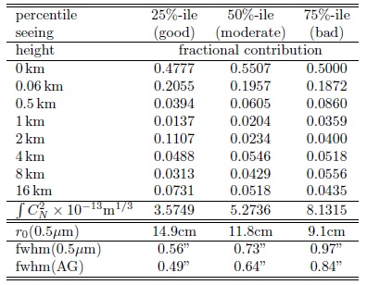
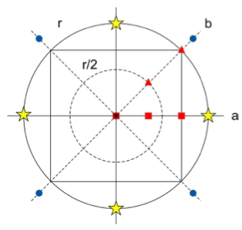

Perfoamance simulation
FWHM
Add to match seeing statistics at Subaru.
 | R | J | H | K
Seeing | 0.65” | 0.51” | 0.49” | 0.44”
GLAO | 0.41” | 0.27” | 0.23” | 0.20”
TMT site test at 13N
Ensquared Energy (0.24”x0.24”)
 | R | J | H | K
Seeing | 9% | 12% | 15% | 17%
GLAO | 16% | 29% | 36% | 41%
Turbulence profile
Zenith angle dependency
 | 0° | 15° | 30° | 45° | 60°
Seeing | 0.44” | 0.49” | 0.52” | 0.60” | 0.76”
GLAO | 0.20” | 0.28” | 0.31” | 0.38” | 0.55”
GS asterism
S. Oya

Slide 9
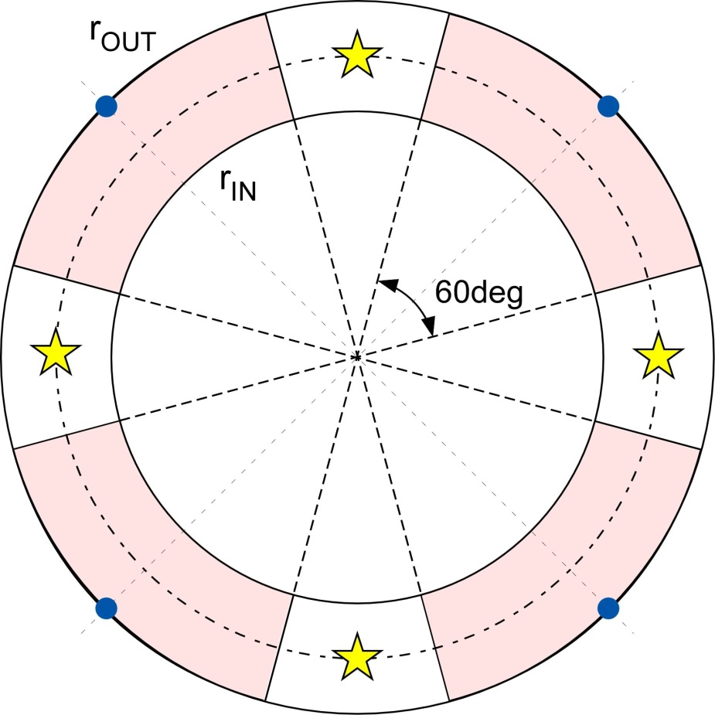
Sky coverage
S. Oya
★:LGS
●: TTFGS
Searching area for TTFGS
Dash circle line: 7.5’ radius
D. Simons, Gemini technical notes TN-PS-G0030, (1995).
r(in, out) = r_circ | TTFGS(R-band) | b: 10~20 deg | 30~50 deg | 60~90 deg
(7' ,8') = 1.6' | < 18 mag | > 6.7 | > 3.0 | > 1.8
 | < 19 mag | > 10.7 | > 4.8 | > 2.8 | 1 mag fainter
(7', 8.5') = 2.0' | < 18mag | > 34.7 | > 7.4 | > 4.3 | 1‘ dia. wider
Notes:
18mag: 34.1670 13.1761 6.7217 4.2019 3.0303 2.3584 1.9951 1.7573 1.7562
19mag: 65.2393 21.7403 10.6814 6.6279 4.7669 3.7023 3.1285 2.7500 2.7500
17': 101.1209 33.6974 16.5562 10.2732 7.3887 5.7385 4.8492 4.2625 4.2625
In .conf: 800Hz & effectively half for EM-CCD, i.e. actually x8
LGS(32x32SA): 10mag ⇒ 33.597 x 8 = 268.776
TTF(4SA): 18mag ⇒ => 5.397 x 8 = 43.1760
9

Slide 10
Conceptual study
Performance simulation update
Deformable secondary mirror
Laser system
Telescope interface and modification
Optical design of NIR instrument

Slide 11
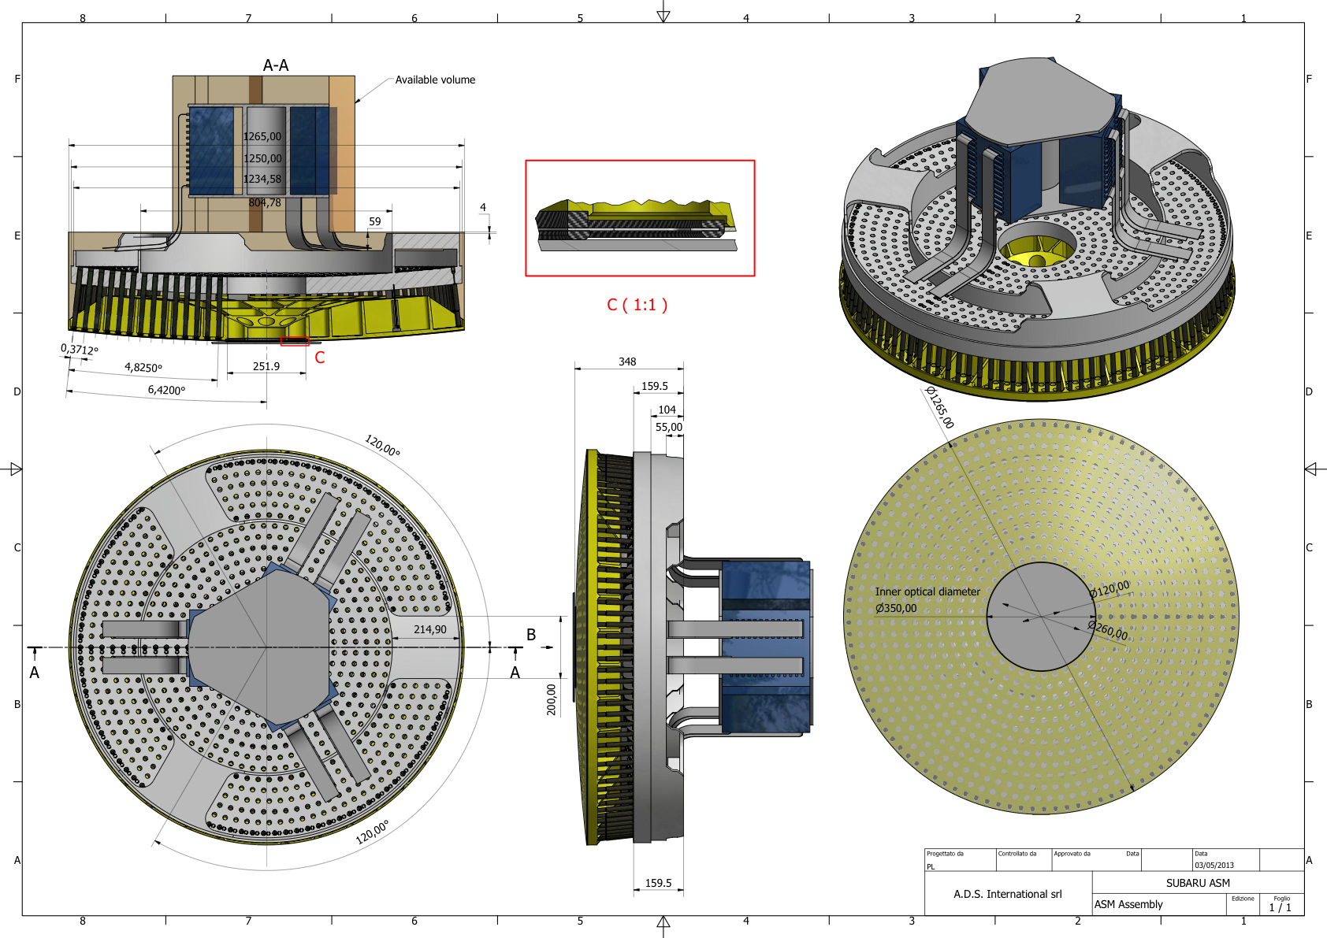


Preliminary model for ASM
Mirror Dia: 1265mm
Actuators: 924
Spacing: ~ 35 mm
Center obscuration:
350mm

Slide 12
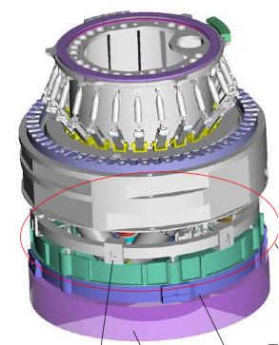
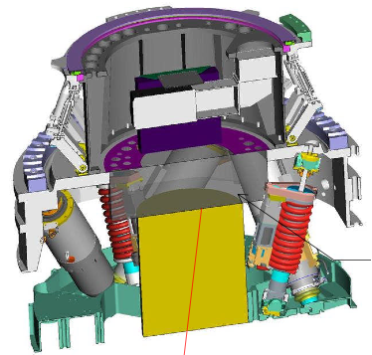

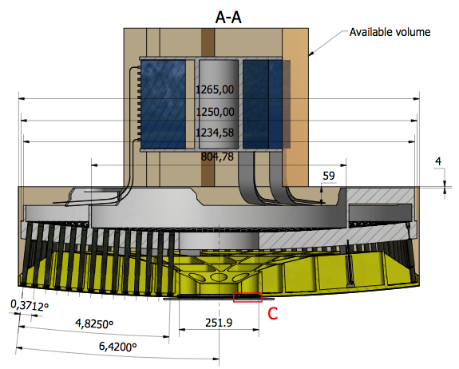
Interface to existing IR M2

Slide 13
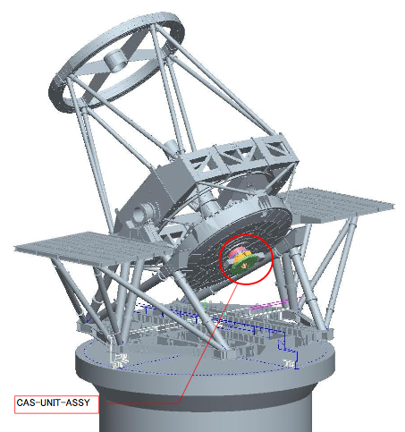
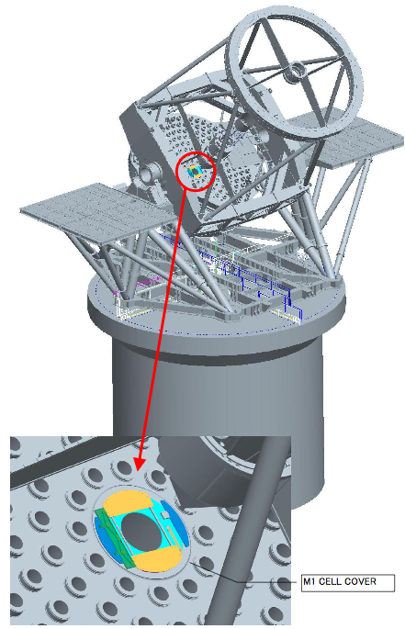
Vignetting by telescope structures
M3 Unit
Cassegrain Unit
M1 cell
cover

Slide 14
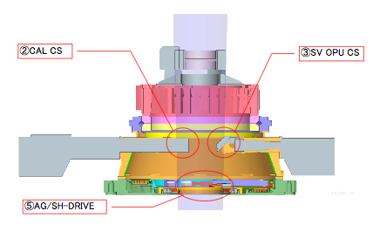
Cassegrain Unit
φ16 arcmin
① ADC
Remove
Remove
Remove
Modify

Slide 15
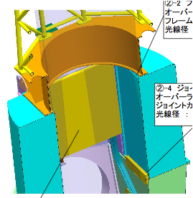
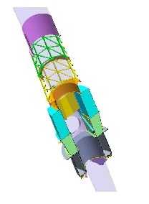
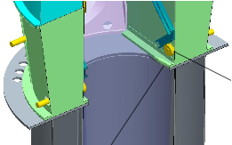
M3 unit
φ16 arcmin

Slide 16
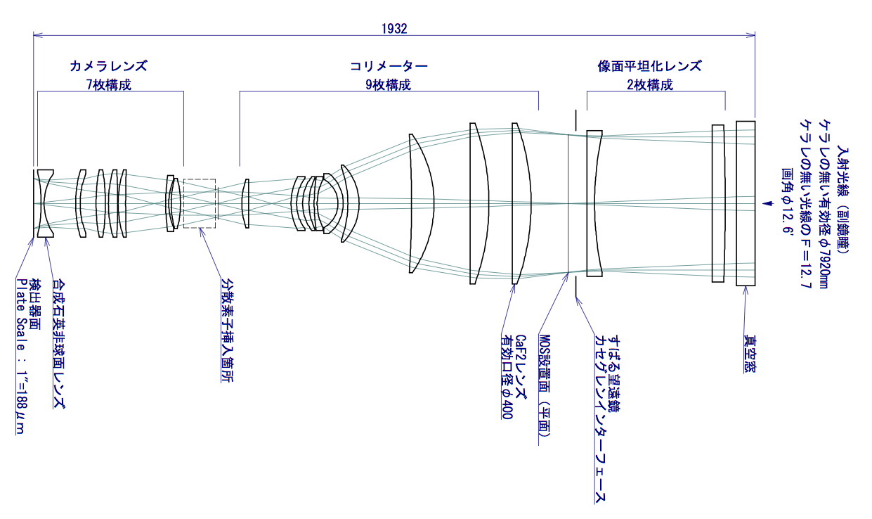
Wide-Field NIR Imager+Multi-Object Spectrograph
(A case without FoV splitting)
Optical Design by Dr. Yamamuro (Optcraft)
focusing lenses
collimating lenses
field flattener
input window
FoV 12.6’

Slide 17
Project preparation
Project organization
  PI (Nobuo Arimoto, Director of Subaru Telescope.)
  Project management (Hayano)
  Project AO scientist (Oya, Lai)
  Project scientist (Kodama, Iwata, Minowa)
International collaborators
  Gemini, HIA, ASIAA etc.

Slide 18
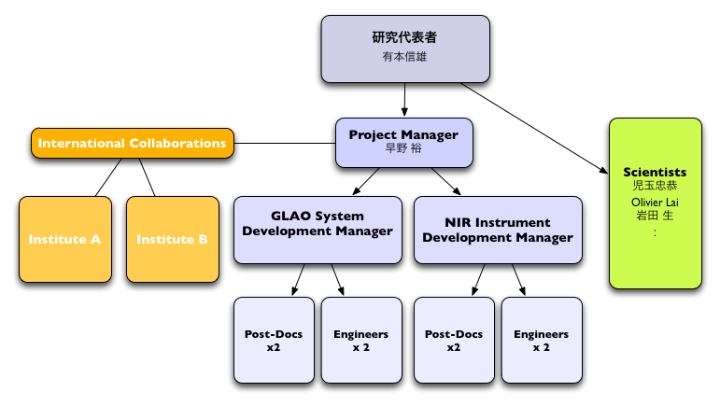
Project organization
Primary Investigator
N. Arimoto
Project Management
Y. Hayano
T. Kodama
O. Lai
I.Iwata
S. Oya
Y. Minowa

Slide 19
Schedule
2012
13
14
15
16
17
18
19
2020
Review
Review
Concept Design
Review
Prelim Design
Detail Design
Fabrication
Telescope Modification
FL
Integration and Test
Science Operation
AO188/LGS
HSC
PFS
TMT

Slide 20
Feasible schedule (plan)
Upgrade to Adaptive Telescope
  Adaptive Secondary Mirror.
    Grant-in-Aid, Specially Promoted Research, (Tokubetu-shuishin), 2014 or 2015, 5 years,
  Wavefront sensor and lasers.
    Grant-in-Aid, New research field, (Shin-gakujutu), 2014 or 2015, 5 years.
    Collaboration with biology researcher.
  GLAO + Nu MOIRCS
NIR wide field instrument.
  Imager, MOS or M-IFS.
  International collaboration or other Grant-in-Aid.

Slide 21
Cost Estimation
Item | Cost (USD)
Adaptive Secondary Mirror | 5-10M
Laser System | 4-8M
Wavefront Sensor System | ~3.5M
Computers | ~0.2M
Telescope Modifications | 15-20M
Instruments | 5-20M
(Additional) Human Resources | ~2M
Total | 35-60M

