Slide 1
SCExAO/CHARIS PDI derotator and HWP crosstalk
Preliminary results
Jasper Ruigrok, Steven Bos, Rob van Holstein, Frans Snik
+ SCExAO team

Slide 2
Summary
SCExAO at the Subaru telescope is a visible and near-infrared high-contrast imaging instrument employing extreme adaptive optics and coronagraphy. The instrument feeds the near-infrared light (JHK) to the integral field spectrograph CHARIS. Recently, a Wollaston prism was added to CHARIS’ optical path, giving CHARIS a spectropolarimetric capability that is unique among high-contrast imaging instruments. We present a comprehensive and detailed Mueller matrix model describing the instrumental polarization effects of the complete optical path, thus the telescope and instrument, using measurements with the internal source and observations of standard stars. The 22 wavelength bins of CHARIS provide a unique opportunity to investigate in detail the wavelength dependence of the instrumental polarization effects. We find that the image derotator (K-mirror) produces strongly wavelength-dependent crosstalk, in the worst case converting ~95% of the incident linear polarization to circularly polarized light that cannot be measured. We fit the crosstalk of the half-wave plate (HWP) for all wavelengths with a simple two-parameter model of an achromatic HWP consisting of a layer of quartz and a layer of MgF2. While the magnitude of the telescope-induced polarization varies with wavelength, its angle varies solely with the altitude angle of the telescope. We show initial steps toward correcting on-sky data for the instrumental polarization effects, with which we aim to achieve a polarimetric accuracy <0.1% in the degree of linear polarization. Our calibrations of CHARIS’ spectropolarimetric mode enable unique quantitative polarimetric studies of circumstellar disks and planetary and brown dwarf companions.
Van Holstein, Bos, Ruigrok, Snik et al. (in prep, SPIE proceeding)

Slide 3
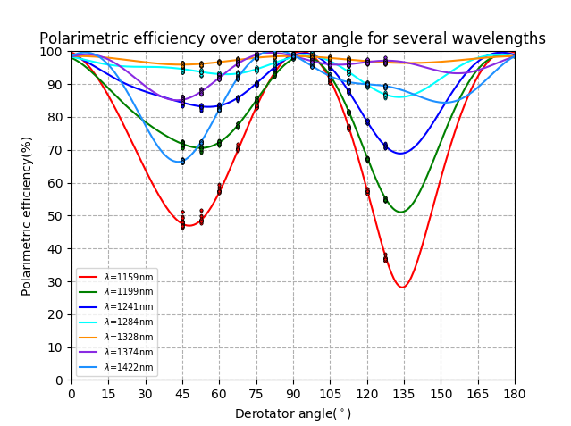
Preliminary results
Van Holstein, Bos, Ruigrok, Snik et al. (in prep, SPIE proceeding)

Slide 4
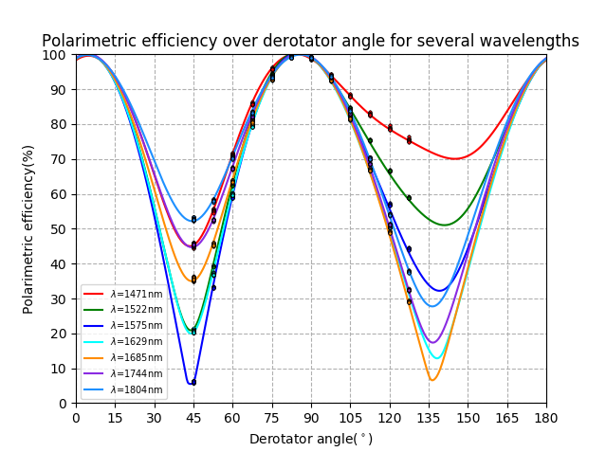
Preliminary results
Van Holstein, Bos, Ruigrok, Snik et al. (in prep, SPIE proceeding)

Slide 5
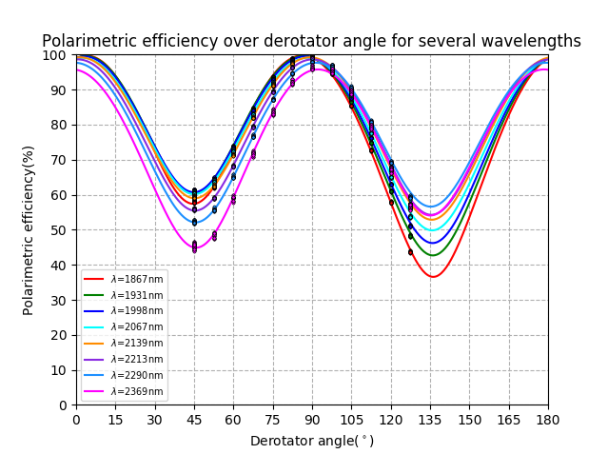
Preliminary results
Van Holstein, Bos, Ruigrok, Snik et al. (in prep, SPIE proceeding)

Slide 6
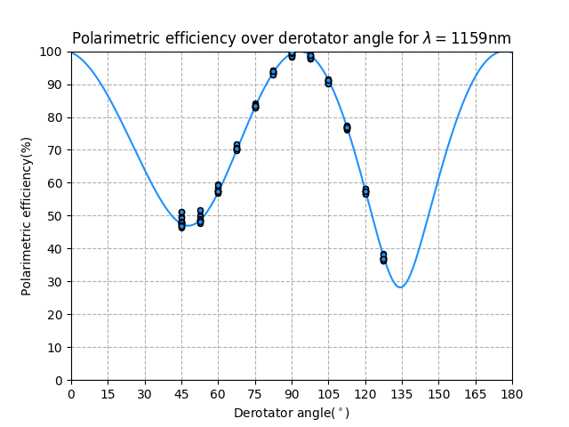
Preliminary results
Van Holstein, Bos, Ruigrok, Snik et al. (in prep, SPIE proceeding)

Slide 7
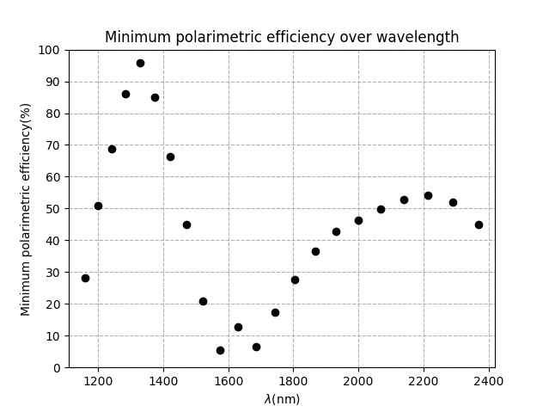
Preliminary results
Van Holstein, Bos, Ruigrok, Snik et al. (in prep, SPIE proceeding)

Slide 8
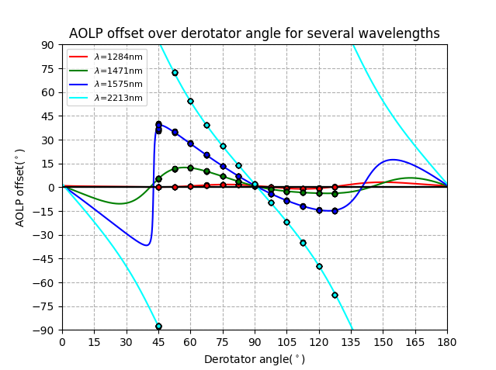
Preliminary results
Van Holstein, Bos, Ruigrok, Snik et al. (in prep, SPIE proceeding)

Slide 9
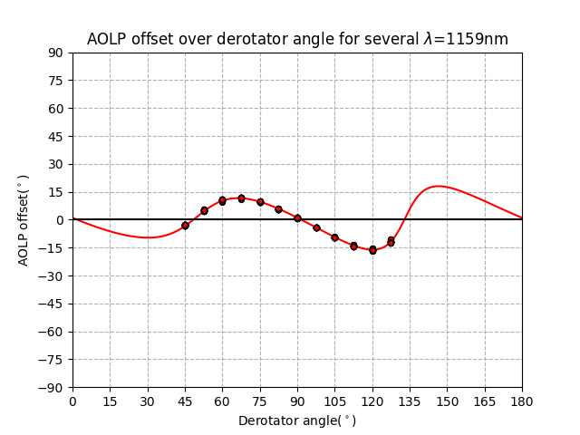
Preliminary results
Van Holstein, Bos, Ruigrok, Snik et al. (in prep, SPIE proceeding)

Slide 10
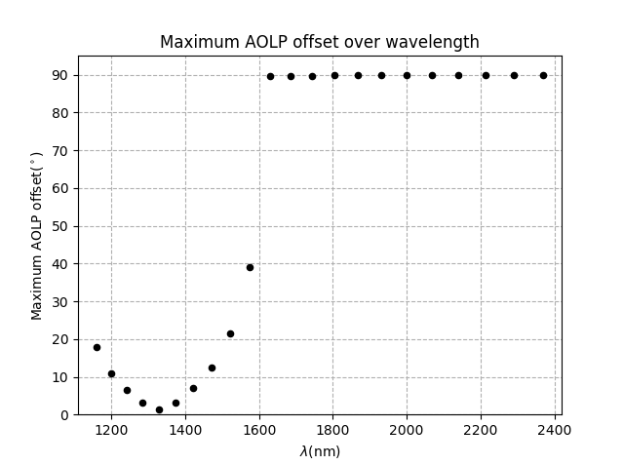
Preliminary results
Van Holstein, Bos, Ruigrok, Snik et al. (in prep, SPIE proceeding)

Slide 11
Next steps
Update model for parameter fit.
Measure diattuenutation HWP and derotator.
Measure instrumental polarization from M3 Subaru.
Integrate into data reduction pipeline.

