Slide 1
Past and Future Collaboration Activities with Subaru:
A Korean View
Myungshin Im
Center for the Exploration and the Origin of the Universe (CEOU),
Astronomy program/Dept. of Physics & Astronomy, Seoul National University)

Slide 2
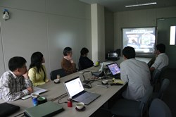
Subaru-related collaboration
Many discussions/workshops (2003 ~ )
Individual collaboration

Slide 3
Since 2006 (12 years)
Papers by Korean or Japanese as the main author (with M. Im)
Red: AKARI, Blue: GRB, Green: HighzQSO, Bold: Subaru
2017: Onoue, M.+, Huang, KY.+
2016: Kim, SJ.+
2015: Goto, T.+, Yoon, Y.+, Jun, H.+, Kim, D.H.+ Kashikawa, N.+
2014: Urata, Y.+, Oi, N.+, Karouzos, M.+
2013: Yamada, R.+, Sakamoto, T.+
2012: Kim, JH.+, Kim, SJ.+, Hanami, H.+, Ko, J.+, Takagi, T.+
2011: Jang, M.+, Burrows, D.+, Koo, B.C.+, Shim, H.+
2010: Lee, I.+, Goto, T.+, Takagi, T.+
2009: Urata, Y.+, Kim, M.+, Ko, J.+, Lee, H.M.+
2008: Goto, T.+, Wada, T.+, Koyama, Y.+
2007: Takagi, T.+, Matsuhara, H.+, Lee, H. M.+, Hwang, N.+
2006: Matsuhara, H.+

Slide 4


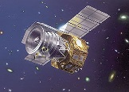
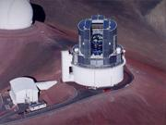
Summary (since 2006)
37 papers
17 : 20
26 : 3
AKARI
Subaru

Slide 5
Subaru-related collaboration
Continued discussion/workshops (2003 ~ )
Limited collaboration
- Imbalance in facilities and expertise (1.8m vs 8.2m)
- Lack of project-based collaboration (SDSS, AKARI)

Slide 6
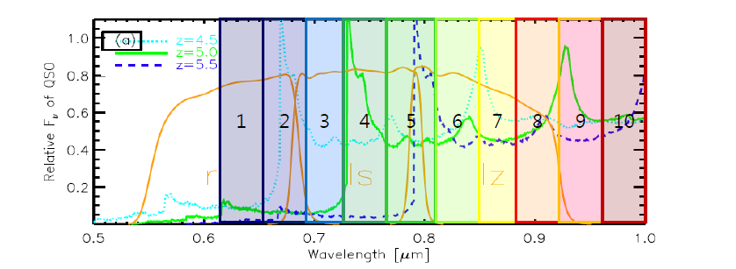
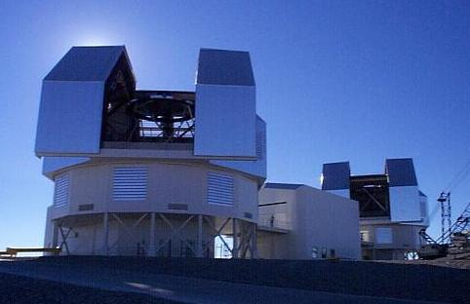
Getting better
KASI – Gemini, MMT, KMTNet, …
Special funding for groups in university (Research center, research institution)
Magellan 6.5m
SQUEAN: Medium-band imager at
McDonald 2.1m telescope

Slide 7
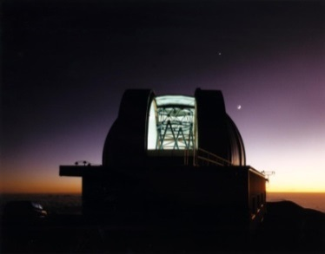
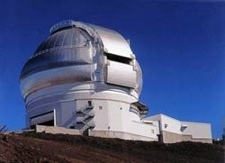
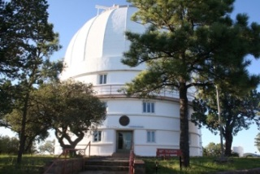
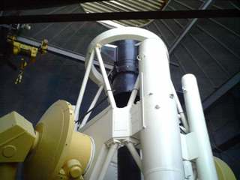
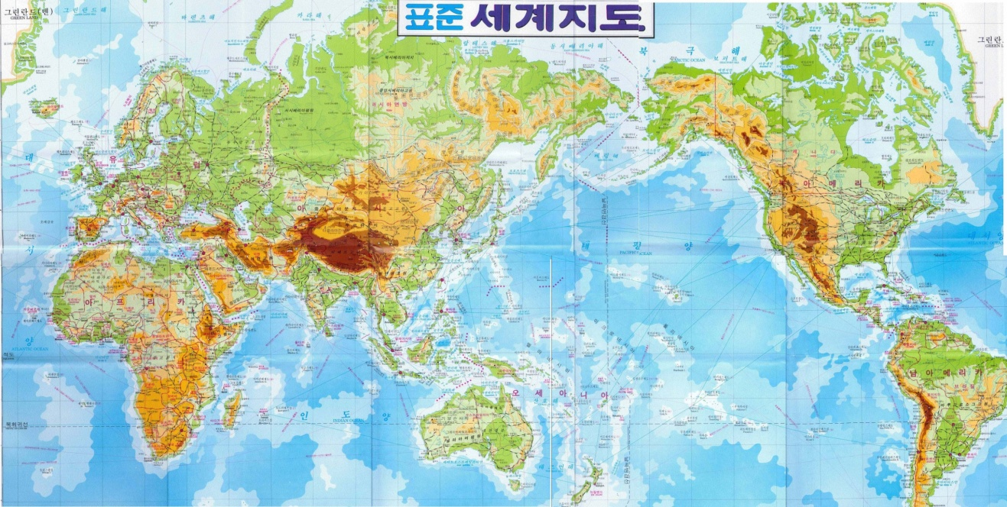
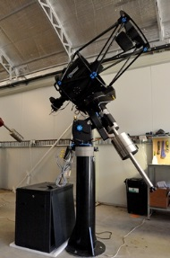
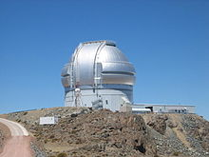

CEOU/SNU Facilities
Korea: Many small ones
US: LOAO 1-m
Maidanak:
1.5m Telescope
Hawaii: UKIRT, (Gemini-N)
US: McDonald
2.1-m, 0.8m, 0.25m
(KMTNet 1.6m)
Chile: Magellan, (Gemini-S, GMT)
Australia: LSGT 0.43m (SSO)

Slide 8
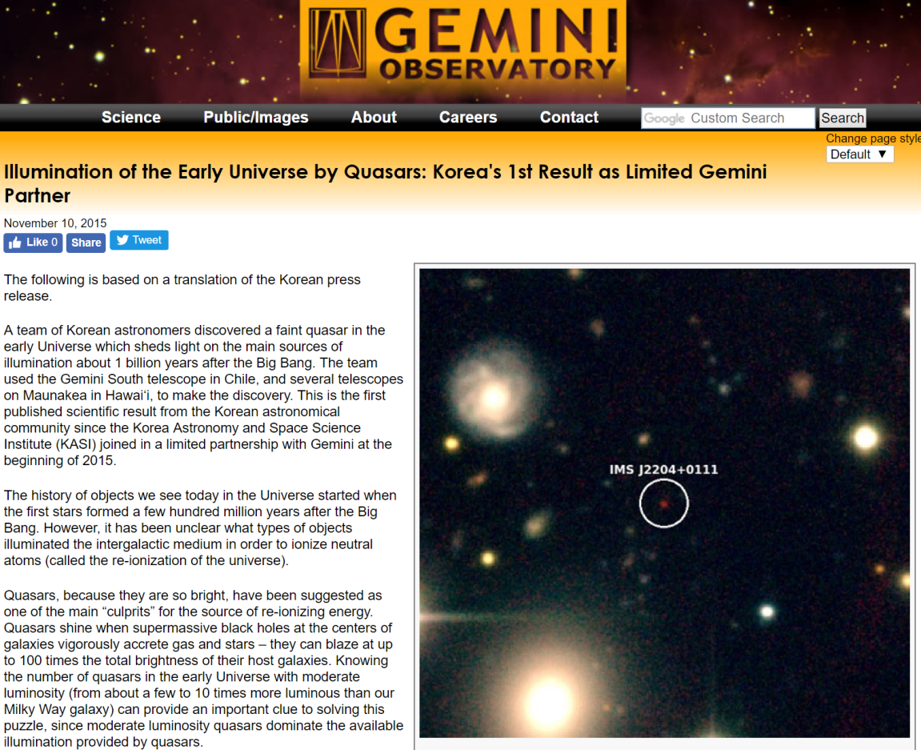
High redshift quasars from
Infrared Medium-deep Survey
Faint quasars at z ~ 5 to 6 (2.1m, Magellan, Gemini)
Also, galaxy clusters at 0.8 < z < 1.4
Kim et al. 2015 ApJL, 2018 ApJ

Slide 9
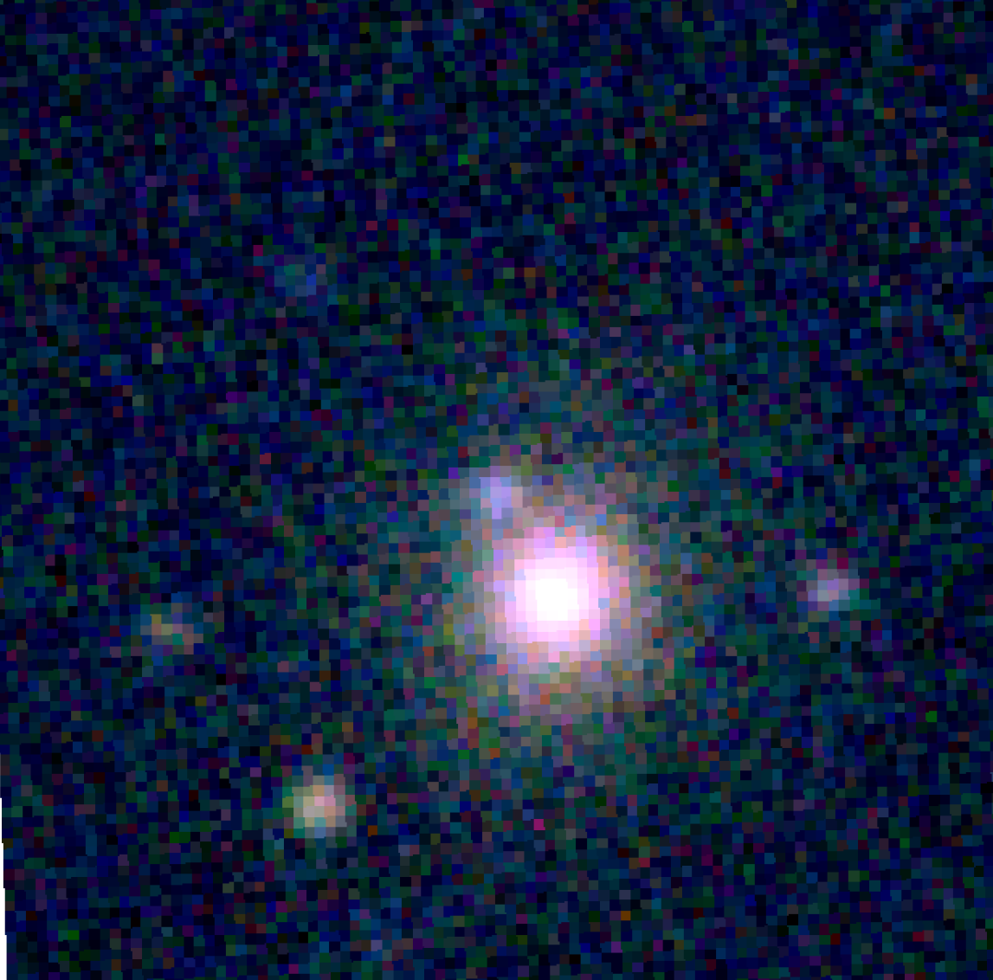
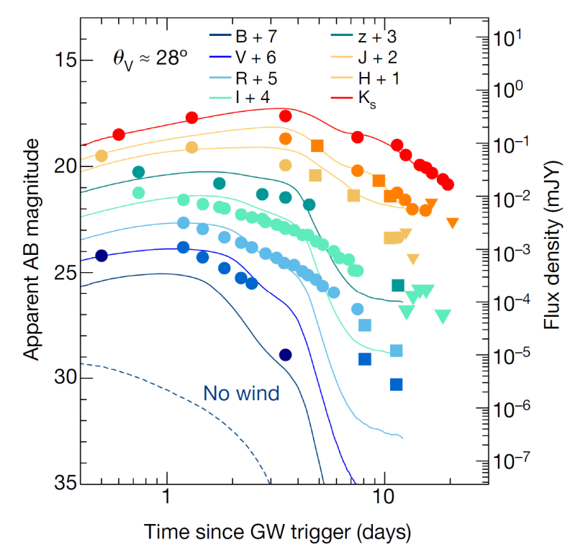
GW170817 (Kilonova)
2017-08-18 10:08:01(UT)
GW170817
NGC 4993은하
서울대학교 초기우주천체연구단
21hrs after GW emission
LSGT at SSO
(Im et al. 2017 ApJL, 2018 in prep,
Abbott et al. 2017 ApJL)
KMTNet follow-up observation
(Troja, …, Im, M., et al. 2017, Nature)

Slide 10
Future
Specific science project collaboration
- Examples) High-z QSO, Galaxy clusters
- Time-domain study (GRB, SNe, GW)
Project-based collaboration
- Past example: SDSS, AKARI
University-based center/institution
Workshops (e.g., EA-AGN)

