Slide 1
PI type instruments
Yosuke Minowa
Naruhisa Takato, Ikuru Iwata
(New Development group, Subaru Telescope)
Subaru User’s Meeting 2013 (2014/01/21)

Slide 2
PI type instruments
Not necessary to be general purpose instruments, but to be single purpose instruments to pursue PI’s own science.
Can be a test-bed of the latest technology for future instrument development.
Complementary to the facility instruments
Provides opportunities to develop human resources (especially for students)
Smaller scale and shorter turn-around time compared to the facility instruments.
Less supported by Subaru.

Slide 3
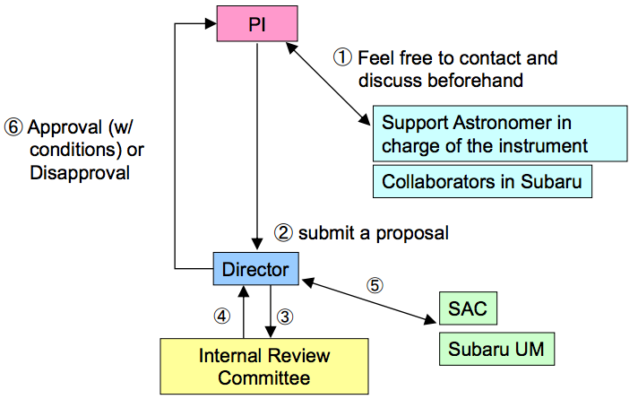
PI instrument acceptance procedure
Submit a instrument proposal to the director
Proposal Review based on:
Science merit
Feasibility
Impact on the observatory
  Infrastructure
  Human resources
Budget
Schedule
If the proposal is accepted,
Subaru will support its installation and provide engineering time.
Science time is not guaranteed (PI team have to apply for the open use time)
The PI team is occasionally requested to report the status to the review committee.
The PI instrument needs to pass several reviews during development and commissioning phases before starting science observations.

Slide 4
Applying open-use time with PI instruments
A fact sheet and performance table must be provided by the PI of the instrument before the deadline of the proposal submission.
  Referees of the proposal can assess the feasibility of the proposed science based on these information.
To submit the proposal to the PI instruments, proposers have to obtain the permission from the PI of the instrument and include the instrument group in co-investigators.
  Subaru does not support the operation of the PI instruments.
  If the proposal is accepted, the members of the PI instrument group have to participate the observations to operate the instruments.

Slide 5
Current lineup of the PI instruments
Nasmyth IR:
-- fully commissioned
HiCIAO – NAOJ
-- partly commissioned
Kyoto-3DII – IPMU
SCExAO – Subaru
-- commissioning phase
RAVEN – Univ. of Victoria
--- development phase
GIGMICS -- Nagoya Univ.
CHARIS -- Princeton Univ.
IRD (fiber injection module) -- NAOJ
Cassegrain:
-- fully commissioned
Kyoto-3DII – IPMUPMU?
-- development phase
MIMIZUKU – IoA, Univ of Tokyo
SWIMS – IoA, Univ. of Tokyo
Coude:
-- development phase
IRD (spectrograph) – NAOJ
(Visible, NIR, MIR)

Slide 6
Exoplanet Science instruments
HiCIAO – Coronagraphic Image in Near-Infrared
  DI, SDI, PDI with and w/o coronagraph for expoplanet and disk survey
  Use with AO188, SCExAO
  SEEDS program (120 nights) are on going until S15B
SCExAO – Extreme AO system in Visible and NIR
  High-contrast with pupil apodization with PIAA + Coronagraph
  Low-order Tip/Tilt IR WFS + High-order visible Pyramid WFS
  Speckle nulling, Visible aperture masking interferometry
CHARIS – IFU spectrograph in NIR
  Exoplanet search and characterization of its atmosphere
  J + H (+ K), R~40, > 1.8” x 1.8”
  Use with AO188, SCExAO
IRD – High-Dispersion Spectrograph with laser comb
  Systematic radial velocity survey of M-type star
  R=70,000, Y, J, H, Optical Frequency Comb (OFC), < 1 m/s
  Fiber feed from AO188
(Kasdin’s talk tomorrow for more details)

Slide 7
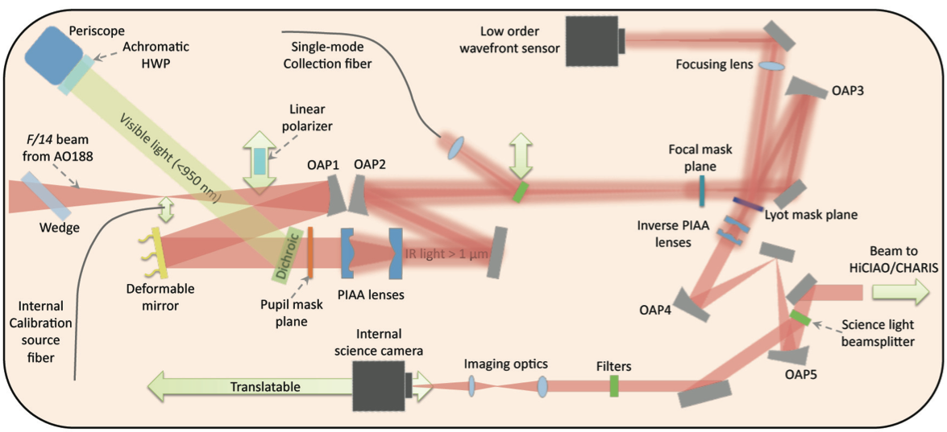
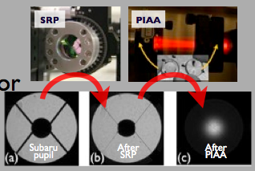
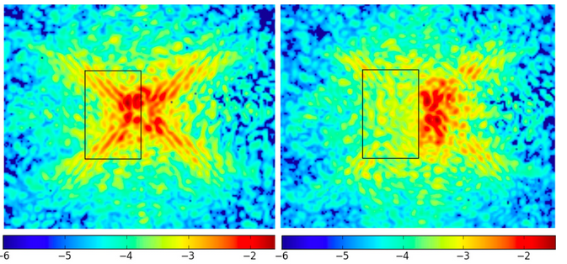
Exoplanet Sceience Instruments:
SCExAO Phase I (IR bench)
PIAA(pupil apodization)
Speckle nulling (labo test)
Phase-I capabilities
Pupil Apodization (PIAA)+Coronagraph
Low-order tip/tilt correction with IR WFS
Quasi-static speckle nulling with DM
→ SCExAO Phase-I is ready for science
PLEASE APPLY IN S14B!

Slide 8
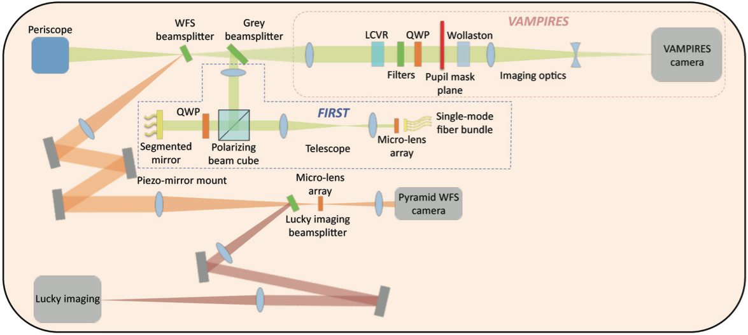
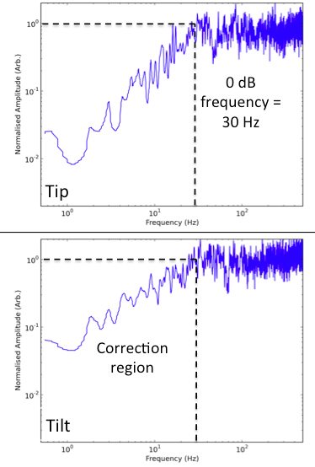
Exoplanet Sceience Instruments:
SCExAO Phase II (visible bench)
Pyramid Wavefront Sensor:
Closed loop laboratory performance on 5 Zernike’s at 1.7 kHz.
Simulation
w/o PWFS
w/ PWFS
0 dB frequency = 30 Hz
Pyramid WFS for high-order correction
  Provides 90% Strehl Ratio in H-band
  Closed loop operation was succeeded in the laboratory.
  (1.7kHz with 5Zernike modes, 300Hz with 900 Fourier modes)
  On-sky test will be performed on Apr. 2014
  Available for science obs. from S14B or S15A
  Competitive to Gemini/GPI or VLT/Sphere
Aperture Masking Interferometry in visible wavelength (guest module)
    VAMPIRES (polarization) and FIRST (pupil remapping with fiber)
  Small inner working angle (<40mas, better than PIAA+Coronagraph at IR)
Correction region
Notes:
7

Slide 9
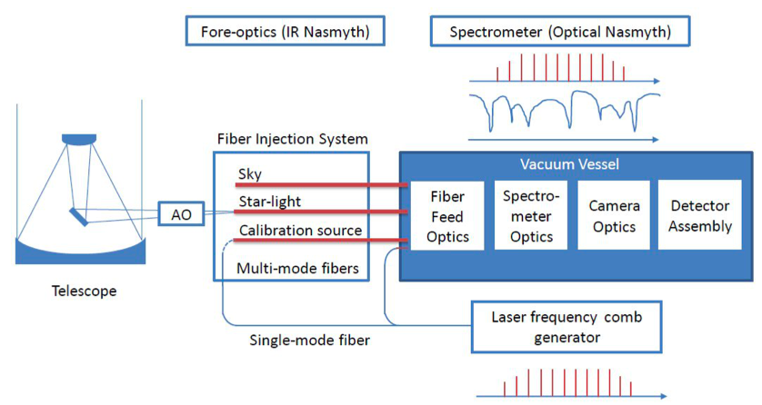
Exoplanet Sceience Instruments: IRD
R=70,000 spectral resolution with laser frequency comb generator
→ 1m/s RV precision
Search for planets in the habitable zone around M dwarfs.
Fiber Injection module will be placed on the movable stage in AO188 optical bench, which enable flexible instrument exchange to IRD from any other AO assisted instruments during the night. → increase the chance of the observation with IRD
First light obs. will be Jan-Mar, 2015.
Coude room
NsIR
Obs. floor

Slide 10
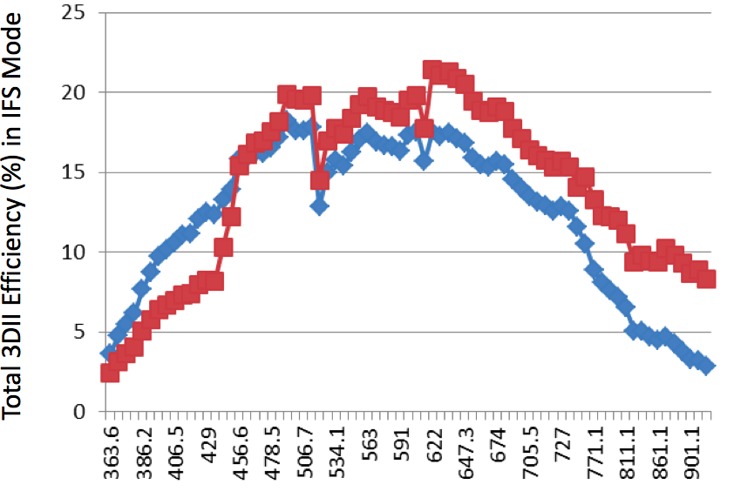
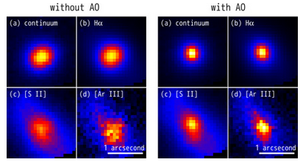

Unique capabilities
Kyoto-3DII: Visible IFU sepctrograph and Fabry-Perot imager
  Provide the only IFU capability at the Subaru.
  Use with AO at NsIR, which provides FWHM~0”.1 at ***-band.
  IFU mode was successfully commissioned with AO188
  Fabry-perot mode will be tested during S14A.
  CCD will be replaced from EEV to Hamamatsu FDCCD, which largely improve the sensitivity at around 9000A from S14B.
GIGMICS : MIR high-dispersion spectrograph
  Study of physical and chemical condition of inter-stellar molecules
  Germanium immersion grating echelle spectrograph
  Engineering obs. will be conducted somewhere between S14A-15B.
  → R~40000 at 8-13μm
Ge immersion grating

Slide 11
Test Bed
RAVEN --- Multi-Object AO system
  Simultaneous observation of two objects within Φ3’.5 FOV
  used with IRCS
  Test bed for TMT MOAO system
  First science demonstrator with MOAO
  (see Oya-san’s talk for more details)
SWIMS – NIR wide field multi-color imager and MOS muti-color
MIMIZUKU – MIR multi-filed imager and spectrograph
  TAO 6.5m telescope’s facility instruments.
  Provide opportunities for initial instrument test
  Perform early science with Subaru
  (see Konishi-san and Kamizuka-san’s talk for more details)

Slide 12
 |  | 2013 | 2014 |  | 2015 |  | 2016 | 2017 | 2018 | 2019
P | S-Cam
 | FMOS
 | HSC
 | PFS
Cs | FOCAS
 | MOIRCS
 | COMICS
 | * K3DII
 | * SWIMS
 | * MIMIZUKU
 | GLAO
NsOpt | HDS
NsIR | *IRD
 | AO188
 | IRCS
 | * HiCIAO
 | * SCExAO
 | *CHARIS
 | * K3DII
 | * RAVEN
 | * GIGMICS

Slide 13
Roles of PI instruments in the future
Subaru’s Future Strategy toward 2020
  Strengthen capabilities of wider field survey with HSC, PFS, and GLAO(?).
  Most of 1st and 2nd generation facility instruments will be decommissioned.
Important roles of the PI instruments toward 2020
  Accommodate science which does not require wide field (such as exoplanet instruments)
  → Maintain cutting-edge science capabilities at Subaru
  Test bed for TMT’s 2nd generation instruments (such as RAVEN)
  → Facilitate the TMT’s instrument development
  → Develop human resources

