Slide 1
The Environmental Impacts on the Star Formation Main Sequence Tackled by MAHALO-Subaru Campaign
Subaru user’s meeting (2014/1/19-21)
MAHALO-Subaru collaboration
Yusei Koyama (NAOJ)
T. Kodama (NAOJ), M. Hayashi (ICRR/Tokyo), K. I. Tadaki (NAOJ),
I. Tanaka (NAOJ), R. Shimakawa (Sokendai), M. Tanaka (NAOJ),
I. Smail (Durham), J. Kurk (MPE), D. Sobral (Leiden/Lisbon),
M. Swinbank (Durham), J. Geach (Hertfordshire), P. Best (Edinburgh)

Slide 2
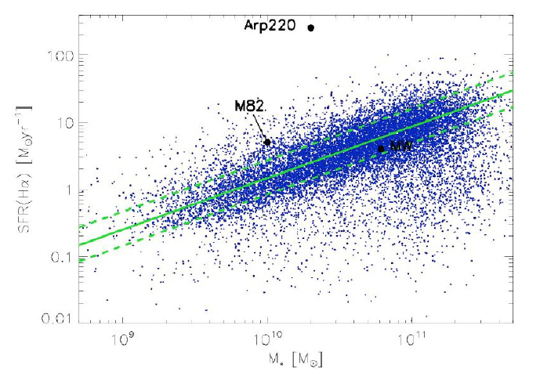
Star Formation “Main Sequence”
= SFR-M★ relation for star-forming galaxies
Starburst
SFR [M/yr]
Main Sequence (normal SF)
Passive
log M★ [M]
Elbaz et al. (2007)

Slide 3
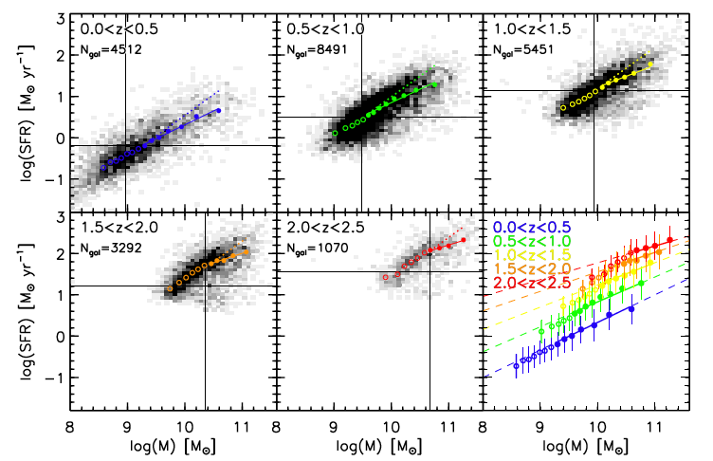
SF main sequence out to z>2
From NEWFIRM medium-band survey (Whitaker et al. 2012)

Slide 4
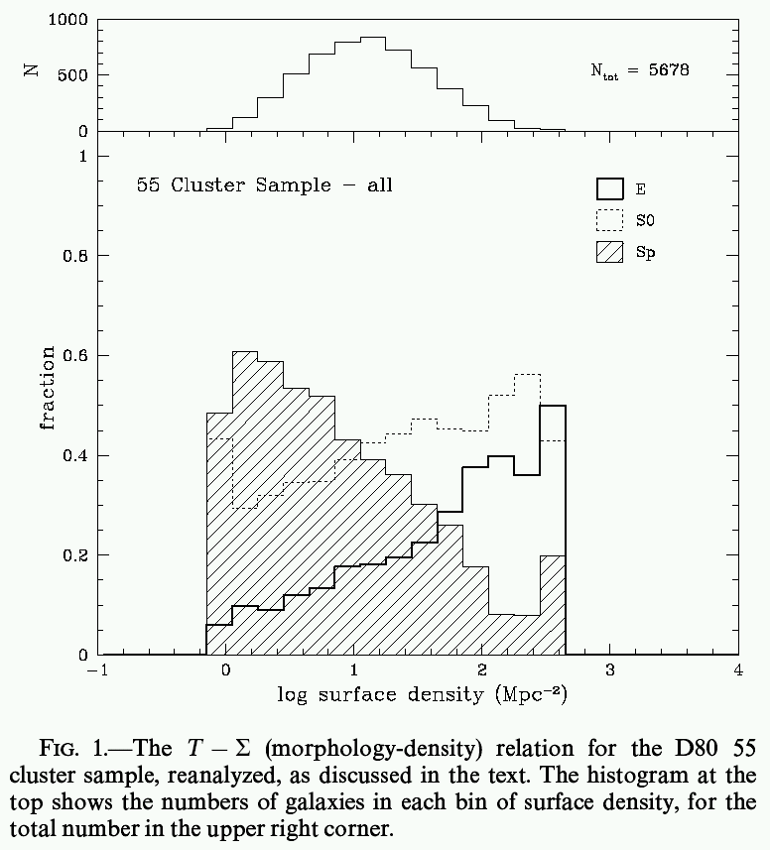
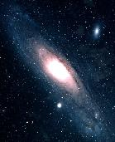
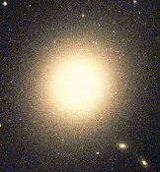
Galaxy properties vs. Environment
“ Morphology–Density Relation”
Spiral
red, old, low SF activity
E
S0
blue, young, high SF activity
Low-density
High-density
(Dressler 1980)
Notes:
4

Slide 5
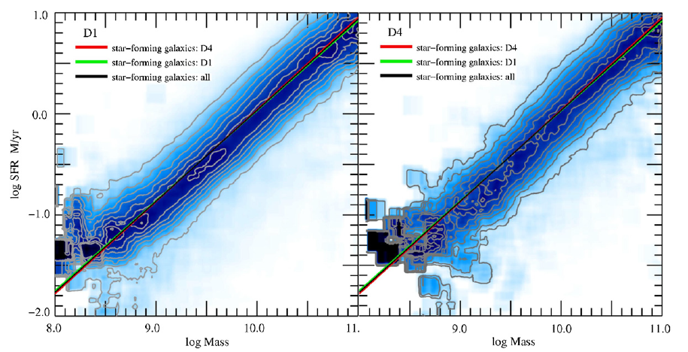
Little environmental impacts ?
SF main sequence is “independent” of environment at z=0
log SFR [M/yr]
low-density
(z=0)
high-density
(z=0)
log M★
Local star-forming galaxies from SDSS (Peng et al. 2010)

Slide 6
Little environmental impacts ?
low density
high density
Field
Cluster

Slide 7
Q: How about in distant universe?

Slide 8
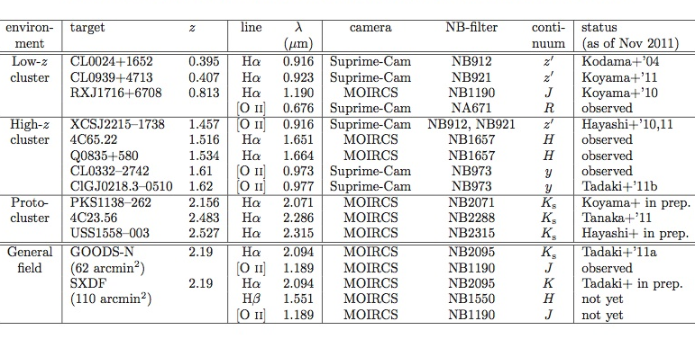
MAHALO-Subaru project
Collaborators: T.Kodama (PI), M.Hayashi, K.Tadaki, I.Tanaka, R.Shimakawa
MApping H-Alpha and Lines of Oxygen with Subaru
Narrow-band Hα/[OII] emission-line survey for 0.4<z<2.5
Dec. 2013
,14
Koyama+ in prep
Tadaki+’12
Koyama+’13a
Hayashi+’12
Tadaki+’13,14

Slide 9
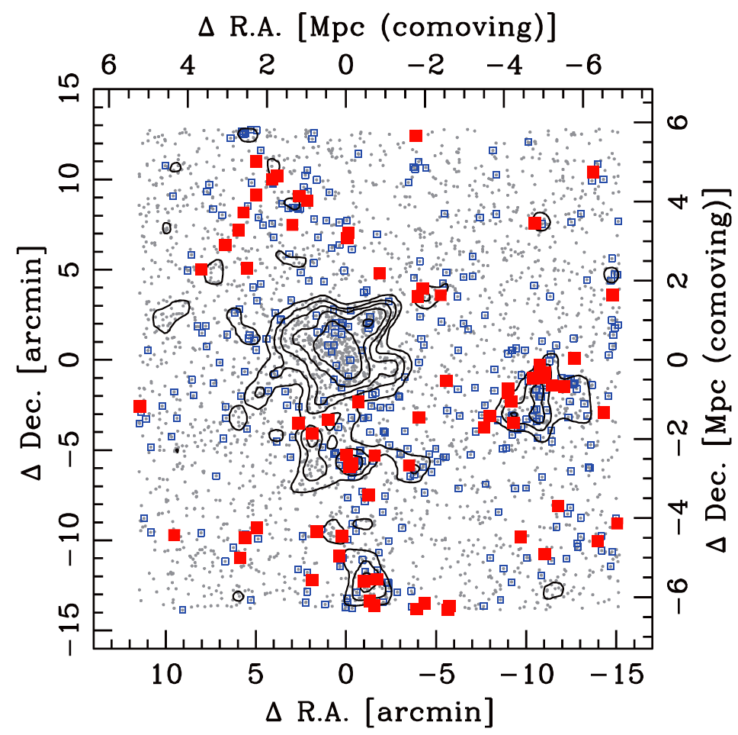
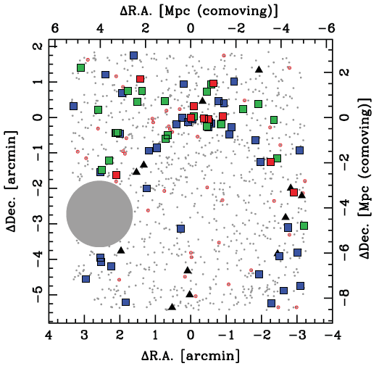
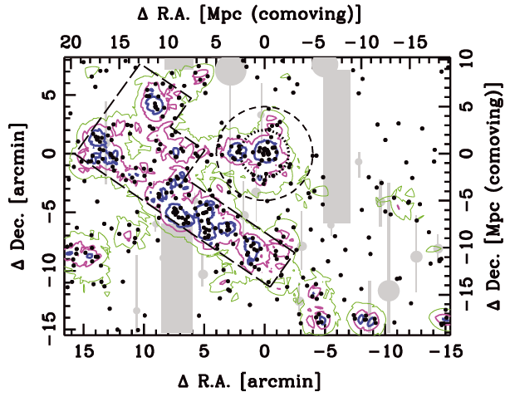
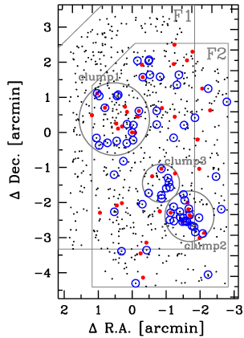
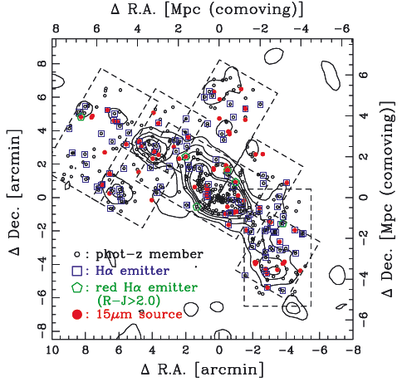
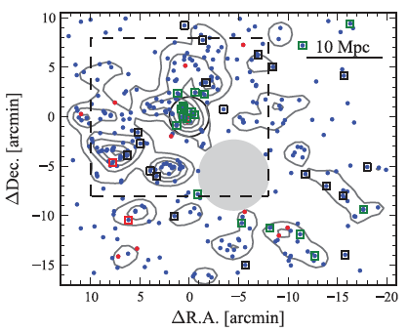
High-z structures revealed by MAHALO
(Hayashi+10, 11)
z=2.2
z=0.4
(Koyama+13)
(Koyama+11)
z=1.5
Many strong emitters
in z>1.5 cluster cores
(Tadaki+12)
z=0.8
z=2.5
z=1.6
(Koyama+10)
(Hayashi+12)

Slide 10
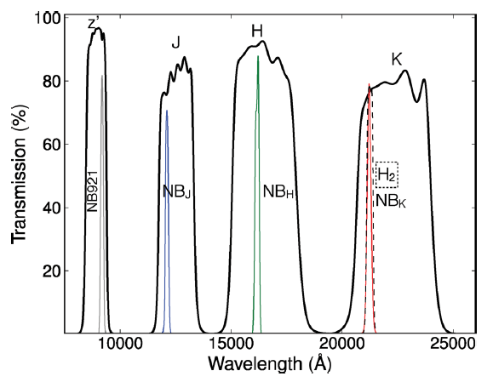
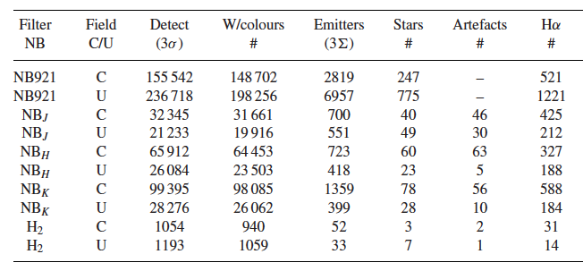
HiZELS: High-Z Emission-Line Survey
Collaborators: I. Smail, P. Best, D. Sobral, J. Geach, M. Swinbank
Hα
@ z=0.4
Hα
@ z=0.8
Hα
@ z=1.5
Hα
@ z=2.2
Total ~2 deg² survey in COSMOS & UDS
~500-2000 Hα emitters at each redshift,
providing excellent comparison sample for our MAHALO cluster samples.
Subaru filter
UKIRT filter
Sobral et al. (2013)

Slide 11
Cluster vs. Field comparison out to z~2
z | T(look-back) | Cluster (MAHALO) | Field (HiZELS) | log M(lim) | SFR(lim)
0.4 | 4 Gyr | CL 0939 (Ngal=80) | NBz (Ngal=252) | 9.0 | 0.3
0.8 | 7Gyr | RXJ1716 (Ngal=34) | NBJ (Ngal=424) | 9.8 | 4.0
2.2 | 10 Gyr | PKS1138 (Ngal=48) | NBK (Ngal=583) | 10.0 | 15.0
Important Notes:
We select galaxies with EWr >30A as SF galaxies.
We use galaxies Rc < 2 Mpc (physical) as “cluster” galaxies.
(Koyama et al. 2013b, MNRAS, 434, 423)

Slide 12
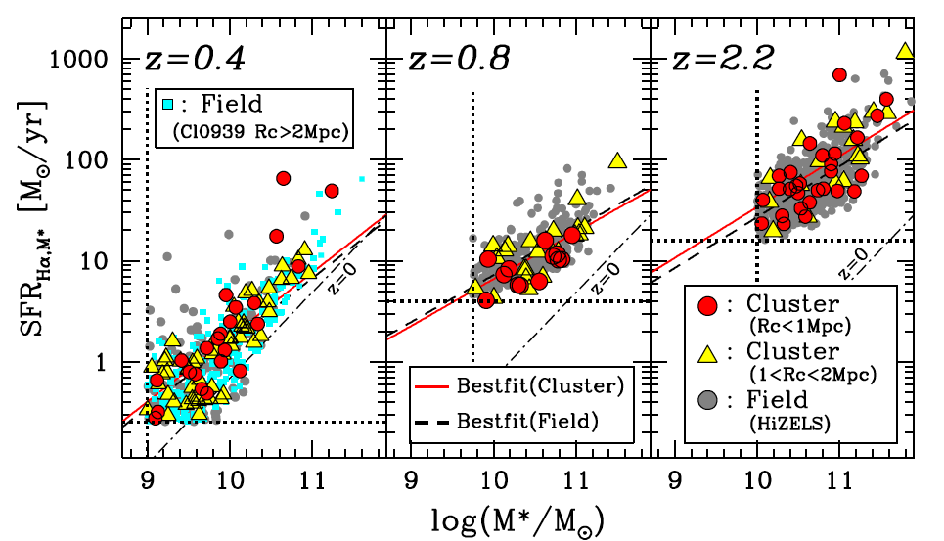
Cluster vs. Field comparison out to z~2
Main sequence is always independent of environment since z~2 !
Hα emitters with EWr > 30A
(Koyama et al. 2013b, MNRAS, 434, 423)

Slide 13
Interpretation: rapid SF quenching
Cluster

Slide 14
Interpretation: rapid SF quenching
✓
✗
SFR
SFR
M★
M★
rapid quenching
slow quenching
: normal SF galaxy
: transitional galaxy
: passive galaxy

Slide 15
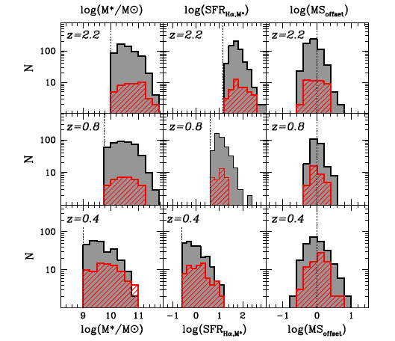
M★, SFR, ΔMS distribution
Excess of massive galaxies in proto-cluster PKS1138-262
SFR
M
SFR
: Field
(HiZELS)
M
: Cluster
SFR
(MAHALO)
M
(Koyama et al. 2013b)

Slide 16
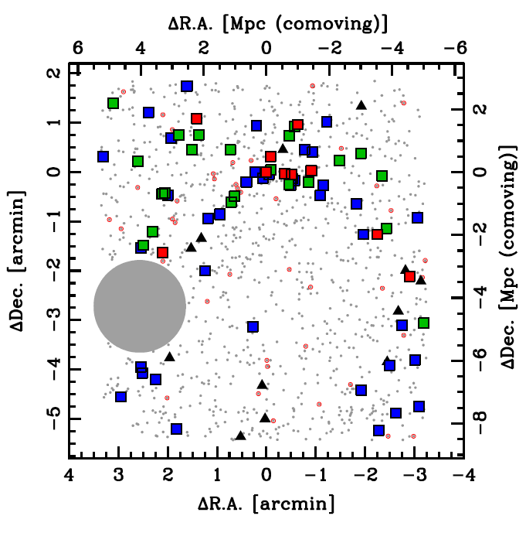
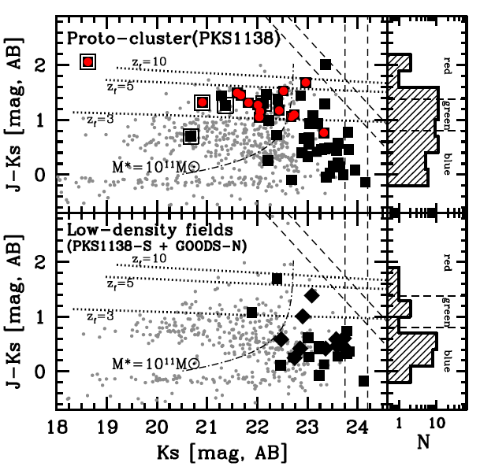
Massive SF galaxies in z>2 proto-cluster
Our MOIRCS+NB(Hα) survey revealed red Ηα emitters occupy the core of z=2.16 proto-cluster (PKS1138-262).
: 24um-source
■: red HAE (J-K>1.4)
■: green HAE (0.8<J-K<1.4)
■: blue HAE (J-K<0.8)
Red emitters are massive (M★ >10¹¹M), and clearly dominate dense environment at z~2.
(Koyama et al. 2013a)

Slide 17
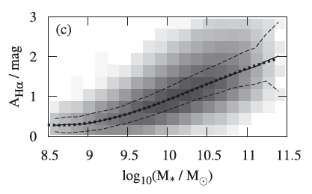
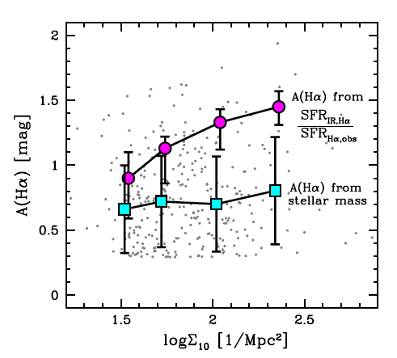
Dust extinction vs. environment
Dust extinction may be higher in high-density environments.
AHα-M★ relation (z=0)
A(Hα) from
SFR(IR)/SFR(Hα)
z=0.4 sample
(Garn & Best 2010)
A(Hα) from
A(Hα)-M★ relation
(Garn & Best 2010)
(Koyama et al. 2013b)

Slide 18
Conclusions
(1) With MAHALO-Subaru campaign, we find that SF main sequence is independent of environment at any time in the history of universe since z~2, suggesting rapid SF quenching.
→ Cluster vs. field difference is always small (0.2 dex at maximum)
(2) SF galaxies in z=2.2 proto-cluster environments tend to be more massive (and showing redder J-K colours) than the field counterparts at the same redshift.
→ M★ distribution “along” the MS does depend on environment.
(3) SF galaxies “surviving” in high-density environments tend to be more highly obscured by dust, suggesting a different mode of SF activity in clusters/groups.
→ Environment may affect dust properties (SF geometry or mode).

