Slide 1
W. M. Keck Observatory
Subaru Users’ Meeting
Taft Armandroff
January 22, 2014
Ethan Tweedie Photography

Slide 2
Table of Contents
Keck / Subaru Exchange Program
Recent Keck Observatory Capabilities Enhancement Highlights
Scientific Productivity

Slide 3
Keck / Subaru Exchange Program

Slide 4
Benefits of Time Exchange
Expands observing capabilities for each community
  Subaru’s unique wide-field capabilities
  Keck’s powerful spectroscopic & adaptive optics capabilities
Economical: new instruments are expen$ive
Brings Keck and Subaru communities closer together
Contributes to Mauna Kea Observing System
  As capable as any on Earth

Slide 5
Subaru-Keck Exchange
& Capabilities Offered
Subaru
  Initiated in semester 2007B
  Suprime-Cam: wide-field optical imager
  MOIRCS: IR imager & multi-object spectrograph
  Expanded to also include FOCAS, HDS, IRCS (with NGS AO), FMOS, and COMICS
  Hyper Suprime-Cam added in 2014A

Slide 6
Subaru-Keck Exchange
& Capabilities Offered
Keck I
  LRIS: multi-object optical spectrograph
  OSIRIS: adaptive optics near-infrared integral-field spectrograph
  MOSFIRE: multi-object infrared spectrograph
Keck II
  DEIMOS: wide-field multi-object optical spectrograph
  ESI: moderate-resolution optical spectrograph
  NIRSPEC: infrared spectrograph
  NIRC2: adaptive optics infrared imager (& spectrograph)

Slide 7
Keck Community with
Subaru Time
Semester | PI | Instrument | # of nights
2007B | Brown | Suprime-Cam | 2
2007B | Ellis | Suprime-Cam | 2
2008A | Brown | Suprime-Cam | 2
2008A | Steidel | MOIRCS | 2
2008B | Brown | Suprime-Cam | 2
2008B | Brodie | Suprime-Cam | 2
2009A | Wilson | MOIRCS | 1
2009A | Brown | Suprime-Cam | 2
2009B | Stanford | Suprime-Cam | 2
2009B | Fraser | Suprime-Cam | 1
2010A | Stanford | Suprime-Cam | 2
2010A | Brodie | Suprime-Cam | 1
2010B | Stanford | Suprime-Cam | 1
2010B | Steidel | MOIRCS | 2
2010B | Brodie | Suprime-Cam | 1
2011 A | Stanford | Suprime-Cam | 1
2011 A | Bullock | Suprime-Cam | 1
2011 A | Spencer | Suprime-Cam | 2
Semester | PI | Instrument | # of nights
2011 B | Stanford | MOIRCS | 3
2011 B | Hansen | MOIRCS | 1
2011 B | Brown | IRCS+AO | 2
2012 A | Hansen | MOIRCS | 1
2012 A | Spencer | Suprime-Cam | 1
2012 B | Spencer | Suprime-Cam | 1
2012 B | Hansen | MOIRCS | 1
2012 B | Brown | Suprime-Cam | 2
2013 A | Brown | Suprime-Cam | 2
2013 A | Wittman | Suprime-Cam | 1
2013 A | Zuckerman | Comics | 1
2013 A | Weaver | Suprime-Cam | 3
2013 B | Spencer | Suprime-Cam | 1
2013 B | Wittman | Suprime-Cam | 1
2013 B | Brodie | Suprime-Cam | 1
2014 A | Wittman | Suprime-Cam | 1
2014 A | Brodie | Suprime-Cam | 1
2014 A | Fassnacht | Suprime-Cam | 1
2014 A | Brown | HSC | 1
2014 A | Spencer | HSC | 1
2014 A | Spencer | Suprime-Cam | 1

Slide 8
Subaru Time on Keck Instruments
(2007B thru 2014A)
LRIS
MOSFIRE
NIRSPEC
OSIRIS
DEIMOS

Slide 9
Recent Keck Observatory
Capabilities Enhancement
Highlights

Slide 10
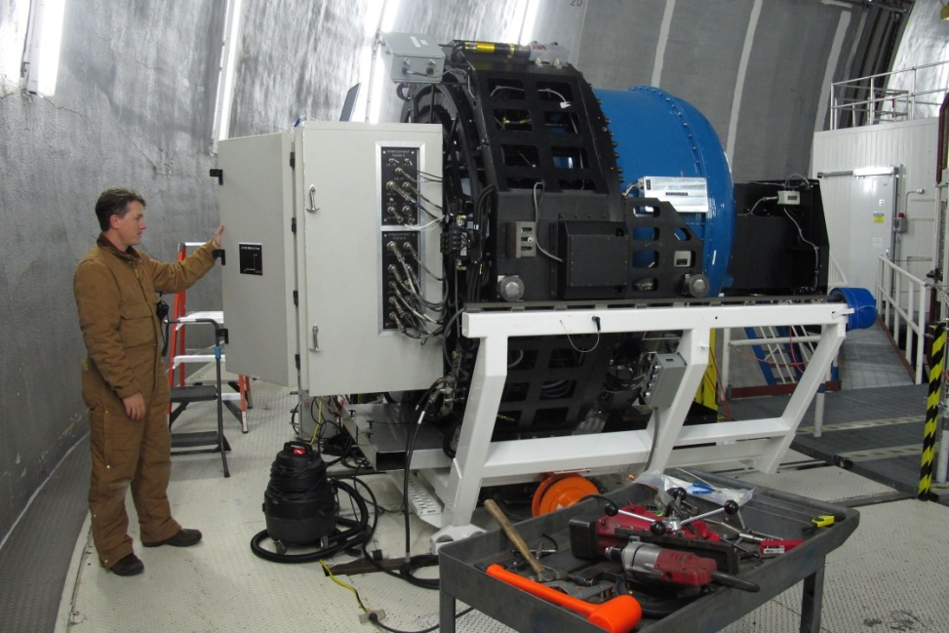
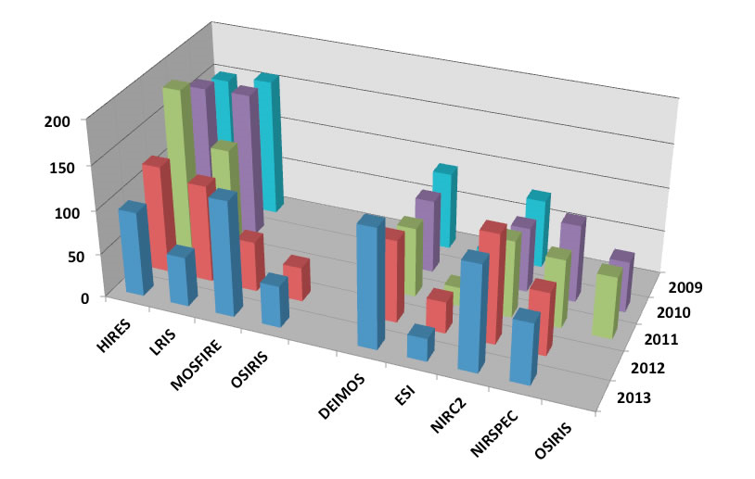
MOSFIRE
Multi-Object Spectrometer For InfraRed Exploration
On Keck I, MOSFIRE
provides:
  46 slits over 6.1' x 3' field using configurable slit mask unit
Unique capability
worldwide
First light: April 4, 2012
Funding: NSF TSIP and
Gordon and Betty Moore
Has become most popular instrument on Keck I

Slide 11
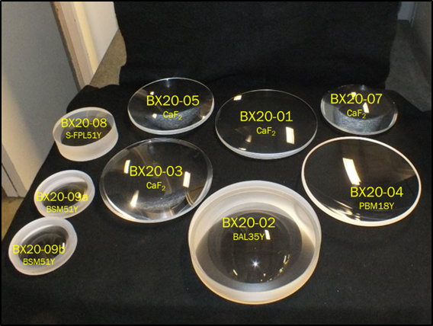
Keck Cosmic Web Imager (KCWI)
Optical Integral Field Spectroscopy for Keck II
Key Strategy:
  Highly efficient for faint sources
  Superb sky subtraction
Key Science:
  Cosmic Web
  Gas outflows from galaxies
  Outer regions of galaxies
Basic instrument and blue channel are under construction at Caltech
  First light: July 2015
Funding:
  NSF TSIP Program
  Private philanthropy
Submitting proposal to NSF for red channel

Slide 12
Adaptive Optics Upgrades
Center Launch of Keck II Laser
  Improves performance
  First light for full system: February 2014
  Shared risk science: Semester 2014B
Infrared Tip/Tilt Sensing on Keck I
  Improves performance and sky coverage
  First light: November 2013
  Science verification tests: April 2014
  Shared-risk science: Semester 2014B
Upgraded Detectors, H2RG, for OSIRIS IFU and Imager
  Greater sensitivity
  Wider field for imager
  First light: August 2015
PSF Determination

Slide 13
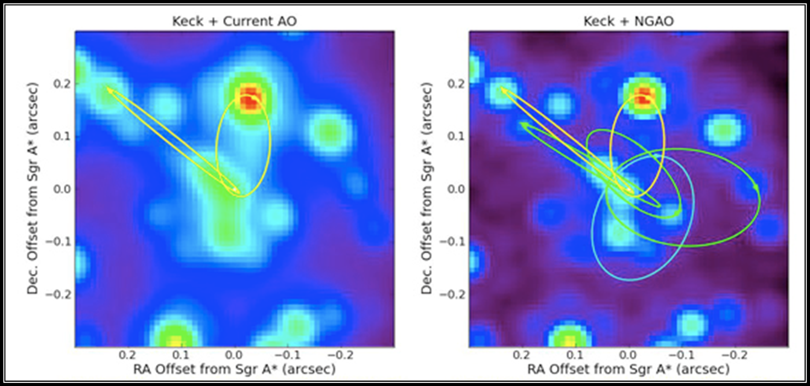
Next Generation Adaptive Optics
Key Strategy:
  Higher Strehl
  Lower background
  High sky coverage
Key Science:
  Test General Relativity using Galactic Center black hole
  Address nature and distribution of dark matter via gravitational lensing
Funding
  Submitting proposal to NSF Mid-Scale Innovations Program (passed first review)

Slide 14
Telescope Control System Upgrade (TCSU)
Upgrade telescope control systems on both telescopes
  Improve pointing
    Absolute pointing accuracy of 2 arcsec RMS
  Decrease acquisition time
  Increase reliability
  Enhance sustainability
    Replace obsolete computers, electronics & software
Keck II TCSU completes in Jan 2015
  Keck I approximately 1 year later

Slide 15
Scientific Productivity

Slide 16
Number of Publications per Year

Slide 17
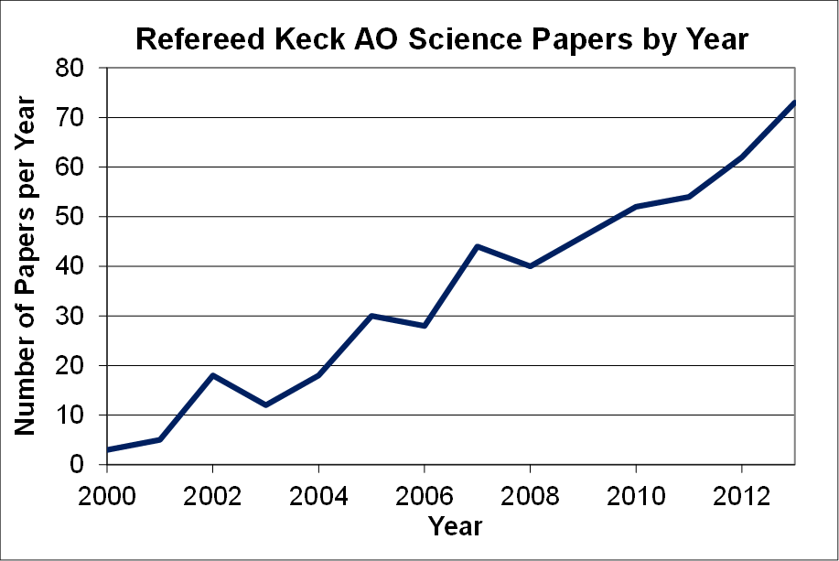
Adaptive Optics Publications
Per Year

Slide 18
Ph.D. Theses Based on
WMKO Observing

Slide 19
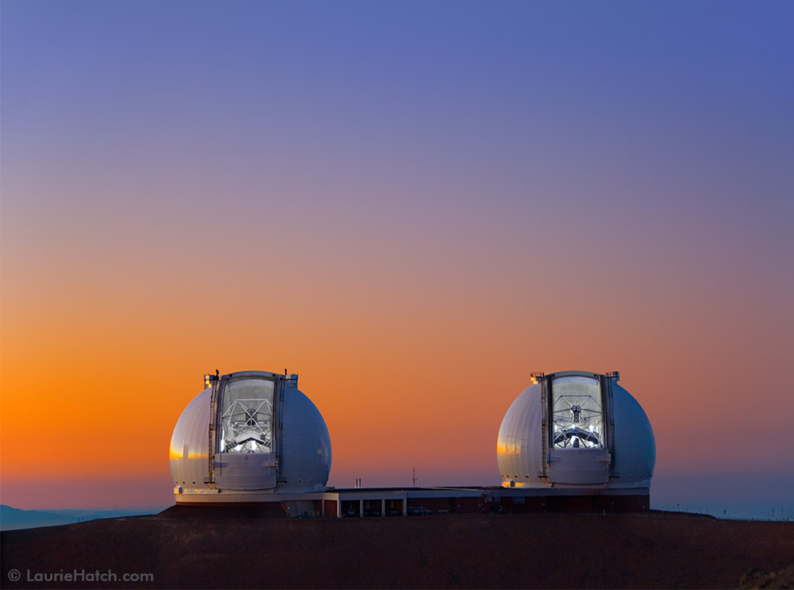
Keck Observatory and our science community strongly value our collaboration with Subaru
Let the Universe Inspire You
19

