Slide 1
Infrared Observations of Novae with Subaru/COMICS and Gemini/T-ReCS
Sakon, I., Sako, S., Shimonishi, T.,
Onaka, T. (Univ. of Tokyo)
Takahashi, H. (Gunma Observatory)
Yamashita, T., Fujiyoshi, T. (NAOJ)
Rodomski, J. (Gemini Observatory)

Slide 2
Infrared Observations of Novae
Mid-infrared Imaging and Spectroscopic monitoring observations of Galactic dust forming novae
→ unique laboratories to study the process of dust formation and to understand
the mass-loss history of the CO white dwarves from the chemical point of view
Infrared Spectral Evolution of CO Novae and ONeMg Novae
Hot ejecta gas is initially seen as an expanding photosphere or “fireball”
When the expanding material becomes optically thin, free-free and line emission dominate
1). CO Novae;
- Thermonuclear runaway (TNR) on the surface of relatively
low-mass CO white dwarves (e.g., M_{WD}<1.1M☉)
-Dust formation after the free-free phase is reported for several CO novae
[e.g., V2362 CYGNI (Lynch et al. 2008), V705 Cas (Evans et al. 1997), etc.]
- Complicated dust compositions (both Silicates and Carbonaceous dust)
2). ONeMg Novae;
- Thermonuclear runaway (TNR) on the surface of relatively higher-mass ONeMg white dwarves
(e.g., M_{WD}>1.1M☉)
- coronal emission-lines phase comes after the free-free phase
- No or little evidence of dust formation (cf., V1974 CYGNI; Woodward et al. 1995 )
chemical evolution of the Nova ejecta over various physical phases is not fully understood

Slide 3
V1280 Scorpii
-Discovered on 2007 Feb 4.86 by Y. Nakamura and Y. Sakurai (Yamaoka et al. 2007)
d = 1.6±0.4 kpc (Chesneau et al. 2008)
Dust formation occurred at d~23days after discovery (Das et al. 2007)
VLTI/AMBER and MIDI observations between t=23 d and 145 d (Chesneau et al. 2008)
An apparent linear expansion rate for the dust shell; 0.35±0.03mas day⁻¹
Expansion velocity of the nova ejecta; 500±100 km/s
Dust production rate; 2-8x10⁻⁹ M_{sun} day⁻¹ (a probable peak in production at t=36-46 days)
The amount of dust in the shell; 2.2x10⁻⁷ M_{sun}
Late-epoch Observations of Dust Forming Nova V1280Sco
- July 7, 2007 (epoch ~150 days)
Subaru/COMICS; N-band spectroscopy (8-13.4μm)
N- & Q-band photometry (8.8μm, 11.7μm, 18.8μm, 24.5μm)
Kanata/TRISPEC (June 26, 2007; epoch ~140 days); Ks-band photometry (2.15μm)
- September 8, 2009 (epoch ~940 days)
AKARI/IRC; near-infrared spectroscopy (2.5-5μm)
- August 1, 2010 (epoch ~1270 days)
Gemini-S/TReCS; N-band spectroscopy (7.7-13.2μm)
N- & Q-band photometry (7.8μm, 9.7μm, 11.7μm,18.8μm, 24.5μm)
Gunma (Aug 26, 2010; epoch ~1300 days);
J, H, Ks-band photometry (1.24, 1.66, 2.15μm)

Slide 4
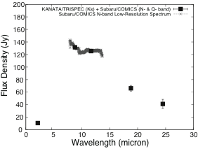
Infrared Spectral Energy Distribution of V1280Sco at ~150 days with Subaru/COMICS
Possible Silicate Absorption Feature at ~10μm

Slide 5
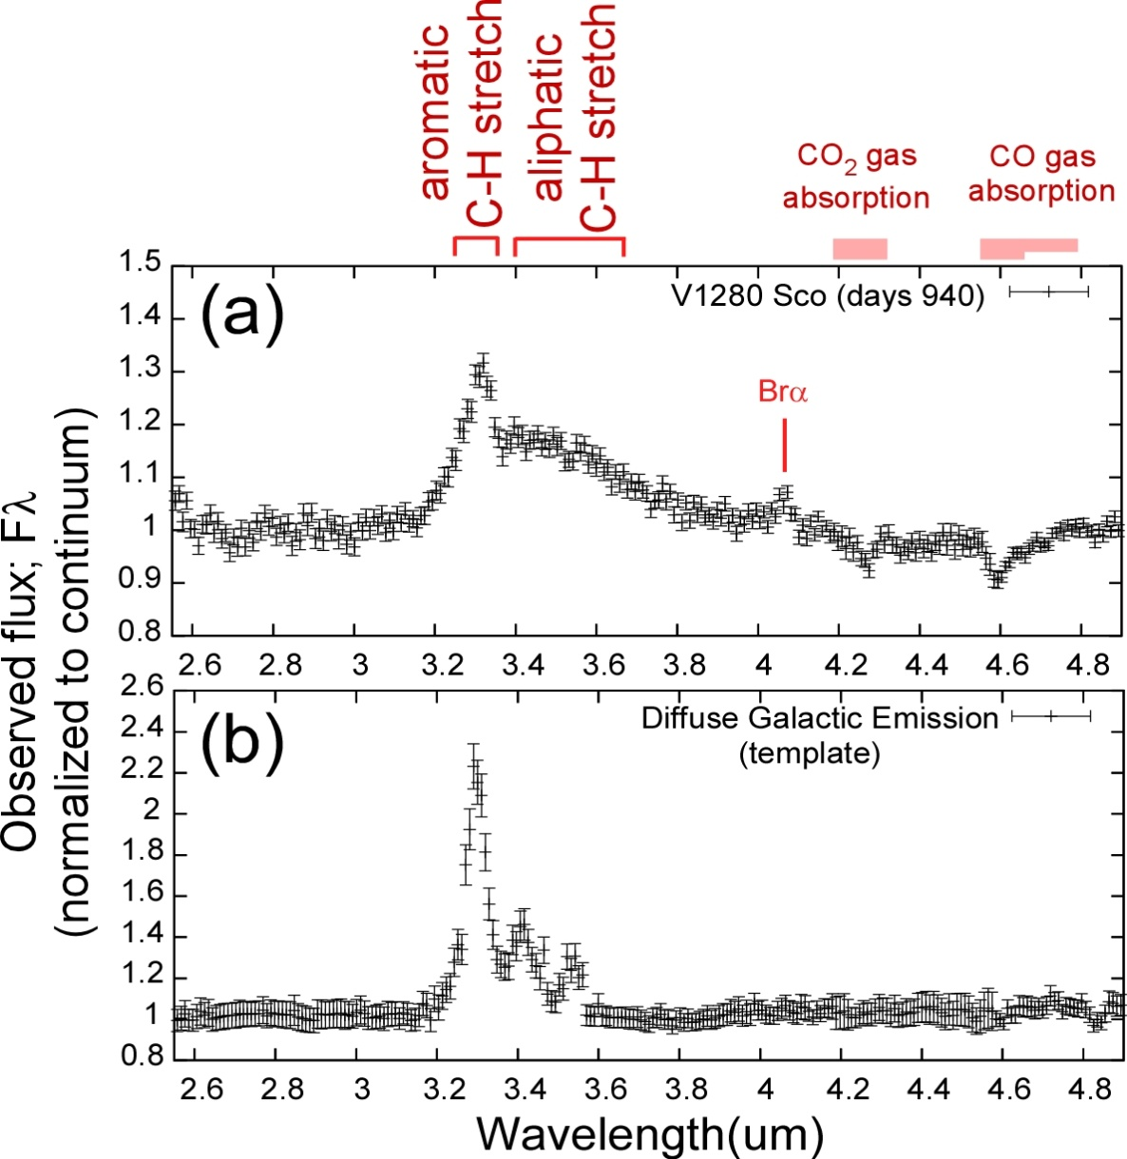
Near Infrared Spectrum of V1280Sco at ~940 days with AKARI/IRC
(a) Near-Infrared spectrum of V1280 Sco on the epoch 940 days after the discovery normalized to the continuum obtained with Infrared Camera (IRC) onboard AKARI.
A PAH 3.3μm feature with a strong redwing in 3.4-3.6μm was recognized.
(b) Near-infrared spectrum of Galactic ISM as an example of typical spectrum of PAH features with a normal inter-band ratios among 3.3, 3.4 and 3.5μm features obtained with AKARI/IRC.
15

Slide 6
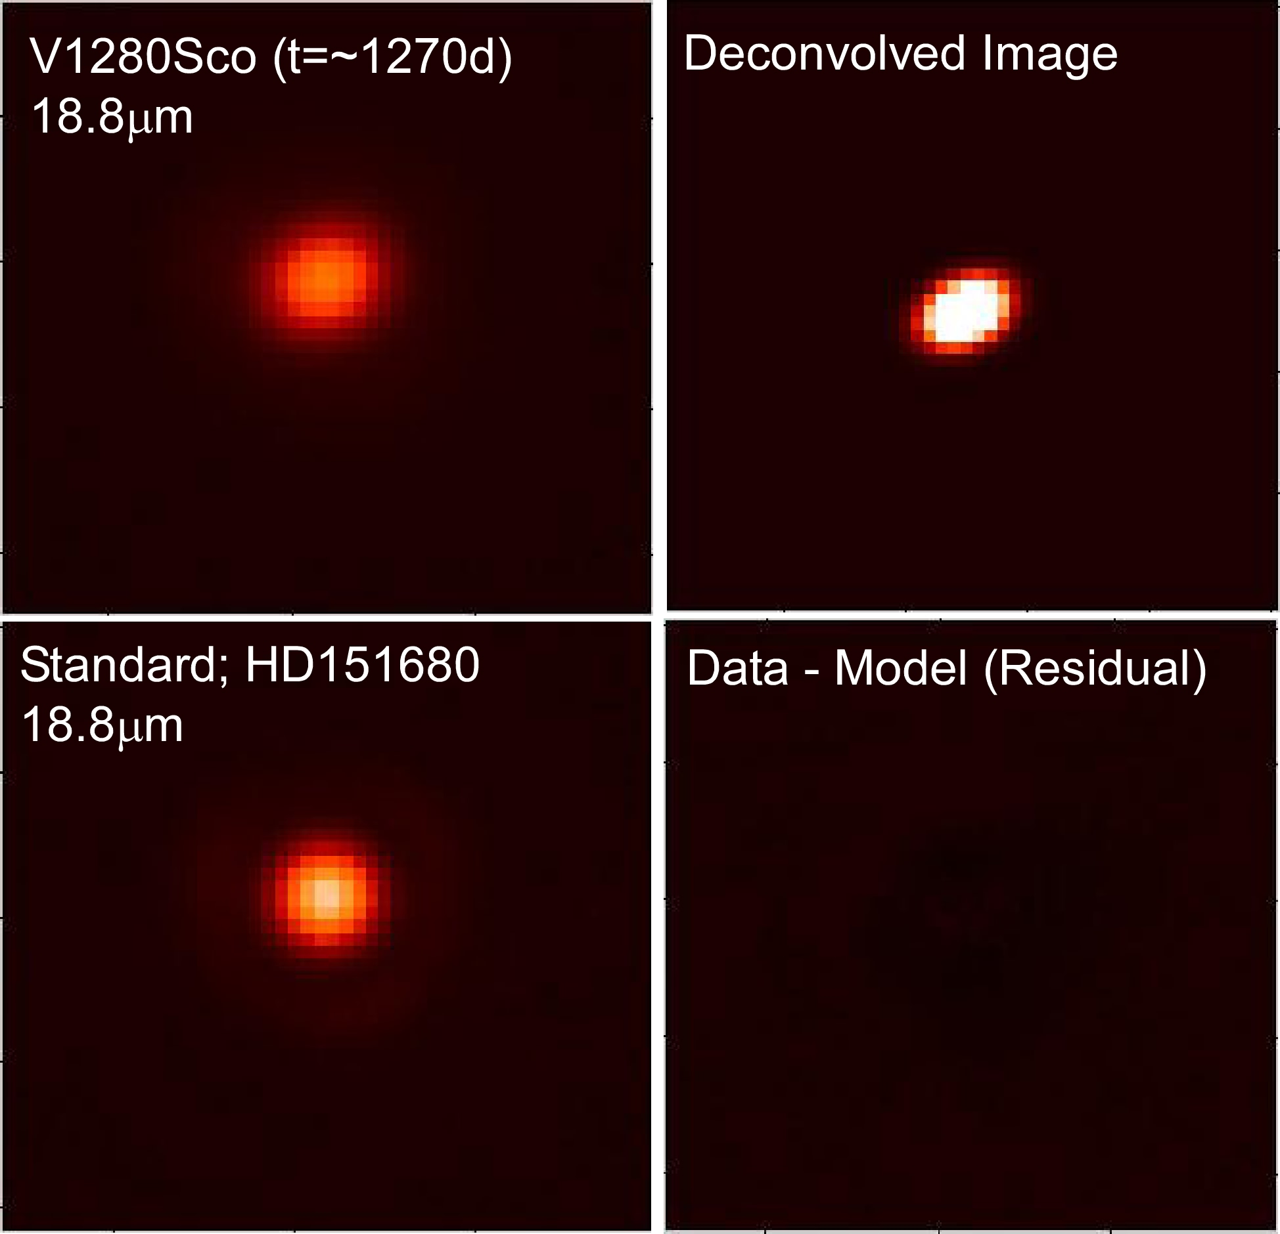
Results of N- & Q-band imaging observations of V1280 Sco at t=~1270 days with Gemini-S/TReCS
Example; Qa band data of V1280Sco and HD151680
θ
σb
σa
Intrinsic profile of the dust emission;
3D-Elliptical Gaussian
θ ; position angle for the major-axis
σa ; semi-major axis radius
σb ; semi-minor axis radius
18.3μm
The best-fit 3D-Elliptical Gaussian parameters
Band λ(μm) θ (deg) σa (“) σb (“)
Si-1 7.73 25 0.32±0.02 0.19±0.02
Si-3 9.69 25 0.30±0.02 0.18±0.02
Si-5 11.66 25 0.29±0.02 0.15±0.02
Qa 18.30 25 0.29±0.03 0.20±0.03
Qb 24.56 25 0.38±0.03 0.23±0.03
Non-spherical distribution of dust emission
Effective size of the dust shell; 7.2x10¹⁰ k (~500AU)
→ Much smaller than the size of the expanding Ejecta Shell with 500km/s at t~1300d; 2x10¹³ km
18.3μm

Slide 7
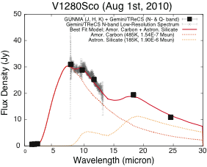
Spectral Decomposition of model fit to the Infrared Continuum Spectrum of V1280Sco at ~1300 days obtained with Gemini-S/TReCS
Amorphous Carbon; 485±5 (K), 1.54x10⁻⁷Msun
Astronomical Silicate; 185±5 (K), 1.90x10⁻⁶Msun

Slide 8
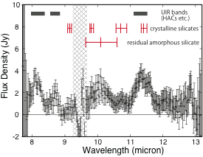
Mid-Infrared Spectral Features over the Infrared Continuum modeled with amorphous carbon and astronomical silicate
Features at ~8.1μm, ~8.7μm, ~11.35μm;
Hydrogenated Amorphous Carbons (HACs), NH2-rocks (Grishko & Duley 2002)
→ similar to those found in V704 Cas 1993 (Evans et al. 1997, 2005)
A Broad Feature at ~10.1μm; amorphous silicate
Features at ~9.2μm, ~9.8μm, ~10.7μm, ~11.4μm;
Possible contributions of forsterite, enstatite and diopside (Molster et al. 2002)

Slide 9
Interpretations; IR observations of V1280Sco
-Near- to mid-infrared (1-25μm) spectrum at t = ~1270 day with Gemini-S/TReCS is well
reproduced by Emission from warm (T~185±5K) astronomical silicate dust of 1.9x10⁻⁶M_{sun}
and hot (T~485±5 K) amorphous carbon dust of 1.5x10⁻⁷ M_{sun}
→ presence of both carbonaceous dust and (pre-existing?) silicate dust
→ the emitting regions of both components are confined within ~500AU
(within an expanding dust shell; 0.35mas/day).
-Strong 18-μm /10- μm silicate band ratio
→ presence of lower temperature astronomical silicate dust (T~185K) of 1.9x10⁻⁶M_{sun} ?
→Possible annealing effect? (evolution of circumstellar silicate) (Nuth & Hecht 1990)
(consistent with the possible presence of crystalline silicate band emission.)
-Detection of 3.3μm feature with strong red-wing in AKARI/IRC NIR spectrum at t = ~940 days
-Detection of 8.1, 8.7 and 11.35μm features in the spectrum of of V1280 Sco at t=~1270 days
with Gemini-S/TReCS
→ Formation of Hydrogenated Amorphous Carbons (HACs) in the nova ejecta
-Presence of silicate absorption in the N-band Low-resolution spectrum of V1280Sco
at t = ~150 days with Subaru/COMICS
-CO gas absorption in the AKARI/IRC near-infrared spectrum of V1280Sco at t=~940 days
→ presence of rich circumstellar medium around the white dwarf

Slide 10
Summary
Mid-infrared Imaging and Spectroscopic monitoring of Galactic dust forming novae
→ unique laboratories to study the process of dust formation and to understand
the mass-loss history of the CO white dwarves from the chemical point of view
Late epoch observations t>1000 days are important to examine the chemical evolution
of dust grains formed around novae in harsh UV radiation environment
High spatial resolution achieved by 8-10m class telescopes in the mid-infrared
is indispensable to resolve the dust shell structures at those late epochs
Excellent Performance of Gemini-S/TReCS, not just in N-band, but also in Q-band
Subaru/COMICS; Useful N-band, Q-band Spectroscopic capability with slit viewer
→ crucial to examine the distribution of each dust component
by means of the spectral decomposition of the spatially resolved spectra
Whole sky coverage achieved by Subaru/COMICS and Gemini-S/TReCS
Strong advantages in the chemical understanding of dust formation around evolved stars
Good collaboration with Space Infrared missions (AKARI, SPICA, etc.)
Observations of time varying phenomena with a timescale of several years;
(novae, Wolf-Rayet +O-type binary stars, nearby supernovae, optical transients etc.)
- Continuous multi-epoch observations are indispensable

Slide 12
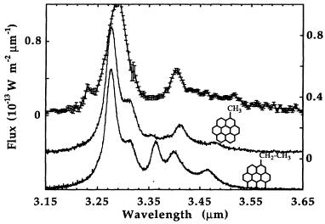
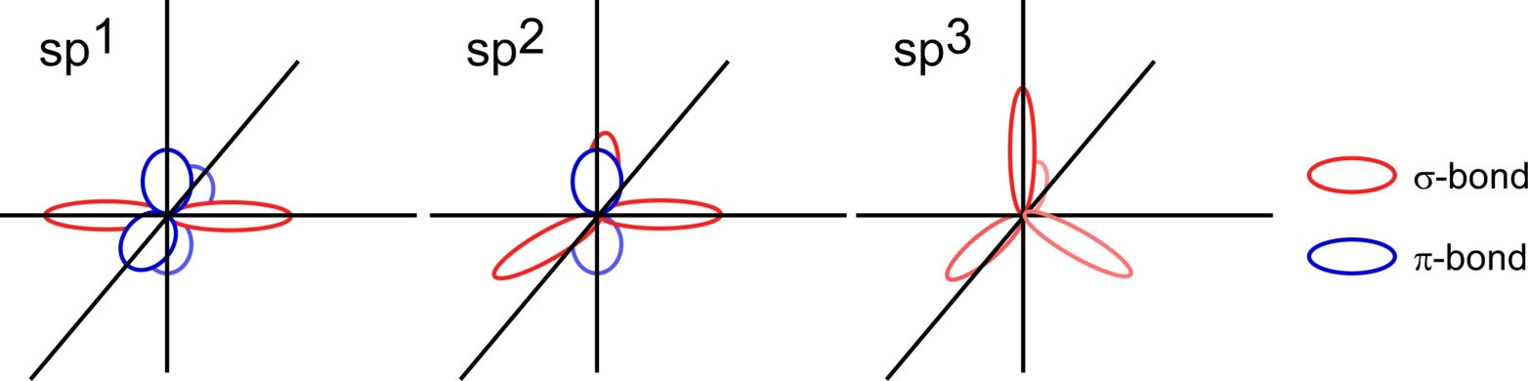
Near infrared spectrum of NGC1333
with UKIRT (Joblin et al. 1996)
Polycyclic Aromatic hydrocarbons
(PAHs) (Allamandola et al. 1989)
3.3μm feature; aromatic C-H stretch mode
3.4μm feature; aliphatic C-H stretch mode
Hydrogenated Amorphous Carbons (HACs) (Duley & Williams et al. 1990)
contain PAH-like units weakly bounded by van der Waals forces
consist of a mixture of aromatic hydrocarbons dominated by sp² bonds which can produce the polycyclic ring and aliphatic hydrocarbons including sp¹ bonds (like in acetylene) and sp³ bonds (like in methane).
The “aromatic” to “aliphatic” ratio in HACs can be modified by the irradiance of UV fields.

