Slide 1
Computer and Data Management Report
Junichi Noumaru
Subaru Telescope

Slide 2
Staff
Camron Fox (FMSA – SE)
James Hayasaka (FMSA – SE)
Yasushi Nakajima (Research fellow – Mitaka)
Junichi Noumaru (CDM Division Chief)
Kiaina Schubert (SA)
Richard Tom (FMSA – CE)
Kenji Uchida (Engineer)
Tom Winegar (DB programmer)
Hisahito Yamada (FMSA – Manager)

Slide 3
Computer and Network System CDM Division covers
Local Area Network
Wide Area Network
Computer hardware and OS for SOSS (Summit, Hilo Remote and Mitaka Remote)
Applications in ANA, HANA and SBANA
External web servers and emails
STARS and MASTARS
ProMS
Video Conferencing equipment

Slide 4
STN Computer Status
Very stable operation continues.
One hour down of STARS during Jan 2010 – Nov 2010 made to clear error from the file server. This is the only unscheduled down time.
Preventive maintenance is made monthly for 4 to 8 hours. Some services become unavailable for 0.5 to 4 hours during each maintenance.

Slide 5
STARS/MASTARS
(Subaru Telescope Archive System/Mitaka Advanced Subaru Telescope Archive System)

Slide 6
Yearly Data Registrations (GB)

Slide 11
ProMS
（Proposal Management System)

Slide 12
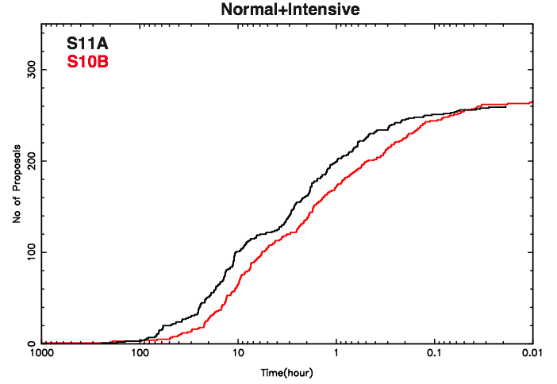
How ProMS has been used
181 and 197 proposals for S10B and S11A were processed without major troubles.
A half of submission (including update and failure) was made in the last 2-3 hours.

Slide 13
ProMS Improvements in 2010
An FAQ page
  typical troubles in submitting proposals are listed
Enlargement of the “magnitude” field in target list
  more detailed description and automatic folding of a line
TeX entry for backup targets
  for efficient telescope operation
PIs can register their CoI(s) to STARS via a Web page.

Slide 14
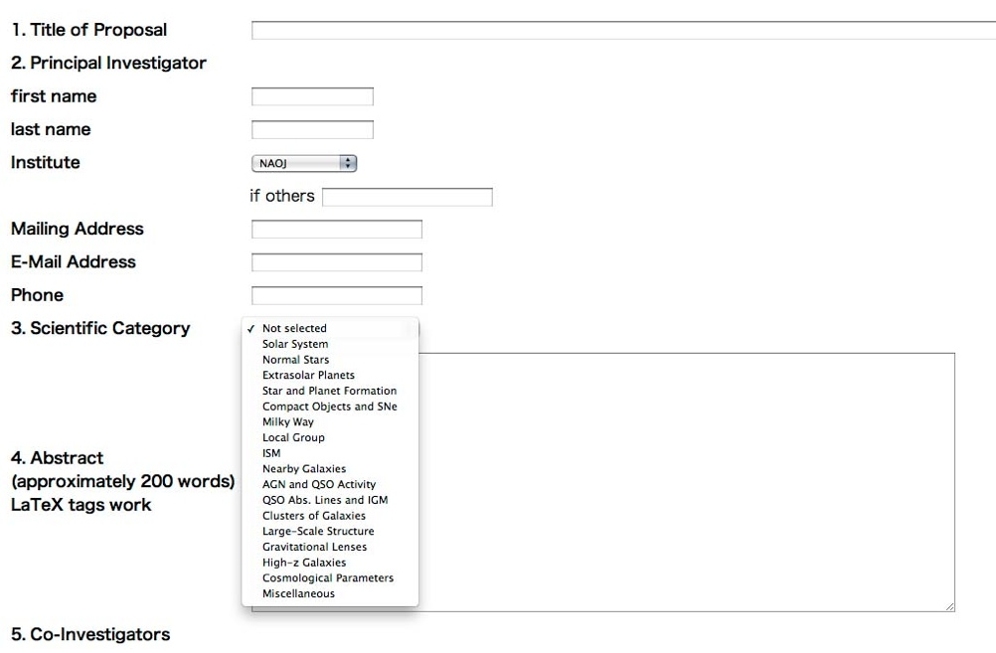
ProMS Plan in 2011
Web submission
  PIs can fill in web forms and upload scientific justification and finding chart in PDF files from a web page.
Use of STARS ID to identify users.

Slide 15
Supporting Work for HSC in 2011
Modernizing dome network
Supporting design/procurement/installation/
operation/maintenance of HSC data analysis computers
Upgrading ana and hana
Modifying STARS to accept compressed FITS files
Enhancing STARS buffers

