Slide 1
First Unbiased Estimates of the Metallicity and Star-Formation Activity of
Lyman Alpha Emitters
Kimihiko Nakajima(U. Tokyo)
- Co-Investigators -
Masami Ouchi, Kazuhiro Shimasaku, Yoshiaki Ono(U. Tokyo),
J. Lee(Carnegie), C. Ly(STScI), D. Dale(U. Wyoming),
S. Salim(U. Indiana), R. Finn(Siena College)

Slide 2
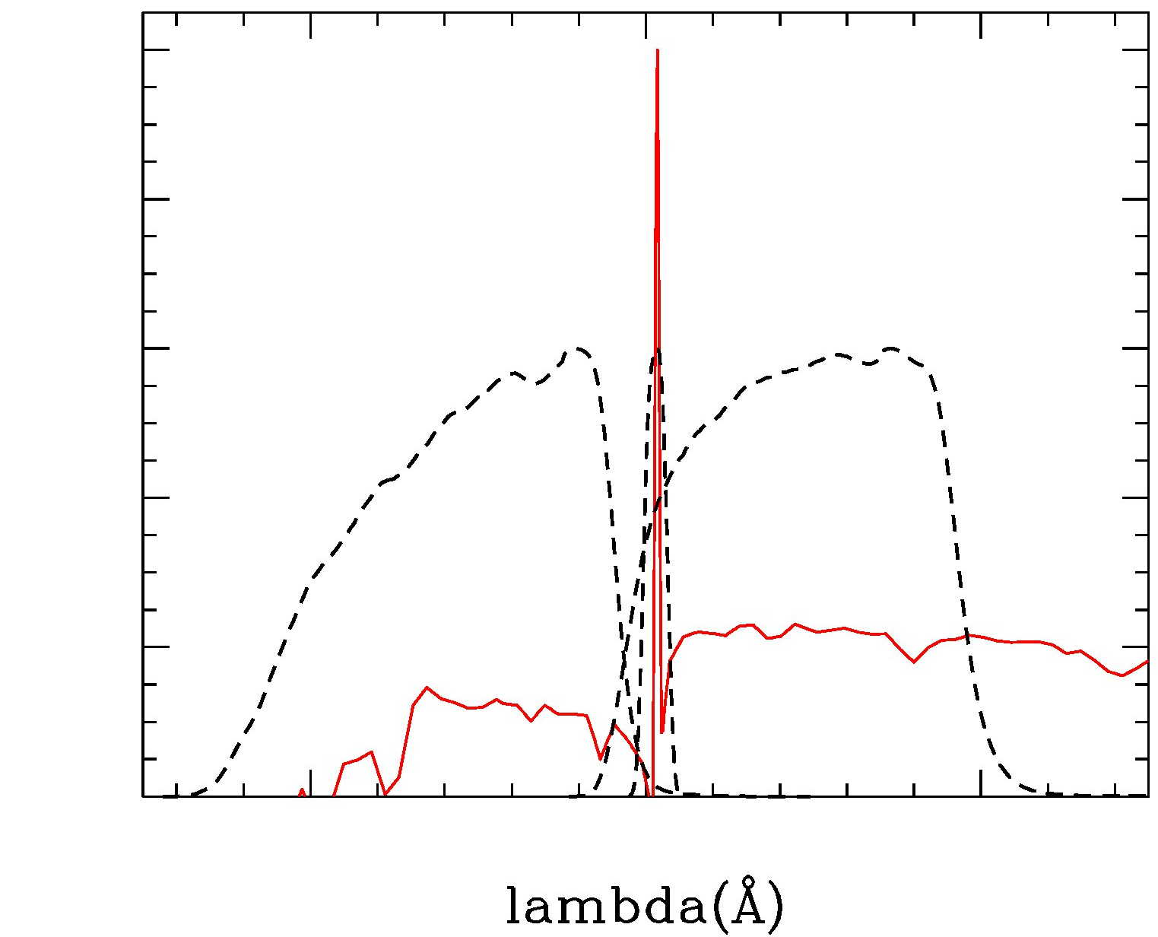
Lyman Alpha Emitters (LAEs)
1. Introduction
Galaxies with strong Lyα emission, faint UV continua
  young, low-mass, and
  actively star-forming
  → promising candidates of
  building blocks of
  future massive galaxies
  → clues to solve the mystery of
  galaxy formation/evolution
Ouchi+2008
Flux
1216 x (1+z) A

Slide 3
Unsolved problems about LAEs
1. Introduction
No reliable measurements of SFR and metallicity
  Combinations of nebular emission → detailed measurements
  At z>3, spectroscopy of nebular emission(and Hα) is very difficult
  SED fitting is frequently used, but has some problems
  (e.g., metallicity degenerates with age; Ono+2010a)
A solution is …
  to observe lower-z LAEs
  → Nebular emission can be obtained from the ground
  At z<2, Lyα is not observable from the ground
  → LAEs at z=2-3 are good targets !

Slide 4
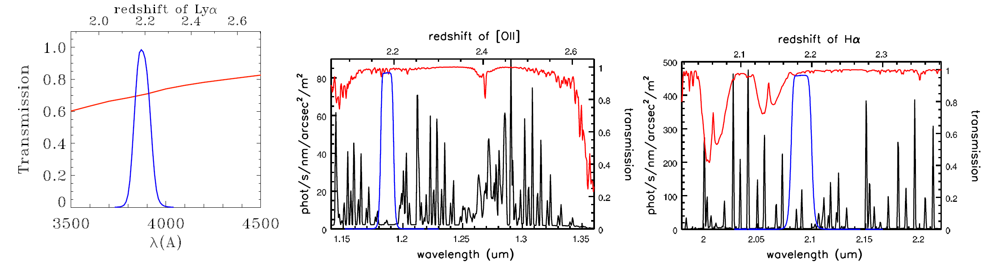
Outline of our study
1. Introduction
Focus on LAEs at z=2.2
Derive SFR and Metallicity
  Hα → SFR
  [OII] + Hα → Metallicity
NB387 | NB118 | NB209
Lyα | [OII] | Hα (+[NII])
Blue : Narrowband
Red : Transmission of the atmosphere
Black : OH-airglow
Ⓒ Ouchi, Lee

Slide 5
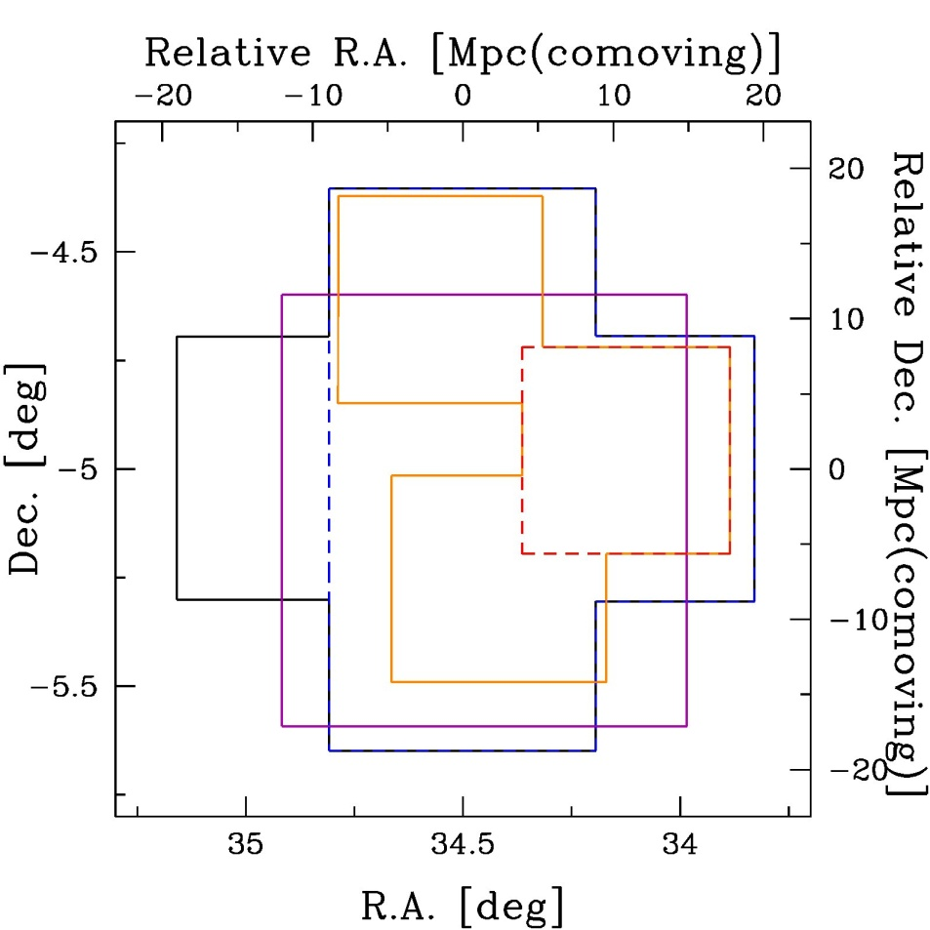
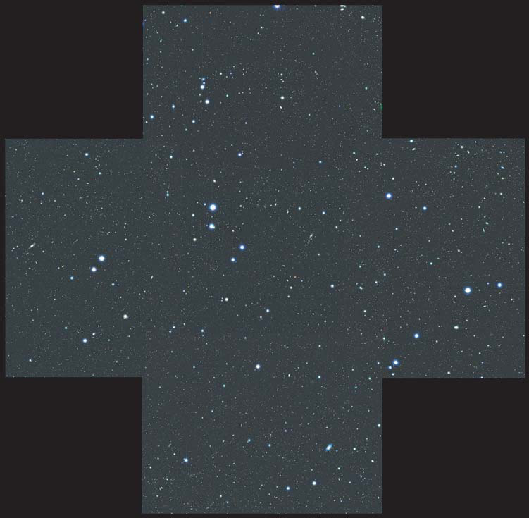
Data
2. Data and Selection method
1.3 deg
Field：Subaru/XMM-Newton Deep Survey
(SXDS; Furusawa+2008)
Imaging Data
vey
NB387
u*, JHK
BVRiz
Band Instrument, PI | Limiting mag （5σ, aper） | Area (arcmin²)
NB387 Suprime-Cam Ouchi+ | ~25.6 AB (2.0”) | ~2000
u* CFHT/MegaCam Foucaud+ | ~27.0 AB (2.0”) | ~2000
BVRiz Suprime-Cam Furusawa+ | 26 - 28 AB (2.0”) | ~2000
JHK UKIRT/WFCAM Lawrence+ | ~24.6 AB (2.0”) | ~2000
NB209
NB118
NB118 KPNO/NEWFIRM Lee+ | ~22.6 AB (3.5”) | ~1300
NB209 KPNO/NEWFIRM Lee+ | ~22.2 AB (3.5”) | ~350

Slide 6
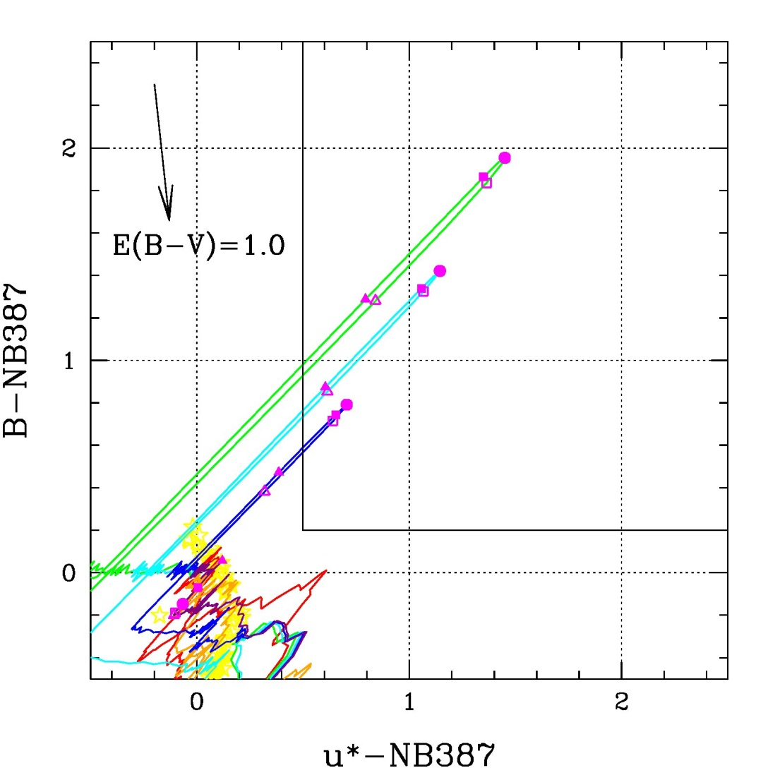
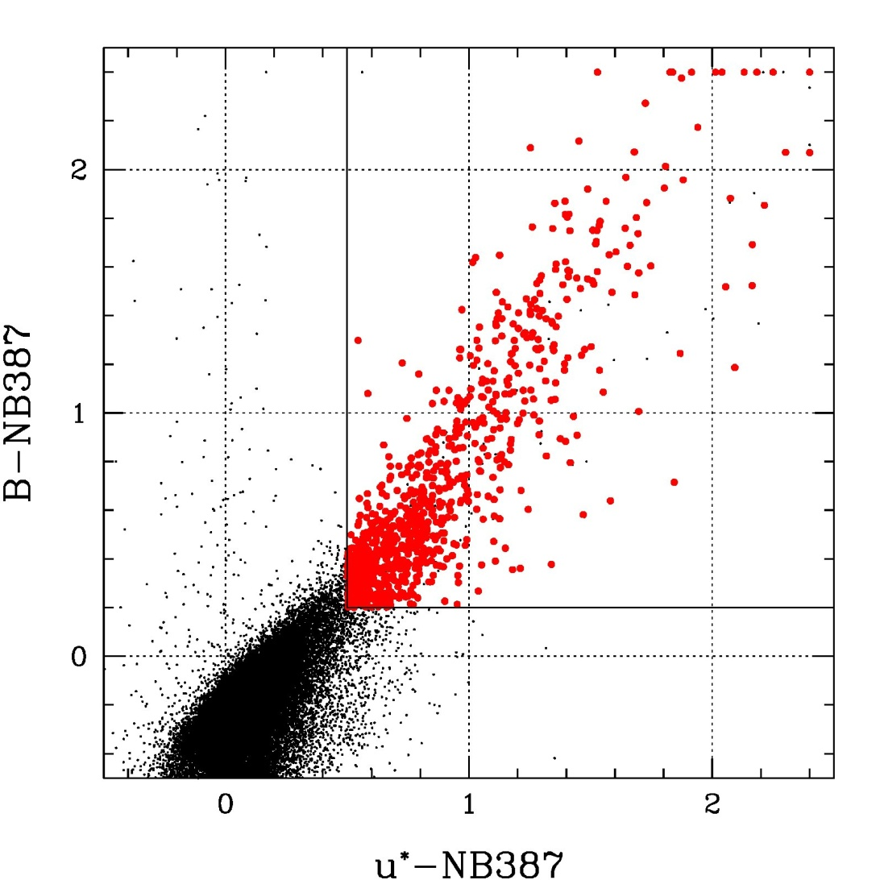
Selection of z=2.2 LAEs
2. Data and Selection method
Combination of NB387 with u* and B
  Emitters with EW > 40A fall into this region
  → Emitter candidates
919 candidates are found !
→ 105 candidates have both
NB118 and NB209
Black：All objects (NB387)
Red ：LAE candidates
u*-NB387=0.5
LAE templates
B-NB387=0.2

Slide 7
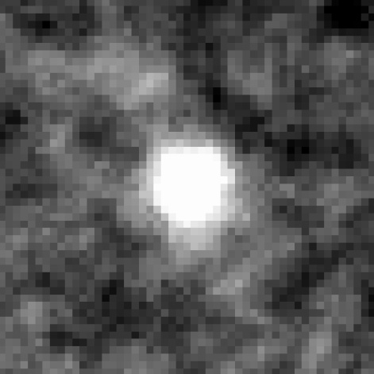
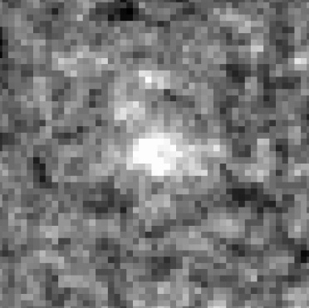
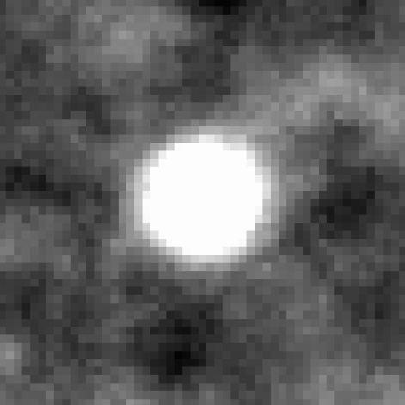
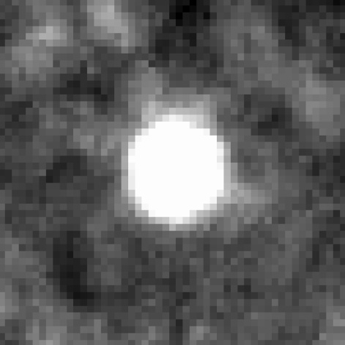
Stacking of 105 objects
3. Stacking analysis
Stacking images of each LAEs to increase S/N ratio and
detect [OII] and Hα: “Stacking Analysis”
→ typical, and unbiased properties of LAEs
 | [OII] | Hα
Narrow-band
magnitude [3.2”, AB] | 24.33±0.07 | 23.95±0.13
Broad-band
magnitude [3.2”, AB] | 24.72±0.03 | 24.54±0.03
NB118
NB209
15.5σ
8.3σ
J
K
32.9σ
28.2σ

Slide 8
First detections of [OII] & Hα from typical LAEs
3. Stacking analysis
  J – NB118 = 0.39 ± 0.08
  K – NB209 = 0.60 ± 0.14
→ First detections of [OII] and Hα from typical LAEs !!
NB387 and u* images are also stacked in the same manner
  u* – NB387 = 0.66 ± 0.03
→ EW_{rest} (OII) = 98 (+22/-19) A
→ EW_{rest} (Hα) = 207 (+206/-90) A
→ EW_{rest} (Lyα) = 86 (+5/-5) A

Slide 9
SFR from L(Hα)
4. Discussion
Hα luminosity is a good indicator of SFR (e.g., Kennicutt+1998)
→ typical LAEs have smaller SFRs than LBGs at high-z
(consistent with past results by SED fittings; e.g., Gawiser+2006)
M* is derived from SED fitting (Ono+ in prep.)
  M* = 5 x 10⁸ M_{sun}
  → much smaller than other high-z populations (M*>10⁹M_{sun})
 | EW (A) | Luminosity (erg/s) | SFR (M_{sun}/yr)
Hα | 207 (+206/-90) | (6.9 +/- 1.4) e+41*† | 5.5 +/- 1.1*†
( Lyα | 86 +/- 5 | (1.8 +/- 0.04) e+42* | 1.8 +/- 0.04* )
* Dust-Uncorrected
† [NII] is subtracted

Slide 10
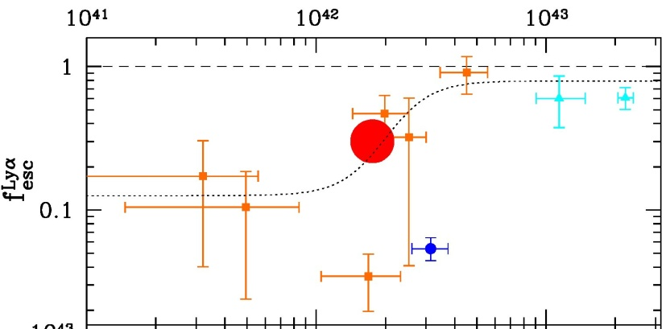
Lyα escape fraction: f_{esc}(Lyα)
4. Discussion
A fraction of Lyα photons that can escape from a galaxy
  f_{esc}(Lyα) = L_{obs}(Lyα)/L_{int}(Lyα) = L_{obs}(Lyα)/( 8.7xL_{int}(Hα) ) = 35%
  → larger than those of HAEs and LBGs with Lyα
  + HAEs : f_{esc}(Lyα) ~ 5% (Hayes+2010)
  + LBGs : f_{esc}(Lyα) ~ 5% (Kornei+2010)
  Brighter LAEs have larger f_{esc}(Lyα) (?)
  → galaxies with higher f_{esc}(Lyα) are
  more easily selected as LAEs
L_{obs}(Lyα)=L_{int}(Lyα)
L（Lyα）
f_{esc}(Lyα)
Orange ■ : Hayes+2010
Cyan ▲ : Finkelstein+2010
Blue ● : NB209-detected LAE
Red ● : our result (stacked LAE)

Slide 11
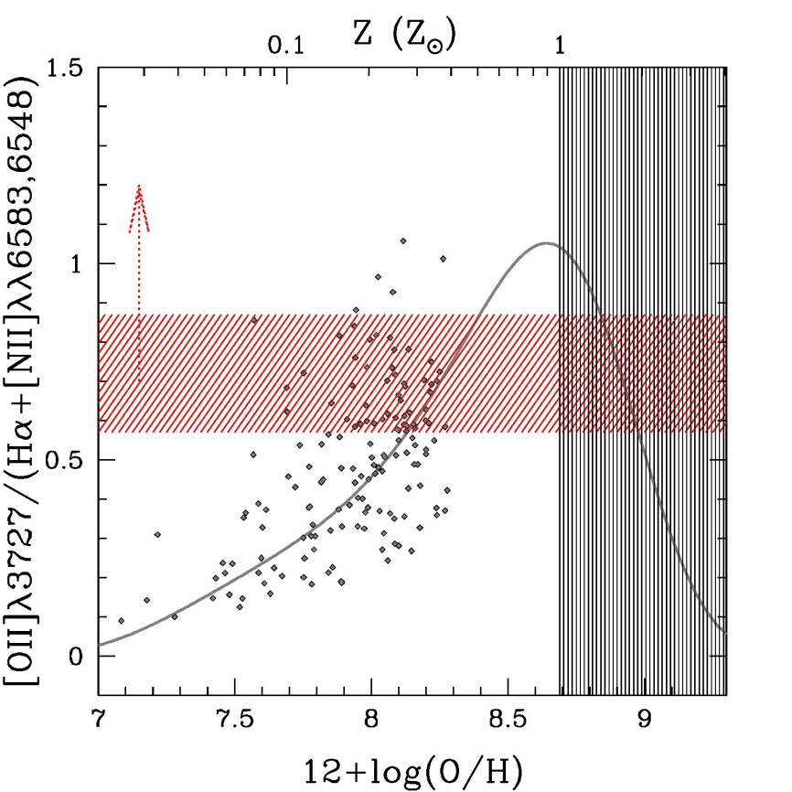
Metallicity
4. Discussion
The ratio of [OII] and Hα+[NII] can be an indicator of metallicity
  Combine two indicators: [OII]/Hβ and [NII]/Hα （Maiolino+2008）
  → Empirical metallicity indicator : [OII]/(Hα+[NII])
  [OII]/(Hα+[NII]) = 0.72 +/- 0.15
  → Z > ~ 0.15 Z_{sun}
  → First constraint on lower-limit
  of metallicity for LAEs
Typical LAEs are not so metal-poor
→ do not support the hypothesis that
LAEs are extremely metal-poor
galaxies (e.g., Schaerer 2003)
[OII]/(Hα+[NII])
1σ uncertainty
of the indicator
(@ low-Z)

Slide 12
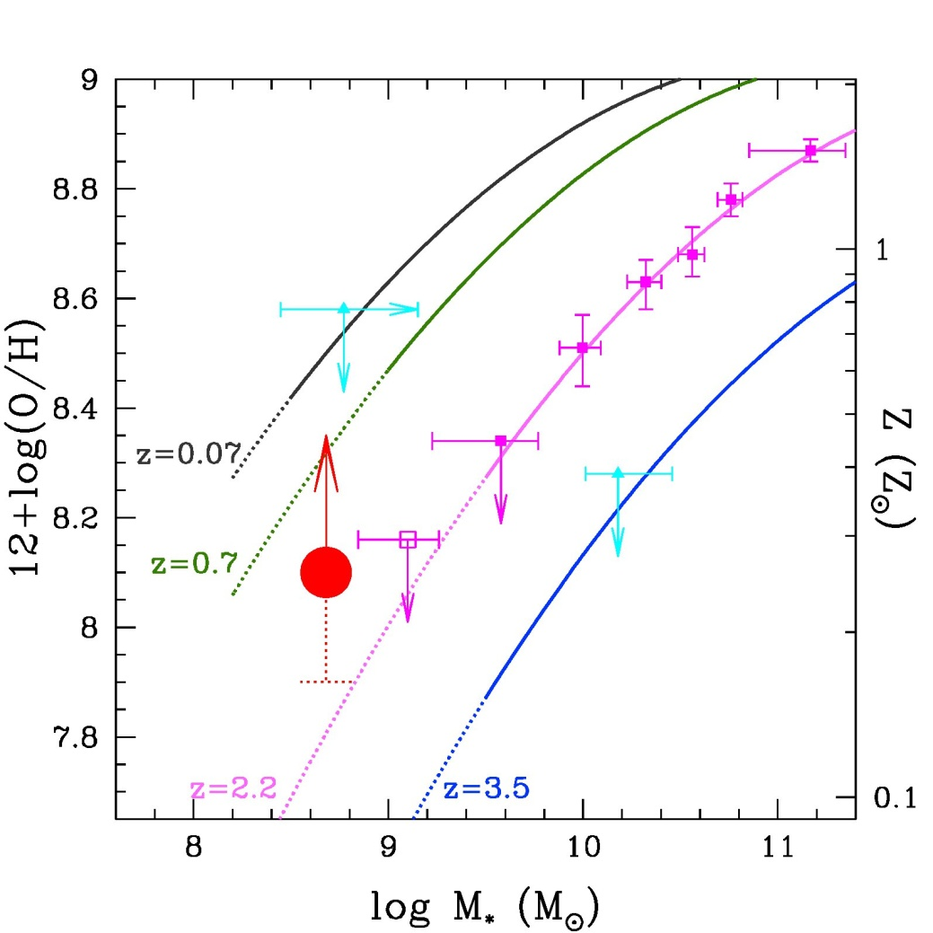
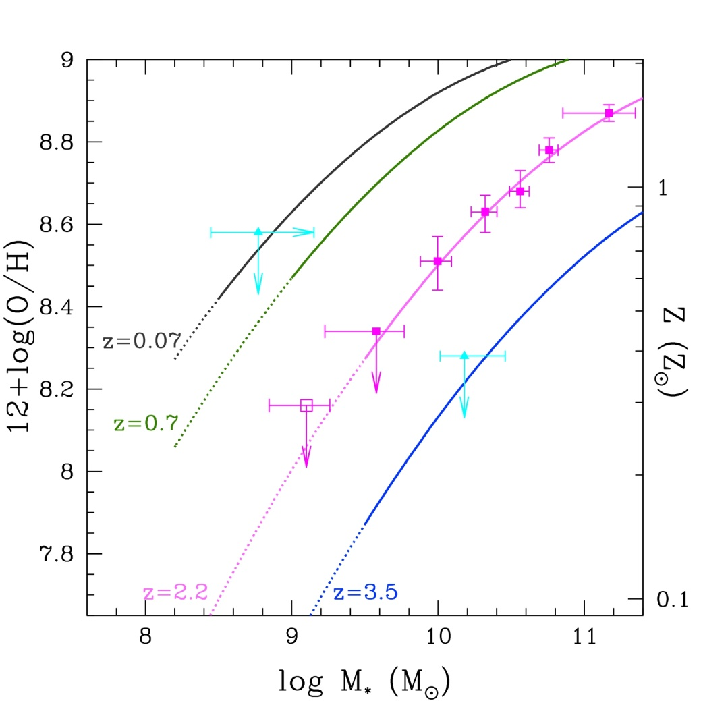
Mass-Metallicity Relation
4. Discussion
M-Z relation is known to evolve with redshift
  Our result have an offset from
  the M-Z relation at z~2
  (Erb+2006)
Solid lines : Maiolino+2008
Magenta ■ : Erb+2006,2010
Cyan ▲ : Finkelstein+2010
Red ● : our result (stacked LAE)

Slide 13
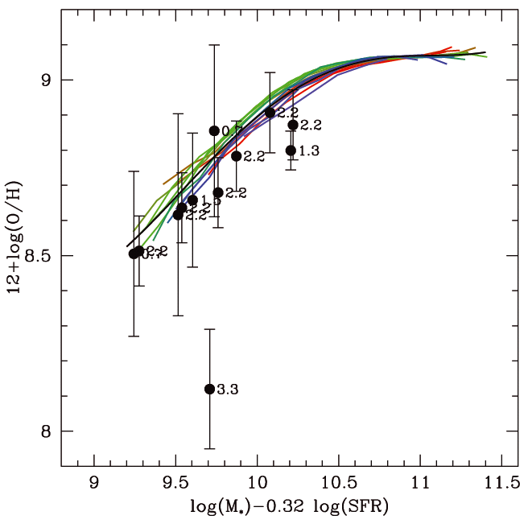
Fundamental Metallicity Relation
4. Discussion
SFR can be a key parameter to describe the M-Z relation
→ FMR (Mannucci+2010, Richard+2010)
  High SFR → low metallicity
  Our result is placed near
  a smooth extrapolation of
  the FMR
  → The offset seen in the M-Z R.
  may be due to small SFRs
  of LAEs
（?）
Solid lines : Mannucci+2010
Black dots : Mannucci+2010
Red ● : our result (stacked LAE)
Mannucci+2010

Slide 14
Summary and future works
5. Summary
We carry out Suprime-Cam/NB387 imaging survey to find
LAEs at z=2.2
  919 LAE candidates are selected in the SXDS field
Stacking of 105 objects yields the first detections of
[OII] and Hα from typical LAEs (NB387 < 25.6AB)
  EW_{rest} (OII) = 98 (+22/-19) A, EW_{rest} (Hα) = 207 (+206/-90) A
  SFR = ~6 M_{sun}/yr : much smaller than that of LBGs
  f_{esc}(Lyα) ~ 35 % : larger than those of other populations
  Z > ~ 0.15 Z_{sun} : larger than that inferred from the M-Z relation
  → our result supports the FMR in the lower M* side
Keck/NIRSPEC follow-up observation will bring more
information of LAEs in detail !!

