Slide 1
PFSとWFMOSのちがい
仕様への要望のまとめ
Kentaro Motohara (U. Tokyo / Subaru Advisory Committee)

Slide 2
WFMOS vs PFS
WFMOS はどうだったのか？
  2009年時点で、WFMOSを進めることについて、（一応）コミュニティの合意は取れていた。
  ちょっと復習

Slide 3
光天連シンポジウム
Report on WFMOS Negotiation at GOPIRA Symposium：Aug. 2008
光天連シンポジウム（2008/8/21-22）では、
これまでの経緯をまずコミュニティへ説明
期待されるサイエンスのトピックス、
WFMOSについての懸念
などが示された。
最後に、挙手による意見分布を求めたところ、WFMOSの
渉を進めることに肯定的・中立的意見がほぼ半々となった。
⇒交渉を進めることとした

Slide 4
WFMOS Shock
2009/1のすばるUMでも進めることは合意
NAOJ-Geminiの合意書取りまとめは最終段階であった
2009/6 (Subaru-Gemini Kyoto Conference直前)
突如キャンセル

Slide 5
NAOJ/Gemini WFMOS Agreement Draft
(Ver. 3.16/Apr. 2009)
(Responsibilities of Gemini) Gemini will design and construct the Gemini Provided Elements (GPE).
  WFMOS shall meet the requirements of a prime focus instrument of Subaru telescope.
  Gemini will cooperate with Subaru to install the GPE at Subaru and provide the technical support and labor needed to prepare WFMOS for Final Acceptance.
  Final Acceptance testing shall be done by Gemini with cooperation from Subaru.
(Responsibilities of Subaru) Subaru shall design and construct the Subaru Provided Elements (SPE) and accept WFMOS as a Subaru facility instrument upon its completion.
  Subaru will provide telescope nights for testing and commissioning of WFMOS.
  Subaru will provide the routine operations and maintenance of WFMOS.
  Subaru shall provide Gemini with the technical support and information necessary for completion of WFMOS as a Subaru facility instrument.

Slide 6
(Joint Science Campaigns – JSC) Three hundred nights of WFMOS observing time will be allocated for one or more JSC.
  The JSC nights will be assigned over a 5 year period.
  Additional nights may be added to the JSC later if both parties agree to do so.
  Each JSC team shall be a unified team with an approximately equal number of both Japanese and Gemini scientists.
  Gemini will provide Subaru with ½ night of Subaru Exchange Time on Gemini for each allocated JSC night.
(PI Programs) WFMOS will be open to both the Subaru and Gemini communities as an open-use instrument.
  Gemini PI time on WFMOS will be based on the framework of the Subaru-Gemini Time Exchange Program.
  The number of PI nights offered for use on WFMOS shall be equal for both the Gemini and Subaru communities and shall be at least 10 nights per year. and shall not exceed the number of nights allocated for the Subaru-Gemini Exchange Program. The number of nights allocated for the Subaru-Gemini Exchange Program (that includes WFMOS and other Subaru facility instruments) may be determined each semester by mutual agreement among Subaru SAC, Subaru director, Gemini director, and ??? , and shall be at least 5 nights per semester.

Slide 7
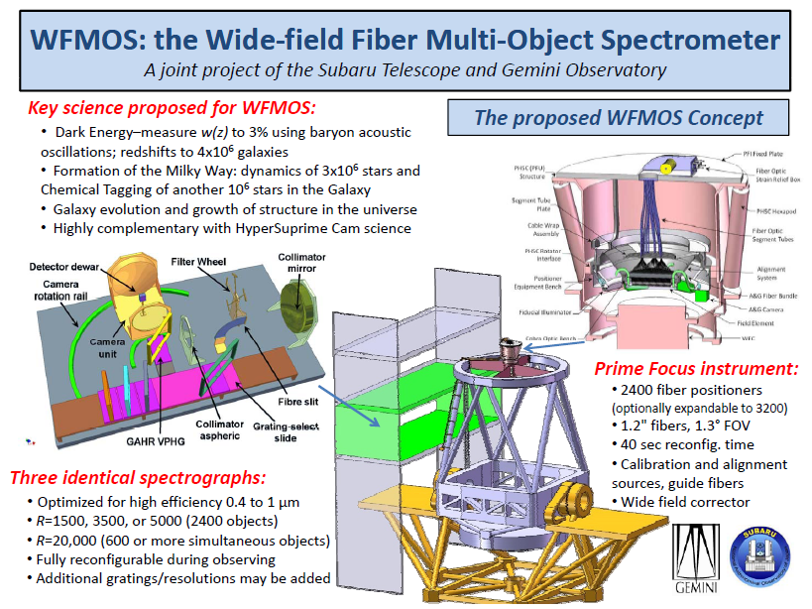

Slide 8
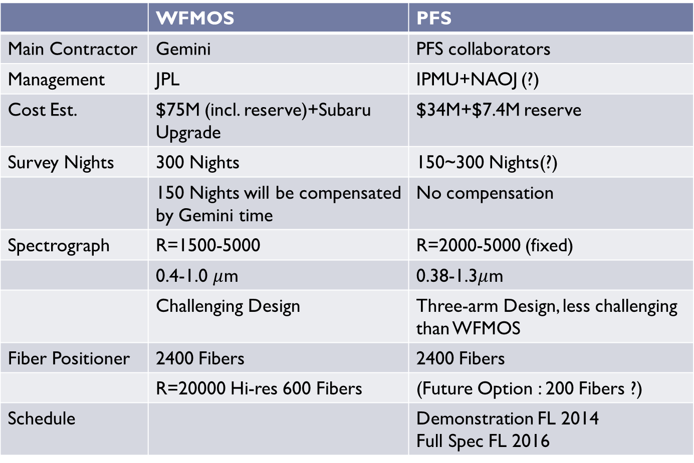
WFMOS vs. PFS
 | WFMOS | PFS
Main Contractor | Gemini | PFS collaborators
Management | JPL | IPMU+NAOJ (?)
Cost Est. | $75M (incl. reserve)+Subaru Upgrade | $34M+$7.4M reserve
Survey Nights | 300 Nights | 150~300 Nights(?)
 | 150 Nights will be compensated by Gemini time | No compensation
Spectrograph | R=1500-5000 | R=2000-5000 (fixed)
 | 0.4-1.0 $μ$m | 0.38-1.3$μ$m
 | Challenging Design | Three-arm Design, less challenging than WFMOS
Fiber Positioner | 2400 Fibers | 2400 Fibers
 | R=20000 Hi-res 600 Fibers | (Future Option : 200 Fibers ?)
Schedule |  | Demonstration FL 2014 Full Spec FL 2016

Slide 9
WFMOS vs PFS
PFSはWFMOSに比べて
  DE survey / Galaxy Evolutionに特化している
  組織はより複雑に
    プロジェクトのマネジメント
    利害調整
  日本側がどっぷりとマネージメントをしないといけない
  Geminiによるサーベイ時間のcompensation がない
すばるコミュニティへのインパクトはより大きい。
チャンスに転化できるか？

Slide 10
Summary: Science requirements on PFS
Science | Scientific objectives | Key requirements | Minimum nights | The need of IR | Synergy
Cosmology | DE, neutrinos | # of fibers + thpt | >40 nights (2000deg^2) | wider z-range (up to higher z’s) | HSC
GA | DM, the origin of MW | Wide λ-coverage (390 – 600nm) | 90 nights | NA | GAIA, TMT HSC-wide
Dusty galaxies | Galaxy evolution | # of fibers (~500 per deg^2) | Follow-up obs. | Yes | HSC, Herschel, AKARI, SPICA
Galaxies at z<2 | Galaxy evolution | NIR arm | ~80 nights | Essential to study galaxies over 0.5<z<2 | HSC-deep
Galaxies at z>2 | Reionization, galaxy evol. | Thpt (20%) | ~60 nights | Wider z-coverage. [OII] systemic vel. for z~2 gals | HSC, LOFAR, TMT, ALMA, JWST, SKA
QSO/AGN | Reionization, BHs | High thpt at >6000A | 45 nights | Yes (metal lineｓ) | HSC, TMT, ALMA
Ly-α forest | DE, neutrinos | Thpt + low read-out noise (3e) | TBA | NA | HSC
Star formation | Stellar evol. | Current design okay | 2 | NA | HSC, X-ray survey

Slide 11
PFSで得られるものは？
次世代の装置
大型国際共同プロジェクトの経験
IPMUに光赤外装置グループ
若手の育成（を積極的に考えてないと）
国内技術の蓄積
失うものと見比べて、
コミュニティの10年先を見据えて
良く考えてほしい。

